Slide 1

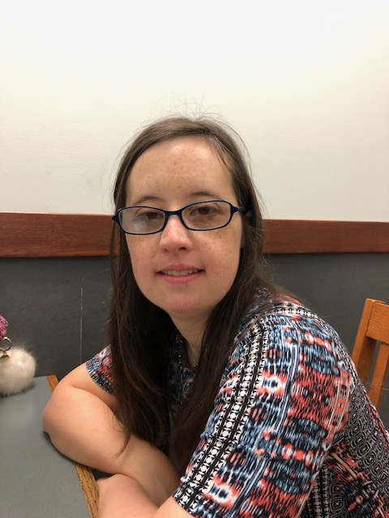
Molly
A Story of Discovery
&
Success

Slide 2
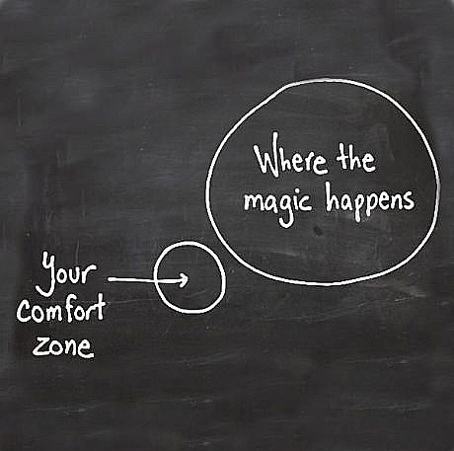
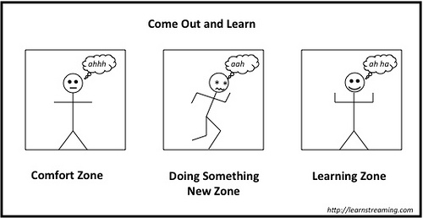
Steps to achieving vocational goals-
A Person Centered-Individual Driven
Approach
Discovery & Career Exploration
Plan Interviews with job seeker, friends & family
Identify interests, preferences, skills and talents, discuss home and work experiences as well as advocacy skills
Observe the job seeker in different settings
Identify supports needed
Understand learning styles
Identify both pathways as well as barriers, situations that need to be avoided
Discuss expectations
Arrange Benefits Counseling
Identify vocational themes and potential employers
Prepare application materials for paid competitive employment and interview preparation
Engage in Team work and Action-Placement Plan
Be open to step out of comfort zones and grow

Slide 3
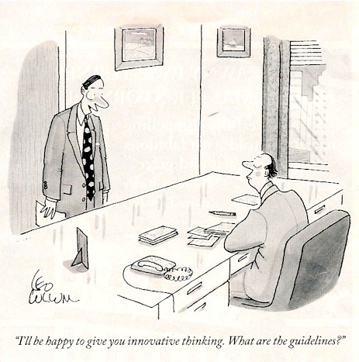
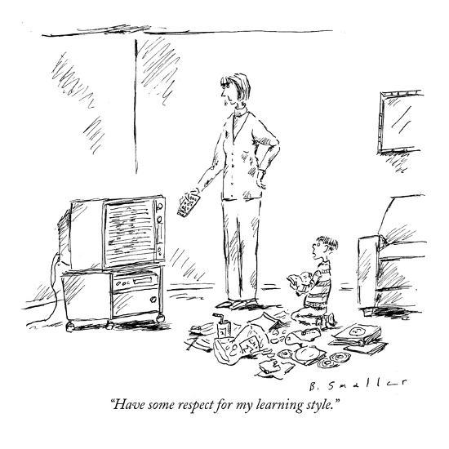
Humor, Creativity
and
Communication

Slide 4
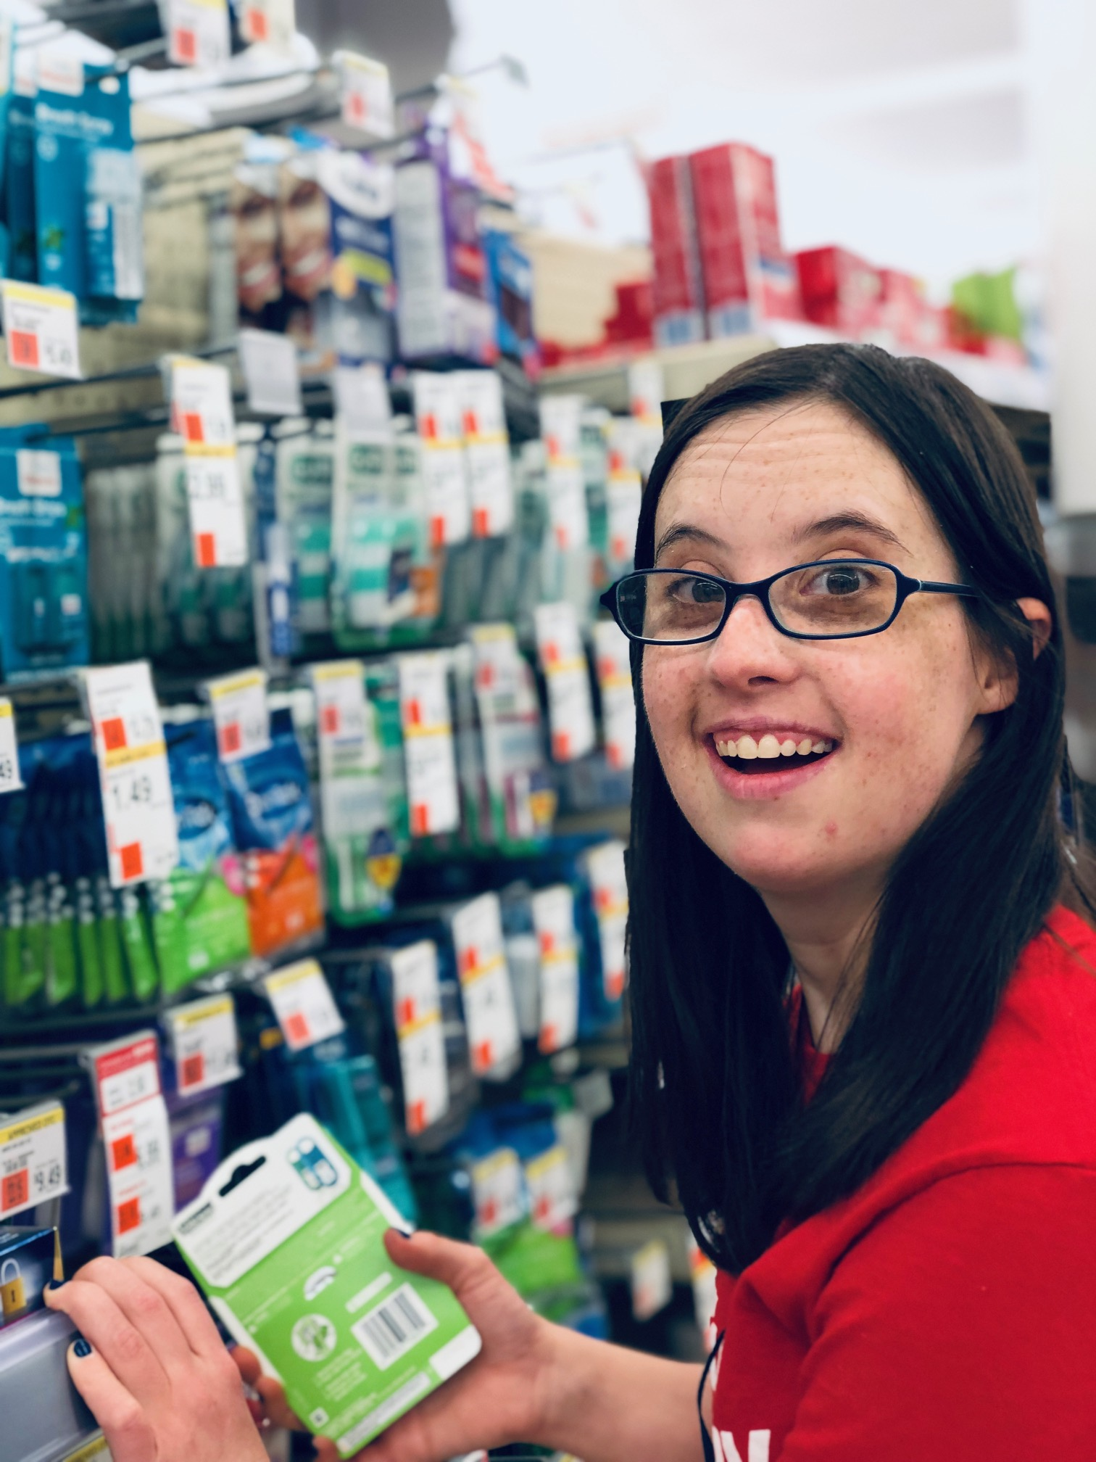
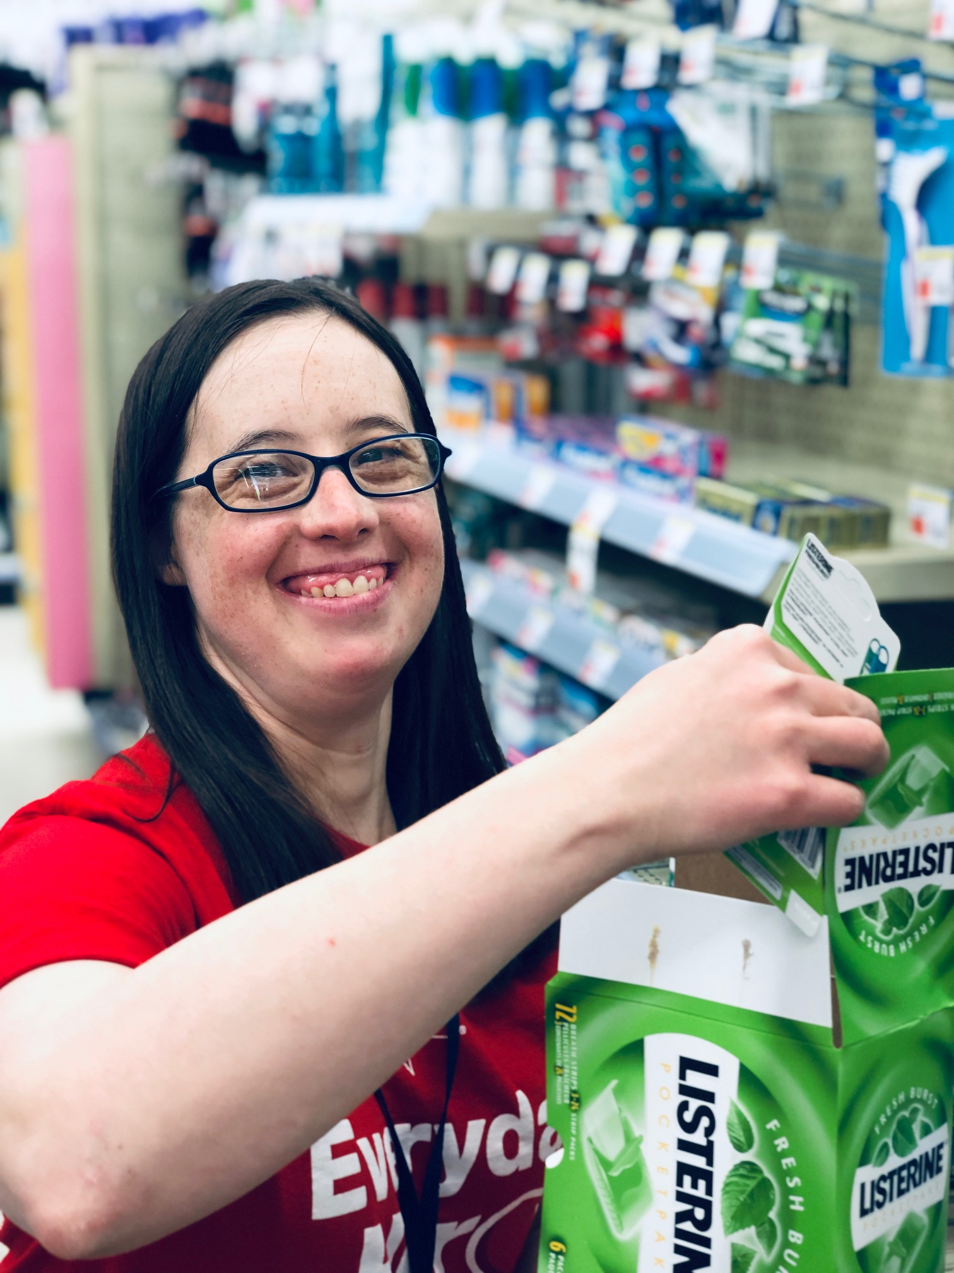
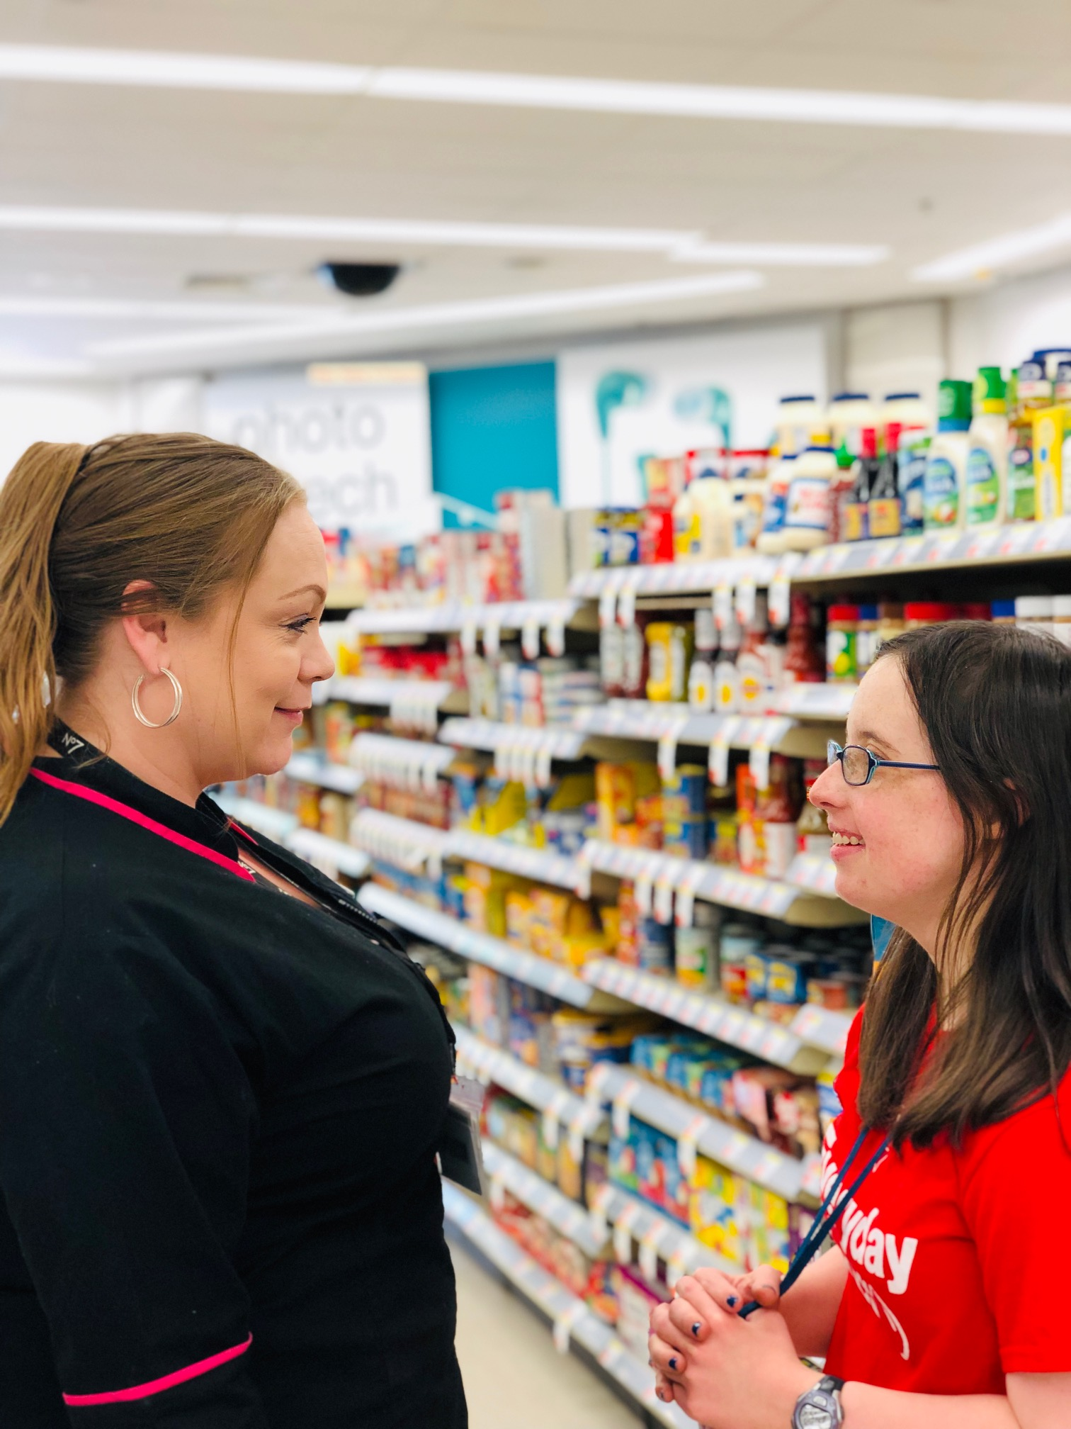
Career Planning continued….. ○ Plan Informational Interviews ○ Arrange Job Shadowing ○ Conduct Assessments ○ Visit work environments that are aligned with job seeker goals and interests ○ Engage in Networking ○ Plan Travel Training ○ Revisit and reassess approaches ○ Maintain communication between stakeholders ○ Utilize all available resources ○ Foster Creativity and attention to detail Steps after career exploration: What’s next? ○ Engage in Active job development ○ Network and negotiate with employers ○ Secure a job placement and put in place a support plan into effect ○ Identify natural supports ○ Advocate and encourage professional growth and advancement

Slide 5
Team Molly
Molly has been successfully employed at her worksite for 7 months now. She enjoys working at Walgreens and has been fortunate to have a supportive employer that is willing to accommodate her needs and support her continued growth. Molly has made friends at her worksite and enjoys hanging out with her peers during break times. Molly has a great support system that allows her to succeed. Molly is also a musician and songwriter. Molly is an active member of SAAC (Self- Advocacy Advisory Council) and loves collecting rocks from various places around the world. Walgreens is another stepping stone for Molly in her professional career as she learns how to navigate the world on her own with a little help from her friends

