Slide 1

You’re With Us!
The Why 2016

Slide 2
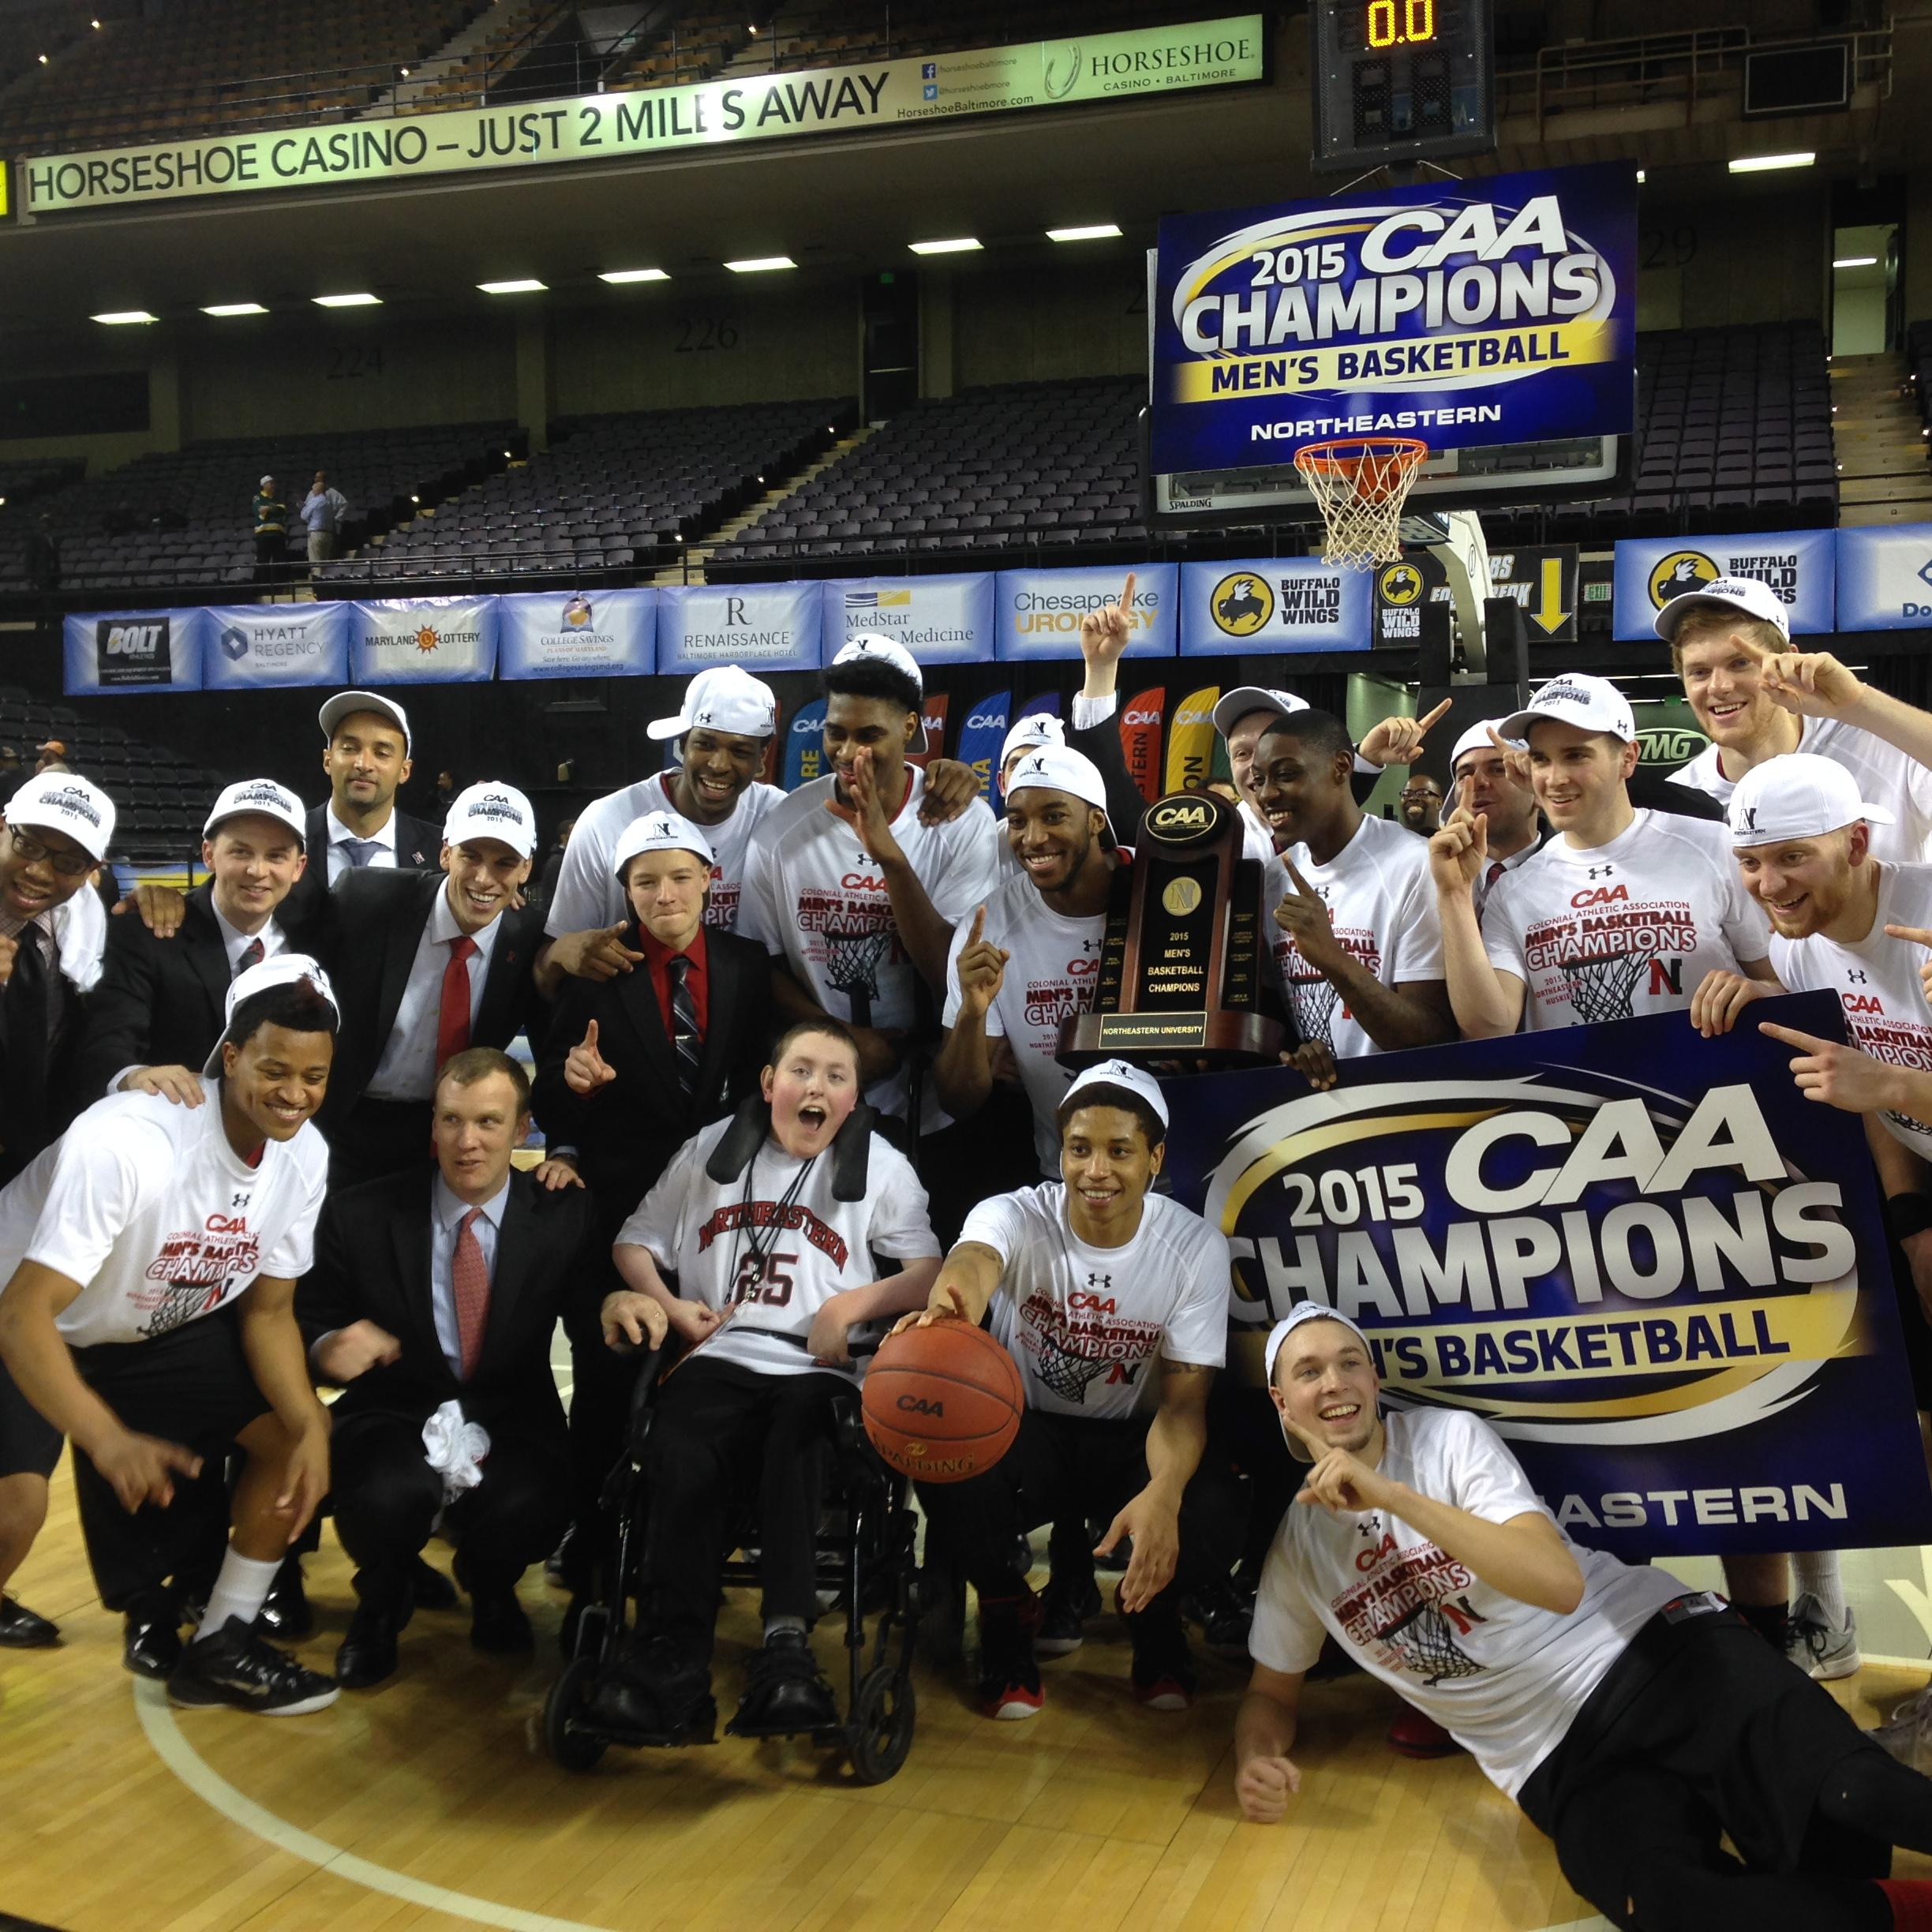
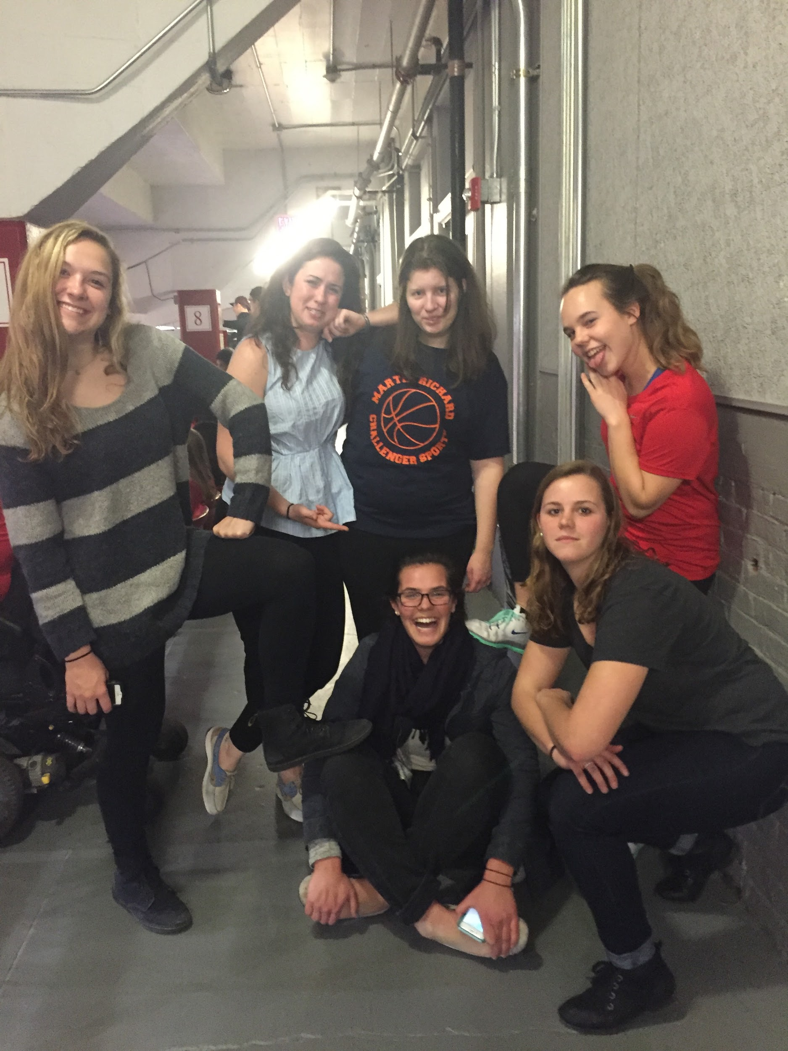
What do people want?
To be Healthy, Happy, and Safe
Meaningful Day Activities (interesting things to do)
To live in their own home
To be able to get around
Friendships and relationships

Slide 3
Statistics about people with disabilities
76% unemployed or underemployed
Only 6.1% own their own home (69% norm)
Friendship voids and social isolation
Vulnerable people at greater risk of violence
Only 32% report being “very satisfied”
Limitations in civic engagement
Increased morbidity (10 to 12 years sooner)

Slide 4
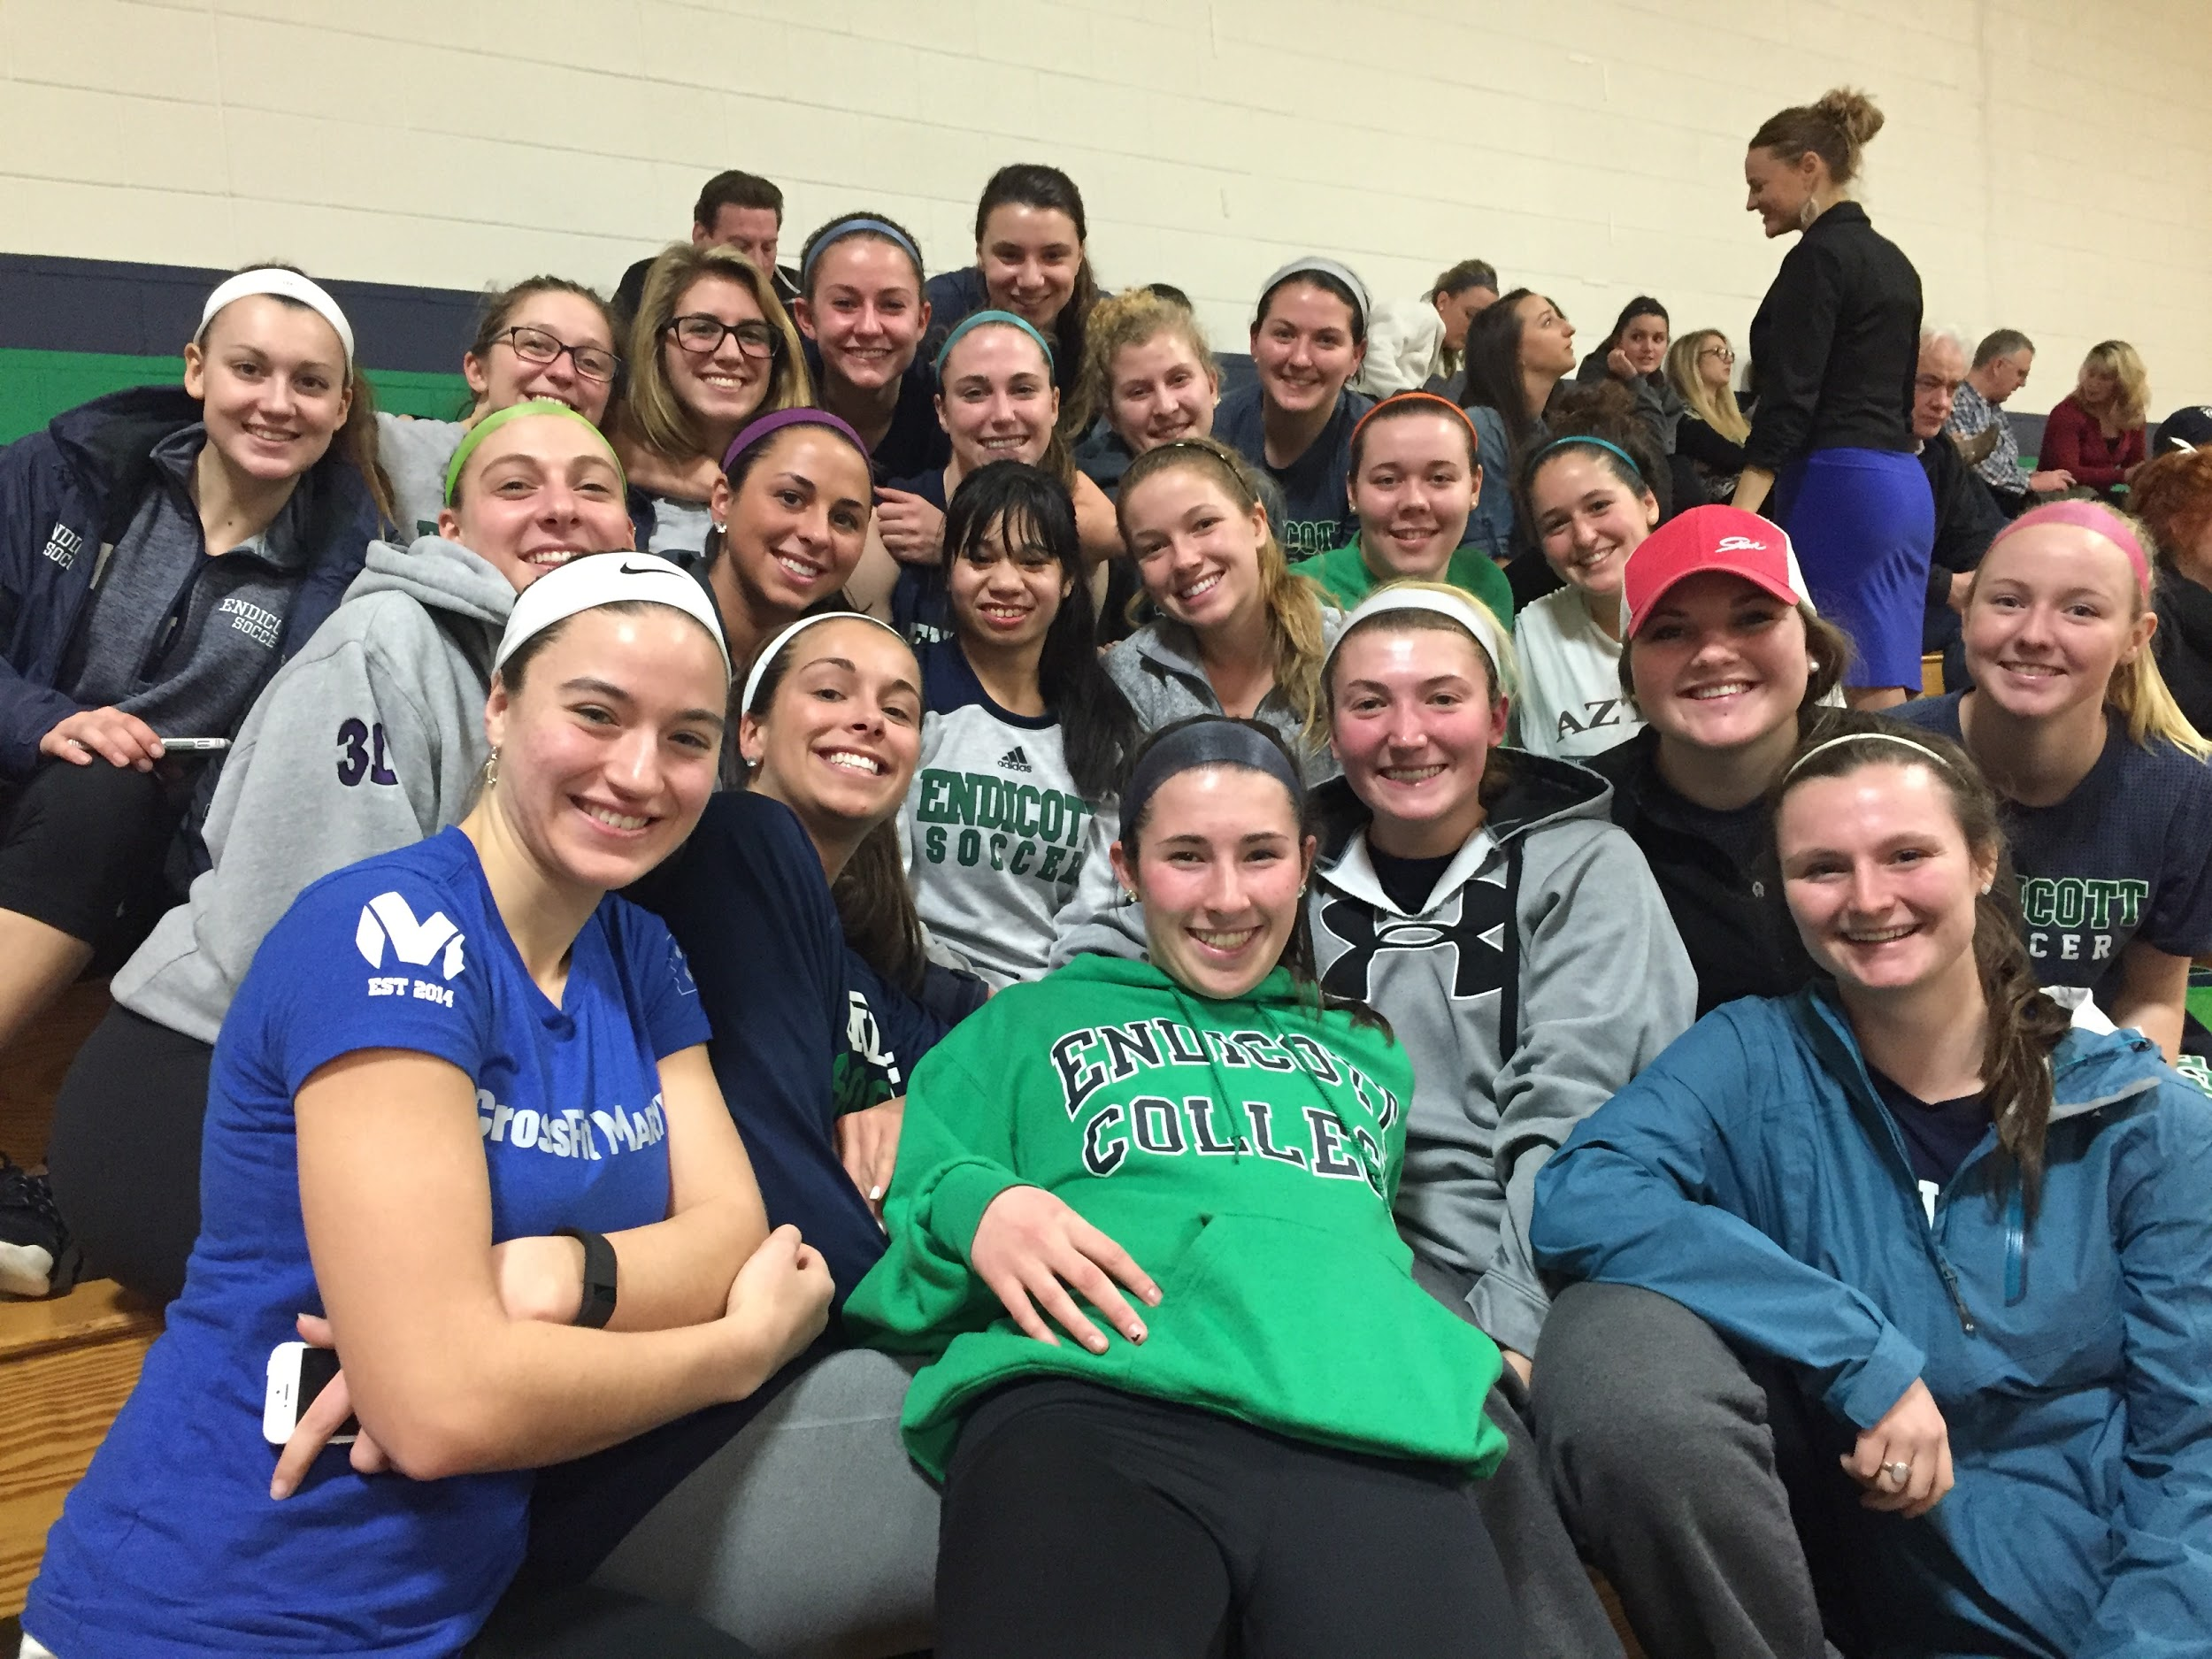

Why You’re With Us!
Eliminate isolation
Increase quality of life
Build Social Capital
Tap into resources and networks to reach adult goals
Create a sense of belonging
Notes:
Focus on just a few bullets and then go in depth about them in following slides

Slide 5
Isolation
Nearly 40 percent of young adults with autism never saw friends and half were not receiving any phone calls or being invited to activities
Isolation kills people. People who are more isolated than they want die 10 to 12 years earlier than those connected.
What is our number 1 punishment in America? Solitary confinement

Slide 6
Why You’re With Us! eliminates isolation
After the age of 12 people are most influenced by their peers.
Who are the peers of people with disabilities?
Bessel van der kolb (international trauma leader)…6 years ago research showed that the best way to get through trauma is through physical activity and being part of a group.
Inclusion not coming and knocking on your door

Slide 7

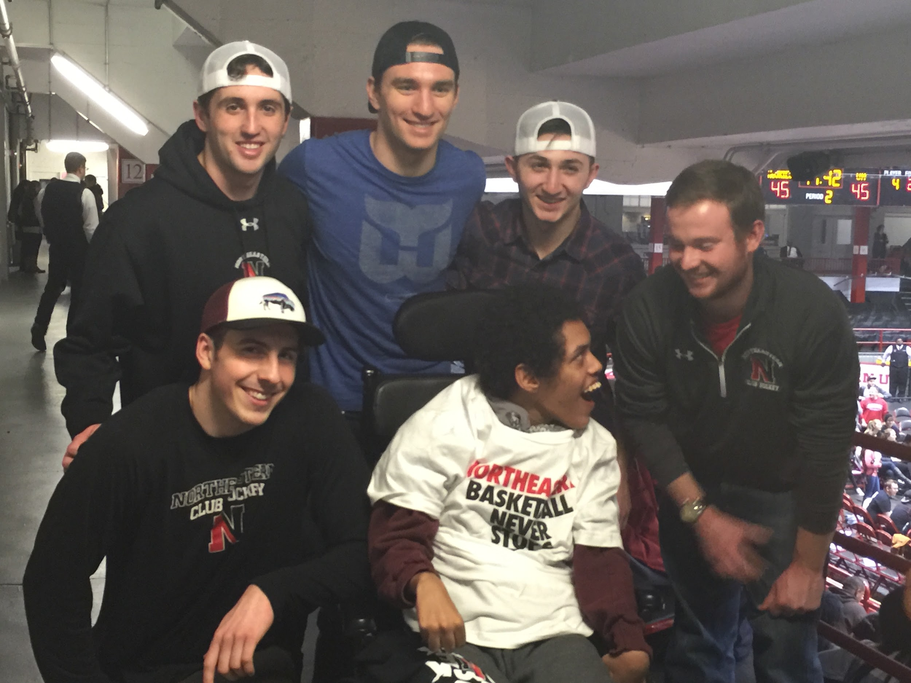

Definition of Inclusion:
Inclusion means to be incorporated and welcomed into the community as you are

Slide 8
Benefits of being a member of a group
strength in a team - people desire being a part of a group.
Camaraderie
Self Sacrifice
Shared Hardship
Shared Experience

Slide 9
Quality of life
Harvard University has been doing research the past 75 years on quality of life….where does happiness come from…Robert Waldinger, current president of research project: Three main takeaways:
Number one indicator of happiness and quality of life is quality relationships..
Social connections are really good for us, and that loneliness kills
Good relationships protect both our body and our minds

Slide 10
How You’re With Us! increases quality of life
Quality of life increased by the following:
Creating positive quality relationships
How do we do that?
Knowing the individual’s story. Put yourself in their shoes.
Making time for interaction with individual. Meet them when they arrive. Check in before they leave
Belief in the individual’s ability to succeed
Praise individual’s strengths and successes

