Slide 1
Meeting Employer Demand in a Job-Driven Economy
Alison S. Levy
Disability Employment Program Manager
Office of Human Resources Management
Alison.Levy@dm.usda.gov
August 2, 2017

Slide 2
U.S. Department of Agriculture Mission Areas
Approximately 100,000 employees
Farm Production and Conservation
Food, Nutrition and Consumer Services
Food Safety
Marketing and Regulatory Programs
Natural Resources and Environment
Research, Education and Economics
Rural Development
Trade and Foreign Agricultural Affairs
+ 18 Additional Staff Offices
Notes:
Food, Nutrition and Consumer Services
Dietary guidance, nutrition policy coordination, nutrition education...
Food Safety
Meat, poultry, and egg inspection, food recalls, food labeling, packaging...
Marketing and Regulatory Programs
Organic program, animal and plant health, grain inspection...
Natural Resources and Environment
Forestry, conservation, damage prevention, land management, sustainable land management...
Research, Education and Economics
U.S. food and fibers system, library, statistics, research, analysis, education...
Rural Development
Financial programs, water and sewer systems, housing, health clinics, economic development, loans, lending pools…

Slide 3



Forest Service
Forestry Technician, GS-0462
Notes:
Mission Critical Jobs
Forestry Technician, GS-0462 = 8,224
General Biological Science, GS-0401 = 4,375
Soil Conservation, GS-0457 = 4,140
Consumer Safety Inspection, GS-1862 = 3,774
Miscellaneous Administration and Program, GS-0301 = 3,733

Slide 4
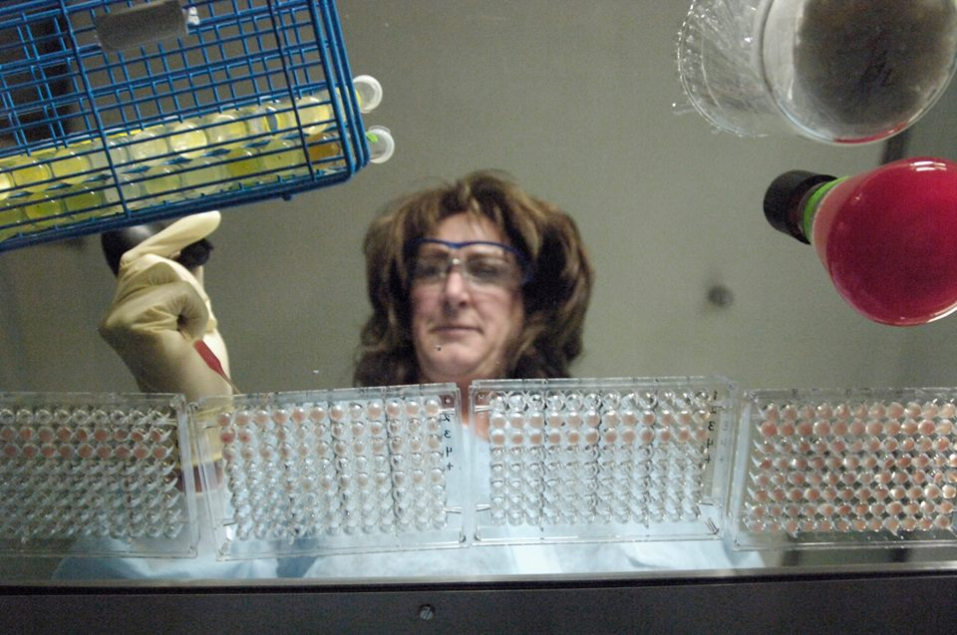
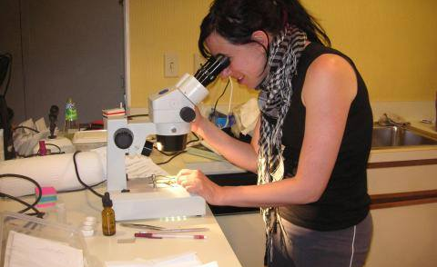

National Institute of Food and Agriculture (NIFA) and the Forest Service
General Biological Science, GS-0401

Slide 5
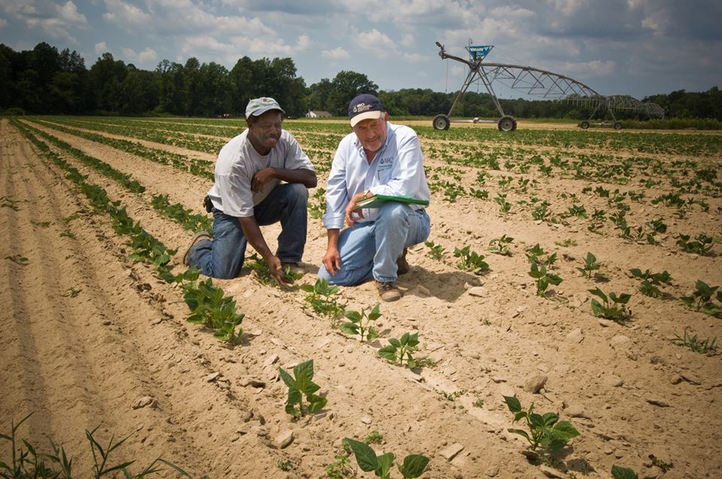
Natural Resources Conservation Service
Soil Conservation, GS-0457

Slide 6
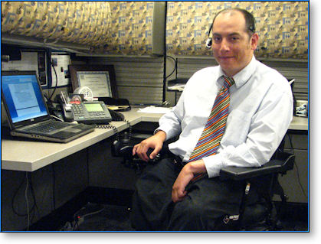

All Agencies
Miscellaneous Administration and Programs GS-0301, and Miscellaneous Clerk and Assistant, GS-303

Slide 7


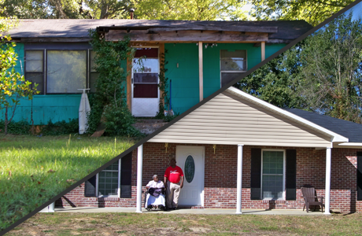
Rural Development
Loan Specialist, GS-1165
Notes:
First Time Home Owner Age 81 in Mississippi
American Indian and Alaska Native Programs
USDA Rural Development can help American Indian and Alaska Natives become full partners in the American economy, so their children and grandchildren can have an equal opportunity at pursuing the...Learn More >
Substantially Underserved Trust Area (SUTA)
The Rural Utilities Service (RUS), a Rural Development policy, planning and lending agency of the USDA is implementing the Substantially Underserved Trust Area ("SUTA") provisions of the Food,...Learn More >
Sustainable Rural Downtowns Case Studies
From a new downtown senior housing development in California to the creation of a value-added production facility in Vermont, rural communities across the United States are using USDA financing...Learn More >

Slide 8

All Agencies
General Business and Industry, GS-1101

Slide 9
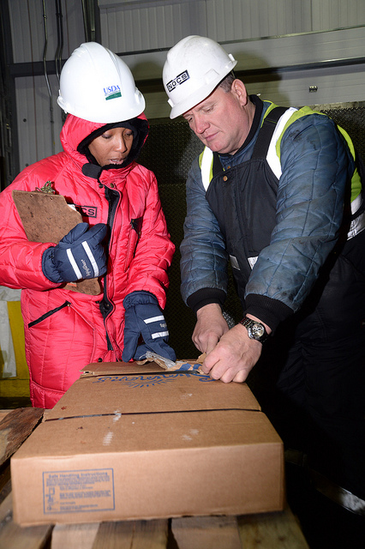
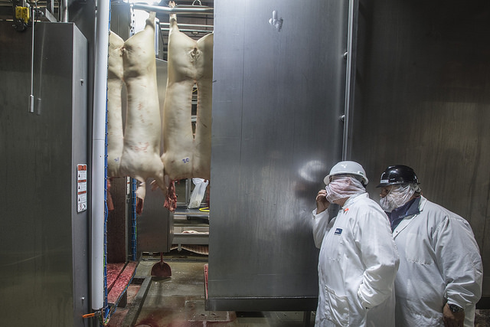
Food Safety and Inspection Service
Food Inspection, GS-1863
Notes:
The Food Safety and Inspection Service (FSIS) is the public health agency in the U.S. Department of Agriculture responsible for ensuring that the nation's commercial supply of meat, poultry, and egg products is safe, wholesome and correctly labeled and packaged.
Consumer Safety Inspector
Consumer Safety Inspector
Verify that meat and poultry slaughter and/or processing establishments’ Sanitation Standard Operating Procedures (SSOP) and Hazard Analysis and Critical Control Point (HACCP) Plans meet regulatory requirements and are being executed effectively to prevent unsanitary conditions and adulteration of product.
GS-9 (SJ-518): Independently performs Hazard Analysis Verification (HAV). HAV is an analytical review of establishments' production process in order to ensure regulatory obligations to conduct a food safety hazard analysis.
Review records, observe plant operations and conduct hands-on verification to ensure compliance with regulatory requirements. You will prepare detailed documentation (Non-Compliance Records) of noncompliance with regulatory requirements. You will determine when regulatory control action is necessary. You will assess whether the plants corrective or preventative actions are acceptable and effective, if there are trends in noncompliance, or if enforcement action is warranted.
Have contact with plant managers, owners and others to explain legal and regulatory requirements, discuss operation of the plants SSOP, HACCP plan and other food safety programs. You will communicate on and defend determinations on noncompliance issues and discuss plans for addressing non-compliance. You may conduct various samplings, surveys and tests to obtain pertinent data on potential problem areas, industry trends, or other issues of current interest to the Agency.
You may be involved in performing health and safety verification sampling and tests for detection of specific microbes (e.g., salmonella, listeria, etc.), residues or contaminants. You may also perform direct, structured sampling involving Protein Fat Free (PFF), undeclared species, undeclared ingredients or suspected economic violations involving net weight or
Entry-level Food Inspector positions filled through this job announcement generally work in slaughter plants. Our Food Inspectors:
Examine food animals in privately-owned meat or poultry plants
Perform their duties before and after slaughter, guaranteeing that the product is not contaminated
Maintain sanitation procedures
Are a valued member of a dynamic team that ensures the product is fit to eat and compliant with Federal laws

Slide 10

Food Safety and Inspection Service
Consumer Safety Inspector, GS-1862

Slide 11

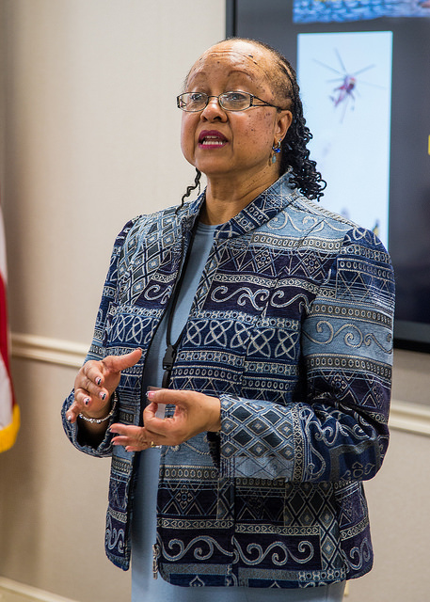
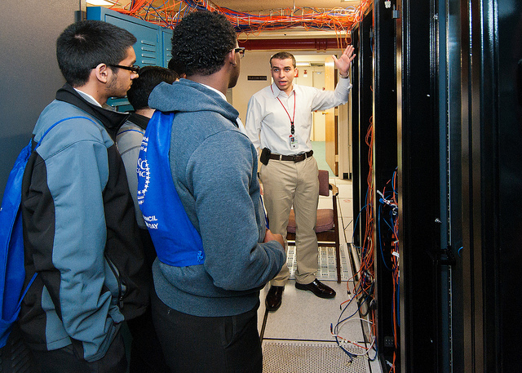
All Agencies
Information Technology Management, GS-2210

Slide 12
What are Targeted Disabilities?
The most severe disabilities
People with targeted disabilities have the lowest participation rate in Federal service.
There are now 11 categories, including:
Deafness
Missing extremities
Complete paralysis
Psychiatric disabilities
Distortion of limb and/or spine
Blindness
Convulsive disorders
Intellectual Disabilities
Developmental Disabilities
Traumatic Brain Injury
Notes:
The purpose of focusing on targeted disabilities is to encourage the hiring, placement, and advancement of selected individuals with disabilities in affirmative action planning.
The Federal government, as a matter of policy, has identified persons with targeted disabilities for special emphasis in recruitment and hiring.
Deafness - Blindness
Missing extremities - Partial paralysis
Complete paralysis - Convulsive disorders
Psychiatric disabilities - Intellectual disabilities
Distortion of limb and/or spine

Slide 13
FY 2017 USDA Goals to Hire Individuals with Disabilities
Reportable Disabilities:
*USDA: 10.23% (10%)
Targeted Disabilities:
*USDA: 1.12% (4%)
As per USDA Metrics and Milestones Report
FYTD March 2017
Notes:
Executive Order 13548 signed on July 26, 2010
Requires Departmental Plans with regular reports to OPM and OMB

Slide 14
A Wholistic Approach to Federal Careers
Outreach & Recruitment
Engagement & Inclusion
Professional Development & Advancement
Retention
Hiring & On Boarding
Notes:
Recruitment
Employment
Inclusive Work Environment
Advancement
Return to Work/Retention

Slide 15
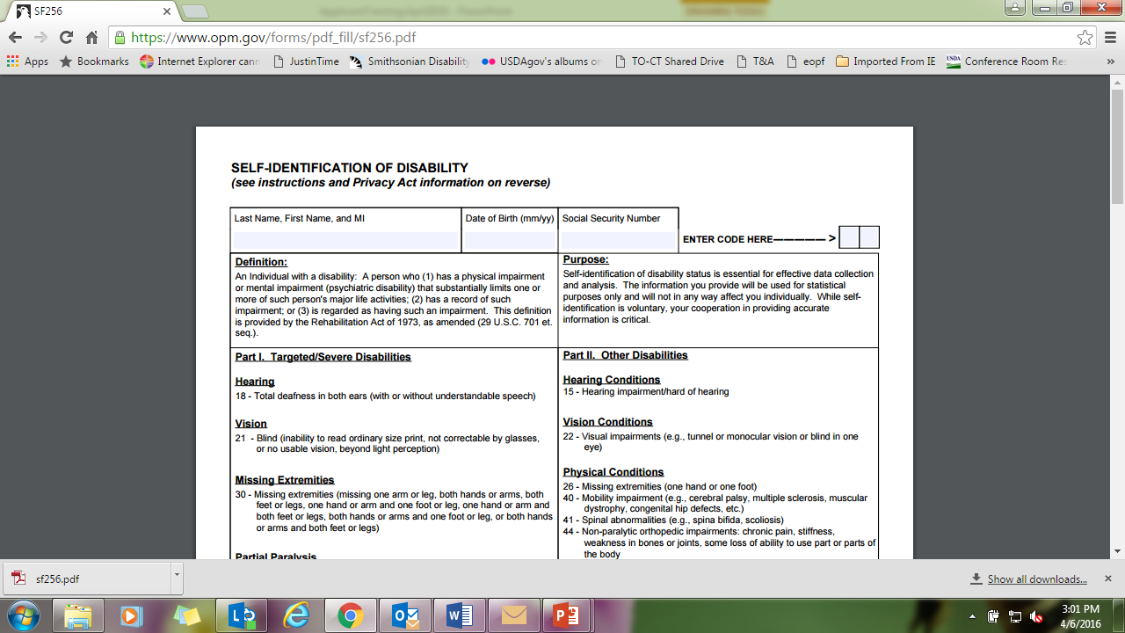
Fed. Gov’t Tracks Hiring: Standard Form 256
Mandatory for Schedule A Hires

Slide 16
Tips for Landing a Federal Job
Client Homework:
Identify Possible Job Titles/Series
Identify GS Level
Obtain signed/scanned Schedule A Letter
Review and understand the job announcement
Create a Detailed Federal Resume
Save in www.USAJobs.gov
Apply on line and via Agency SPPM
Notes:
Schedule A Letter
Regulation changed in 2006
See sample letter

Slide 17
Guidelines for Grade Level Equivalents
GS 2 = High school graduation or equivalent
GS 3 = One academic year above high school
GS 4 = Two academic years above high school OR
90+ Associate’s degree
GS 5 = Four academic years above high school leading to a
bachelor’s Degree OR a Bachelor’s degree
GS 7 = Bachelor’s degree with Superior Academic Achievement
for two grade interval positions OR 1 academic year of graduate education (or law school, as specified in qualification standards or individual occupational requirements)
Note: Grades higher than 7 are determined based on advanced education, and/or work experience.

Slide 18
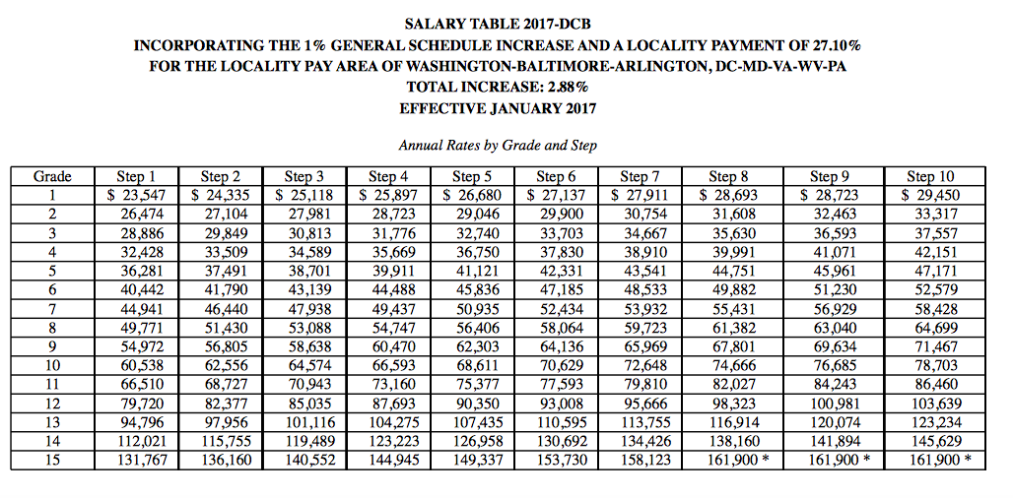
Salary Table 2017
National Locality Pay Tables

Slide 19
Resume Tips
Modify every application to match each specific job.
Review “specialized skills” and “how applications are evaluated” for each job.
Questionnaires replace former KSAs essays.
Ensure answers are supported in resume.
Include volunteer work and school activities.
Include pay/salary for each job.
Add a skills summary at the top of the resume.

Slide 20
Agency Points of Contact
Disability Employment Program Manager
Helps with overall program
Selective Placement Program Manager
Helps with recruitment, hiring, and on boarding
Reasonable Accommodation Specialist
Helps with needs assessments and guidance on providing effective accommodations.
Student Employment Coordinator
Helps recruit students into internship opportunities
Notes:
Demographics
Approximately 2,205 students
119 students are veterans
62% of students (1,364) self identified as Schedule A eligible

