Slide 1
Fostering Workforce Partnerships
Kathy Burris,
Workforce Initiatives

Slide 2
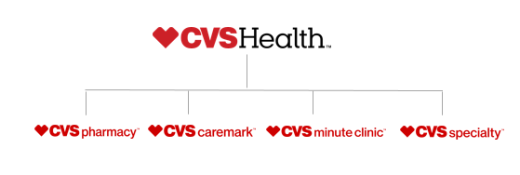
Our Service Brands
Notes:
CVS Health is a Innovation Company
Our service brands define the work we do.
As a company, we are broken into four business units. Each provide a unique purpose in helping people on their path to better health.
CVS Pharmacy: Which are retail stores – this includes 1600 target locations
CVS Caremark: Our Pharmacy Benefits Manager (PBM); Call centers – mail order prescription services
CVS Minute clinic: Retail walk-in clinics open 7 days a week .
Run by nurse practitioners and physician assistants
Provide services for minor illness provide all kinds of wellness services, including vaccinations, physicals, screenings and monitoring for chronic conditions.
CVS Specialty: Our specialty pharmacy which helps our patients manage rare and complex conditions to live longer, healthier lives. For people with complex medical conditions, we offer drug therapy management, dispensing and infusion services, and customized support and counseling to help ensure appropriate and safe medication use and achieve positive health outcomes
Our Purpose at CVS Health is focused on “helping people on a path to better health”. No matter what we do, what our priorities are within our organization, it is critical that all of our work results in fulfilling our purpose.
1-2 min

Slide 3
Our integrated model allows us to be a pharmacy innovation company
LEADING ASSETS
Retail
Mail
Long-term Care
Retail
Clinics
Specialty
C O S T Q U A L I T Y A C C E S S
Clinical Programs
Infusion
Digital
Patients
Medical Claims Editing
Payors
Providers
Notes:
CVS Health is very different than our competitors.
We have a wide range of jobs that are related to helping people on the path to better health.
Whether you are a pharmacist in our healthcare division or pharmacy tech in our retail division we have a career for you.

Slide 4
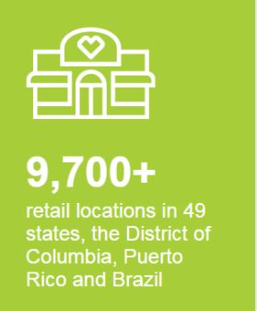
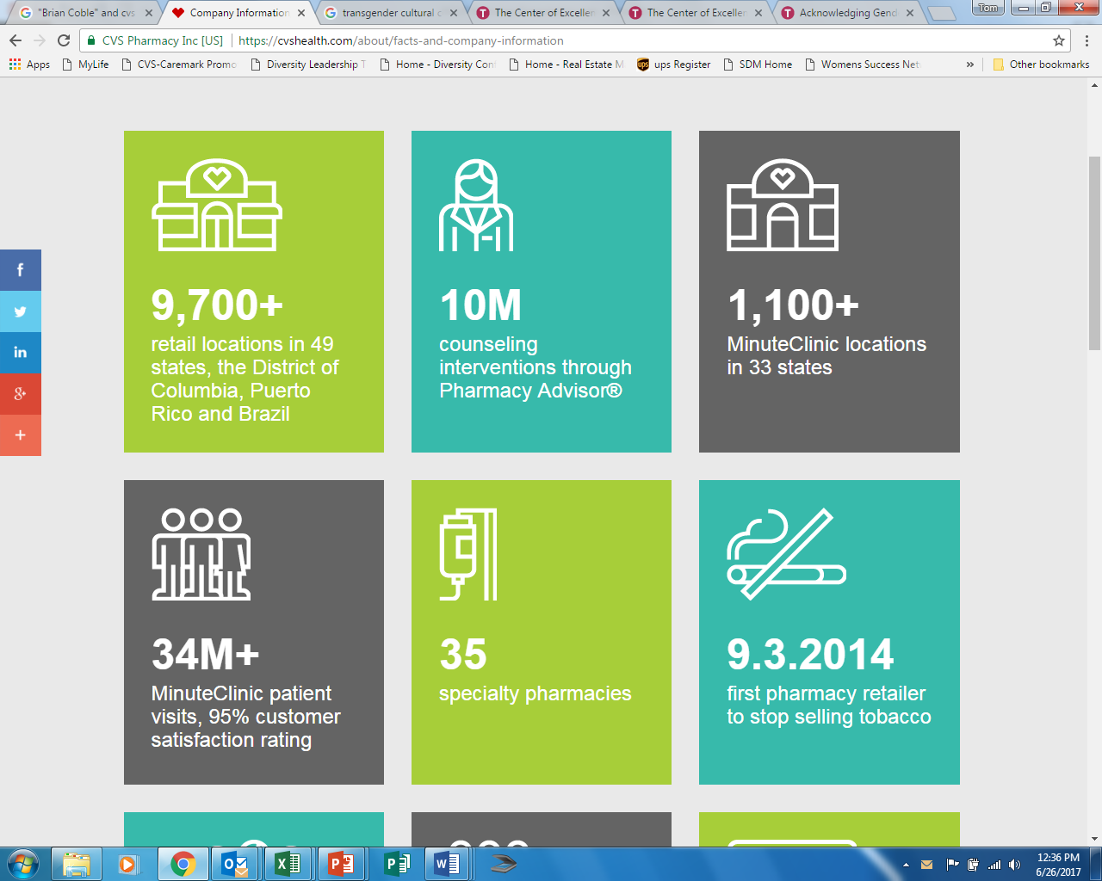
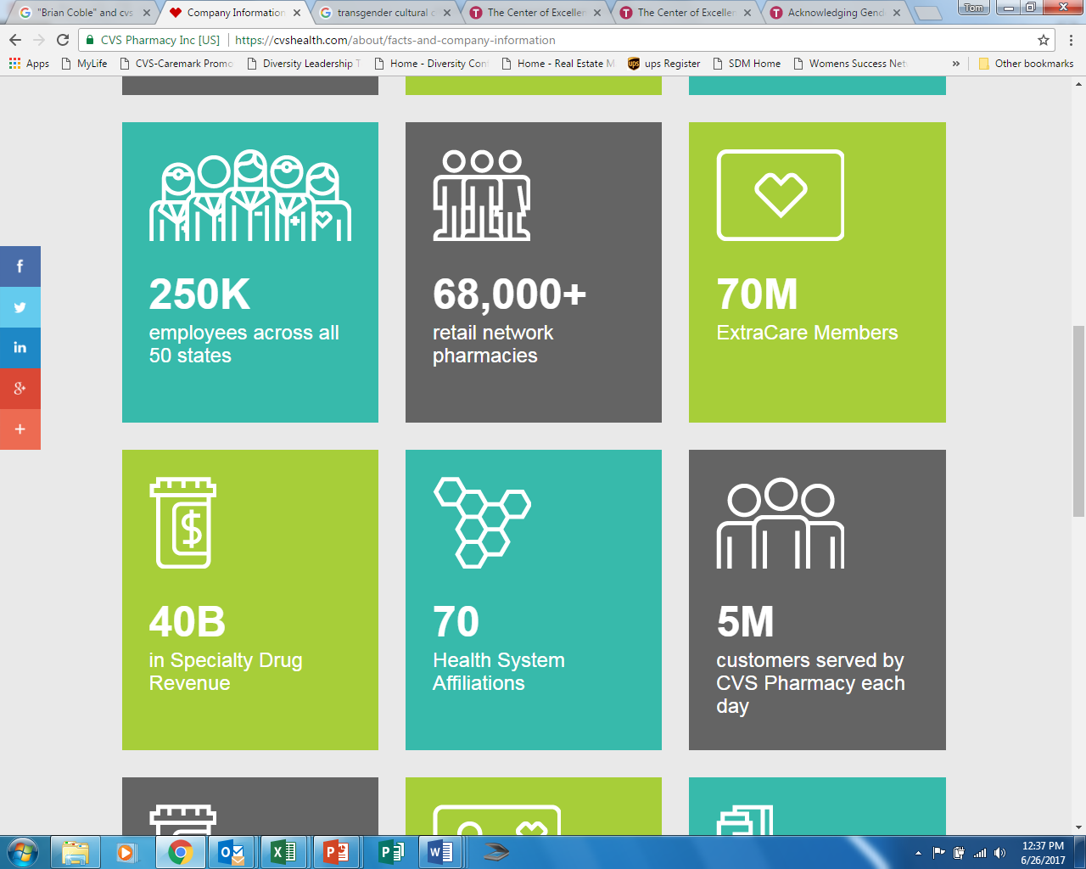
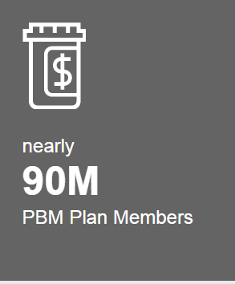
CVS Health Facts
Notes:
Here are a few examples of how our 250,000 colleagues who touch the lives of millions of people every day.
With over 9700 retail locations,
1100 minute clinics with 34 million visits
5 million Pharmacy customers are served each day
In Sept 2014 – we stop selling tobacco products

Slide 5
Our Strategic Diversity Management Framework
Objectives
Goals
Workforce Representation
A workforce that reflects the communities we serve
Colleague Engagement
An inclusive and collaborative workplace culture.
Talent Systems
Opportunities for development and growth.
Marketplace Diversity
Exceed the needs of customers, clients, communities and external constituents.
Our Company Purpose: Helping People on a Path to Better Health
Notes:
I am a part of Workforce Initiatives team at CVS Health. We define our work with four main objectives,
Workforce Representation – A workforce that reflects the communities we serve
Colleague Engagement – An inclusive and collaborative workplace culture
Talent Systems – Opportunities for development and growth
Marketplace Diversity – Exceed the needs of our customers, clients, communities and external constituents
these all connect back to Our Purpose and Mission. “ Helping people of the path to better health”

Slide 6
Our Model
WORKFORCE PROGRAMS
Apprenticeships
Work Experience Programs
Internships
On-the-job Training Programs
Customized Training Programs
HEALTH AND WELLNESS PROGRAMS
Health Education
Chronic Disease Prevention
Tobacco & Rx Drug Abuse Programs
Health Screenings and
Access to Care
Notes:
Our two models, workforce and health and wellness,
Both focus on helping people on a path to better health in slightly different ways and both are aligned and ensure meaningful outcomes to our communities.
The workforce team works with organizations such as yours to provide career pathway opportunities. Which include the following:
Apprenticeships – 1500 apprentices across the country
Work experience programs
Internships
On the job training programs – such as our Pharmacy Tech externships
Customized training programs – such as Regional Learning Center programs
These programs help effectively serve the need for a diverse workforce which is reflective of the communities we serve.
On our Healthcare side the focus is around enhanced care for the most at-risk and underserved groups
Partnering with our health care professionals. We have tailored programs that focus on the elderly but currently have two new programs:
One Choice – educating youth on prescription drug abuse
Be The First – education around smoking and tobacco use.
Both areas point to our shared focus “helping people on the path to better health”

Slide 7
Our Business Strategy
Collaborate effectively with our partners to drive specific, meaningful and measurable outcomes for both CVS Health and our community partners. Win - Win
Reflect the communities we serve across all areas of our business.
Impact the largest
CVS Health communities. Underserved populations
Partners’ priorities align to our overall business objectives
Together we are able to increase job opportunities and help create a healthy workforce
Meeting our partnership parameters will drive mutual business results
Partnership Parameters
Notes:
Our Business Strategies
Our strategy remains focused on long term, ongoing, sustainable workforce programs and partnerships.
This strategy remains consistent across the country in all markets,.
Our partnerships parameters:
Impact largest CVS Health communities and underserved populations
To ensure our partners are aligned to our overall business objectives
Creating job opportunities
By meeting our partnership parameters we will drive mutual business outcomes

Slide 8
Thank You
Kathleen.Burris@cvshealth.com

