Slide 1
Using LMI as a Counseling Tool
Amanda Gerson
Coordinator of Vocational Rehabilitation and Transition Services
NJ Commission for the Blind and Visually Impaired

Slide 2
Presentation Objectives
Review NJ CBVI’s LMI Project Objectives
Review Training Initiatives and Implementation
Discuss Pre- and Post-Test Results
Challenges and Lessons Learned
Future Goals and Next Steps

Slide 3
Background
JD-VRTAC Project Plan Goals:
  Evaluate current knowledge base and usage of LMI, implement a training, and re-assess knowledge and use
  To provide our VR Counselors information on:
    What is Labor Market Information
    Where to find the resources
    How to use it as a counseling tool

Slide 4
LMI: Awareness and Use
Pre-Assessment - April 2016
Pre-assessment data told us:
  Counselors aren’t fully aware of what the term Labor Market Information means
  Counselor usage of LMI is inconsistent
  Although some LMI tools are being used, an entry-level training was needed
  Most counselors who responded reported being open to using LMI with consumers, and desired training

Slide 5
The Main LMI Training: May 2016
Economist from NJ Dept. of Labor
  Overview of LMI, online resources, and NJ-specific information on industry clusters and key industry sectors
ICI Presenter Mary Ann Bedick
  Reinforced LMI, including local and real-time LMI; Additional occupational exploration online resources; LMI as a counseling tool; Motivational Interviewing
JD-VRTAC Team Lead – Linda Mock
  Discussed JD-VRTAC and other TACs
Amanda Gerson - NJCBVI Coordinator of VR and Transition Services
  Business Relations Unit and tied all of the day’s information to agency projects and goals; Intro to Talent Acquisition Portal

Slide 6
Major LMI Resources Shared
Explore VR Labor Market Information Toolkit: http://www.explorevr.org/toolkits/labor-market-info-toolkit
America’s Job Center Career One Stop Toolkit http://www.careeronestop.org/Toolkit/toolkit.aspx
The Career Index: http://www.thecareerindex.com/dsp_intro.cfm
The O*NET: http://www.theonetonline.org
New Jersey Department of Labor LMI Information: http://lwd.state.nj.us/labor/lpa/LMI_index.html

Slide 7
Additional LMI-Related Trainings
VR 101 Series – regularly incorporated discussion of LMI into relevant trainings and discussions with VRCs
  March 22, 2017 – Choosing a vocational goal for the IPE and Informed Choice using LMI
  May 11, 2017 – Case notes and documentation – what to include?? LMI discussions!
June 5-8, 2017 – Business Engagement Training from Mississippi State University – Included a unit on using LMI for Business Engagement

Slide 8
LMI: Awareness and Use
Post-Test - May 2017
Issued the same assessment one year later
Some staff turnover and new counselors brought on board since pre-assessment
# of Respondents – 2016 = 23; 2017 = 28
Overall, saw an increase in self-report of understanding and use of LMI from 2016 to 2017

Slide 9
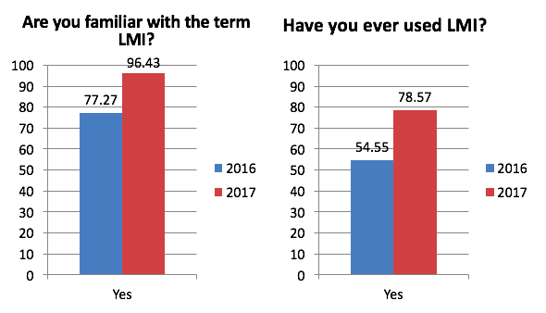
Assessment Results:

Slide 10
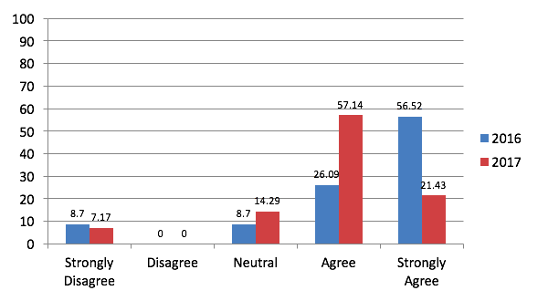
Describe your opinion on the following statement: LMI should be included in vocational planning with CBVI consumers.

Slide 11
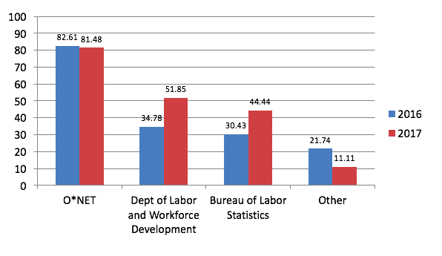
What resources do you use to access LMI for vocational planning purposes with CBVI consumers?

Slide 12
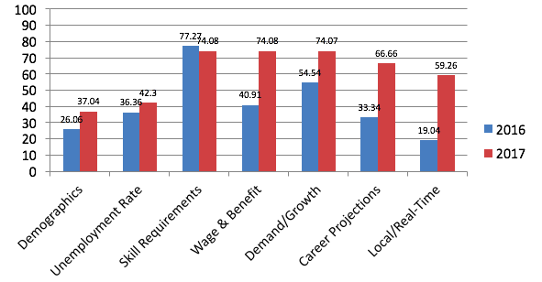
How often do you incorporate each of the following components of LMI into your vocational planning with CBVI consumers?
Response Options: Never, Rarely, Sometimes, Regularly, Frequently
% below represents combination of Regularly and Frequently for ease of presentation

Slide 13
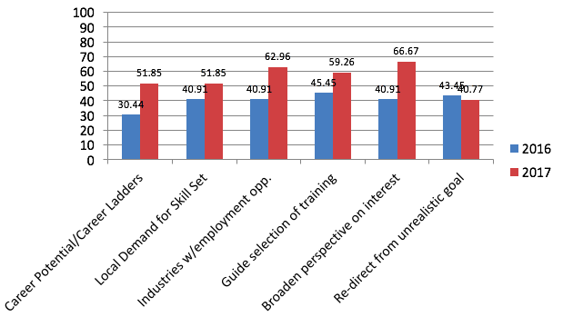
How often do you use LMI for the following purposes?
Response Options: Never, Rarely, Sometimes, Regularly, Frequently
% below represents combination of Regularly and Frequently for ease of presentation

Slide 14
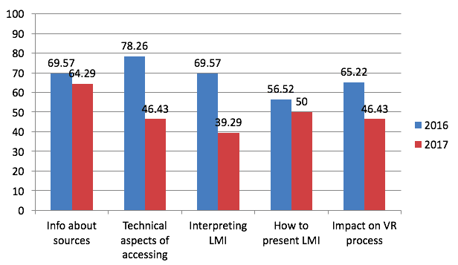
What type of support or training would you require to increase your use of LMI in your vocational planning with CBVI consumers?

Slide 15
Challenges & Lessons Learned
Many new initiatives going on at CBVI
Increased reporting per WIOA
Multiple online sources to search to gather all the LMI data can be overwhelming; not always AT-friendly
Counselor self-report only – actual use unknown; impact on outcomes unknown

Slide 16
Next Steps
Business Relations Specialists involved in LWD key industry sector initiatives; continue to build their capacity as LMI subject-matter experts
Implementation of The Career Index Plus – Working out TA agreement now with WINTAC/JD-VRTAC for a Fall 2017 roll-out
  One-stop shopping for LMI
  Consumer-friendly
  Able to track counselor/consumer use, not only rely on self-report
Focus on improved use with transition population
Determine impact on employment outcomes

Slide 17
Contact Information
Amanda Gerson
Coordinator of Vocational Rehabilitation and Transition Services
New Jersey Commission for the Blind and Visually Impaired
Amanda.gerson@dhs.state.nj.us

