Slide 1
“On the origin of species” Evolution of middle-skills training by natural selection
Mark Schultz (NVR), Janet Drudik (NVR), and Kartik Trivedi (ICI)

Slide 2
Presentation Objectives
Discussing the evolution of middle-skills certification program in Nebraska
Discussing the middle-skills certification program in the healthcare sector
ICI’s role under the VR-RRTC on Demand-Side practices
Future of the program

Slide 3
Nebraska Vocational Rehabilitation
Nebraska Facts:
77,421 Square miles
3.5 times as many cows as people
200 staff: counselors, evaluators, employment services
12 offices across the state
Serve 6-7,000 individuals/year
Over 2,000 outcomes the last several years (66-68% rehab rate)

Slide 4
Four Stages of Change (Evolution)
Stage 1: “What you’re saying is worthless nonsense.”
Stage 2: “What you’re saying is an interesting but perverted point of view.”
Stage 3: “What you’re saying is true but quite unimportant.”
Stage 4: “I have always said so.”
Notes:
Four Stages of Change (Evolution)
(Richard Susskind‘s The Stages of Change)
Stage 1: “What you’re saying is worthless nonsense.”
Trades had a need for workers (electricians, plumbers, construction)
They needed workers now
Job candidates lacked work skills and training that matched the needs of businesses
Stage 2: “What you’re saying is an interesting but perverted point of view.”
Project Search model/success
High school: one business, multiple jobs
Last year in school
Stage 3: “What you’re saying is true but quite unimportant.”
Certificate Programs
Community college: many businesses, single job focus
Customized curriculum based on needs of business
Short term training to address work and work place expectations
Stage 4: “I have always said so.”
Community College and Employer-based Training
Career pathways
Internships/Apprenticeships

Slide 5
A focus on Middle Skills. Why?
Middle skill jobs are defined as those in which the employee needs skills that are generally beyond high school but less than college.
Very low unemployment in Nebraska for many years.
About half of the jobs in Nebraska are defined as middle skill jobs and about half of job openings in Nebraska will be middle skill jobs.
9% Skill Gap: Not enough middle skill workers for the jobs now.
Jobs with higher wages with a potential career ladder.
Notes:
Source: National Skills coalition - http://www.nationalskillscoalition.org/resources/publications/2017-middle-skills-fact-sheets/file/Nebraska-MiddleSkills.pdf

Slide 6
Nebraska VR’s Middle-Skills Programs
The Nebraska VR partners with employers, community colleges and other public agencies to create middle-skills training programs
VR clients attend a training program and complete an internship with a prospective employers
Clients who pass all the requirements receive a certificate or credentials
VR staff brings the candidates to the employers, however the employers select who stays in the program.
Employers use their interview process to select the trainees.
Businesses are involved in developing the curriculum and are connected with the instructors

Slide 7
NVR would initiate a Middle Skills Training If:
At least 5 businesses would participate
If there were at least 5 jobs available
A community college with sufficient capacity
Critical number of potential candidates (≥ 5)
Availability of funds for a new program

Slide 8
Characteristics of Middle-Skills Programs in Nebraska
In response to emerging labor market trends
Business driven and short term
Includes training in technical hard skills and soft skills
Continuous employer engagement – from start to finish

Slide 9
Early Days
Middle-Skills Certification Programs in –
Electrician Helper Certificate Program
Auto Tech Certificate Program
HVAC Certificate Program
Welding Certificate Program
Characteristics of the program in the early days –
In partnership with employers and community colleges
Only VR clients
All the programs in trades
Based on existing courses and somewhat conventional job-types
Mostly hands-on training

Slide 10
The Triangle
VR Staff
VR seeks out employers
VR partners with community colleges
VR connected the CC and businesses
VR recruits and funds clients
VR Client
Community Colleges
Employers
Notes:
Navigating between three – partners.

Slide 11
Evolution – Middle-Skills Certificate for Community Healthcare Worker (CHW) (2013 and after)
Continuation of Features from Early Efforts
Decision to develop a program based on emerging needs of a few employers
In partnerships with employers and community college
Only VR clients
Differences from previous version
First ever NVR program that was not in trades
Creation of a new certificate in NVR - Community Healthcare Worker
Significant portion of the program involved classroom based training to accommodate training for Medical Aide, Nursing Aide (CNA) and courses specifically related to the CHW position

Slide 12
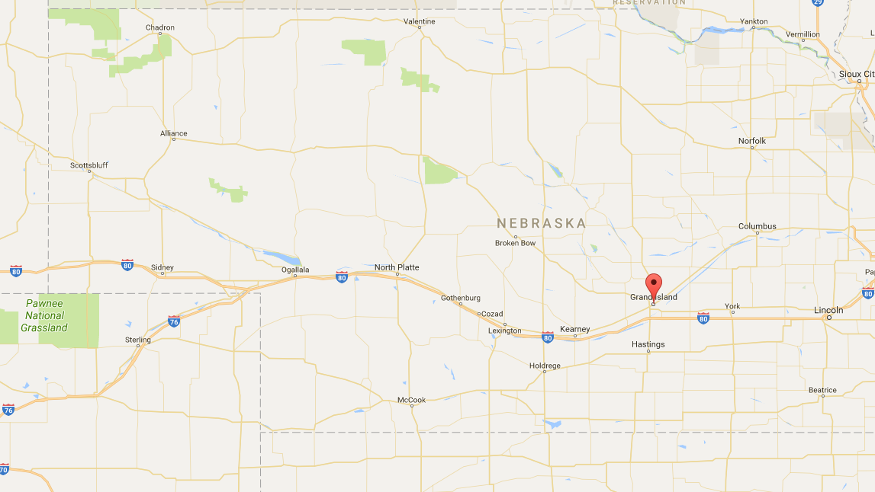
CHW Program
Implemented in: Grand Island, Nebraska
Partnering Community College: Central Community College, Grand Island
Partnering Employers: St. Francis Medical Center, Good Samaritan Medical Center, Mary Lanning Medical Services, Centers for Independent Living, Health Connect ad Home and Office on Aging
Orientation: November, 2013
Academic Program Start Date: January, 2014

Slide 13
CHW Program
Credit Courses:
Nurse Aide
Medication Aide
Community Health Needs
Role of Community Healthcare Worker
Involves Internship/OJT
Internship/OJT
45 hours over 8 weeks
Start Date: June, 2014

Slide 14
Motivation for Employers
Potential Financial Benefits
Healthcare reform (Affordable Care Act)
Prevention of readmission
Need for follow-up care
Community based services could keep some frequent users out of emergency room
Potential to provide preventive care which could reduce hospital costs
Some early success – Small local study saw reduction in readmission rates of individuals with diabetes prompting efforts to develop CHW
Similar positions (CHW) in other states

Slide 15
Motivation for Community Colleges
Develop partnerships with employers
Continued engagement with NVR
Developing courses for emerging labor market needs

Slide 16
Motivation for VR Clients
Middle-Skill jobs potentially leads to higher wages
Certification can lead to career advancement
Individuals with prior experience in healthcare can use it to refresh or build upon their existing skills
Individuals can use the program to get recertified (e.g. C.N.A., Med Aide)
Notes:
Pivot to motivations for VR and implementation.

Slide 17
Implementation
Early on Central Community College expanded content so that if CHW jobs were not available, students had options.
The content change had implications for VR clients as physical requirements changed (i.e., CNA and the ability to lift).
The Governor chose not to expand Medicaid. The hospitals then did not see a financial advantage to having a CHW for which they could not bill their time. CHW’s do not generate revenue but prevent costs.

Slide 18
Next Set of evolution!
Focus more on Employer Training and Partnerships in the Health Care Sector
CHW initiated prior to WIOA. With WIOA, there was more opportunity to partner with the workforce system with business with in-demand labor needs.
Increase the connection between a current position and training.
Certain jobs may be better suited to partnerships between VR, community colleges, employers, and workforce system.
Other jobs may be better suited to connecting in with “employer based training” so that there is more of a commitment to hire at the outset.

Slide 19
Middle-skills healthcare program, Now…
Certified Nursing Assistant training program developed by Business Account Managers (BAMs) and started this year at Nebraska Methodist College in Omaha
Actively engaging with employers in the healthcare sector in Nebraska
Trying to develop employer driven training programs in healthcare sector
Focusing on rapid middle-skills training to meet employers’ needs
Increasing the number of regional point of contacts
Added Business Account Managers (BAMs) across the state
Exploring partnership opportunities with Department of Labor within healthcare sector

Slide 20
To Evolve…
How to leverage different training partners for different sectors and training programs?
Credentials for a job or for better job prospects?
Employer driven training
Credentials as an asset for continuing towards advanced courses
Middle-Skill jobs in trades vs. Middle-Skill Jobs in non-trades
Appreciating the effect of policies at the state or national level
Reconsider VR Clients only classes – find more students (Mark)
Partner with other agencies
Single point of contact for businesses to contact community partners
Notes:
Use this slide to pivot to Upskill/Backfill

Slide 21
Evolving into Upskill/Backfill
To assist clients closed successfully in the past to advance within their career pathway
Economic self-sufficiency for individuals with disabilities
Using positions vacated by advancement of VR clients for other VR clients wanting to enter a career pathway
Developing multiple entrance and exit points within the career pathways to help clients advance

Slide 22
Evolving towards a pathway
Identify existing career pathways and develop new pathways
More partnerships
Working with other state agencies (e.g., Nebraska Department of Labor)
Employers
Institute of education and training providers
Focusing on high growth – high wage sectors
Information Technology
Manufacturing
Transportation, Distribution and Logistics (TDL)
Healthcare

Slide 23
Future – Next set of evolution
Businesses seeing VR as the disability experts
Contacting businesses to help them advance their incumbent employees with disabilities
Working with businesses to develop training programs to meet their needs
Providing Section 503 Training to businesses
Providing disability awareness training
Providing ergonomic assessments to businesses within the career pathways of IT, Manufacturing, Healthcare, Construction and Transportation, Distribution and Logistics (TDL)

Slide 24
Questions?

Slide 25
Contact Information
www.explorevr.org
Mark Schultz - Mark.Schultz@nebraska.gov
Janet Drudik – Janet.Drudik@nebraska.gov
Kartik Trivedi – Kartik.Trivedi@umb.edu

Slide 26
VR Client Perspectives
“Well, it’s [program] a good idea. It’s a good class. It’s a good exposure. It was positive for me personally. Am I employed? No. Am I employable? Yes.” – VR Client (Interview, October 2014)

Slide 27
Central Community College Perspectives
"I do think that everybody had a different sense of what a community health worker could do for them. And so some were better able to understand how they could see the community health worker fitting into their organization than others." MK – Central Community College (Interview, December 2014 )

Slide 28
NVR Counselor Perspectives
"Originally, they [the community college] said the CNA [altered requirements] would be fine, that they would still get the certificate for the whole thing [community healthcare worker]. Just if they wanted - they couldn't go and work as a CNA because they wouldn't legally be a CNA with a certificate. It would be without the physical requirements. And they said it was fine. Then they said it wasn't." TS – VR employee, (Interview, November 2014)

Slide 29
Employer Perspectives
“Both administrators and clinics are saying, "We're doing a good job. We think we're fine." And so until they get penalized, then they start searching for ways to improve their--we've had process improvement going on from the outset. And I'm sure others have too. But taking the step of going outside your hospital walls into the community to be proactive with patients instead of reactive is, I think, sort of a foreign concept to hospitals and to clinics. So we needed to find a way to--that's where the sales job comes in. And then their response is, "Well, prove it. Show me some data." And right now there isn't any. And so this [program] helps develop that.” – BB, Employer (Focus Group Discussion, November 2014)

Slide 30
Positives – VR Clients
“I've done this kind of work for years. But by taking this class, it's given me the ability to zone in on, focus in on a person's need better and know what path I need to send them down to hopefully get them to where they need to be. I'm trying to think of an example.” – VR Client, (Focus Group Discussion, November 2014)
“I had gotten out of it--I had got recertified in med aide and CNA. I learned a lot with CHW. I got to take a 40-hour practicum additionally with the 40-hour class time, and that was wonderful. Good contacts, I learned a lot. The new insurance guidelines that are hitting America, very interesting. It’s been an extremely positive experience for me.” – VR Client, (Interview, October 2014)

Slide 31
Positives – NVR Counselor
“It is different than some of the others because where it’s--it is something that is going to be out in the community. And part of what we talked about and looked at was with the other programs we have, they could have offender status and some of those things, depending on the employer’s hiring policies. But with a community health care worker, you’re looking at people that are going to be working like in the hospitals and clinics and things like that. They have to be able to pass a background check, all the screenings that that agency provides. So that was something that we had never had to look at with some of the other programs that we had, except for the para-educator being in the school system, but not on the same level or whatever, because it is a higher level to work in, you know, like in a hospital or whatever.” – TS, VR Counselor (Interview, November 2014)

Slide 32
Positives – Central Community College
“I think we started in one thinking that if, when we had this opportunity presented to us, that we could maybe do a program, as one of you alluded earlier, kind of thinking outside the box, "Hey, can we be ahead of the need here and get the education so when these jobs become available, these students will be in the forefront of getting in a field that's new?" That's always exciting. That's a bonus for a community college to be able to be in that role.” – MK, CCC (Interview, November 2014)

Slide 33
Positives - Employers
“I think community health workers are needed. There's a lot of work to it. And there's a lot of things that come up that you don't think of ahead of time, but the effort's well worth it if we can develop the idea of community health workers. If we can get that system set up in our state and have it working, I think we'll have better patient outcomes. And I do believe that it's an economically solid idea that eventually will save money if you employ community health workers.” – BB, Employer (Interview, November 2014)

