Slide 1

The Creation, Implementation, and Challenges of Rolling Out an LMI Dashboard in Alabama and Preliminary Perspectives of Users
Michael Quinn
May-Lorie Saint Laurent

Slide 2
Presentation Objectives
The objectives of this presentation are two fold:
To give a brief overview of the results from the pre and post dashboard expansion surveys, &
To discuss lessons learned from the development of the dashboard, and share some of the features.

Slide 3
Project Background
The ICI is working with the ADRS to implement a set of research activities to examine important features of strategic planning and data integration into a business intelligence (BI) effort.
This effort is subdivided into multiple studies:
Study a) Intends to examine ADRS’s VR outcomes in correlation with labor market trends using secondary data analysis methods.
Study b) Documents the process of incorporating LMI into strategic planning efforts through qualitative case studies.
Study c) Investigates the changes in job placement strategies resulting from specific BI efforts using a mixed-methods approach.

Slide 4
Research Methods/Project Implementation
The ICI and ADRS have conducted a series of pre-test and post-test surveys to measure the impact of the dashboard expansion on agency staff. Respondents were selected from three organizational levels (agency, field services, and counselors), and from geographically diverse offices across the state of Alabama.
Using the surveys, we assessed the level of understanding, use, and access of LMI and BR before and after the dashboard expansion.

Slide 5
Survey Responses
Pre-test and post- test surveys were conducted at two different time periods using different methodologies.
The pre-implementation survey was conducted onsite in 2016 and yielded 105 surveys.
The post-implementation survey was conducted online in 2017 and yielded 86 surveys.
For the purposes of this presentation, in addition to looking at data from all respondents, we will also be presenting data from individuals that completed both surveys. To date, 30 surveys have been matched.

Slide 6
Project Accomplishments/Results I
The top 5 ways in which ADRS staff are accessing labor market information after the implementation of the dashboard are as follows:
69.4% Work with the ADRS BRC
67.1% Google (or other search engine)
52.9% Look for LMI on Department of Labor websites
37.6% Talk to another VRC
34.1% Use the ADRS LMI Dashboard
The top 5 best ways
31.0% Work with the ADRS BRC
25.0% Look for LMI on Department of Labor websites
15.5% Use of the ADRS LMI Dashboard
13.1% Google (or other search engine)
9.5% Other

Slide 7
Project Accomplishments/Results II
Of the 64.0% that had accessed the dashboard at the time of the survey, 44.6% thought that it was very easy or easy to use, 40.0% that it was ok to use, and 15.4% that it was difficult or very difficult to use.
They found the following features to be helpful:
Local labor market data (59.2%)
BRC job leads (52.1%)
Information about Occupations (i.e., Outlook, Wage data, ADRS placements) (52.1%)
Links to One-Stop job leads (42.3%)

Slide 8
Project Accomplishments/Results III
Matched pairs (N=30)
Prior to the implementation of the dashboard, 62.1% had heard of traditional LMI, and 60.7% had heard of agency-generated LMI. Post-implementation, 93.3% have heard of traditional LMI and 83.3% have heard of agency-generated LMI.

Slide 9
Project Accomplishments/Results IV
Traditional LMI
Agency-generated LMI
Frequency | PRE | POST
Several times a week | 6.9% | 3.3%
Weekly | 6.9% | 20%
Monthly | 34.5% | 43.3%
Quarterly | 13.8% | 23.3%
Other | 37.9% | 3.3%
Frequency | PRE | POST
Several times a week | 24% | 3.3%
Weekly | 16% | 10%
Monthly | 8% | 36.7%
Quarterly | 16% | 13.3%
Other | 20 | 16.7%

Slide 10
Lessons Learned in Dashboard Design & Implementation
Build on What You Have
Align Internal and External Data
Divide and Conquer
Agency Generated
Traditional
Real Time

Slide 11
Brief Illustration & Examples

Slide 12
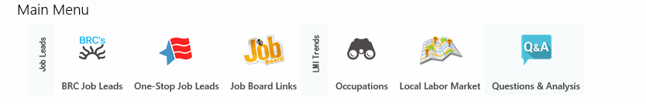
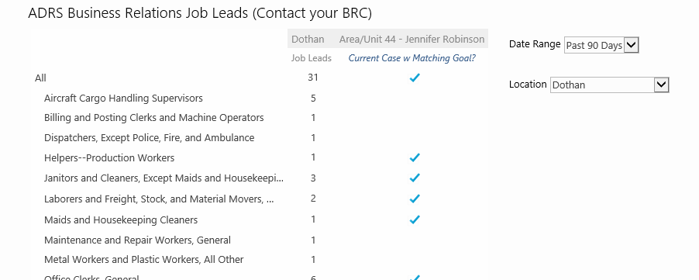

ADRS LMI Dashboard Demonstration I

Slide 13
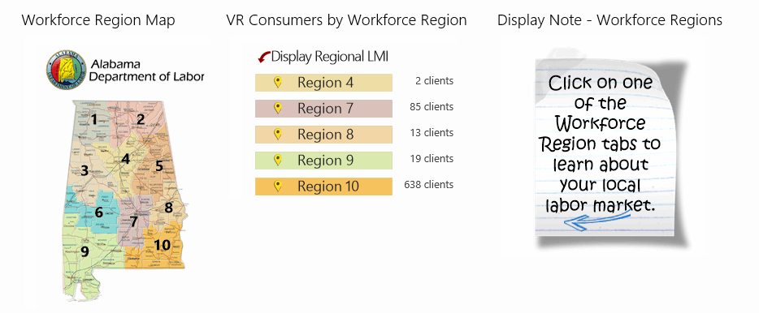
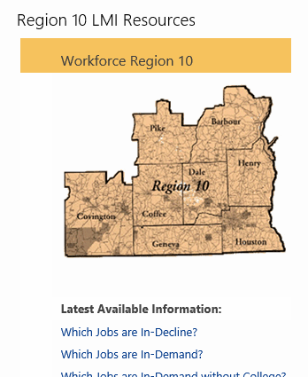
ADRS LMI Dashboard Demonstration II

Slide 14
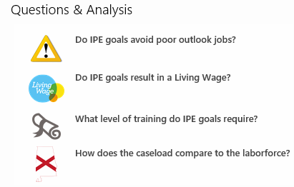
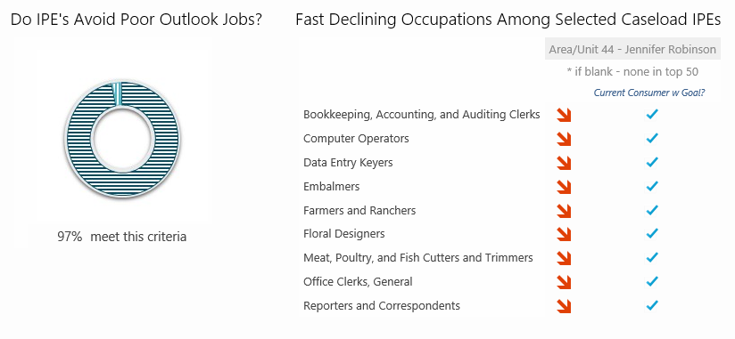
ADRS LMI Dashboard Demonstration III

Slide 15
Questions?

Slide 16
Contact Information
www.explorevr.org
Michael Quinn: michael.quinn@rehab.alabama.gov
May-Lorie Saint Laurent: maylorie.stlaurent@umb.edu

