Slide 1



SuRGE
An engine for adaptive, emergent learning
and
research and development of best practices in vocational rehabilitation
6th Summit Conference
Providence, Rhode Island
September 16, 2013
Andrew Clemons, Graduate Student
Darlene A. G. Groomes, Ph.D., LPC, CRC

Slide 2
What is SuRGE?
The Summit Reading Groups for Excellence (SuRGE) is a nation-wide online learning community which permits the exchange of information across VR stakeholders, state agencies, CSAVR, and NCSRC.
SuRGE has evolved from a reading group into an engine for developing and presenting knowledge, conducting research, and contributing to promising practice in vocational rehabilitation (VR) program evaluation and quality improvement.

Slide 3
What are the goals of SuRGE?
SuRGE strives to:
Offer information on the process behind program evaluation, quality improvement, and performance management
Provide an opportunity to build a professional library and reference base
Create conversations about innovative ways to face day-to-day concerns or challenges for the improvement of state VR agencies
Identify topics critical to improving practice in VR
Develop tools, examples, and recommendations for strategic integration within participating organizations

Slide 4
How is information exchanged?
There are two groups that comprise a Reading Group:
  1. the Fundamental Group, which consists of practicing program evaluators and quality specialists in VR agencies.
  2. the Principal Group, which consists of VR State Directors and members of the National Coalition of State Rehabilitation Councils
Utilizing teleconferencing and website postings, Fundamental Group members exchange information, share resources, apply models presented in the selected book, and develop tools for consideration by the Principal Group.
Outcomes from our quarterly combined teleconferences are posted on the Summit Group website, under Summit Reading Groups/Project Development: http://vocational-rehab.com/summit-reading-groups/project-development/

Slide 5
SuRGE:
The Engine
Deliverables developed by the Reading Group may become a strategy integrated into practice within the VR agency;
These tools are vetted through facilitated discussion at the annual Summit Conference;
Once strategies are integrated into practice, these will be evaluated for utility, value, and recommended improvements to VR processes.
Once leadership modifies these strategies according to feedback, these are then evaluated for utilization and effectiveness as a promising practice leading to improvements in the VR program.

Slide 6
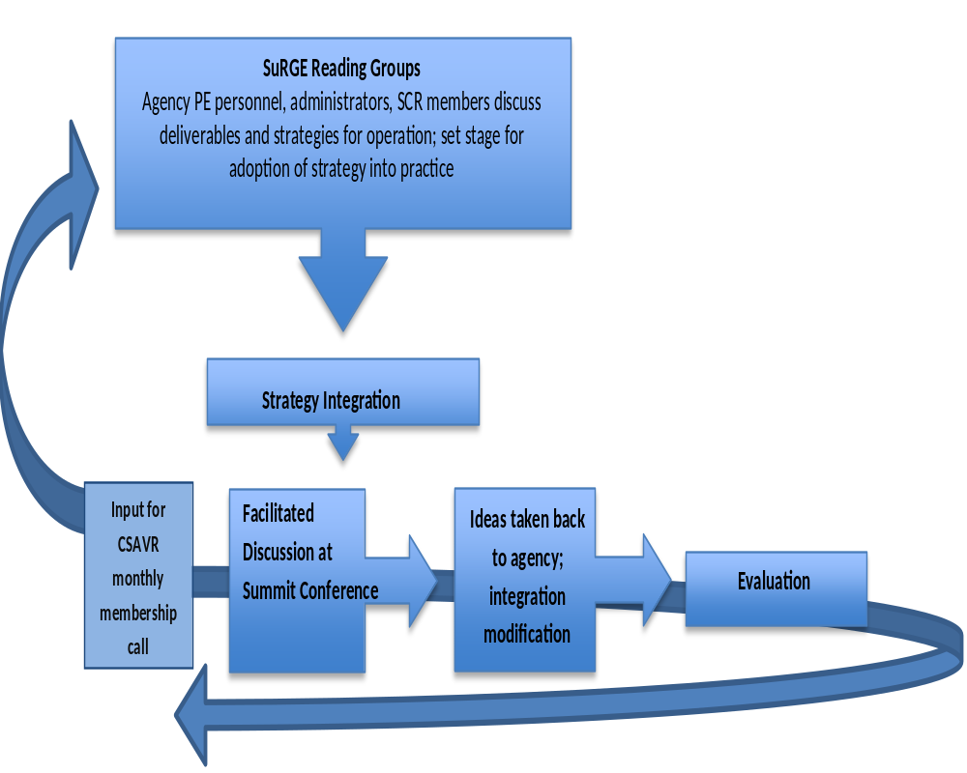

Slide 7
The Evolution of SuRGE
SuRGE was developed in 2010 as a professional development opportunity within The Summit Group. SuRGE engaged Summit Group members in the exchange of information on high-priority topics in VR evaluation.
The 1st and 2nd SuRGE groups shared resources and created new knowledge through community learning; Dr. Groomes presented findings from preliminary experiences with SuRGE at the 2010 Summit in Vancouver, Washington.
With the 3rd group, SuRGE evolved into its current form: an engine for emergent learning which also generates new knowledge and practice to share with the VR community.

Slide 8
The 1st SuRGE Group
April 2010
The 2nd SuRGE Group
November 2010
The 1st SuRGE group read and discussed Michael Quinn Patton’s book entitled: Utilization-Focused Evaluation (2008, Fourth Edition).
The 2nd group explored Sylvia and Sylvia’s Program Planning and Evaluation for the Public Manager (2004, 3rd edition).
Early in its evolution, the first two groups did not produce specific deliverables, and the duration of the reading group was five months.

Slide 9
The 3rd SuRGE Group
June 2011
This 3rd group read Stephen Few’s Information Dashboard Design: The Effective Visual Communication of Data (2006).
In 2012, Dr. Groomes, Dr. Steve Collins, Thomas A. Jones, HarrietAnn Litwin, Michael Shoemaker, and Michael Quinn presented the 3rd group’s findings at the San Antonio Summit: “The Development and Use of Dashboards in VR Programs”.
It became evident that producing a conference presentation added value to the training and development of Summit Group members and Summit conference attendees; the duration of reading group involvement became 10 months.
Notes:
Can we remove the “it became evident that” from the 3rd point?

Slide 10
The 4th SuRGE Group
November 2012
Beginning with the 4th group, SuRGE took its present form and began producing deliverables for adaptation in VR practice.
The 4th group is currently reading Peter Scholtes’ book, The Leader’s Handbook: Making Things Happen, Getting Things Done (1998).
The ongoing work of the 4th group is centered on the Summit Group mission and priorities; it utilizes Summit Group resources, applies Baldrige Criteria for Performance Excellence, and will focus on information that contributes to value creation and innovation in the VR Program.
Notes:
Need conference name

Slide 11
Future Groups
Future SuRGE groups may explore:
de Vaus, D. (2001). Research Design in Social Research, Thousand Oaks, CA: Sage Publications, Inc.
Deming, W.E. (2000). Out of Crisis, Boston, Massachusetts: The MIT Press.
Dillman, D.A., Smyth, J.D. & Christian, L.M. (2008). Internet, Mail and Mixed-Mode Surveys: The Tailored Design Method, Hoboken, New Jersey: John Wiley & Sons, Inc.
Elsdon, R. (2003). Affiliation in the Workplace: Value Creation in the New Organization. CT: Praeger.
Galloway, D. (1994). Mapping Work Processes, Milwaukie, WI: American Society of Quality Press.
Levin, H.M. & McEwan, P.J. (2000). Cost Effectiveness Analysis: Methods and Applications, Second Edition, Thousand Oaks, CA: Sage Publications, Inc.
Morgan, D.A. & Krueger, R.A. (1997). The Focus Group Kit, Volumes 1-6 [Box Set], Thousand Oaks, CA: Sage Publications, Inc.

Slide 12

Future SuRGE groups may explore:
Ouchi, W. (1993). Theory Z: How American Companies Can Meet the Japanese Challenge, New York, NY: Avon Books.
Rossi, P.H., Lipsey, M.W. & Freeman, H.E. (2003). Evaluation, A Systematic Approach, Seventh Edition, Thousand Oaks, CA: Sage Publications, Inc.
Schiuma, G. (2011). Managing Knowledge Assets and Business Value Creation in Organizations: Measures and Dynamics. PA: Business Science Reference.
Walton, M. (1988). The Deming Management Method, New York, NY: The Berkley Publishing Group.
Wholey, J. S. Handbook of Practical Program Evaluation: Essential Texts for Nonprofit and Public Leadership and Management.
Zaffron, S. & Logan, D. (2009). The Three Laws of Performance: Rewriting the Future of Your Organization and Your Life. CA: Jossey-Bass.

Slide 13
Become involved in SuRGE
Interested in becoming a member of SuRGE?
Request a place in an upcoming reading group by visiting:
http://vocational-rehab.com/summit-reading-groups/
Do you know of a book or topic SuRGE should explore?
Please contact SuRGE facilitator,
Dr. Darlene Groomes:
groomes@oakland.edu

