Slide 1

Beam us up, DRS: Visualizing Employment Decisions
Todd Sink, Ph.D.
Research Specialist II
WV Division of Rehabilitation Services
Joseph “Zeke” Hampton, MA
Research Specialist III
WV Division of Rehabilitation Services
Douglas Snuffer, MA
Research Specialist II
WV Division of Rehabilitation Services
Pisnu Bua-Iam, MA
Senior Manager
WV Division of Rehabilitation Services

Slide 2
Outline
Rehab Act and Informed Consumer Choice
Selecting a Vocational Goal
  Geospatial Visual Analytics
OnTheMap
West Virginia Division of Rehabilitation Services

Slide 3
Rehab Act and Consumer Choice
Throughout the Rehabilitation Act, value is placed on consumer choice and informed choice in each step of the VR process.
VR agencies and counselors assist consumers in making informed choices through counseling and guidance and the exploration of options.
  Exploring Employment Options
  Choosing an Appropriate Vocational Goal
West Virginia Division of Rehabilitation Services

Slide 4
Rehab Act and Consumer Choice
VR Requirements (CFR 361.52(b)(4)
Consumer Benefits
Consumers must be active and full partners in the VR process
Counselors must provide or assist eligible individuals in acquiring information that enables informed choice throughout the VR process, including the selection of an appropriate vocational goal
  Local Labor Market Trends
  Employment Opportunities
Enhanced service quality
  Increased choice
  Self-determination
  Empowerment
Higher levels of satisfaction
West Virginia Division of Rehabilitation Services

Slide 5
Selecting a Vocational Goal
Counselor Considerations (DRS CSM)
Consumer Considerations
Placement demand for the consumer’s employment goal.
If placement is not available in the local area, the client must be willing to relocate to facilitate placement.
The long-range outlook and recent industry trends
The counselor must document resources utilized to support the availability of employment.
Are there compatible employment options locally?
Is employer size important?
Are they willing to relocate?
Do they have access to transportation?
Long-term plans for employment/advancement in the desired industry?
West Virginia Division of Rehabilitation Services

Slide 6
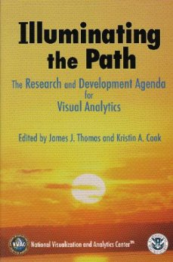
How can we enhance VR consumers’ ability to choose a vocational goal?
Answer: GeoSpatial Visual Analytics
  Decision support facilitated by interactive visual interfaces (Andrienko et al., 2010)
  Focus: enhance analytical reasoning process
  Data Information Knowledge Decision
  Origins
    Canada Geographic Information System 1960s-1970s
    Map performance vs table performance debate surrounding decision making
      Maps…….
      Improve performance on complex tasks by reducing the amount of time involved and task difficulty by reducing cognitive load of information (Smelcer and Carmel, 1997).
      Increase decision effectiveness (Stanney and Slavendy, 1995).
      Enhance quality of decision making (Taylor and Iwanek, 1980).
    U.S. Department of Homeland Security’s National Visualization and Analytics Center (NVAC)
….now has broader scope and impact
West Virginia Division of Rehabilitation Services

Slide 7
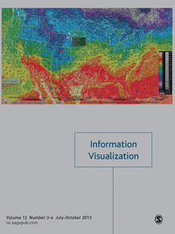


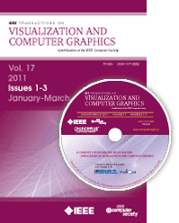

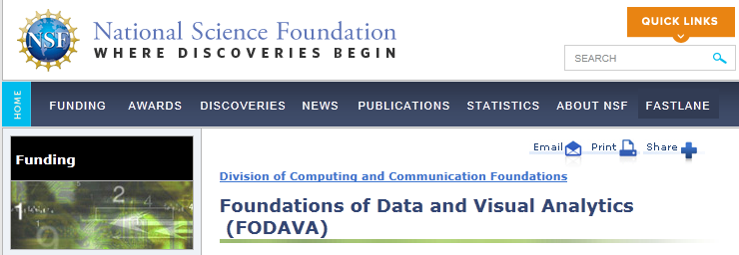






Research
Commercial Products
Conferences
Professional Organizations
Government Products

Slide 8
OnTheMap
Interactive employment visualization website. http://onthemap.ces.census.gov/
  Center for Economic Studies at the U.S. Census Bureau.
  Supported by the Employment and Training Administration (ETA) at the U.S. Department of Labor
West Virginia Division of Rehabilitation Services

Slide 9
OnTheMap: Data
Longitudinal Employer-Household Dynamics (LEHD)> Origin-Destination Employment Statistics (LODES)
  Unemployment Insurance (UI) Wage Records: private sector and state and local government
  Office of Personnel Management (OPM): employees and job for most federal employees
  Quarterly Census for Employment and Wages (QCEW): firm location
Years
  2002-2011 (Reference period: Quarter 2, April-June)
Job Definition
  Worker is employed with positive earnings during Quarter 2 and in Quarter 1
States
  Arizona –2004‐2011 only.
  Arkansas –2003‐2011 only.
  District of Columbia –2010-2011 only.
  Mississippi –2004‐2011 only.
  New Hampshire –2003‐2011 only.
  Massachusetts, Puerto Rico, and U.S. Virgin islands – No data available.
  All other states – Data available for 2002‐2011.
Geographical Base
  2010 census blocks: smallest Census enumeration unit. Often the size of a city block.
  Aggregated for larger Census enumeration units: census tract (multiple blocks); county; state; etc.
Data Structure
  Job data available by 10 different labor market segments
  Age; Earnings; Industry; Sex; Race; Ethnicity; Education; Ownership (firm owning job: Private and Public); Job Dominance (Primary Job and All Jobs); Job Type (All Jobs; All Private Jobs; Primary Jobs; and Private Primary Jobs)
West Virginia Division of Rehabilitation Services

Slide 10
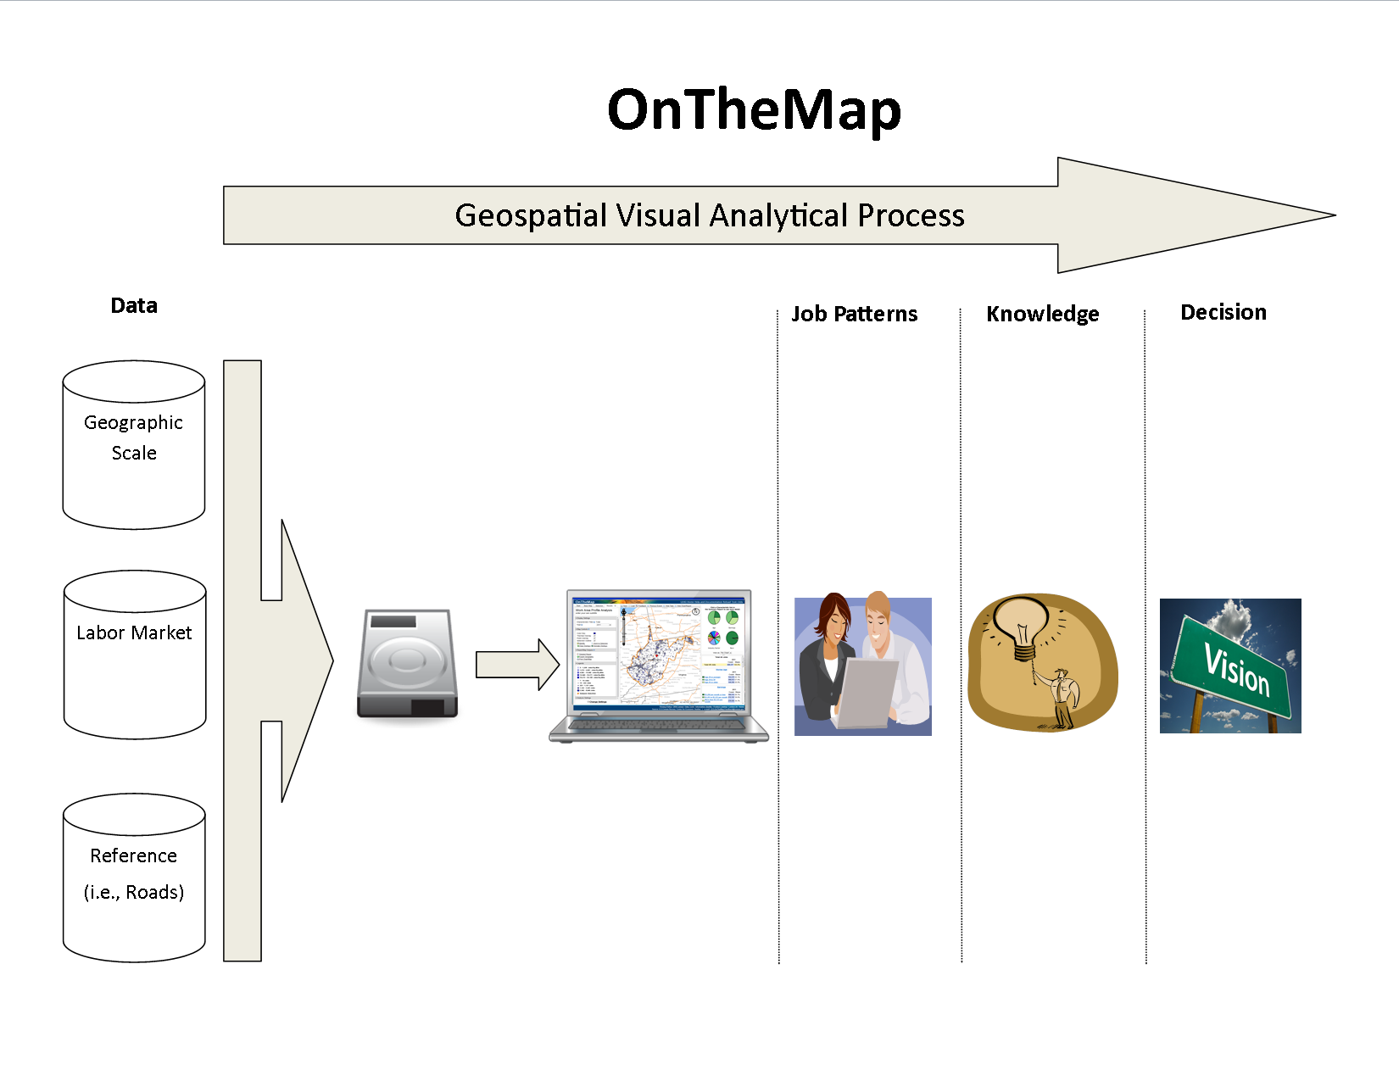
West Virginia Division of Rehabilitation Services

Slide 11
OnTheMap
  Benefit……Greater knowledge of labor market trends: state; region; county; city; zip code; neighborhood.
TY Consumer: I really want to establish a career in my hometown, but I don’t know what opportunities exist there. Can you help?
VR Counselor: Absolutely. Lets take a look at OnTheMap
West Virginia Division of Rehabilitation Services

Slide 12
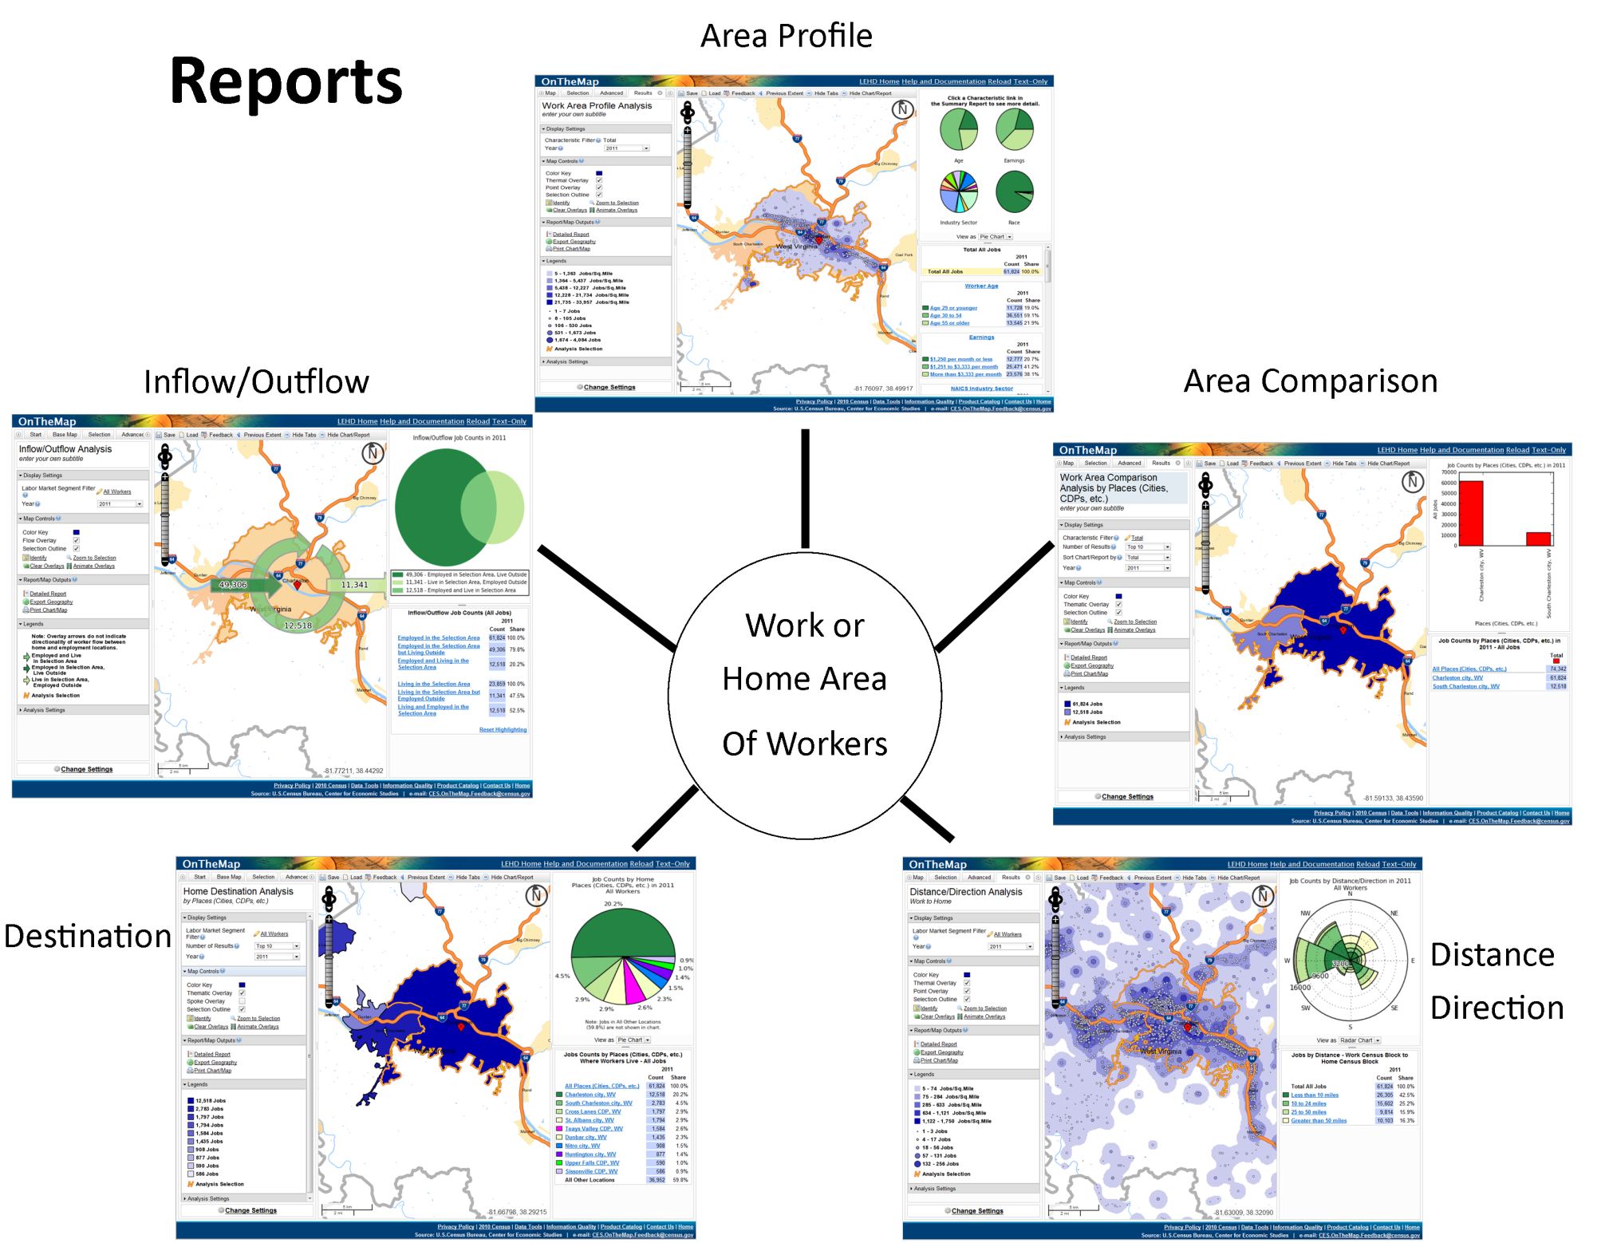
West Virginia Division of Rehabilitation Services

Slide 13
VR Scenarios
A transition youth client is interested in finding employment in the Agriculture, Forestry, Fishing, and Hunting industry sector and needs help with determining if his home city is a good place to look for employment in this field.
A client wants to avoid a long work commute or relocation and thinks a good place to start in her job search is to know where her neighbors are traveling to work so that she gain some perspective on how far she might have to travel.
A transition youth client who has enrolled in college for nursing and wants to compare the employment outlook in the Health Care and Social Assistance industry sector for a couple of small cities where she could see herself working.
A client and his parents need help finding potential places to search for employment in a field that requires less than a high school education and is located within walking distance of a city bus route.
A counselor who wants to better help his transition youth clients in WV decide on a career.
West Virginia Division of Rehabilitation Services

Slide 14
OnTheMap: Overview and VR Application
  http://onthemap.ces.census.gov/
West Virginia Division of Rehabilitation Services

Slide 15
Uses for Program Evaluators
Does the VR agency have difficulties with job placement?
  Knowledge gap
  Skills gap or mismatch
  Distance or transportation issues
Answer: Improve labor market awareness and job placement with OnTheMap.
  Specific industry sectors in the local labor market.
  Identify if a VR consumer has the necessary skills for a particular location.
  Typical distance and direction travelled for work.
  Refined data for younger VR consumers.
West Virginia Division of Rehabilitation Services

Slide 16
Other OnTheMap Applications
Text-Only
OnTheMap Mobile
Manual Download of Raw Data
http://lehd.ces.census.gov/applications/help/onthemap.html#!what_is_onthemap
West Virginia Division of Rehabilitation Services

Slide 17
Other LEHD Applications and Resources
Local Employment Dynamics Partnership Extraction Tool
Quarterly Workforce Indicators (QWI)
Industry Focus
  http://lehd.ces.census.gov/applications/
Training and Assistance
  http://lehd.ces.census.gov/learning/
West Virginia Division of Rehabilitation Services

Slide 18
Special Thanks
Special thanks to:
Donna L. Ashworth, Director of the West Virginia Division of Rehabilitation Services
Marijane Waldron, Assistant Director of Field Services, West Virginia Division of Rehabilitation Services
Susan Newhouse and Basil White, Jr. of the WVDRS State Plan and Program Evaluation Unit

Slide 19
References
Andrienko, G., Andrienko, N., Demsar, U., Dransch, D., Dykes, J., Fabrikant, S., Jern, M., Kraak, MJ., Schumann, H., & Tominski, C. (2010). Space, time and visual analytics. International Journal of Geographical Information Science, 24(10), 1577-1600.
Smelcer, J., & Carmel, E. (1997). The Effectiveness of Different Representations for Managerial Problem Solving: Comparing Tables and Maps. Decision Sciences, 28(2), 391-420.
Stanney, K., & Salvendy, G. (1995). Information visualization: Assisting low spatial individuals with information access tasks through the use of visual mediators. Ergonomics, 38(6), 1184-1198.
Taylor, P., & Iwanek, R. (1980). Intuitive versus optimal solutions to some problems in distribution. OMEGA, 8(2), 183-192.
U.S. Census Bureau. 2013. OnTheMap Application. Longitudinal-Employer Household Dynamics Program. http://onthemap.ces.census.gov/

Slide 20
Questions?

