Slide 1

Electronic Case Reviews and Consumer Surveys
Soon to be known as: Opportunities for Ohioans with Disabilities
Presented by:
Janet Cool, MSSA
Alana Evans, MS
September 16, 2013

Slide 2


Case Reviews
Electronic Case Reviews & Consumer Surveys 9/16/2013

Slide 3
Background for Case Reviews
Random Selection of VR Cases
  IT generated list
  Beginning of each month
  Reflection of statewide patterns and trends
Electronic Case Reviews & Consumer Surveys 9/16/2013

Slide 4
Background (continued)
Random Selection of VR Cases statewide that are either:
      Eligible (with a Plan created)
      Service
      Employed
      Closed-Rehabilitated or
      Closed-Other
Electronic Case Reviews & Consumer Surveys 9/16/2013

Slide 5
Background (continued)
Additional Criteria for Random Selection of VR Cases:
    cases Closed-Other must have at least reached Eligible (with a Plan created) status
    cases opened in Application status throughout the previous 24 months
    either of the Closed statuses for cases closed within current FFY
Electronic Case Reviews & Consumer Surveys 9/16/2013

Slide 6
Background (continued)
# of random reviews completed by QA-RPS (PIE) determined by PIE Manager during first month of each new FFY
  based upon previous years’ total number of plans written
  statistically sound sampling
  (minimum of a 90 percent confidence level)
Electronic Case Reviews & Consumer Surveys 9/16/2013

Slide 7
History of Ohio Case Reviews
Prior to FFY2012 –
  VR Supervisors = 10 case reviews per VR Counselor each year
  PIE RPS = 10 case reviews per office, -> then later, 1 case review for each VR Counselor statewide
FFY 2012 and 2013
  approx. 375 random case reviews per year
  VRS = as needed for performance
Electronic Case Reviews & Consumer Surveys 9/16/2013

Slide 8
Types of Case Reviews
Programmatic –
(Program Specialists)
Performance - (Supervisors)
Targeted - (RPS & VRS)
Electronic Case Reviews & Consumer Surveys 9/16/2013

Slide 9
Case Review Guide
Referenced throughout case review process to:
  verify the meaning of each item
  determine how to rate item(s)
  identify where information is typically documented in AWARE
Electronic Case Reviews & Consumer Surveys 9/16/2013

Slide 10
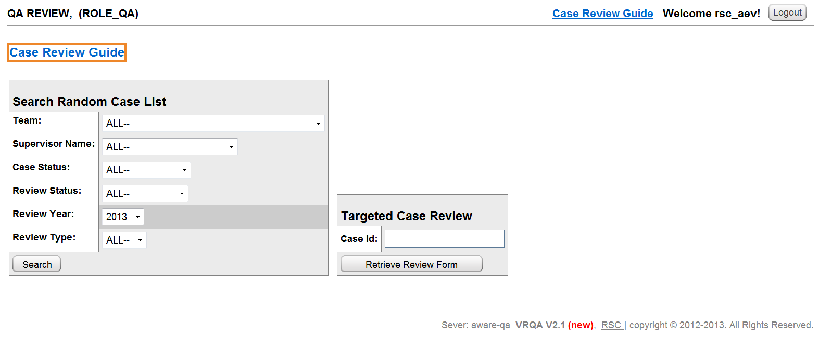

VRQA System App.
Electronic Case Reviews & Consumer Surveys 9/16/2013

Slide 11
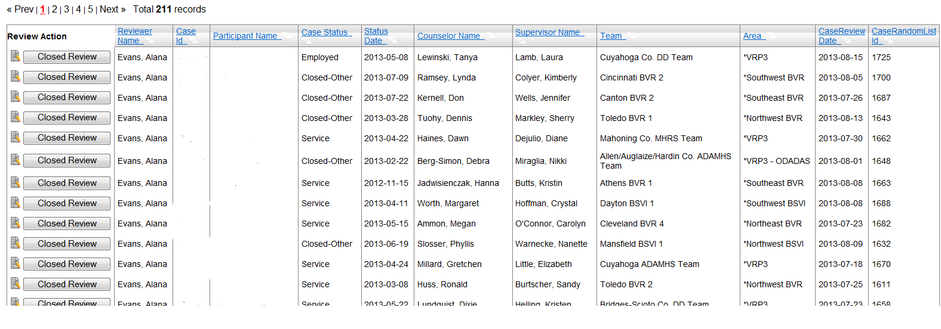
VRQA System App. (continued)
Electronic Case Reviews & Consumer Surveys 9/16/2013

Slide 12
VRQA System App. (continued)
Identifying information pre-populated from the AWARE system
Each item is rated by clicking the circle beneath the appropriate rating (P, PP, NP, N/A).
Electronic Case Reviews & Consumer Surveys 9/16/2013

Slide 13
VRQA System App. (continued)
Each section considers pertinent quality indicator:
      Case documentation
      Vocational guidance & counseling
      Informed choice
      Timeliness
      Fiscal responsibility
Electronic Case Reviews & Consumer Surveys 9/16/2013

Slide 14
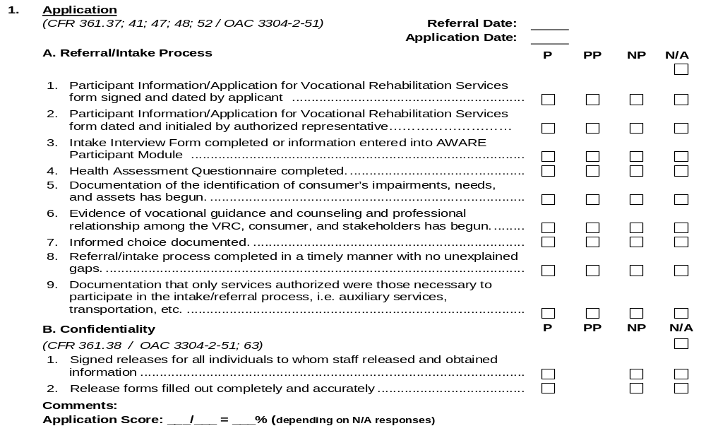
Case Review Form – (APPLICATION)
Electronic Case Reviews & Consumer Surveys 9/16/2013

Slide 15
VRQA System App.
Complete all sections (or only those items desired for targeted review)
    If a new case review is commenced and the reviewer gets interrupted the “Save” button can be selected.
    VRQA saves those completed portions as “In Process”.
Electronic Case Reviews & Consumer Surveys 9/16/2013

Slide 16
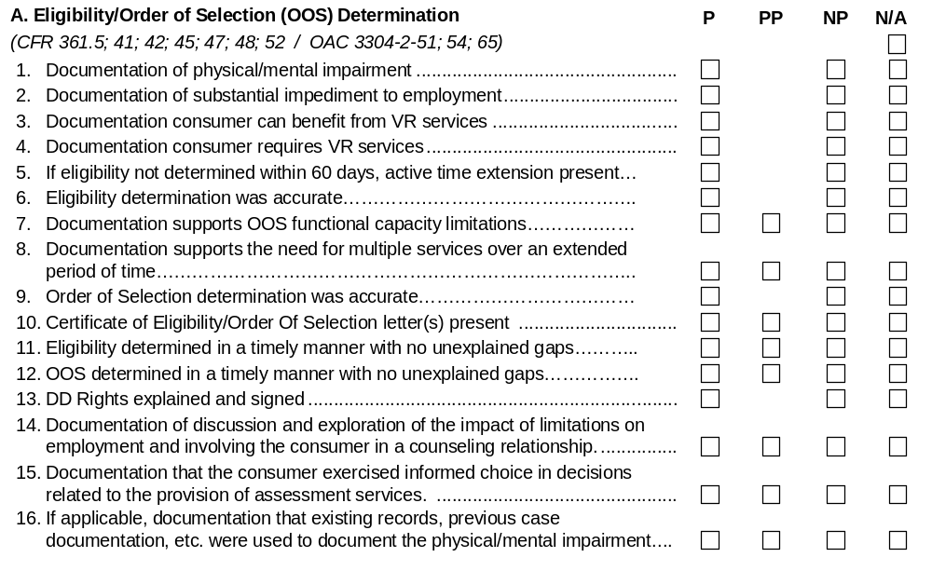
Case Review Form – (ELIGIBILITY)
Electronic Case Reviews & Consumer Surveys 9/16/2013

Slide 17
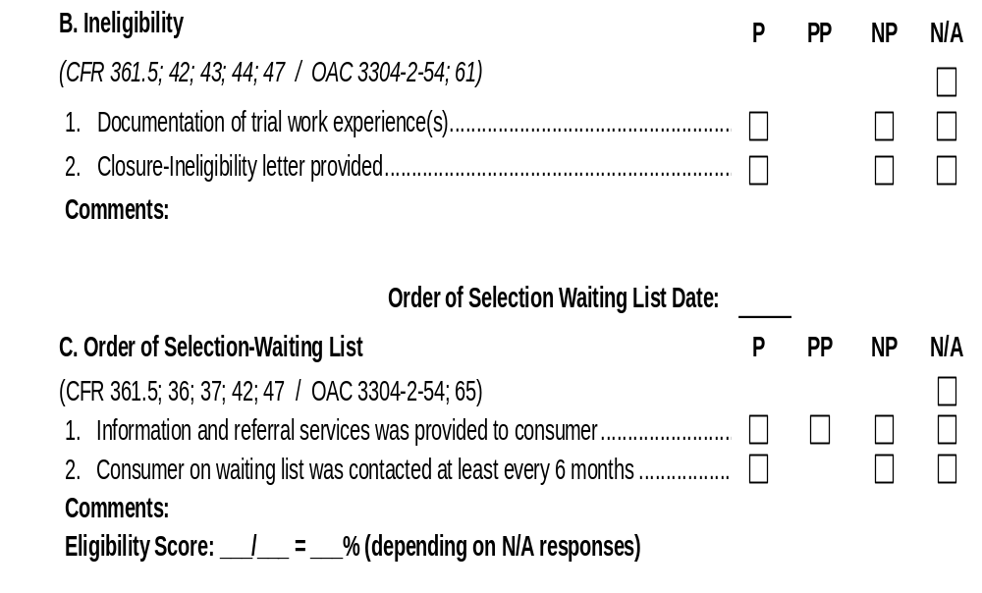
Case Review Form – (ELIGIBILITY)
Electronic Case Reviews & Consumer Surveys 9/16/2013

Slide 18
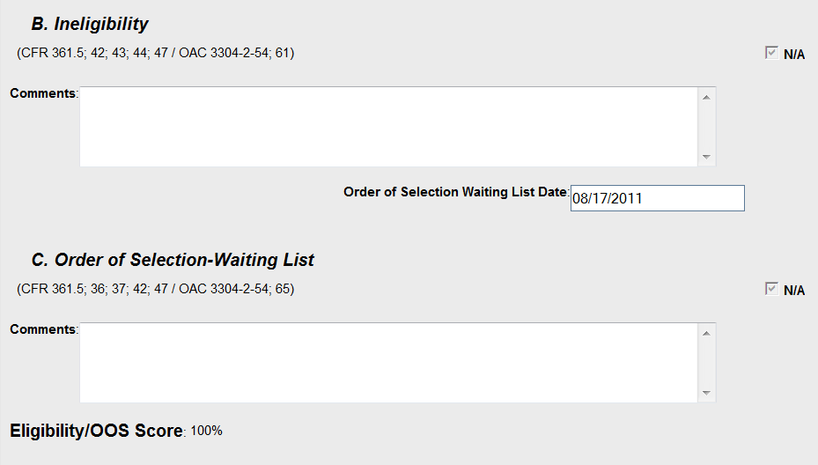
VRQA System App.
Electronic Case Reviews & Consumer Surveys 9/16/2013

Slide 19
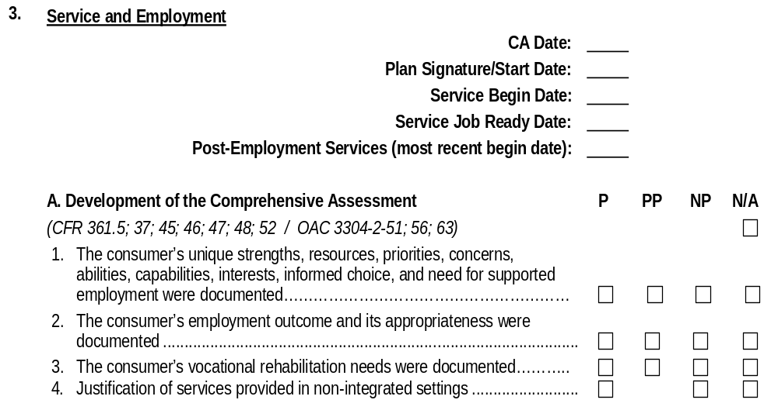
Case Review Form –
(SERVICE & EMPLOYMENT)
Electronic Case Reviews & Consumer Surveys 9/16/2013

Slide 20
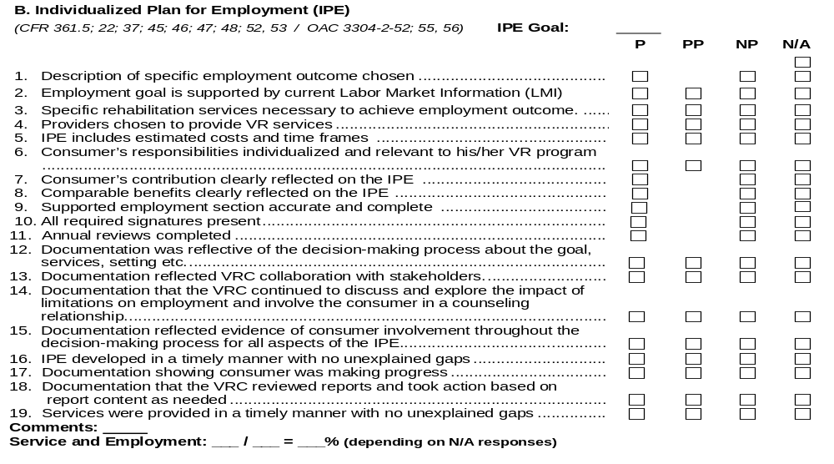
Case Review Form –
(SERVICE & EMPLOYMENT)
Electronic Case Reviews & Consumer Surveys 9/16/2013

Slide 21
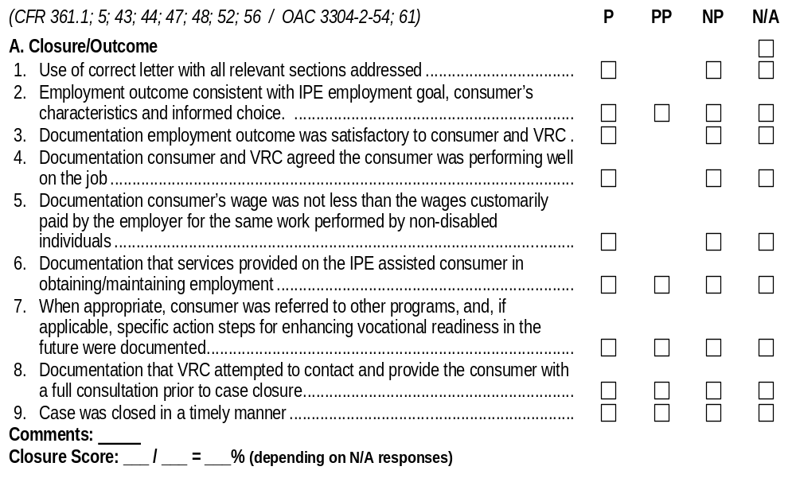
Case Review Form – (CLOSURE)
Electronic Case Reviews & Consumer Surveys 9/16/2013

Slide 22
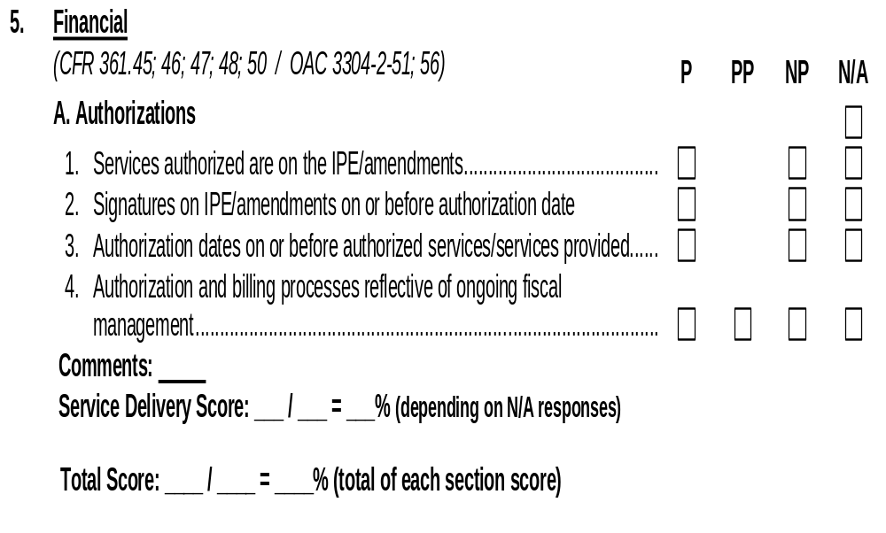
Case Review Form – (FINANCIAL)
Electronic Case Reviews & Consumer Surveys 9/16/2013

Slide 23
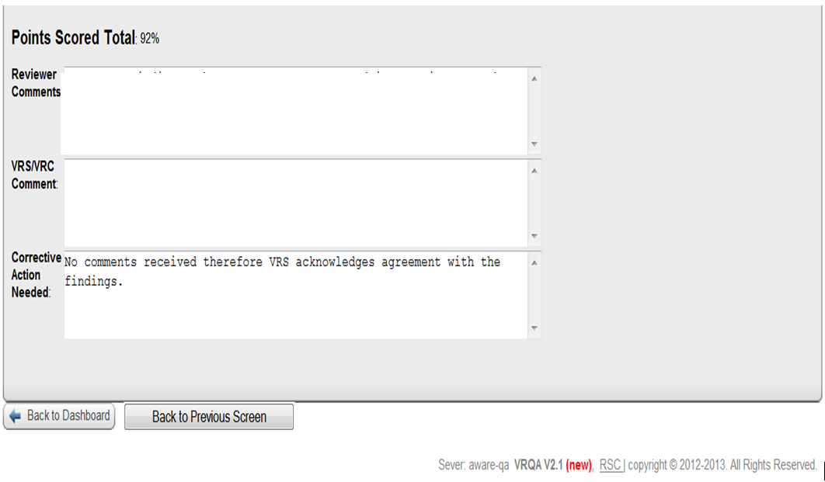
VRQA System App.
Electronic Case Reviews & Consumer Surveys 9/16/2013

Slide 24
VRQA System App.
    Once completed -> select “Complete” button
    VRQA saves the review and forwards notification to the appropriate counselor/coordinator for comment
    Case is then in “Completed” status rather than “In Process”.
Electronic Case Reviews & Consumer Surveys 9/16/2013

Slide 25
VRQA Case Review Reports
Tableau reports updated daily
Available online and accessed by DPI staff, VR Deputy Directors, VR Assistant Deputy Directors, Area Managers, VR Supervisors and VR/VRP3 Program Specialists.
Electronic Case Reviews & Consumer Surveys 9/16/2013

Slide 26
VRQA Case Review Reports
Data can be drilled down separating:
  PIE reviews from supervisor reviews
  full case reviews from targeted case reviews
  time periods (ie. Federal Fiscal Year, Quarters, etc.)
  location (statewide, bureau, area, team, and counselor/coordinator levels)
Electronic Case Reviews & Consumer Surveys 9/16/2013

Slide 27
VRQA Case Review Reports
Case Review Dashboard Report
  updated quarterly and sent to VR administration
  identifies areas of strengths, opportunities, and threats for specific case review items
  highlights statewide trends
Electronic Case Reviews & Consumer Surveys 9/16/2013

Slide 28
VRQA Case Review Reports
PIE Case Review Reports
  scores for each item on the case review form as well as a total case review score
  used to generate the quarterly Case Review Summary Report previously referenced
  used to evaluate overall programmatic performance and to determine both programmatic and training decisions
Electronic Case Reviews & Consumer Surveys 9/16/2013

Slide 29
VRQA Case Review Reports
PIE Case Review List Report
  identifies case reviews currently in VRQA System for each counselor by:
    review status
    review status date
    division/bureau, area, office/team, supervisor, reviewer, type of review, and counselor/coordinator
Electronic Case Reviews & Consumer Surveys 9/16/2013

Slide 30
VRQA Case Review Reports
PIE Case Review List Summary Reports
  identifies case reviews by type:
    New
    In process
    Completed
    Commented
    Finalized
Electronic Case Reviews & Consumer Surveys 9/16/2013

Slide 31
Technical Assistance
  In addition to PIE reports, several additional reports utilized to provide technical assistance, feedback and guidance related to program expectations and outcomes:
    Master List
    Front Door (aging)
    Area Performance
    Current Year Activity
    Standards and Indicators
Electronic Case Reviews & Consumer Surveys 9/16/2013

Slide 32
Training
PIE staff work with VR Training Manager and Area Managers to coordinate training topics based on patterns and trends from case reviews
Training addresses statewide issues, area issues, and PIE updates and may also include specialized populations (i.e. transition, TBI, substance abuse, etc.)
Electronic Case Reviews & Consumer Surveys 9/16/2013

Slide 33
VR Action Plan
Action steps identified by VR management for prioritized areas that are below 90 percent compliance on a statewide level
Coordinated with the PIE Manager who establishes methods to proactively address item(s) and reports to track progress on these priority area(s)
Electronic Case Reviews & Consumer Surveys 9/16/2013

Slide 34
Administrative Review and Resolution
Case review finding is considered unjustified, discussed with VR Supervisor
If Supervisor disagrees with findings, contact reviewer within ten (10) business days of completion of the review and provide supporting written documentation contrary to the findings
Electronic Case Reviews & Consumer Surveys 9/16/2013

Slide 35
Administrative Review and Resolution
Reviewer discusses with his/her manager to see if the documentation provided warrants having the finding rescinded
Manager contacts PIE Manager, if necessary, to discuss the issue in further detail prior to making a decision
Electronic Case Reviews & Consumer Surveys 9/16/2013

Slide 36

Consumer Surveys
Electronic Case Reviews & Consumer Surveys 9/16/2013

Slide 37
Consumer Survey Types
Consumer Satisfaction (CFR 361.52)
Ineligibility (CFR 361.43)
Extended Employment (CFR 361.55)
Electronic Case Reviews & Consumer Surveys 9/16/2013

Slide 38
Consumer Satisfaction
Completed for cases on the QA random list whose case was reviewed by PIE staff that assesses overall satisfaction with VR services including resources/information provided, staff, and outcome/results.
Electronic Case Reviews & Consumer Surveys 9/16/2013

Slide 39
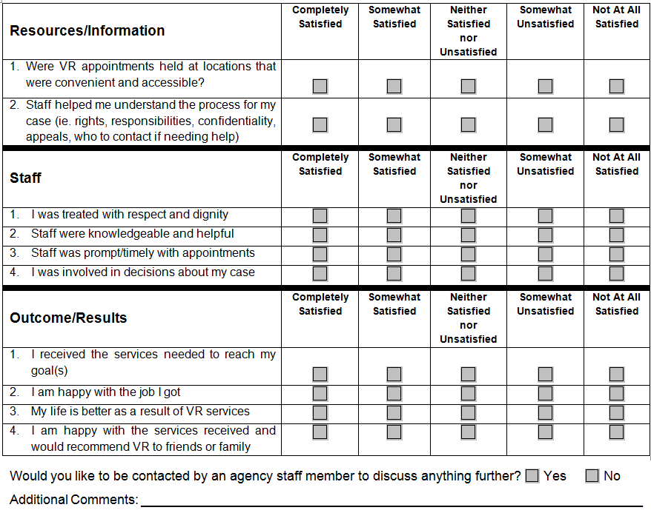
Consumer Satisfaction
Electronic Case Reviews & Consumer Surveys 9/16/2013

Slide 40
Ineligibility
Completed within twelve (12) months of closure, and annually thereafter if requested, to determine the individual’s current work status and need for VR services.
Electronic Case Reviews & Consumer Surveys 9/16/2013

Slide 41
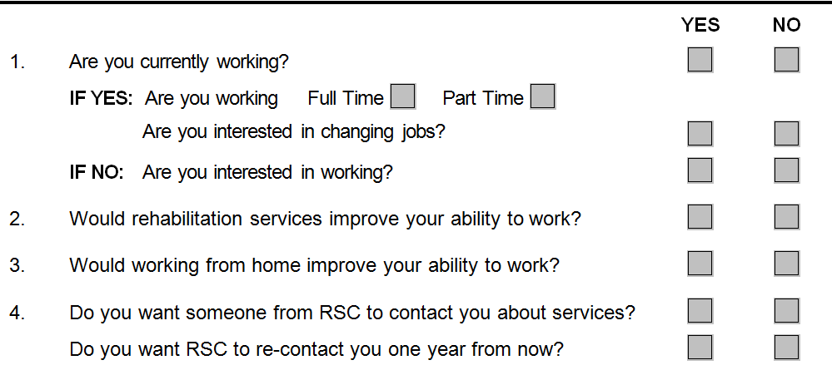
Ineligibility Survey
Electronic Case Reviews & Consumer Surveys 9/16/2013

Slide 42
Extended Employment
Completed annually for two (2) years, and then as requested for consumers closed in extended employment to determine interests, priorities, and needs with respect to competitive employment or training for competitive employment.
Electronic Case Reviews & Consumer Surveys 9/16/2013

Slide 43
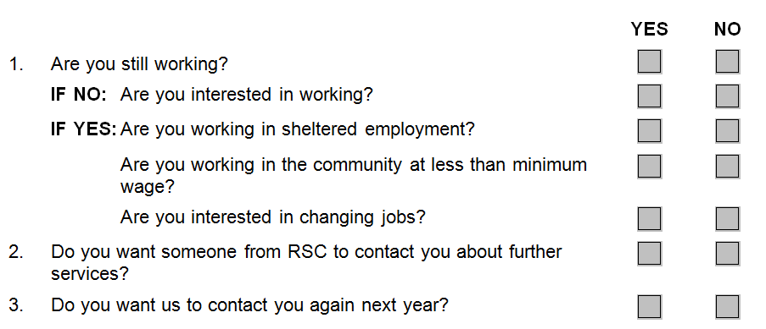
Extended Employment Survey
Electronic Case Reviews & Consumer Surveys 9/16/2013

Slide 44
VRQA System App.
The electronic system that stores and manages information related to case reviews, consumer surveys, and program monitoring.
***VR staff attempts to secure an email address to promote more rapid feedback and to decrease the cost of time spent to contact consumers by telephone to obtain feedback.
Electronic Case Reviews & Consumer Surveys 9/16/2013

Slide 45
Consumer Survey Procedure Basics
Consumers can provide feedback anonymously (no name required)
Sign in to QA application online to provide electronic feedback, w/ ability to “opt out”
Surveys available in English, Spanish, and can be modified with web browser for large print
Respond to survey online (within 90 days) or by telephone
No longer sending hard copy surveys by mail
Electronic Case Reviews & Consumer Surveys 9/16/2013

Slide 46
Procedure Basics (continued)
QA staff obtain lists of consumers for each of the 3 surveys every month.
  QA RPS uses AWARE to email the survey cover letter as an attachment in a case note
  If no response within the first month following notification, QA RPS sends a second email
  If no response after second email notification, consumer’s name is added to the list to contact by phone
  If no email address, consumer contacted by phone
Electronic Case Reviews & Consumer Surveys 9/16/2013

Slide 47
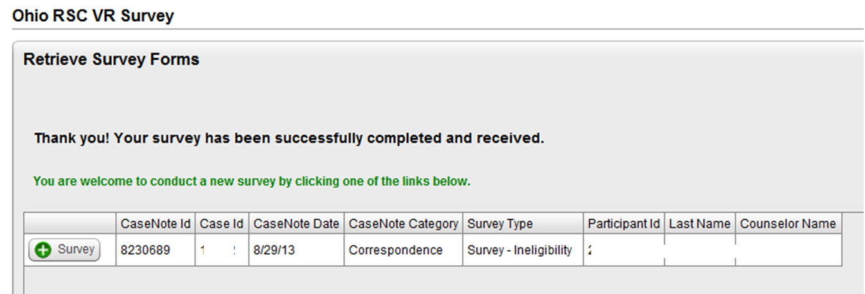
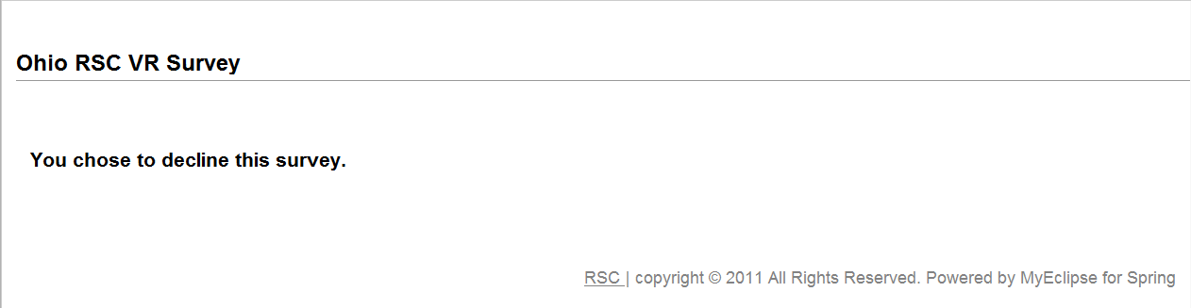
Procedure Basics (continued
OR
Electronic Case Reviews & Consumer Surveys 9/16/2013

Slide 48
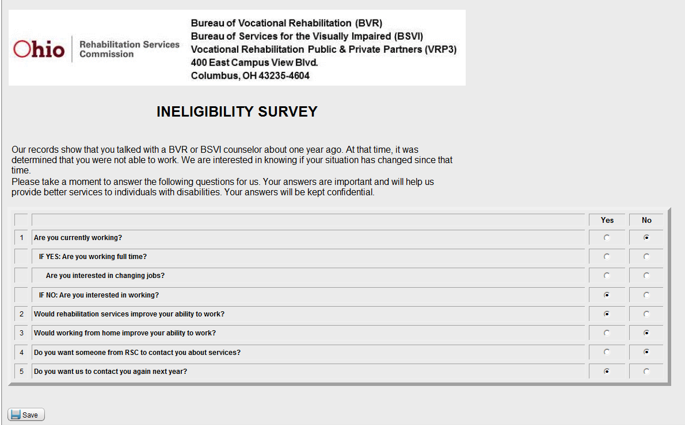
Procedure Basics (continued
Electronic Case Reviews & Consumer Surveys 9/16/2013

Slide 49
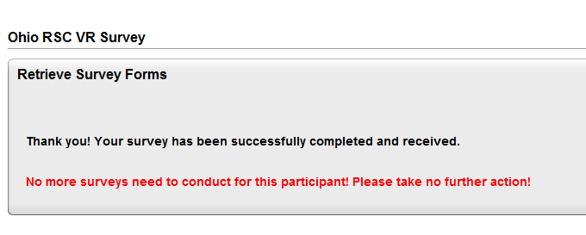
Procedure Basics (continued
Electronic Case Reviews & Consumer Surveys 9/16/2013

Slide 50
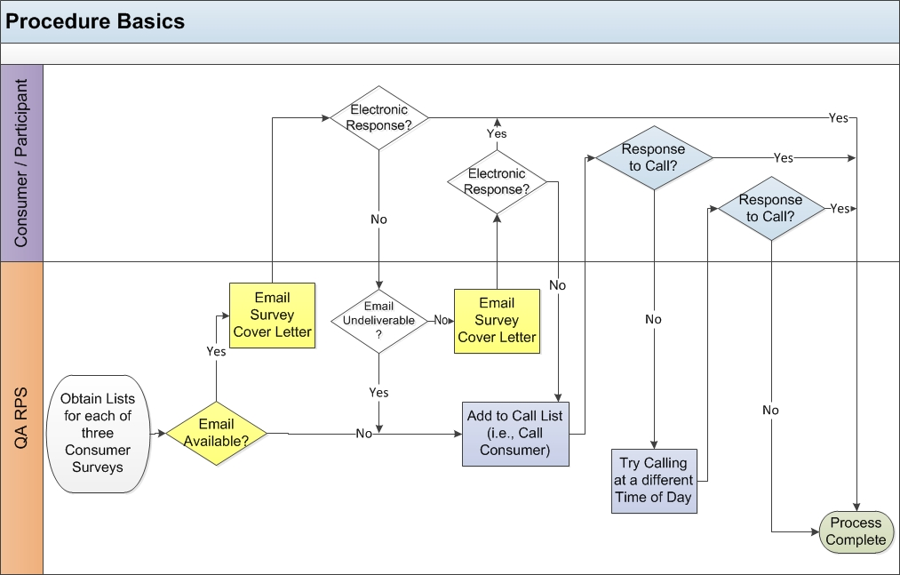
Procedure Basics (continued)
Electronic Case Reviews & Consumer Surveys 9/16/2013

Slide 51
Survey Follow Up Procedure
Each office/area designates staff responsible to follow-up with consumers who indicated that they want to be contacted by RSC.
Consumer Survey Follow-Up lists indicate the consumers requesting to be contacted and the type of survey completed.
Area Management (or designee) determines distribution and management of the completion of follow-up contacts and documents this in AWARE case notes.
Electronic Case Reviews & Consumer Surveys 9/16/2013

Slide 52
VRQA Consumer Survey Reports
Consumer Survey Dashboard Report
Survey Status Summaries
Survey Status Details
Electronic Case Reviews & Consumer Surveys 9/16/2013

Slide 53
Customer Satisfaction Survey Reports
Customer Satisfaction Summary
Customer Satisfaction Detail
Electronic Case Reviews & Consumer Surveys 9/16/2013

Slide 54
Ineligibility Survey Reports
Ineligibility Survey Summary
Ineligibility Survey Detail
Electronic Case Reviews & Consumer Surveys 9/16/2013

Slide 55
Extended Employment Survey Reports
Extended Employment Summary
Extended Employment Detail
Electronic Case Reviews & Consumer Surveys 9/16/2013

Slide 56

Contact Information:
Janet Cool, Manager
Program Integrity and Evaluation
614-438-1282
janet.cool@ood.ohio.gov
Alana Evans
QA Rehabilitation Program Specialist
614-438-1283
alana.evans@ood.ohio.gov
Agency name changes October 1
Electronic Case Reviews & Consumer Surveys 9/16/2013

Slide 57

QUESTIONS
Electronic Case Reviews & Consumer Surveys 9/16/2013

