Slide 1
Indicators of Quality for Customer Focus:
A 5-Why Approach
6th Summit Conference
Providence, Rhode Island
September 16, 2013
Darlene A. G. Groomes, Ph.D., LPC, CRC, Summit Reading Group Facilitator
Jennifer Beilke, MS, CRC, State Program Administrator, Minnesota Blind
Jacqueline Geib, MA , Policy and Quality Assurance Specialist, Colorado DVR
John Stem, M. Ed., CRC, Program Evaluation Specialist, Maryland DORS

Slide 2
Summit Reading Groups: A New Format
SuRGE: Summit Reading Groups for Excellence
  Learning Community of Summit Group
  Professional Development and Training
  Exciting Partnerships with CSAVR, NCSRC, TACEs
Combined Groups
  Fundamental
  Principal
Deliverable Development
Strategy Integration
Evaluate for Best Practice/Improvement

Slide 3
SRG-4: An Initial Look
Embody three professional entities; represented General, Combined, and Blind VR Programs
Represent seven states across the nation
Read Peter R. Scholtes’ (1998) The Leader’s Handbook: Making Things Happen, Getting Things Done
Challenged by new format
Engaged, responsive, patient, attentive, determined, research-focused, practical-minded

Slide 4
SRG-4: A New Perspective
Ten months and three combined calls
After the 1st Combined Call, we had to regroup
  Focus only on Chapters 2 and 8
  Charged with task of identifying 4-5 Indicators of Quality
    What best gauges the quality services that lead to counselor-client outcomes?
Connected leadership competencies and asking good questions to the development of these Indicators of Quality…everybody’s business.

Slide 5
Systems Thinking, GEMBA, and Process Improvement
Actionable information helps to identify systemic issues
Never to blame an individual, but to situate in the system where improvement is needed
“Gemba are the critical resources and sequence of interdependent activities that add value to the customer…the success of the organization is how well it serves the Gemba.” “Everything is felt in the Gemba.”
When focused on performance excellence, then situate improvement in the process, as well (SIPOC)

Slide 6
Lou Adams, Acting Director, Michigan MRS
Sue Page, Director, Maryland DORS:
Using this tool will take resources and effort because the different domains allow inquiry at different points in time/process. How best to instill that implementation of this tool is worth the effort and resources.
Use of this tool can result in rich information, learning outcomes, and systems perspective. We see program evaluation growing in value, that it is necessary. The Summit Group is evidence that the field sees the importance of doing things differently to improve.
This tool, an elegant design that captures data on relationships, services, and system issues, can make a contribution that may, over time, guide systems thinking and display value to those that choose to adopt its use. Use may result in small shifts and challenge people to look in a broader way; may show what we can do with expectations of quality.
With this tool, we may create a case for “I know quality when I see it.”

Slide 7
Leadership Competencies
Six competencies - based on Scholtes’ interpretation and elaboration of:
Deming’s System of Profound Knowledge
Competency #1: Ability to think in terms of systems and knowing how to lead systems
Competency #2: Ability to understand the variability of work in planning and problem solving

Slide 8
Leadership Competencies
Competency #3: Understanding how we learn, develop and improve; Leading true learning and improvement
Competency #4: Understanding people and why they behave as they do

Slide 9
Leadership Competencies
Competency #5: Understanding the interaction and interdependence between systems, variability, learning, and human behavior; knowing how each affects the others
Competency #6: Giving vision, meaning, direction and focus to the organization

Slide 10
Leading by Asking Good Questions
Leadership that fosters collaborative relationships
  Coach vs. Director
  Experimenter vs. Controller
  Educator vs. Advice-Giver
  Inquirer vs. Inspector
Scholtes encourages asking good questions surrounded by collaborative relationships
  “Why” and “How” rather than “Who”

Slide 11
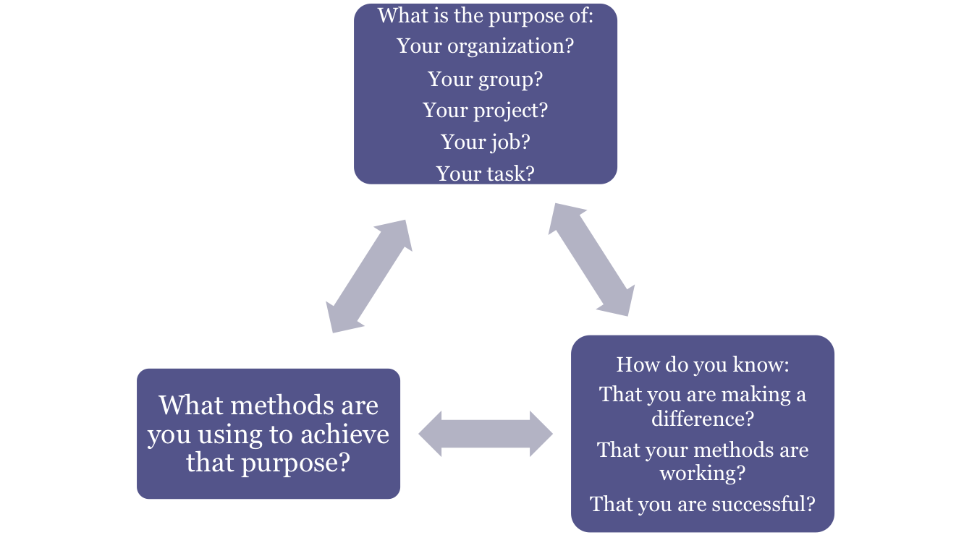
Leading by Asking Good Questions

Slide 12
Framework for Quality Indicators
Chose to focus on customer:
  What is at the root of problems associated with meeting the needs of VR customers?
Quality via Summit Group research
  Achieving Excellence
  Impact on Stakeholders
  Evaluating Change
Baldrige Criteria for Performance Excellence
  3.0 Customer Focus
  7.2 Customer Focus Results
Review Customer Satisfaction Research and Summit Surveys
  12 states from VR, Blind, Combined Programs

Slide 13
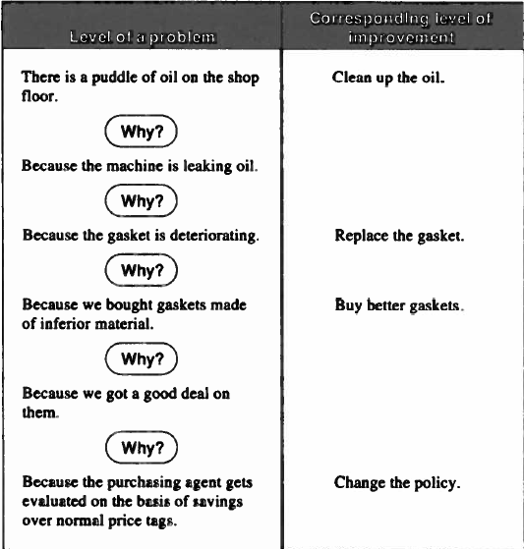
Framework for Quality Indicators
Scholtes borrowed the 5-Why model for asking good questions from Japanese industry.
“Mile Deep” and “Inch Wide” concept.
Each “Why” brings us closer to the root of the issue.
Each response also relates to a corresponding level of improvement.
With the root concern identified, it is clearer what part in the system needs improvement.
Scholtes, P. R. (1998). The Leader’s Handbook: Making Things Happen, Getting Things Done, p. 267.

Slide 14
Framework for Quality Indicators
Based on the customer satisfaction survey reviews, several common themes emerged.
Based on the 5-Why model, a framework was designed for collecting actionable information from customers around these themes:
  An introduction to each indicator
  5 Statements
    1 broad anchor statement
    4 specific “Drill Down” statements
  Likert-Scale provided for responses
    Untrue
    Mostly Untrue
    Mostly True
    True
  Optional True/False statements related to each “Drill Down”

Slide 15
Framework for Quality Indicators
Verification through Principal Group
Three Indicators:
  Working Relationship with Counselor and Client
  Need for and Usefulness of Services
  Vocational Rehabilitation System and Partnerships
Indicator 1 = Working Relationship Issues
Indicators 2-3 = VR System Issues
Quick Look at the Proposed Customer Satisfaction Survey

Slide 16
Indicator 1
Working Relationship with Counselor and Client
Frame discussion by listing common influences on customer satisfaction
Anchor Statement:
  I was pleased with the way my counselor related to me.
1-Untrue 2 –Mostly Untrue 3–Mostly True 4–True
Example “Drill Down” statement:
  My counselor took my concerns seriously
Follow-up True/False statements:
  My counselor took the time to listen to my concerns.
  My counselor took my opinion into consideration and responded appropriately.
  My counselor was open to me expressing my complaints.

Slide 17
Indicator 2
Need For and Usefulness of Services
Frame discussion by providing examples of reasons individuals give for choosing to work or not to work after receiving VR services
Dual Focus:
  Specific services
  Impact on employability
Two methods for collecting information:
  1) Table format
    Rows listing broad categories of service provided by the agency
    Clear definition of each category of service with examples
    Columns for consumer to give “Yes/No” responses to:
      Whether the service was “Needed”
      Whether the service was “Provided
      How helpful was the provided service
  2) “5-Why” Statements

Slide 18
Indicator 2
“5-Why” Statements
Anchor Statement:
  I am satisfied with how well the agency prepared me for employment.
  1-Untrue 2 –Mostly Untrue 3–Mostly True 4–True
Example “Drill Down” Statement:
  I am employed or more prepared for employment because of the services I received.
Follow-up True/False statements:
  Services I received helped to decrease, accommodate, and/or remove my disability-related barriers to employment.
  I can more independently search for employment.
  I can identify and request appropriate accommodations from an employer.
  I obtained or am more prepared for a job that matches my skills and interests.
  I obtained the job goal that was identified in my Individualized Plan for Employment (IPE).

Slide 19
Indicator 3
Vocational Rehabilitation System & Partnerships
Focus:
  The value that you see in your relationships with VR.
  The quality of the services you received.
  The receipt of consistent message from all VR staff, vendors, and community partners.
  How staff worked with you and one another to help you choose and progress toward your employment goal.
  Other experiences that affected your progress towards your VR goal.

Slide 20
Indicator 3
Anchor Statement:
  I had a satisfactory experience throughout the vocational rehabilitation process.
    1-Untrue 2-Mostly Untrue 3-Mostly True 4-True
  Example “Drill Down” Statement:
  My eligibility determination process went smoothly.
Follow-up True/False statements:
  Staff explained why I needed to be found eligible before receiving services.
  Staff explained the steps they would use to determine whether I was eligible for services.
  Staff informed me of my needs to be involved in the eligibility determination process.
  Staff notified me when I was eligible to begin services.

Slide 21
Facilitated Discussion on Deliverable
You are invited to participate in the Chat & Chew Table Topics Luncheon to further discuss:
  the 5-Why approach to identifying VR issues/problems
  varying administration strategies (mail, online, phone)

Slide 22
Lessons Learned
  The value of adaptation and compromise. I went into this group with a vision of the outcome. That outcome changed over time requiring flexibility and adaptation and produced a very unexpected, but positive outcome.
  The value of asking good questions and digging deeper until getting to the core issue.
  Leaders can energize and unify their teams when they provide clear direction with ample encouragement.
  I enjoyed the reading group much more when it changed from simply discussing ideas from the book into a focus group of how to apply the information.
  I feel that this group embodied the intent to discover some meaningful suggestions of new ways to evaluate VR success.

Slide 23
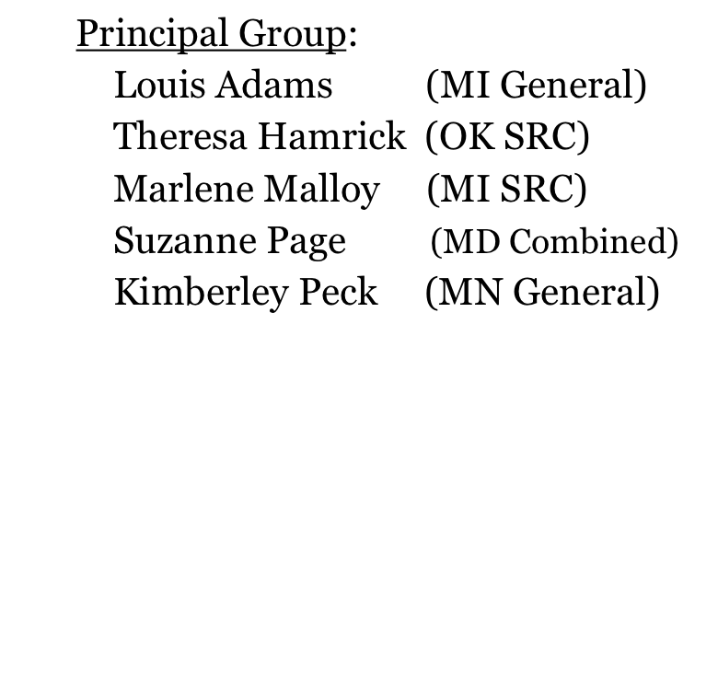
For More Information
  Darlene Groomes Summit Group Website
  248-370-4237 www.vocational-rehab.com
  groomes@oakland.edu
Fundamental Group:
Jennifer Beilke (MN)
Victoria Drake (OK)
Jacqueline Geib (CO)
Kara Lang (NV)
John Stem (MD)
Rosie Thierer (IA)
Thank you!

