Slide 1

Methodologies To Conduct A Comprehensive Statewide Needs Assessment
September 2013
Soon to be known as: Opportunities for Ohioans with Disabilities
Presented by:
David Julian, Ph.D.
Janet Cool, MSSA

Slide 2



Basic Information

Slide 3
Background
Federal requirement every 3 years
Request For Proposals (RFP)
Work began October 17, 2011
Developed Advisory Team (OSU & RSC)
Final Product delivered June 2012

Slide 4
Needs Assessment Questions
How many people will experience each type of disability in Ohio?
How many people with disabilities are unemployed?
How are different racial groups impacted by disabilities?

Slide 5
Needs Assessment Questions
(continued)
How many individuals with disabilities receive appropriate services?
How is the quality of services provided by CRPs perceived?
What are gaps in services provided to individuals with disabilities and how should gaps be prioritized?

Slide 6
Needs Assessment Questions
(continued)
How many of the individuals served by selected state agencies other than RSC would benefit from RSC services?
What are the policy implications of gaps in services?

Slide 7
Needs Assessment Process
Described in RSA manual
Directed by Advisory Team
Key principles:
  Imprecise science
  Data informed decisions
  Aid to decision making
  Stimulate on-going data collection and analysis

Slide 8
Methods for Data Collection
Secondary data review
  Race age and disabilities data
Prevalence and penetration rates
Relative proportionality*
Information from other state agencies*

Slide 9
Methods for Data Collection
(continued)
Perceptions of consumers
  No employment outcomes
  Quality of services
Perceptions of key informants
Perceptions of supervisors
Employers’ perspectives
9

Slide 10
Vetting Results
Executive Team
Advisory Team
Stakeholders
Finalize materials
Program Planning Committee
VR State Plan Public Hearings
Full Commission

Slide 11


Secondary Data Findings

Slide 12
Race and Disabilities
15.5% of African Americans experience disabilities
15.8% of African Americans who experience disabilities are seeking employment
10.2% of Hispanics experience disabilities
15.8% of Hispanics experience disabilities seeking employment

Slide 13
Key Findings: Secondary Data
Significant differences in median incomes
  Individuals with disabilities=$17,095
  Individuals without disabilities=$28,200
Significant reduction in available resources
  $25.3 million in GR dollars in 2007
  $12.7 million in GR dollars in 2011

Slide 14
Transition-Age Youth with Disabilities
Students with disabilities between ages 12 and 17 constitute 46% of children served under IDEA in Ohio (Office of Special Education, 2009)
Speech and communication disorders are among the most common disorders in the US

Slide 15
Transition-Age Youth with Disabilities
(continued)
Nationally 24.1% of children served under IDEA received speech/language services
Prevalence for any developmental disability in children ages 3-17 is 13.87%. Prevalence of developmental disabilities has increased 17.1% from 1997 to 2008 (CDC)

Slide 16
Transition-Age Youth with Disabilities
(continued)
New prevalence estimates indicate that 1 in 88 children are diagnosed with Autism; 1 in 54 boys (CDC, 2012)
NLTS2 data indicate that the percent of young adults with Autism who had a job was nearly half that of all young adults with disabilities (33% vs. 59%)

Slide 17
Transition-Age Youth with Disabilities
(continued)
The estimate for youth with severe emotional disturbance ranges between 5% to 9% nationally; Variability in the range is influenced by poverty rates, as SED is highly correlated with poverty

Slide 18
Veterans and Aging
25.8% of the Veterans population in Ohio ages 18 and over are considered disabled (ACS, 2010)
By 2020, Ohio’s age 60+ population is projected to reach 2,822,000 and represent 23.2% of the state’s population (Scripps Gerontology Center)

Slide 19
Additional Consideration
By 2020, Ohio will have about 348,000 individuals with severe disability who will need formal long-term services and supports (Scripps Gerontology Center)

Slide 20


Specific Methodologies

Slide 21
Penetration Rates
Refers to the number of individuals with a specific disability
  likely to be served
  as a percentage of the total number who could potentially be served
The total number who could potentially be served refers to estimates of individuals with disabilities looking for work.

Slide 22
Penetration Rates
(continued)
Highest penetration rate was 32.5% for communicative disorders
Penetration rates below 15% for majority of counties

Slide 23
Proportionality Data
Definition: Relative proportionality is the discrepancy between needs for services and number of individuals served.
Finding: 24 counties (out of 88) had low proportionality for three or more categories of disability.

Slide 24
Relative Proportionality
Impairment Category | Seeking Employment | Proportion of Total Seeking Employment | Served by RSC | Proportion of Total Served
Visual | 23,504 | 10.4% | 1,236 | 8.2%
Hearing | 16,810 | 7.5% | 1,079 | 7.1%
Communicative | 12,357 | 5.5% | 161 | 1.1%
Physical | 58,927 | 26.2% | 3,732 | 24.6%
Psychosocial | 55,075 | 24.5% | 5,327 | 35.1%
Cognitive | 58,512 | 26.0% | 3,625 | 23.9%
Total | 225,185 | 100% | 15,160 | 100.0%

Slide 25
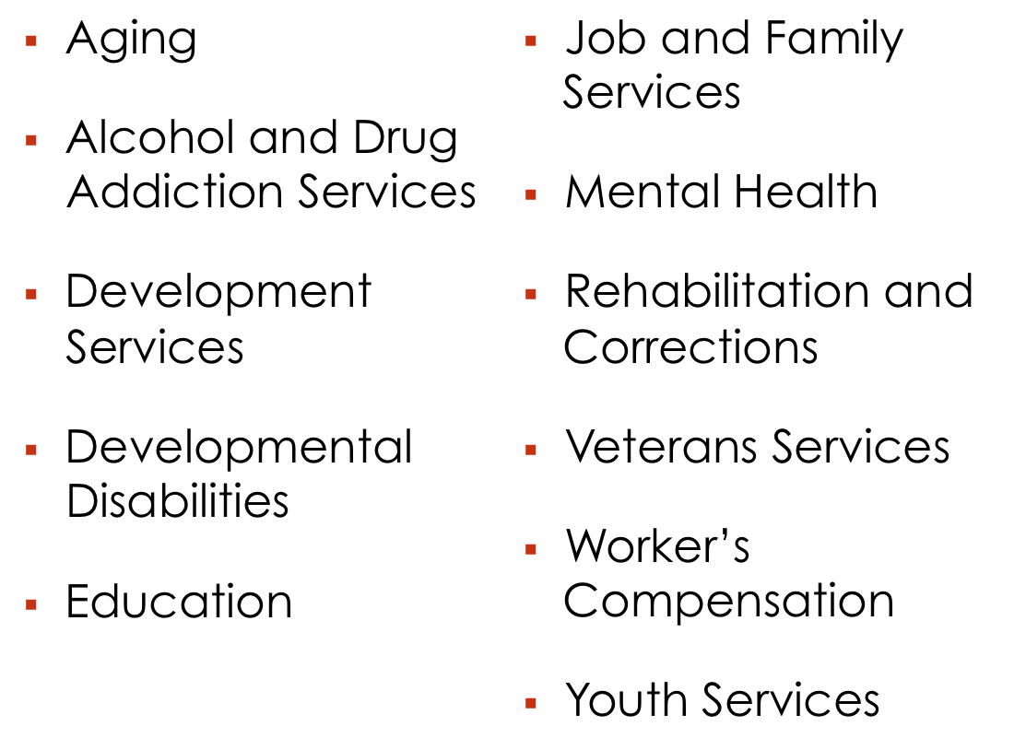
Other State Agency Data

Slide 26
Other State Agency Data
Significant numbers of individuals with disabilities served by state agencies other than RSC
  1,900 served by ODA
  55,078 served by ODODD
  112,927 served by ODADAS
Significant opportunities for collaborative and other types of partnerships

Slide 27



Consumer Survey Results
Consumers Without An Employment Outcome
Quality of Service

Slide 28
Perspective of Consumers:
No Employment Outcome
Reasons respondents did not keep jobs:
  Didn’t get right services
  Needed more training
  Services not available where I live
  RSC office too far away
  People at job didn’t like me
  Didn’t have transportation
*150 randomly selected names were provided to interviewers. The goal was to interview 25 – 30 individuals.

Slide 29
Perspective of Consumers:
No Employment Outcome
Reasons respondents were not placed in jobs:
  No jobs available in my community
  No jobs in my community I wanted
  No jobs for which I had skills
  I didn’t want to go to work
  Didn’t get the right services to prepare me

Slide 30
Perspective of Consumers:
No Employment Outcome
(continued)
Reasons respondents were not placed in jobs:
  Didn’t have the right skills for jobs that were available
  RSC counselor didn’t like me
  Needed services not available where I live
  RSC office too far away
  Didn’t have transportation

Slide 31
Perspective of Consumers:
No Employment Outcome
Reasons cases were closed:
  Family issues
  Approved for SSDI
  Personal decision*
  Health reasons
  Job ended
  RSC issue
  * More than one-third of respondents

Slide 32
Perspective of Consumers:
Quality of Services
600 surveys sent to a random sample of RSC Consumers
125 returned surveys

Slide 33
Perspective of Consumers:
Quality of Services
Services used most
  Assessment
  Guidance and Counseling
  Training
  Job Search, Job Placement or On-the-Job Support Services

Slide 34
Perspective of Consumers:
Quality of Services
Services deemed most helpful by users
  Training
  Job Search, Job Placement or On-the-Job Support Services
  Transportation Services

Slide 35


Key Informant Perspectives

Slide 36
Perspectives of Key Informants
RSC is developing additional partners to accomplish their mission – and they should continue to do so
Consider widening the pool of eligibility so all MSD and more SD are served
36

Slide 37
Perspectives of Key Informants
Re-evaluate staff composition to ensure that it reflects diversity (disability & race)
Enhance school to work services for transition-age youth
37

Slide 38
Perspectives of Key Informants
Use technology as support for consumers and staff
Expand services to transition age youth
Enhance communication and collaboration

Slide 39
Perspectives of Key Informants
More training opportunities
Increase two-way communication with CRPs & partners
Establish and monitor benchmarks for success among CRPs
39

Slide 40
Perspectives of Key Informants
Re-evaluate paperwork and time it takes to determine eligibility
RSC is doing better in communicating with employers

Slide 41


Business Leader Perspectives

Slide 42
Business Leader’s Perspectives
Respondents
  12 of 22 members of the Business Leadership Network
  1 Community Action Team member

Slide 43
Business Leader’s Perspectives
No systematic issues related to hiring practices
Need relevant job experience and basic reading and math skills
Communication and problem solving opportunities

Slide 44
Business Leader’s Perspectives
Educating and creating partnerships with employers
76.9% did not have issues within their companies that impeded hiring people with disabilities

Slide 45
Business Leader’s Perspectives
Fear of increased costs was mentioned by 3 respondents
Inexperience with hiring people with disabilities and limited work with local agencies were noted as external barriers to employing people with disabilities

Slide 46
Business Leader’s Perspectives
Relevant work experience; basic reading and math skills; communication skills and problem solving capacity were identified as qualities necessary to compete for jobs

Slide 47
Business Leader’s Perspectives
Respondents indicated that creating partnerships with local agencies and outreach were the best way to promote hiring
Half indicated that RSC had been helpful or somewhat helpful in providing assistance while one-third had not requested assistance

Slide 48
Research Lead Contact Information
David Julian, Ph.D.
Center for Special Needs Populations
Director, Community Planning and Evaluation
(614) 202-5046
julian.3@osu.edu

Slide 49


Operational Use

Slide 50
Ongoing Operational Use
Area Managers have broken down the county specific data into each of the 4 quadrants of the state for their use.
Contracts Manager has utilized the data to determine where existing service gaps are located (both geographically & by each disability type).
50

Slide 51
Ongoing Operational Use (continued)
Used as reference for establishment of fee structures.
Program Specialists have utilized the data when developing and scoring Requests for Proposals (RFPs).
Communications staff have incorporated various data elements into Weekly Focus newsletter articles.
51

Slide 52
Ongoing Operational Use (continued)
Ohio Business Leadership Network has utilized the data for planning purposes.
Legislative and fiscal staff have found this data useful in establishing the size and market power of the population of individuals with disabilities in Ohio.
Executive Team review and prioritization

Slide 53


Recommendations

Slide 54
Recommendations
The data summarized in the needs assessment report suggested several formal recommendations which were:
  developed as a prelude to and support for formal planning activities.
  accompanied by a brief explanation of the supporting data.
54

Slide 55
Recommendations
Focus efforts to access available federal funding to provide services to individuals with disabilities.
Formalize efforts to understand processes and procedures used in counties that demonstrate effective methods for conducting outreach and addressing the employment needs of individuals with disabilities.
55

Slide 56
Recommendations (continued)
Direct efforts toward establishing better alignment of the distribution of resources across counties in Ohio.
Expand VR services to transition age youth through partnership agreements with Ohio Department of Education (ODE) and by encouraging VR counselors to work closely with local education agencies.
56

Slide 57
Recommendations (continued)
Explore the utilization of a resource investment system in which outcome achievement data is utilized to make decisions about the investment of resources.
Expand VR services to older adults through RSC’s partnership with the Ohio Department of Aging (ODA).
57

Slide 58
Recommendations (continued)
Develop a formal plan to share current methods for collecting and disseminating data with stakeholder groups.
Examine the need to capture additional data related to the use of state supported services at intake and for case management services.
58

Slide 59
Recommendations (continued)
Evaluate the strategic use of “supported employment” services as a method of reducing recidivism.
Direct efforts to use labor market information to assist consumers in developing valid employment goals.
Offer information and referral to consumers waiting for services as RSC continues efforts to eliminate the waiting list.
59

Slide 60

Future Expectations
Presentation at the 6th Annual Summit on Vocational Rehabilitation Program Evaluation and Quality
    September 2013
Program development with other state agencies
60

Slide 61
Future Expectations
(continued)
Policy making and development
Budget hearings
Legislative discussion

Slide 62

Link to RSC CSNA report
http://ood.ohio.gov/
  RSC CSNA Report 2012
  RSC CSNA Report Appendices
    Janet Cool, Manager
  Program Integrity & Evaluation
  614-438-1282 janet.cool@ood.ohio.gov
62

Slide 63

Questions
Thank you for your interest and participation in this session!
63

