Slide 1
Performance Management:
A Behavioral Perspective
James L. Soldner
University of Massachusetts Boston
6th Annual Summit on Vocational Rehabilitation
Program Evaluation and Quality Assurance
Providence, RI
September 17, 2013

Slide 2
OVERVIEW
Field of Behavior Analysis
Sub-Fields of Behavior Analysis
Performance Management / Feedback
Reinforcement – Key Principles
Pinpointing, Measurement, and Goal Setting
Discussion

Slide 3
Overview of Behavior
Activity of living organisms
Anything a person “does”
  Private / covert actions (i.e., thinking, feeling)
  Observable
  Measurable
  Reinforcement
Dead Man’s Test
    “If a dead man can do it, it is not behavior”
A behavioral focus is on the present environmental conditions maintaining behavior and on establishing and verifying functional relations between such conditions and behaviors

Slide 4
Science of Behavior
Behavior analysis: Science that studies environmental events that change behavior
Three branches:
  Experimental
    Basic principles of behavior
  Conceptual
    Theoretical/philosophical issues
  Applied
    Application to human behavior
    Socially important endeavors

Slide 5
Sub-Fields of Behavior Analysis
Experimental Analysis of Behavior (EAB)
  Basic research
  Animal & human participants
Behavioral Economics
  Impulsivity/self control
Behavioral Medicine
  Health conditions (i.e., obesity, diabetes)
  Fitness & nutrition
Applied Behavior Analysis (ABA)
  Human / socially important endeavors
  Disability (autism, brain injury, ID/DD)

Slide 6
Sub-Fields of Behavior Analysis
Behavioral Economics
  Impulsivity/self control
Behavioral Gerontology
Community Affairs
  Child abuse & neglect
Education
  Functional Behavior Assessment (FBA)
  Positive behavior support
Performance Management
  Performance
  Job satisfaction
  Safety

Slide 7
Business is Behavior
Success in business is defined by an organization’s ability to produce results
All organizational results are the product of behavior
To change results, you must change behavior
Build behavior and results will come!

Slide 8
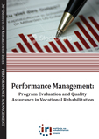
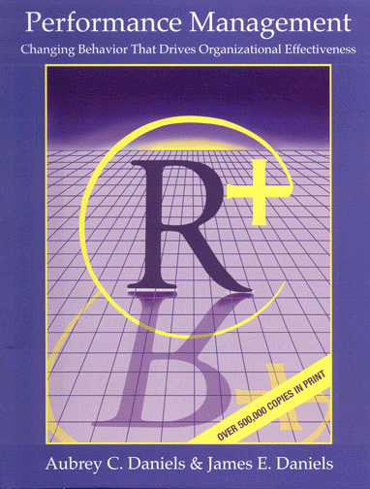
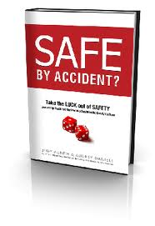
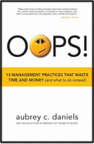

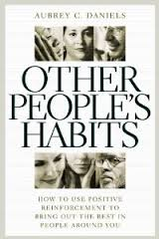
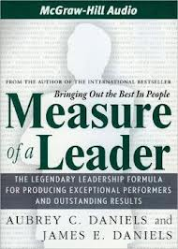
Examples Texts for PM
Institute on Rehabilitation Issues (IRI)
Performance Management Publications
  Aubrey Daniels International (ADI)
  Behavior-based technology in workplace
  Established in 1978
  Consulted with hundreds of organizations
  worldwide
  PM now known as “Precision Leadership”
  ADI Website

Slide 9
Performance Management (PM)
Internet search for PM produces hundreds of hits
Behavior-based PM is grounded in science of ABA
  Large body of empirical evidence of effectiveness
  Unit of analysis BOTH individual and/or group
“Systematic, data-oriented approach to bringing out the best in people by arranging conditions for positive reinforcement in individual and group performance”
Areas of successful PM application
  Customer service, information management, safety, manufacturing, safety, rehabilitation

Slide 10
What PM is Not
PM is not performance appraisal
  Pitfalls of performance appraisal video
PM is not based on organizational hierarchy
PM is not a rigid, narrow system that limits initiative and creativity
PM is not common sense
PM is not an “atta-boy,” a warm fuzzy, a pat on the back, or a One-Minute Manager

Slide 11
Value of PM
PM Works
PM produces short-term as well as long term results
PM requires no formal behavioral training
PM is a system for maximizing all kinds of performance
PM creates an enjoyable place to work
PM can be used to enhance relationships at work, home, and in the community
PM is an open system

Slide 12
ABC Model
Based on scientific research in behavior analysis
Three-term contingency
A – Antecedents
  Before behavior
  Anything that prompts people to act
B – Behavior
  Actions
  What we do, what we say
C – Consequences
  Effects of behavior
  What happens to the person as a result of the behavior

Slide 13
Four Behavioral Consequences
Consequences either increase or decrease behavior
Consequences that increase behavior
  Positive reinforcement (R+)
    Get something to want
  Negative reinforcement (R-)
    Escape or avoid something you don’t want
Consequences that decrease behavior
  Punishers (P+)
    Get something you don’t want
  Penalty (P-)
    Lose something you have and want

Slide 14
Principles of Reinforcement
Key concept in behavior analysis
Reinforcer – Any event, action, or object that has increased the frequency of a behavior.
Reinforcement – Any procedure by which those events or objects increase behavior.
Distinguishing characteristics of reinforcers:
  Reinforcer follows behavior
  Reinforcer increases the frequency of a behavior

Slide 15
Benefits of Reinforcement
Positive reinforcement has positive side effects
Most performance problems in organizations are motivational
  Performance problems as “Can’t do” and “Won’t do” problems
People seek positive reinforcers
Creates a positive climate for positive accountability
Use of positive reinforcement is a values-based decision about how you and your organization treat people

Slide 16
Types of Reinforcers
Primary reinforcers
  Biological importance
  Do not require learning
  Examples: air, food, water, sleep, warmth, etc.
Secondary reinforcers
  Neutral stimuli with no biological importance
  Paired with primary reinforcer
  Examples: Natural and tangible reinforcers
Social reinforcers
  Consequence provided by one person that another than increases the frequency of the other person’s behavior
  Examples: Social praise/attention, and feedback

Slide 17
Choosing Reinforcers
Reinforcement history
Deprivation state
Perceived value of the reinforcer
Consistency
Age / cultural appropriateness

Slide 18
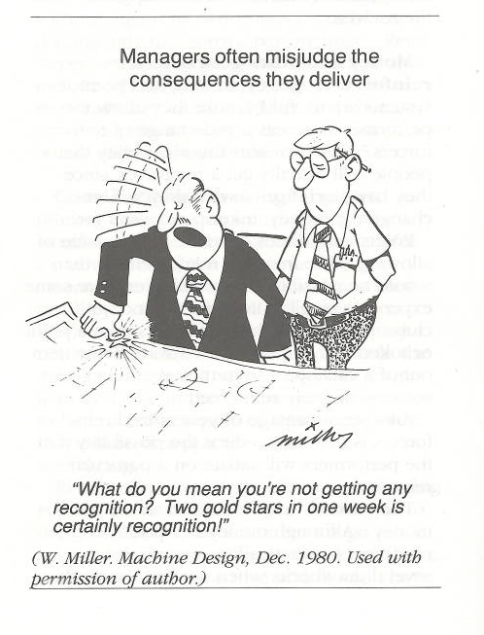

Slide 19
Finding Effective Reinforcers
Consider wants, desires, values, and reinforcers
Common error made in choosing reinforcers for others is that we assume they want what we want
Individuals have a rich history or reinforcement that they bring to workplace
PM will not work effectively unless the individual’s reinforcers are identified

Slide 20
Methods of Identifying Reinforcers
Asking people what they like
  Simply talking to them about interests, preferences (i.e,, hobbies, recreational pursuits, etc.)
  Ask people what they like about work
  Reinforcer survey
Observing people
  Premack Principle – observing people to see what they do when they have a choice ((reinforcer)
  High probability reinforcer could serve as a reinforcer for a low probability behavior
Trial and error
  Try something and see if it works
  Combination of asking and observing

Slide 21
Characteristics of Effective Reinforcers
Effective reinforcers are controllable
  Reinforcers must be under individual’s control
Effective reinforcers are available
  Best reinforcers are those that are readily available
Effective reinforcers are repeatable
  Can be used repeatedly / satiation
Effective reinforcers are efficient
  Cost of the reinforcer should not exceed the value of the accomplishment

Slide 22
Delivery of Reinforcement
Personalize your reinforcers
  Social praise in terms of how you feel (not agency or management)
Reinforce immediately
  Longer the delay between the behavior and the reinforcer, the less impact the reinforcer will have on the behavior
  Employee of the Month video
Reinforce specific behavior
  Do not reinforce people, but their behavior
  Specifying the behavior that you liked
  Use performance data

Slide 23
Delivery of Reinforcement, cont.
Reinforce with sincerity
  Apparent sincerity of your reinforcer is extremely important
  Avoid: overdoing reinforcement and sarcasm
Reinforce frequently
  Generally, more frequent an employee’s behavior is reinforced, the stronger the performance will be
  Amount of reinforcement relative to the consequences is the 4:1 ratio
Don’t reinforce and punish at the same time
  Avoid “sandwich method” – negative sandwiched between two positives
  “Your progress reports have been submitted on time each week for the past month, but…..”
  Sandwich Method Video

Slide 24
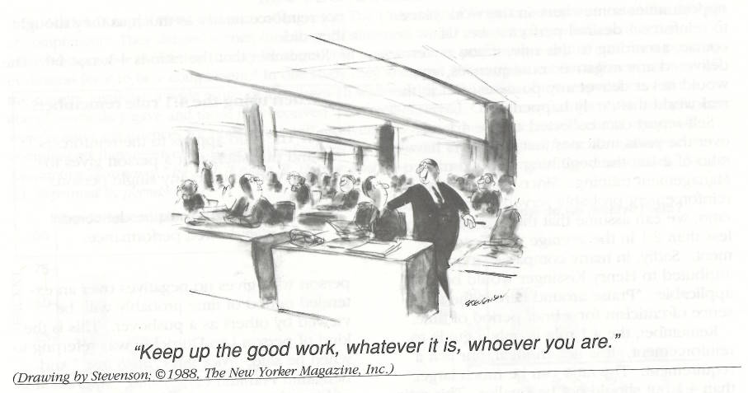

Slide 25
Avoiding Potential Problems in Delivering Reinforcement
Not using a variety of reinforcers
  Avoid satiation – using same or similar reinforcers too often
Asking too much, too soon
Confusing rewards and reinforcers
  Reinforce behavior
  Reward / celebrate (good) results
Confusing reinforcement and bribery
  Difference is the contingency
  Bribery occurs when the reward produces the behavior
  Reinforcement occurs when the behavior produces the reinforcer

Slide 26
Pinpointing
Critical management skill
Process of being specific about what people do
Pinpoints are measurable, observable, and reliable
  NOT interpretations
  Must be under performer’s control
Pinpoint behavior (observable /relevant to outcome)
Pinpoint results (what is left after behavior is completed)

Slide 27
Measurement
If reliable pinpoint = measurement is easy
Most basic measurement = counting
Benefits of measurement
  Progress requires measurement
  Feedback and reinforcement requires measurement
  Measuring increases credibility
  Measuring reduces emotionalism and increases constructive problem solving

Slide 28
Measurement Categories
Quality
  Dimensions: Accuracy, class, and novelty
Quantity
  Most often used
  Involves counting (volume or rate)
Timeliness
  When something gets done
Cost
  Behavior cost of performance
  Labor, material, and management

Slide 29
Measurement Tools
Behavior checklists
  Behaviors (not results) need to be pinpointed
  Pinpoint behavior and count its frequency
Weighted checklists
  Some items on list earn more points than others
  Match reinforcement to effort or difficulty
Point systems
  Weighting different aspects of a job performance according their value (priority) to the organization
  Useful for when two or more measures of performance used
  Example: Performance Matrix

Slide 30
Performance Feedback
Feedback is information about performance
  Information. Data is NOT feedback
Performance feedback specifies which behavior to change
Value of feedback
  Inexpensive
  Ease of delivery
Feedback most effective when it is signal for positive reinforcement
  Seeing the improvement becomes a reinforcer to the performer

Slide 31
Characteristics of Effective Feedback
Give specific how-to information
Give feeback on a performance the person can control
Give immediate feedback
Individualize feedback
Encourage self-monitored feedback
Focus on improvement
Make your feedback easily understandable
Graph your feedback
Feedback should be an antecedent for R+

Slide 32
Setting and Attaining Goals
Goal setting
  Defining a specified level of performance to be attained
Goals alone do NOT improve performance
Goals are antecedents for performance
  Goals must be paired with reinforcement
  Should be challenging, yet attainable
Benefits of goal setting
  Individual: Increased reinforcement
  Organization: Improved performance

Slide 33
Planning Reinforcement
Develop a theme
  Used to generate enthusiasm and excitement about goals set
  Interject fun into the effort
Plan a variety of reinforcers
  Vary social and tangible reinforcers
Plan celebrations for sub-goals as well as the final goal
  Does not need to be formal affair (i.e. coffee room)
Develop a Reinforcement System
  Does not rely solely on the manager(s) to delivery reinforcers
  Can be team driven

Slide 34
Discussion
Common performance challenges at your organization?
  Individual level
  Group level
Common PM techniques utilized?
  Behavior-based?
Use of behavior analysis to address example behavior(s)
Questions Feedback?

Slide 35
Thank You!
Email:
james.soldner@umb.edu

