Slide 1

Project Excellence
Sukyeong Pi, Trent Landon, Chun-Lung Lee,
Jinhee Park & Marwa Alsaman
September 16, 2013

Slide 2







Slide 3

Agenda
Introduction
Purpose of Study
Methods/Procedures
Results
Implications/Future Research

Slide 4
Introduction
Definitions of Transition Youth in Michigan
Transition Youth (Enrolled in Secondary Education)
  Age 14-26 at application AND
  Enrolled in the K-12 education system, including students in traditional public schools, intermediate school districts, private schools, charter schools, alternative schools or schools for individuals with disabilities such as the Michigan School for the Deaf, as well as 504 students, home-schooled students and students in correctional facilities.
Young Adult (NOT Enrolled in Secondary Education)
  Age 14-26 at application AND
  Not enrolled in the K-12 education system

Slide 5
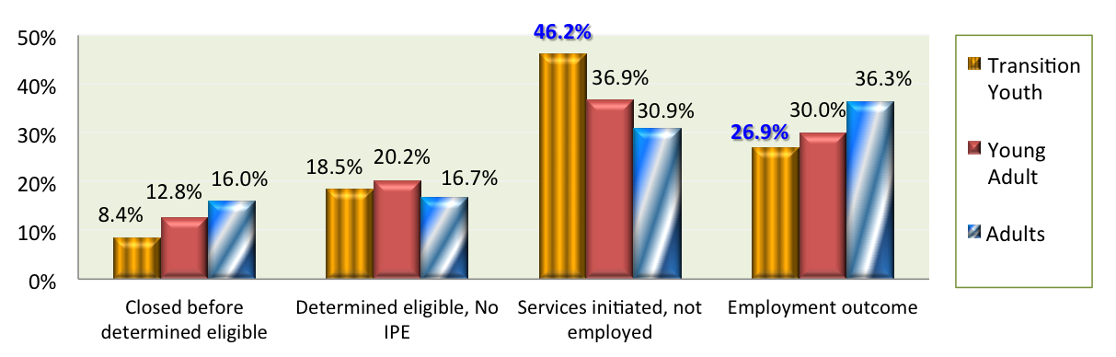
Introduction
RSA-911 Data
  In 2011, a total of 21,621 individuals exited VR agency. Of those closed, 7,177 (33.2%) were either Transition Youth (TY) or Young Adults (YA).
  Differences in individual characteristics and service patterns
  Variations in outcomes across districts/state agencies

Slide 6
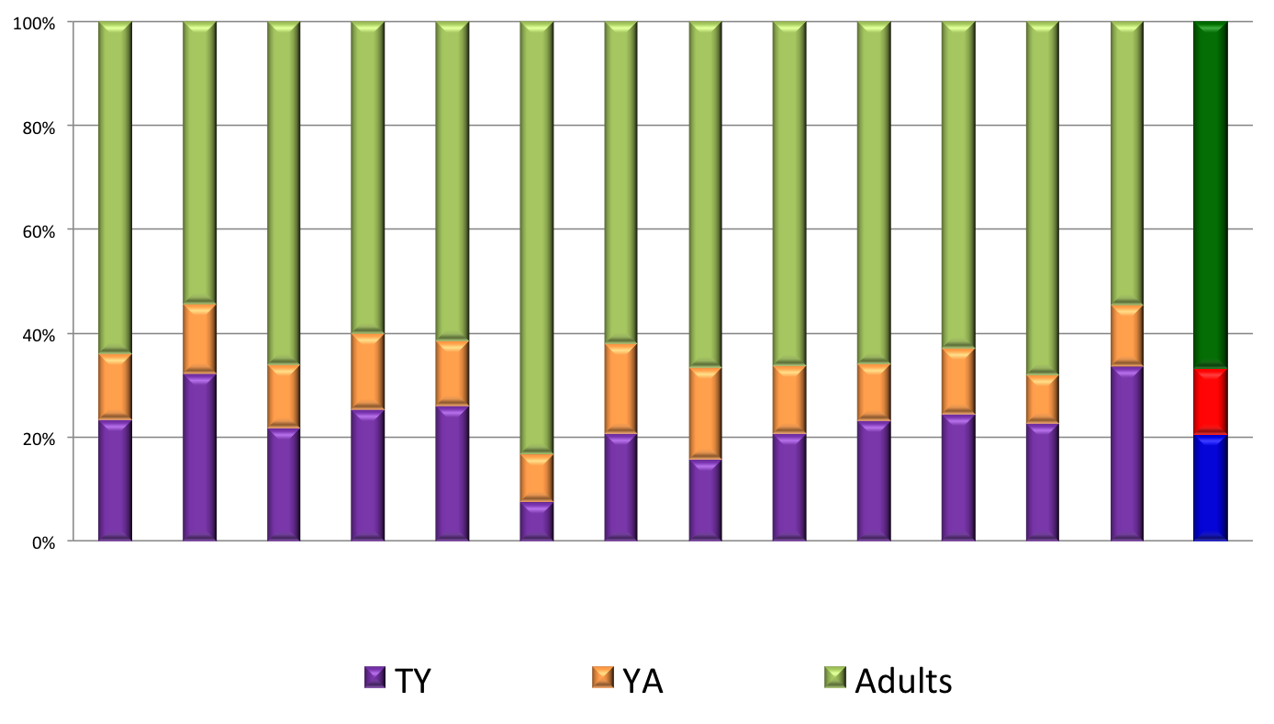
Proportion of Customers (FY 2011) by District
MI

Slide 7
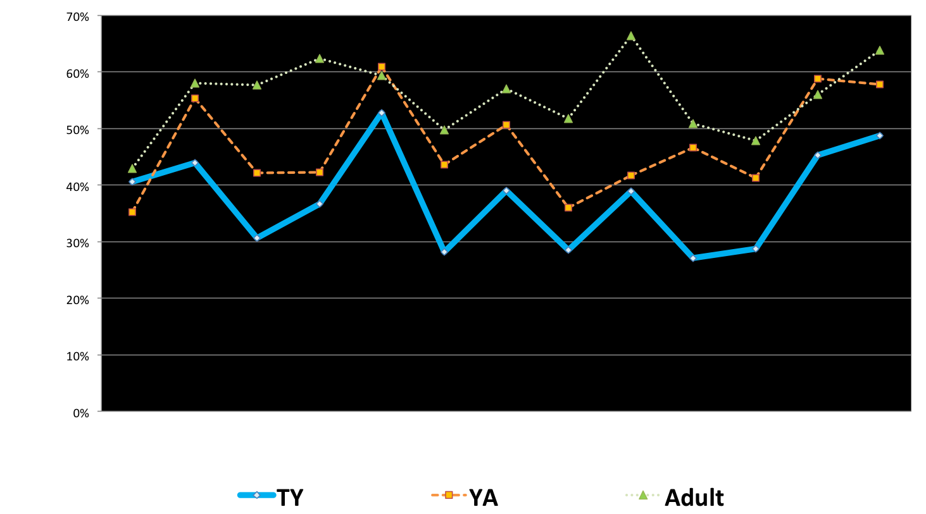
Adj. Rehab Rate (FY 2011) by District

Slide 8
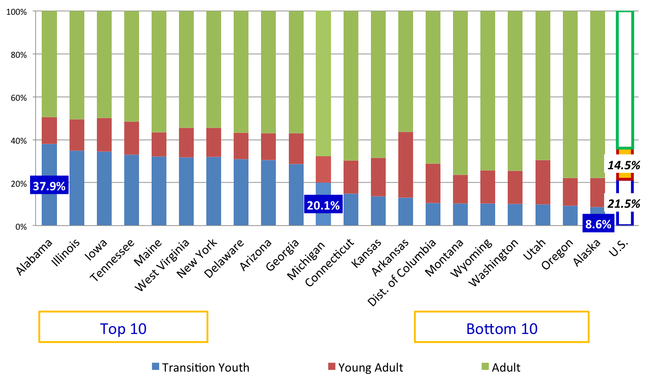
Proportion of Customers (FY 2011) by State
U.S.

Slide 9
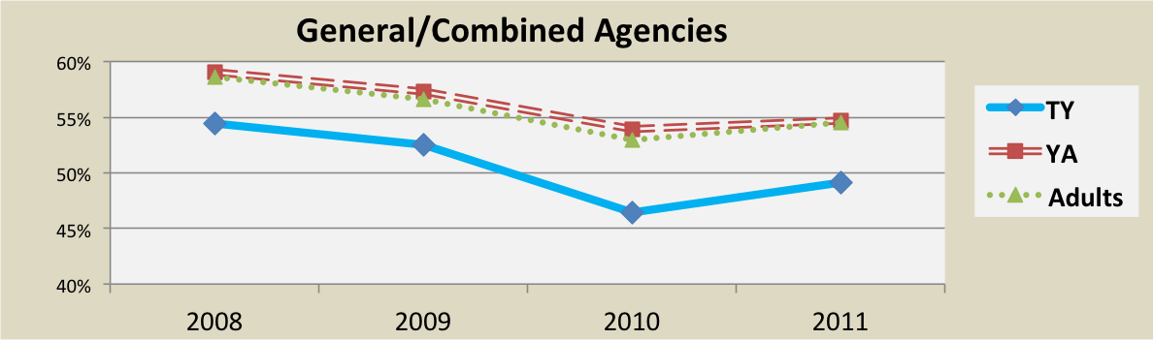
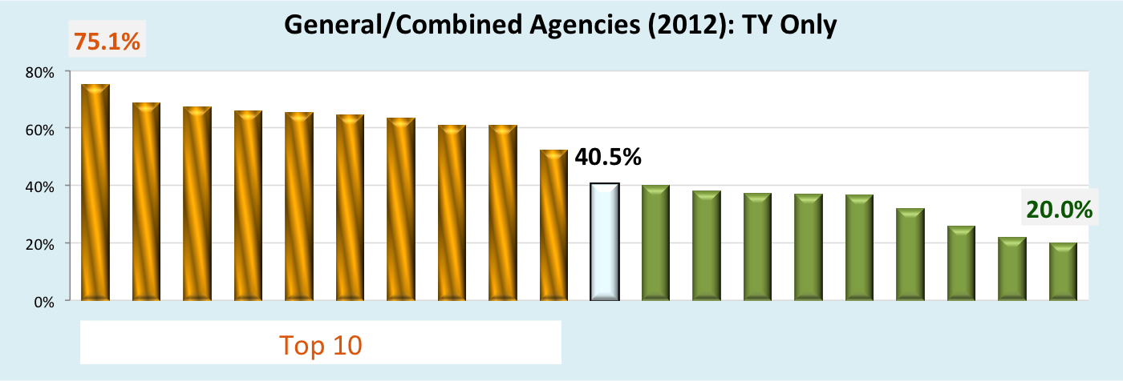
Adjusted Rehab Rate
Bottom 10

Slide 10
Comparison of Individual Characteristics
MI | TY | YA | Adults
No Impairment | 0.9% | 0.9% | 1.0%
Blindness/Visual | 0.4% | 0.7% | 0.8%
Deafness/Hearing | 2.5% | 4.7% | 16.6%
Physical – Ortho. | 1.4% | 2.7% | 6.8%
Other Physical | 4.9% | 9.6% | 20.9%
LD | 51.0% | 32.5% | 5.2%
ADHD | 7.2% | 8.6% | 1.2%
Intellectual Disability | 8.6% | 6.2% | 3.2%
Autism | 6.2% | 5.6% | 0.4%
Mental illness | 10.2% | 19.7% | 29.1%
Substance abuse | 0.8% | 2.7% | 11.2%
TBI | 0.7% | 0.8% | 1.1%
Communicative | 5.2% | 5.0% | 2.4%
Total | 100% | 100% | 100%
MI | TY | YA | Adults
SSI | 16.0% | 18.8% | 10.2%
TANF | 0.8% | 1.7% | 2.6%
General Assistance | 1.0% | 2.7% | 4.4%
SSDI | 2.0% | 6.3% | 18.6%
Other Pub. Support | 14.1% | 12.9% | 29.2%
Race, Referral Source, Level of Ed, Employment Status at App

Slide 11
Comparisons of Service Patterns
 | Service Patterns |  |  | Employment Outcomes
 | TY | YA | Adults | TY | YA | Adults
Assessment | 61% | 64% | 52% | 40% | 44% | 49%
Job Placement Assistance | 37% | 42% | 32% | 58% | 58% | 49%
VR Counseling/Guidance | 33% | 30% | 29% | 46% | 50% | 59%
Maintenance | 33% | 36% | 39% | 51% | 54% | 54%
Miscellaneous Trn | 31% | 26% | 16% | 46% | 46% | 49%
Transportation | 22% | 24% | 26% | 47% | 52% | 50%
Job Readiness Trn | 17% | 10% | 6% | 48% | 52% | 45%
On-the-job Supports | 16% | 15% | 9% | 69% | 72% | 71%
College/University Trn | 9% | 8% | 3% | 48% | 36% | 29%
Occupational/Voc. Trn | 8% | 9% | 6% | 56% | 50% | 46%
Job Search Assistance | 8% | 7% | 6% | 70% | 68% | 59%
Information/Referral | 6% | 6% | 5% | 62% | 100% | 49%
On-the-job Trn | 6% | 6% | 4% | 63% | 69% | 61%
Diagnosis/Treatment | 4% | 12% | 34% | 47% | 57% | 79%
Rehabilitation Technology | 4% | 5% | 6% | 47% | 49% | 80%

Slide 12
Purpose of Study
To investigate the factors that possibly explain why some districts produced better employment outcomes for youth customers than others.
To identify and document practices in selected communities that result in effective transition practices and successful employment outcomes.

Slide 13
Evidence-based Practices in Transition
Paid or Unpaid Work Experience
Employment Preparation & Program Participation
Student Development
  Social Skills Training
  Daily Living Skills Training
  Self-Determination Training
Family Involvement
Interagency Collaboration

Slide 14
Paid or Unpaid Work Experience
One of the most successful practices in the VR system (Test et al., 2009)
A predictor of successful post-school employment as evidenced by post-school job stability (Rabren, Dunn, and Chambers, 2002)
Working at least 10 hours a week was related to the future employment of adults who had emotional disabilities (Sample, 1998)

Slide 15
Emp Preparation & Program Participation
Participation in an employment preparation program
Examples of services
  voc/emp training (Test et al., 2006)
  job-search skills training (Benz et al., 1997)
  career education (Colley & Jamison, 1998)
  work-study programs (Fabian, 2007; Test et al., 2009)

Slide 16
Student Development
Social Skills Training
  It is an important transition planning practice especially for students with autism spectrum disorders, emotional disorders, and intellectual disabilities (Crites & Dunn, 2004)
Daily Living Skills Training
  It is linked to better post-school outcomes for individuals with disabilities (Wagner et al., 2005)
Self-Determination Training
  It is one of the best practices in transition planning and includes choice-making skills; decision-making skills; and problem-solving skills (Test et al., 2009)

Slide 17
Family Involvement
Long recognized as vital to successful transition planning, family involvement has also been considered as one of the best practices in transition (Test et al., 2009)
Family Involvement
  Support and advocacy
  Positive expectations and aspirations
  Provision of intentional career related activities (Lindstrom et al., 2007)

Slide 18
Interagency Collaboration
Interagency collaboration is defined as the involvement of multiple agencies, such as health care providers, social and vocational services, and educators in providing services. (Johnson, Zorn, Yung Tam, Lamontagne, & Johnson, 2003)
It is characterized by
  key positions jointly funded by education and adult services,
  monthly interagency planning meetings,
  cross-agency training opportunities, and
  the use of a variety of practices with collaboration and team building (Benz et al., 2000)

Slide 19
Interagency Collaboration
Factors of successful interagency collaboration
  commitment
  communication
  strong leadership from key decision makers
  understanding the culture of other agencies
  engaging in serious preplanning
  providing adequate resources for collaboration
  minimizing turf issues (Johnson et al., 2003)

Slide 20
Taxonomy for Transition Programming (Kohler)
STUDENT-FOCUSED PLANNING
IEP Development
Student Participation
Planning Strategies
FAMILY INVOLVEMENT
Family Training
Family Involvement
Family Empowerment1
PROGRAM STRUCTURES
Program Philosophy
Program Policy
Strategic Planning
Program Evaluation
Resource Allocation
Human Resource Development
STUDENT DEVELOPMENT
Life Skills Instruction
Employment Skills Instruction
Career & Vocational Curricula
Structured Work Experience
Assessment
Support Services
INTERAGENCY COLLABORATION
Collaborative Framework
Collaborative Service Delivery

Slide 21
Methods/Procedures
Sample Selection Criteria (5 Districts)
  N of TY
  % of TY
  Employment Rate
  Adj. Rehab Rate
Developed questions using the key indicators.
Conducted ten focus groups with VR staff and Ed Partners between 1/28/2013 and 3/12/2013.
Interviewed with managers
Qualitative data analysis

Slide 22
Participants
Age | VR Staff |  | Ed Partners
 | N | % | N | %
Missing | 1 | 2.4% | 1 | 2.7%
<=30 | 3 | 7.3% | 2 | 5.4%
31-40 | 13 | 31.7% | 5 | 13.5%
41-50 | 9 | 22.0% | 12 | 32.4%
51-60 | 11 | 26.8% | 15 | 40.5%
>=61 | 4 | 9.8% | 2 | 5.4%
Total | 41 | 100% | 37 | 100%
Job Title | VR Staff |  | Job Title | Ed Partners
 | N | % |  | N | %
Purchased Service Provider | 6 | 14.6% | Transition Coordinator/ Spec. | 22 | 59.5%
VR Counselor | 33 | 80.6% | Job Coach/ Career Ed Staff | 8 | 21.6%
Other | 2 | 4.8% | SE Admin. | 3 | 8.1%
 |  |  | Agency Mgt | 4 | 10.8%
% of TY caseloads | VR Staff |  | Number of TY | Ed Partners
 | N | % |  | N | %
Missing | 4 | 9.8% | Missing | 1 | 2.7%
100% | 6 | 14.6% | Over 100 | 11 | 29.7%
80% – 99% | 6 | 14.6% | 51 - 99 | 7 | 18.9%
50% – 79% | 5 | 12.2% | 26 - 50 | 11 | 29.7%
30% – 49% | 11 | 26.8% | 11 - 25 | 4 | 10.8%
Less than 30% | 9 | 22.0% | Less than 10 | 3 | 8.1%

Slide 23
Focus Group Results

Slide 24
Career Development Activities
Examples of Effective CDA
  Work experience in the community (paid or non-paid)
  Voc Ed Class (resume development, interview skills, job attitudes, work behaviors, etc)
  Link to other community programs (e.g., Project Search, Center based program, Summer program)
  Job shadowing
  IL skill training
Early inclusion in the training process is key.
To help/encourage students to finish school work and get a diploma.

Slide 25
Outreach Strategies
Examples of Outreach Activities
  IEP meeting
  Community events (e.g., transition fair, parent nights, community resource nights)
  VR Agency orientation (mostly focus on seniors but include juniors)
  Individual meeting with students/parents
  Rural communities: address some difficulties/limitations, rely on relationships
Students usually learn about VR services through SE teachers, transition coordinators, social workers or other students.
  Relationships and good communication skills are KEYS!

Slide 26
Referral Process
School personnel’s role is crucial.
  Introducing VR agency to students/parents
  Collecting documents (e.g., SSN)
  Helping students fill out the application
  Providing a list of eligible students to VRC
VRC’s roles:
  Teaching school personnel for better understanding of the referral process and eligibility criteria
  Being visible and accessible for school students/personnel
  Having a good relationship with school personnel is key to successful referral.

Slide 27
Referral Process
Examples of practices
Educational partners utilized a variety of systems, processes or forms to assist with the referral process. General trends and approaches includes:
    Agency flyer
    Orientation
    Checklist/Tracking form
    Utilization of Pre-Referral document
    Constant reminders
    VR staff’s presence in the school
    Family involvement

Slide 28
Referral Process
Issues raised by educational partners:
  Consistency
  More information about state VR agency
  Early start in referral process
  Continuous communication
  Collaboration between TC and SE teachers
  Development of better evaluation for eligibility and outcomes

Slide 29
Interagency Collaboration
Cash match agreements
  Developed by SE Director/District Manager
  Used for hiring TC or providing transition programs (e.g., summer programs and job readiness programs)
Strategies to maintain a good partnership/relationship
  Building trust
  Having the same goals
  Being open an honest with each other
  Having transition team meetings on a regular basis
  A strong association with one primary VR counselor, using professional and personal relationships.

Slide 30
Interagency Collaboration
Collaboration with other agencies
  CIL, CMH (e.g., Project Search), DHS and non-profit agencies (e.g., Goodwill)
  Utilizing other grants
  Problems/issues that Ed Partners encountered during the collaboration process with VR
  Counselor shortages
  Consistent Services
  Clear Information about VR
  Follow-up
  A need for a better accountability (e.g., eligibility, VR process employment outcomes) addressed

Slide 31
VR Process
Strategies to develop IPE before graduation
  Early contact/orientation/referral - some districts hold the orientation with juniors
  Having a good relationship with teacher is very helpful.
  Career pathway, as an option
Most effective services
  Voc evaluation
  Job readiness skill training (e.g., resume development)
  Job related services (e.g., Job shadow , OJT)
  VR counseling , but mostly rely on job developers/ job placement specialists

Slide 32
VR Process
Strategies for continuous collaboration after referring students to VR services (Ed Partners)
  Ongoing communication
  The early involvement
  Support after graduation

Slide 33
VR Process
Challenges that TY would face to achieve employment outcomes (Ed Partners)
  Transportation
  Students’ lack of responsibility, motivation, work behaviors or attitudes, self-determination and self-advocacy skills
  Current economic status with lack of entry level job
  Educational system with limited emphasis on voc ed/work experience
  Focusing too much on successful closure (accountability)

Slide 34
VR Process
VR system for transition youth - Traditional rehabilitation model might not fit to transition youth (VRC)
  Weak alliance with VRC after receiving services from CRPs (Ed Partner)
  VRCs referring students to CRPs for services without adequately assessing motivation, reliability, and dependability levels of each student (Ed Partner)

Slide 35
Counseling Alliance
Motivational Interviewing is helpful to initiate relationships with students
Use basic components of counseling skills (e.g., respect, honesty, trust, rapport, empathy, listening)
  “Try to find some commonalities and remove any potential barriers”
  Help students develop self-determination and self-advocacy skills
College students: maintain good relationships, meet them on regular basis
Challenges in working with youth:
  Having unrealistic goals in their IEP

Slide 36
Family Involvement
Factors related to successful transition
  Families’ educational level and SES
  Families’ expectations
  Families’ working history
  Family involvement is one of the important factors, but over-involvement is neither helpful nor desirable.
    “Most successful outcomes typically result from supportive parents. So, we would like to allow parents to be involved whenever they can. But, we know too much parental involvement can be a bad thing.”

Slide 37
Family Involvement
Strategies for better family involvement
  Invite parent/family to transition meetings or events
  Bring a successful story: Invite parents of former graduates and have them talk about their story and experience with VR services
  Try to be available for families/parents
  Usually involve family at the beginning (the orientation/application process)
  Try to limit parental involvement and focus on students’ rather than parents’ interests

Slide 38
Exit Survey Results

Slide 39
Exit Survey: VRC versus Ed Partners
Consumer Characteristics | VR Staff |  | Ed Partners
 | Freq. | % | Freq. | %
Level of motivation to succeed | 34 | 82.9% | 29 | 78.4%
Extent of family support | 25 | 61.0% | 22 | 59.5%
Social skills | 22 | 53.7% | 23 | 62.2%
Work habits | 17 | 41.5% | 24 | 64.9%
Emotional stability | 16 | 39.0% | 16 | 43.2%
Severity of disability (e.g., functional limitations) | 14 | 34.1% | 10 | 27.0%
Intellectual capacity | 13 | 31.7% | 5 | 13.5%
Work history | 11 | 26.8% | 7 | 18.9%
Type of disability (e.g., mental illness, autism) | 11 | 26.8% | 9 | 24.3%
Occupational skills | 11 | 26.8% | 10 | 27.0%

Slide 40
Exit Survey: VRC versus Ed Partners
Staff Characteristics | VR Staff |  | Ed Partners
 | Freq. | % | Freq. | %
Personal commitment to the success of customers | 27 | 65.9% | 29 | 78.4%
Interpersonal skills | 17 | 41.5% | 29 | 78.4%
Knowledge about community resources | 17 | 41.5% | 18 | 48.6%
Experience over time | 16 | 39.0% | 17 | 45.9%
Organizational skills | 11 | 26.8% | 8 | 21.6%
VR agency training (In-service training) | 8 | 19.5% | 5 | 13.5%
Formal education (Pre-service education) | 5 | 12.2% | 4 | 10.8%

Slide 41
Exit Survey: Promising Practices
VRC versus Ed Partners
Relationship/communication with TY (working alliance)
Work experience
Work skill Training
Voc eval/assessment
Clear/realistic voc goals/ career plan
Collaboration with partners
Parent/family support
Work-based learning/ experience
Work skill training (Voc Ed)
Collaboration with partners
Relationship/ communication with TY
Voc eval/assessment
Clear/realistic voc goals/ career plan
Family/parents support
Early intervention

Slide 42
Exit Survey: Challenging Factors
VRC versus Ed Partners
Parent/family support
Lack of students' motivation/ confidence
Failure to follow through/difficulty to keep contact
Transportation
Lack of work skills, experience, work exploration, job tolerance
Transportation
Lack of students' motivation/ confidence
Lack of jobs/economy situation
Parents/family support
Lack of work skills, experience, work exploration, job tolerance

Slide 43
Implications for Practices/Training
Importance of having work experience before being referred to VR agency – develop more work experience programs using the Cash Match
Services related to self- determination and motivation, as well as job related services, to be designed and developed (online access)
Staff training (e.g., motivational interview)
Early intervention/referral
Continue to provide joint programs b/w VRC/EP

Slide 44
Implications for Future Research
Intervention Study (for the stage of NSTTAC’s Research/Evidence Based Practices)
More detailed explanation of each promising practices
  Family Involvement in VR Process (qualitative)
  TY with unrealistic goals: how do VRCs assess student’s interests/abilities and use that info to develop the IPE?
Discrepancies in VR outcomes among states (systemic, environmental issues)

