Slide 1

The Story of
ExploreVR.org
A open, accessible site to explore VR datasets
@coburnicus @kartiktrivedi #vrsummit
Notes:
Purpose of talk is to tell you how and why we build this website.
I’m going to talk about the website itself. Kartik will talk about what you can do on the site with the data.

Slide 2

Hello an Introduction

Slide 3
WHo am I?

Slide 4
@COburnicus

Slide 5
I Am a CIVIC Hacker
Or I am a hack
Notes:
Civic hacker
I hack at things until I get something to work
I have journalism background

Slide 6
What is EXploreVR.org
It’s a website. It lets you see data visualized. It lets you download the raw data. It works on many different devices.
Currently, it is at a “proof of concept” phase.
Notes:
It’s not the most exiting thing ever put on the web, but it’s a good start.

Slide 7

Built out of disappointment over Data.gov (version 1)
Currently Version 3.0
Notes:
First meetings with Sue, Heike
Had 3 different working partners (Martha, Holly, Kartik)

Slide 8
Three parts
Asking for more
Sharing your good work
Steal this website

Slide 9
Part 1
Asking for more

Slide 10
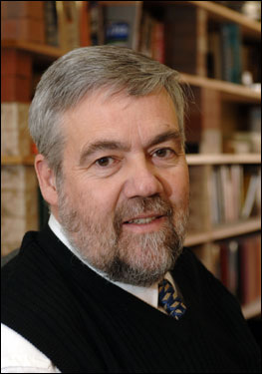
Bill James
Inventor of Sabermetrics
Godfather of modern baseball stats
Notes:
Who has heard of Bill James?
Who has read or watched Moneyball?
Billie Bean put Bill James theory into practice.
It changed the game - pun intended

Slide 11
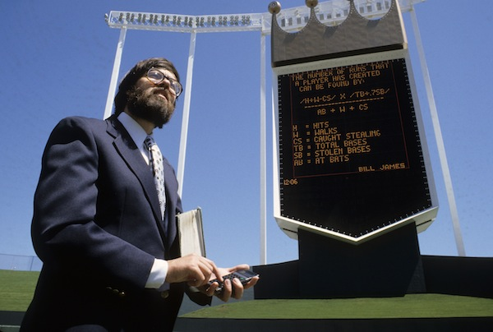
Bill James
Was unhappy with statistics MLB released
Proposed “Project Scoresheet” which became Stats Inc
Notes:
Stat and fantasy nerds wanted play-by-play stats to do their stuff better.

Slide 12

No More sportsball talk

Slide 13

VR-Rtc
A healthy supplement to the RSA 911 dataset
Notes:
RSA 911 is a large dataset, as I understand it. But it doesn’t have tons about VR data. That is where we come in.

Slide 14
The importance of being Earnest
Our data is only as accurate as the good, kind folks filling it out.
Notes:
Please allow me to lecture you.

Slide 15
Part II
Sharing your good work or
Scandinavian’s are good eggs

Slide 16
Volvo
Invented the most important innovation in automobile safety
and gave it away.
Notes:
Ask the crowd what is the most important safety innovation?
Answer it.

Slide 17
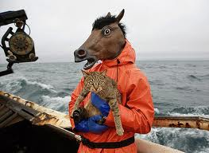
WUT?

Slide 18
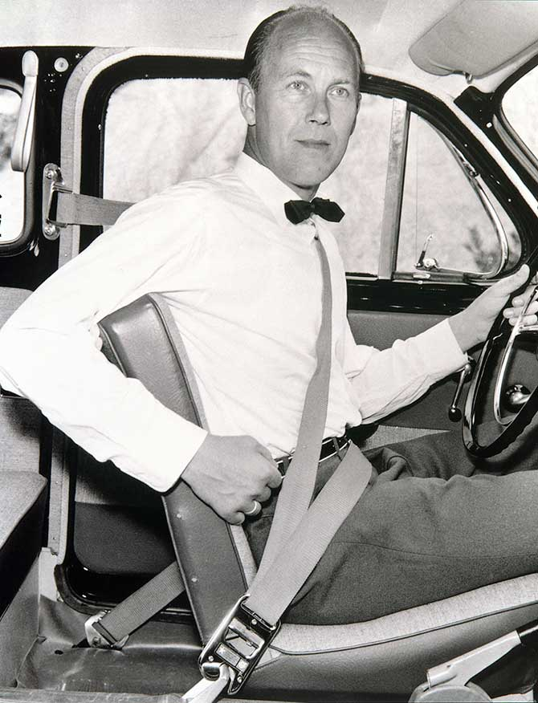
Nils Bohlin
Inventor of 3 Point Seatbelt

Slide 19

Linus Trovalds
Gave us Linux and Git
Known for creative expressions anger/displeasure
Notes:
Ask who has android phone? Tivo? Who owns stocks on the stock exchange? Who has intergrated computers in your car? Who has flown in a plane.

Slide 20
When people give their innovations to the community, we can solve problems and evolve faster

Slide 21

In this Regard, the web is awesome

Slide 22
Problems We need to solve
We need an accessible framework
It needs to work on almost every device (be responsive)
Base site needs to be fast and light because we are pulling in heavy data and graphics
No complex servers, databases, for the CMS
It would be nice if it wasn’t ugly
Notes:
Talk about responsive.
Talk about cmsless sites.

Slide 23
(Spoiler alert)
I’m not smart enough to solve these problems
Thankfully lots of people are the web are, and they are nice.
Notes:
Kartik might be.

Slide 24
Github to the Rescue
Almost every web related problem been solved and the solution given to the community, freely.

Slide 25
Who We took from
twitter
NPR
Obama for America
Github
Notes:
Responsive from Twitter
CMSless web sites from NPR and github (jekyll)

Slide 26
Problems We are trying to solve
Or ripoff people who have
Making data visualizations accessible and responsive
Kill flash
Build in SVG
Notes:
Talk about the history of data and flash
SVG
involvement in w3 accessible SVG community group

Slide 27
What we mean by “accessibility”
Exposed data vs Black box
Notes:
Gap minder vs explorevr.

Slide 28
PART III
STEAl this website

Slide 29

Most downloaded album in one day (at the time)
Named 2004 album on the year by Entertainment Weekly, Village voice and beloved by the New Yorker magazine
Notes:
Any guesses?

Slide 30
The Grey Album
A cappella vocals from Jay-Z’s Black album
+
Instrumental tracks from Beatle’s White album
=
Danger Mouse’s Grey Album
Notes:
Even the name is borrowed
Biggest fans where Jay-Z and Paul McCartney

Slide 31
Extra Credit
Google: Grey VIDeo
Notes:
Borrows even more.
Ed Sullivan
Concert footage

Slide 32
A modest Proposal
Explore our data using the publications and visualizations that we’ve created
Notes:
This is like just simply downloading an album and enjoying it for what it is.

Slide 33
Or
Take our data and make something else with it.

Slide 34
Or
Take our data and combine it with some other data to explore in different ways.

Slide 35
Or
Take our web code and build a better site.

Slide 36
Just Let us know
So we can take from you if you make improvements.
https://github.com/communityinclusion/explorevr.org
https://github.com/communityinclusion

Slide 37
Thanks
Hit me @coburnicus if you have questions, comments.

Slide 38
Now...Kartik
@kartiktrivedi

Slide 39
Designing Graphics
Quick and Sharable

Slide 40
Data to Data-Visualization
Purpose - What’s the purpose of visualization?
Data type - What’s the nature of data?
Data editing - Let’s clean the data!
Design options - Think about the purpose, then think about the options
Designing - Actually working on data
Publishing - Where do you want to put the visualization?

Slide 41
Tools
Socrata
Tableau Public
R

Slide 42
Evaluating the tools
Ease of use
Cost
Capabilities
Accessibility

Slide 43
Socrata
Easy to use
Web based
Easy to share
Limited data manipulation capabilities
Widely used by public agencies (Open Source)
Mostly accessible

Slide 44
Tableau Public
Desktop based (Only for Windows and Linux)
More options - more complicated
More capabilities
Widely used for creating dashboards
Can be linked with large datasets

Slide 45
R
(Programming Language)
Requires some understanding of programming
Highly flexible (Also complex)
Can handle any kind of data
Can produce web ready interactive graphics as well as print ready static graphics
Highly accessible (only limited by present web technology and your programming capabilities and time)

Slide 46
Resources
Opendata.socrata.com
Tableau.com
Github.com
Statmethods.net
Stackoverflow.com

Slide 47
Thanks.

