Slide 1

Department for Aging and Rehabilitative Services
Commonwealth of Virginia

Slide 2

Kathryn Hayfield-VR Director
4 Regional Directors-Larry Overbay, Dale Batten, Jean Steveson, Doug James
Budget Analyst-Sandy Williams
Lead Research Analyst-Barbara Burkett
Audience: Central Office Staff and Office Managers

Slide 3

Identified current barriers for our VR staff in using data for decision making. – COMPLETED
  Human Histogram showed eagerness
  Needs Assessment- held @ statewide managers’ meeting
  On-going Discussion with Staff
Determined usefulness of data, reports and products currently used for programmatic decisions. -COMPLETED
  Two eight hour “Data Days” held with Regional Directors
Refined existing reports, and products and created new products to enhance consistent use of data. COMPLETED
  Williams and Burkett

Slide 4
Developed a website for placement of all data and information for staff. REVISED MONTHLY
  Decisionswithdata.com
Staff Training - COMPLETED
    All day trainings statewide
    Individual Tutorials with all managers
Developed and tested mechanisms to integrate fiscal and program data for planning and management purposes to include predictive models. PILOTING
  Williams & Burkett

Slide 5

Develop a common “data language” for use throughout the agency. On Going
  Decisionswithdata.com
Design and implement interventions to address identified needs of staff. and information gaps. On Going
  Blogs
  Appointments with Policy and Planning Data Staff & AWARE staff

Slide 6

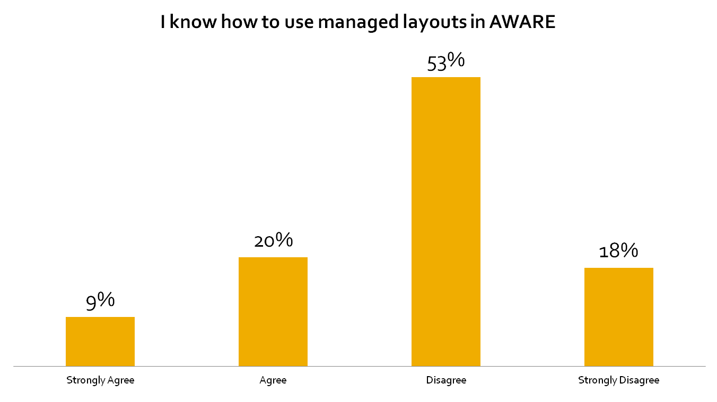
Notes:
71% do not know how to use managed layouts

Slide 7

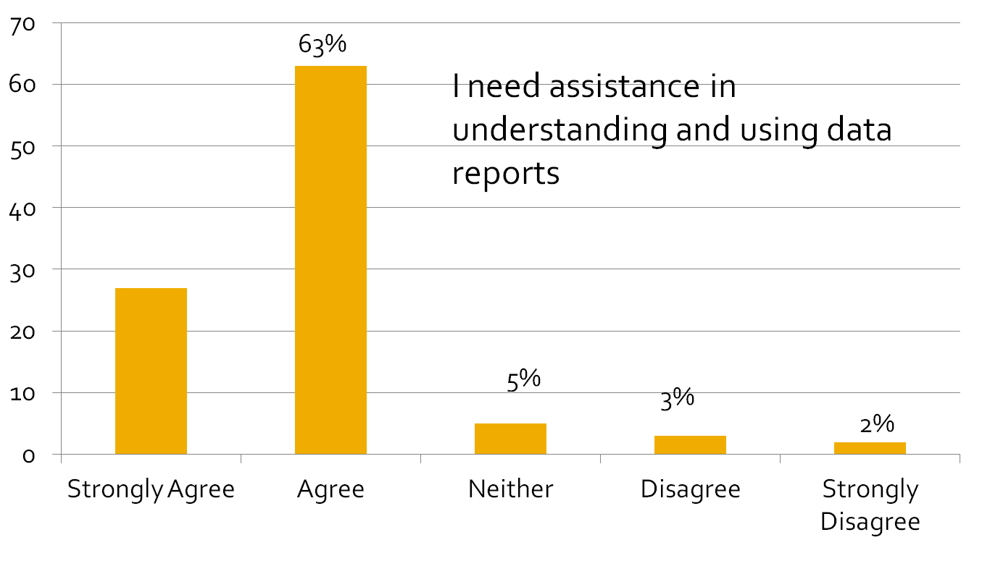
27%

Slide 8

www.decisionswithdata.com

Slide 9

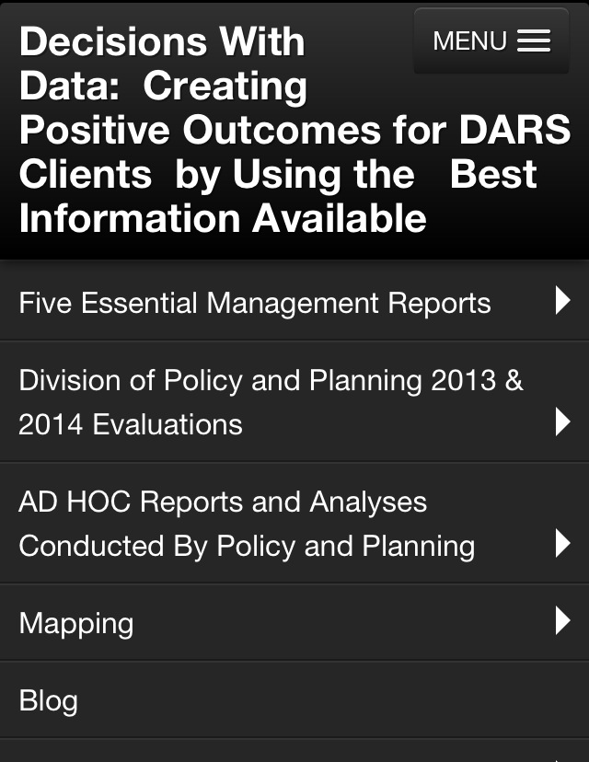

Slide 10
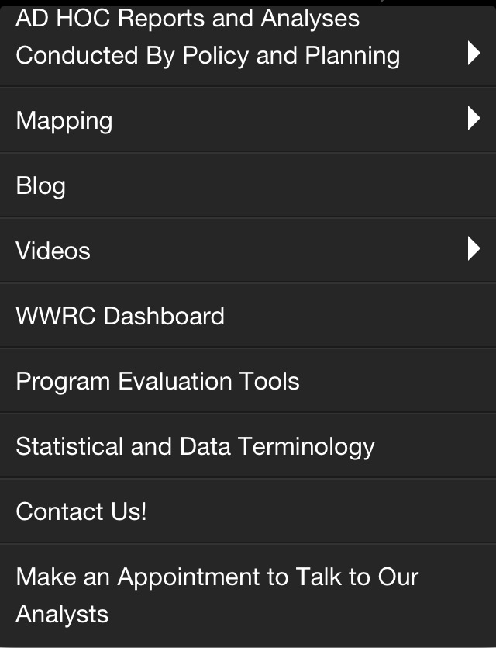

Slide 11

Location of Chesterfield Office using mapping
Expenditure Report to identify potential over or underspending
“Where Are Your Clients” influenced managers to concentrate on referrals.
Use of the scorecard has improved hourly earnings (Harrisonburg, Fishersville)
IPE report illustrated disconnect btw. Ipe’s and jobs.

Slide 12

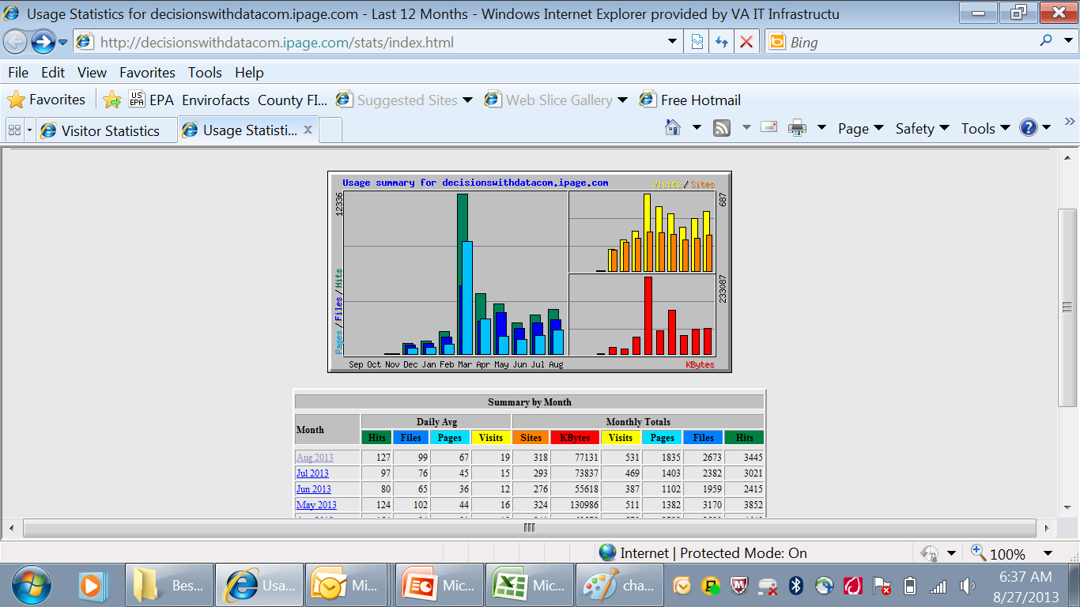

Slide 13

Expensive
Time consuming
We did not get total buy in from some administrators….”just another grant” mentality.
Needed to include other players. (Fiscal, Rehab Center)

Slide 14

Continued Enhancement of Decisionswithdata.com
Discontinuation of old methods of report and data dissemination
Continued Emphasis by Leadership On Importance of Data in Decision Making

