Slide 1
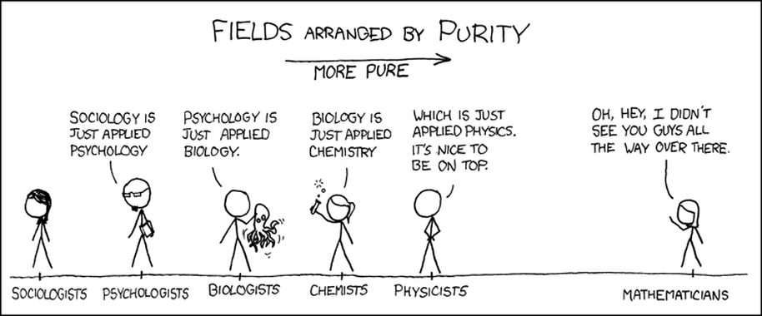
Numbers: What are they good for?

Slide 2
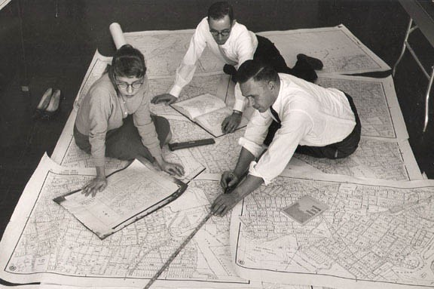
Statistics in Geography
http://blog.forwardmapworks.com/

Slide 3
What’s distinctive about statistics in geography?
Notes:
Difference between descriptive and inferential statistics.
Example: rates of cancer in all state counties.

Slide 4
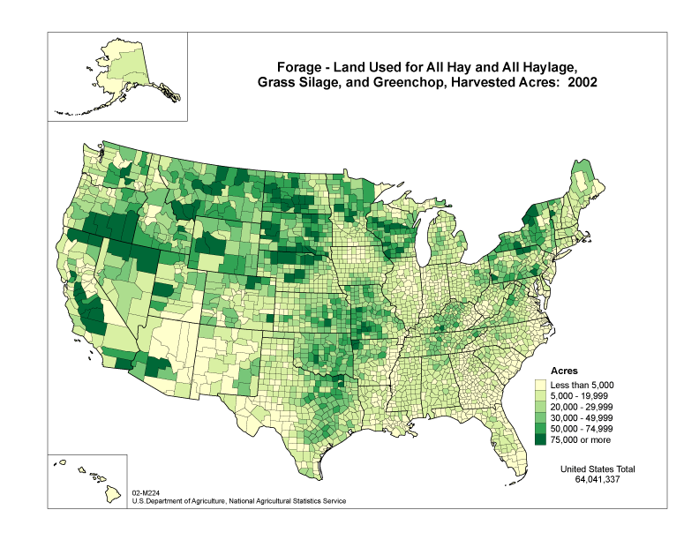
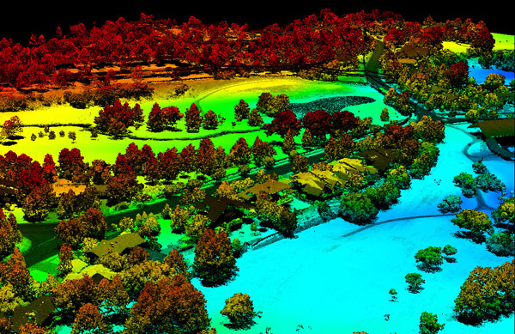
1. Data formats and creation methods
3dgolfcourse.com
Notes:
What makes data geographic?
Wide variety of data sources and methods
Raster and vector based data sources
Information about a place in some form—often now through GIS based techniques
RASTER DATA:
Comprised of raster cells—all the same size and all with a value
VECTOR DATA:
A representation of the world using points, lines, and polygons. Vector models are useful for storing data that has discrete boundaries, such as country borders, land parcels, and streets.
(Jerry uses vector data, I use raster but I don’t call it that)

Slide 5
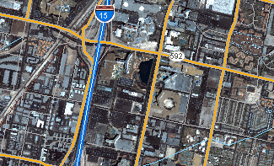
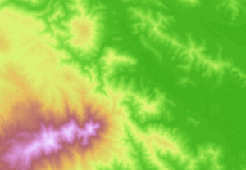
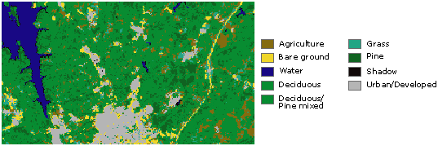
Continuous data
Basemaps
Thematic (discrete) data
Notes:
In its simplest form, a raster consists of a matrix of cells (or pixels) organized into rows and columns (or a grid) where each cell contains a value representing information, such as temperature. Rasters are digital aerial photographs, imagery from satellites, digital pictures, or even scanned maps.
Data stored in a raster format represents real-world phenomena:
Thematic data (also known as discrete) represents features such as land-use or soils data.
Continuous data represents phenomena such as temperature, elevation, or spectral data such as satellite images and aerial photographs.
Pictures include scanned maps or drawings and building photographs.
Common raster maps? Temperature data (interpolated), land cover, classified remote sensing imagery
Questions you could ask of a land cover map—what percentage of an area is covered by various land cover types. What’s the relationship between type of land cover and other characteristics: elevation, proximity to certain features, etc.?

Slide 6
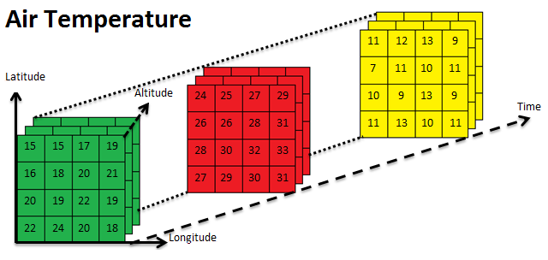
Arrays (multi-dimensional)

Slide 7
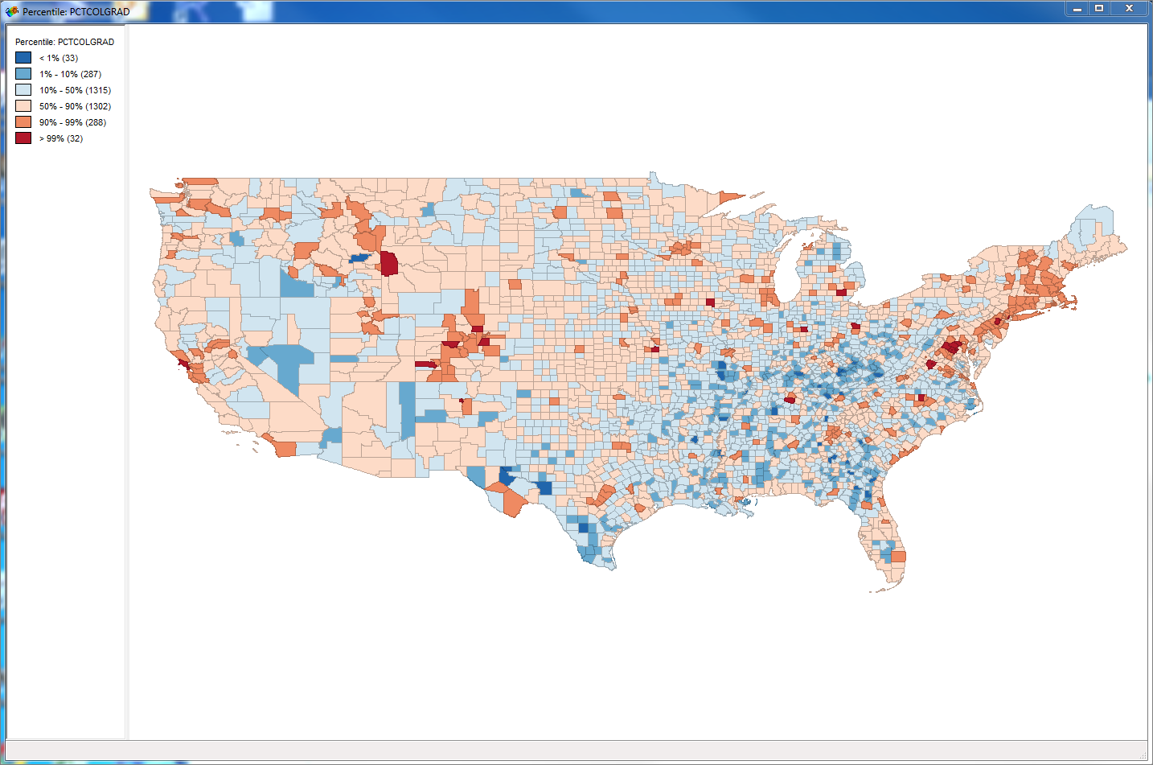
2. Methods of analysis
Spatial clustering
Spatial lag/influence
Space/time geography

Slide 8
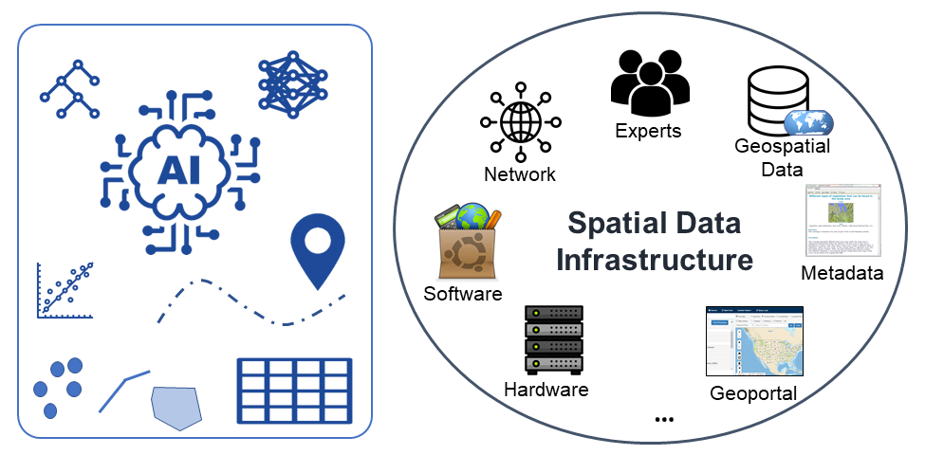

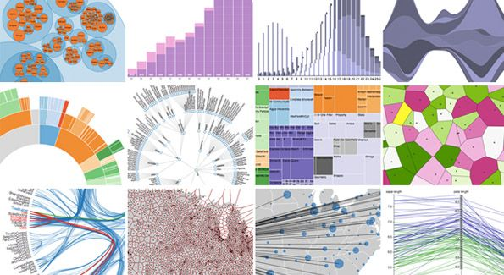
3. Data workflow
Notes:
More recently, new generation of work on quantitative geography drawing on increased computing power, GIS software, and increasing availability of “big data”
Methods for managing and analyzing datasets of multiple terabytes

Slide 9
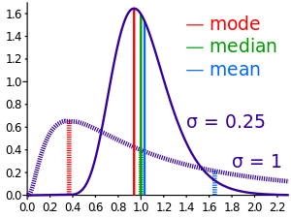
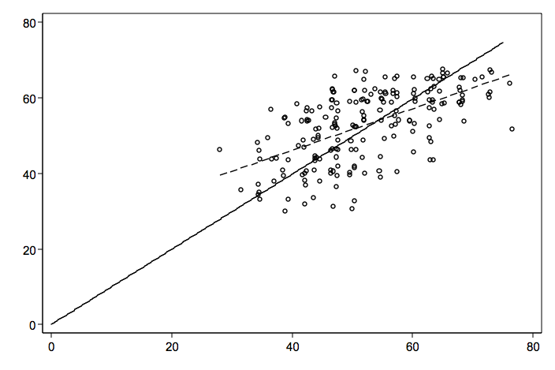
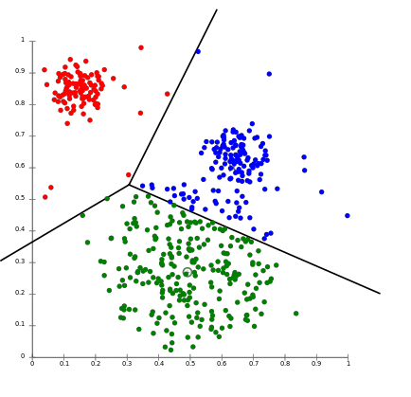
Types of statistics
Notes:
Raster data

Slide 10
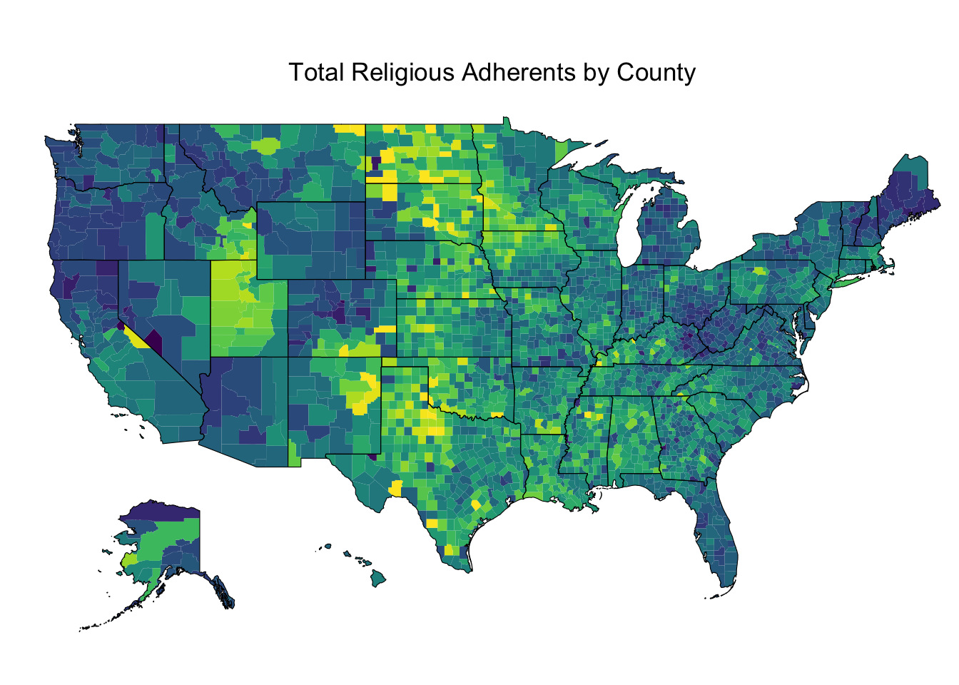
Descriptive statistics
Central tendency
Distribution
Change over time
Data visualization/exploratory analysis
Notes:
Raster data
Comprised of raster cells—all the same size and all with a value
This data is always continuous and there are no discrete units—a single point or area.
Disclaimer: most of my work has been with vector based data
Common raster maps? Temperature data (interpolated), land cover, classified remote sensing imagery
Questions you could ask of a land cover map—what percentage of an area is covered by various land cover types. What’s the relationship between type of land cover and other characteristics: elevation, proximity to certain features, etc.?

Slide 11
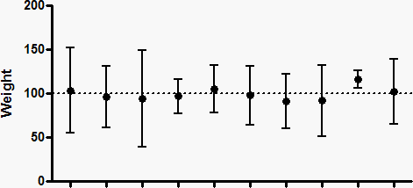
Inferential statistics
Difference in means/t-tests
Confidence intervals
Correlation
Regression

Slide 12
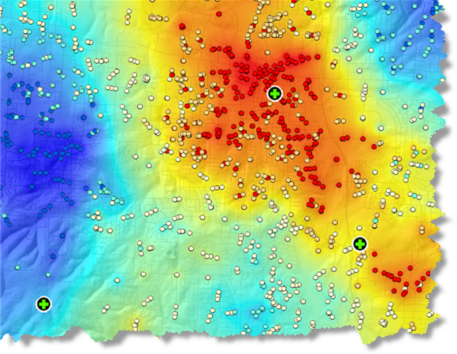
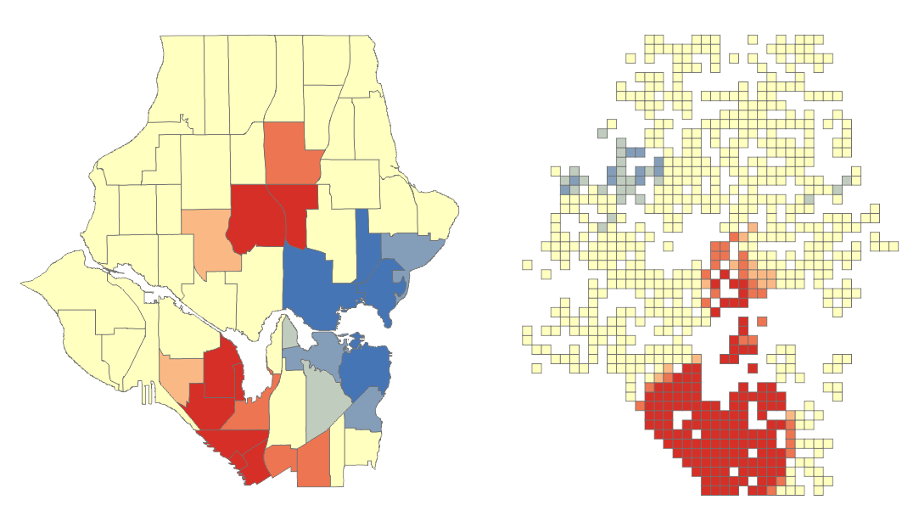
Spatial statistics
Spatial autocorrelation/Hotspot analysis
Spatial clustering
Geographic regression models

Slide 13

Let’s talk about ungrading
Notes:
How did you do in a class?
Depends on the grade? What if there’s not a grade … how you did is more about what you learned, what you did,

Slide 14

What is ungrading?
“The focus of ungrading is to provide extensive feedback to students and then jointly (students and instructors) come to a consensus as to what the grade should be.”
https://www.chemedx.org/blog/ungrading-what-it-and-why-should-we-use-it
Notes:
You have more control in the grading process – you have agency, it’s not some secret formula.

Slide 15
In this course:
General rating (initiated by you), but not tied to a grade
Student goal setting and self-evaluation
A focus on collaborative work and self-motivated learning

Slide 16
Spec grading
Notes:
7 labs.
Come to Class.
That’s a B
You can raise it by completing a ‘challenge’ section.
You can focus on some parts or others to raise your grade if labs aren’t your thing.
Lets go to the syllabus:

Slide 17
What are my goals for you?
Improve confidence in using quantitative techniques
Be able to interpret and constructively critique others’ statistical research
Learn common workflows for exploratory data analysis and data science
Be able to explain common techniques for quantitative and spatial analysis and decide which is relevant to a given research problem
Gain expertise in using R as an open-source programming platform for quantitative analysis
Attend class regularly and be an active participant
Contribute to and benefit from our collective learning

Slide 18
What does an “A” look like for you?
Do NOT use good grades, but focus on what those grades would show about you. For example, you could finish one or more of the following statements:
“I would understand how…”
“I would be able to…”
“I would learn…”
“I could explain…”
Notes:
Raster data
Comprised of raster cells—all the same size and all with a value
This data is always continuous and there are no discrete units—a single point or area.
Disclaimer: most of my work has been with vector based data
Common raster maps? Temperature data (interpolated), land cover, classified remote sensing imagery
Questions you could ask of a land cover map—what percentage of an area is covered by various land cover types. What’s the relationship between type of land cover and other characteristics: elevation, proximity to certain features, etc.?

Slide 19
What does an “A” look like for you?
Post your goals on ELC discussion by next Thursday’s class time. We’ll be reflecting back on these throughout the course.
Notes:
Raster data
Comprised of raster cells—all the same size and all with a value
This data is always continuous and there are no discrete units—a single point or area.
Disclaimer: most of my work has been with vector based data
Common raster maps? Temperature data (interpolated), land cover, classified remote sensing imagery
Questions you could ask of a land cover map—what percentage of an area is covered by various land cover types. What’s the relationship between type of land cover and other characteristics: elevation, proximity to certain features, etc.?

Slide 20
Next time: Getting started with R!
Install R/Rstudio/Git BEFORE class
Take the Introductory Survey
Answer discussion post: what does an A look like for you?
What we will cover:
How to clone the course repository (“repo”)
Get started using data in R: Script S01-1

