Slide 1
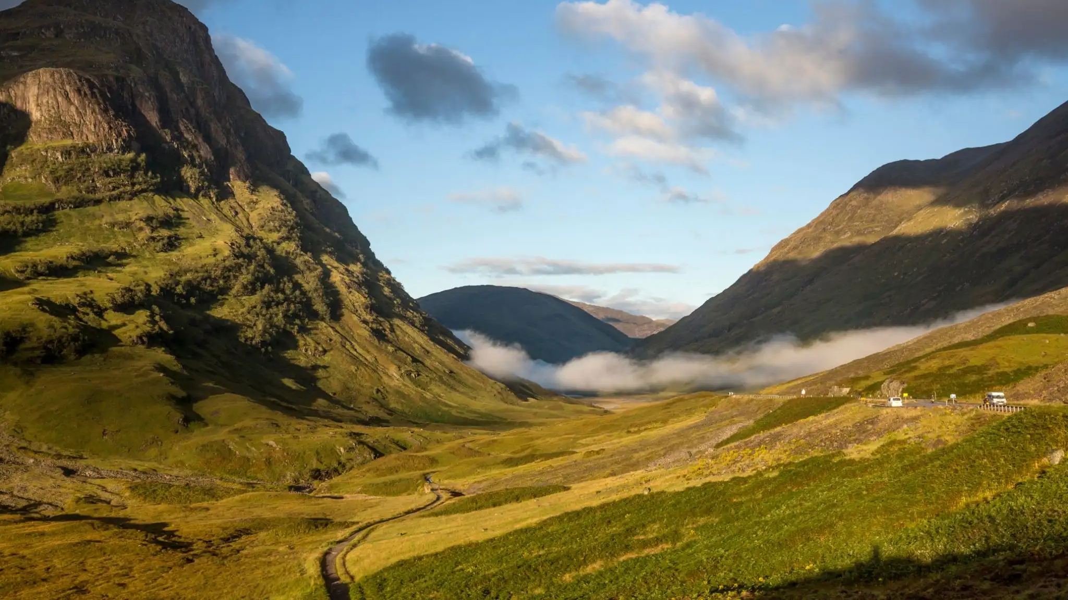
Group Sprint
GEOG4/6300
November 18-20, 2025

Slide 2
How is climate changing on the highest Scottish peaks?
Scottish Munros
UK Met Data

Slide 3
How many peaks currently listed as Munros have always been included on the list?
Which year saw the largest number of changes to the classification?
Which Munro is the most remote?
Which are the rainiest/coldest/sunniest/hottest months to visit the met station closest to the highest peak? Has that changed over time?
Were there any historic years that were particularly rainy/cold/sunny/hot on the peak?

Slide 4
In a group
How would you answer these questions?
What sort of analysis techniques will you use?
What plots can you make to illustrate the changes?

Slide 5
In a group
How would you answer these questions?
What sort of analysis techniques will you use?
What plots can you make to illustrate the changes?
Assign tasks to people in your group.
Get started – check in at the end of class.
End goal: We’ll post your knitted Rmd to a github page.

