Slide 1

Geog4/6300: Data Science in Geography
Dr. Shannon
Fall 2026

Slide 2
What’s this course about?
This course provides an introduction to data science and statistical methods in Geography, including methods of obtaining and cleaning data, descriptive and inferential statistics, and basic spatial analysis. It also provides students with experience conducting analysis in a code based environment through the open source software package R. Students completing this course should gain familiarity with all these techniques, better understand their use within Geography, and be able to apply them to their own research interests.

Slide 3
Course objectives
1. Understand basic concepts and methods of data collection and description
2. Understand basic concepts of mathematical probability theory
3. Understand the logic and practice of simple inferential statistics
4. Understand correlation and regression analysis
5. Ability to use appropriate statistical techniques in tackling geographical problems.
6. Ability to comprehend academic literature that uses statistical techniques.

Slide 4
Main course units
Introduction to R
Data structure and formats
Data wrangling
Descriptive statistics and visualization
Descriptive spatial statistics
Inferential statistics
Tests of difference
Tests of association

Slide 5
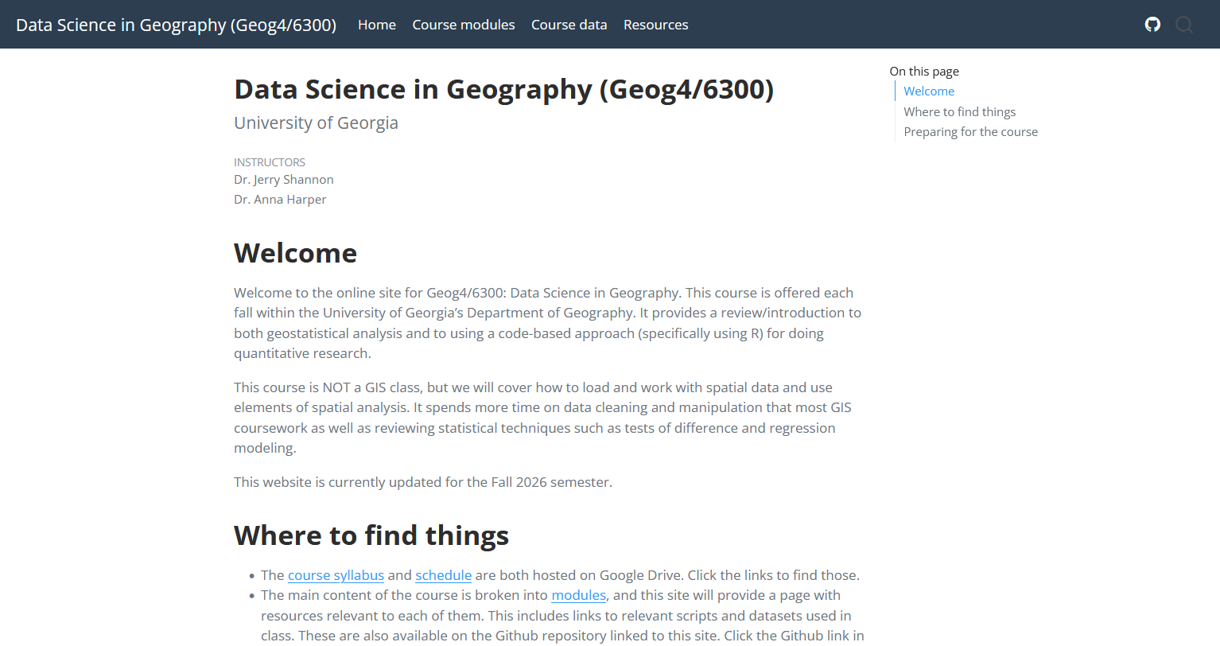
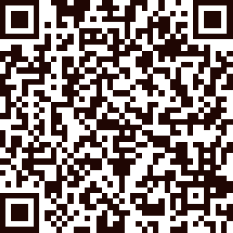
Course website
https://communitymaplab.github.io/geog4300_datascience/

Slide 6
What you need
Readings
Posted on the module pages—some required some optional
Also includes curated video list
Software
R and Rstudio
Excel/Google Sheets
Git (optional)

Slide 7
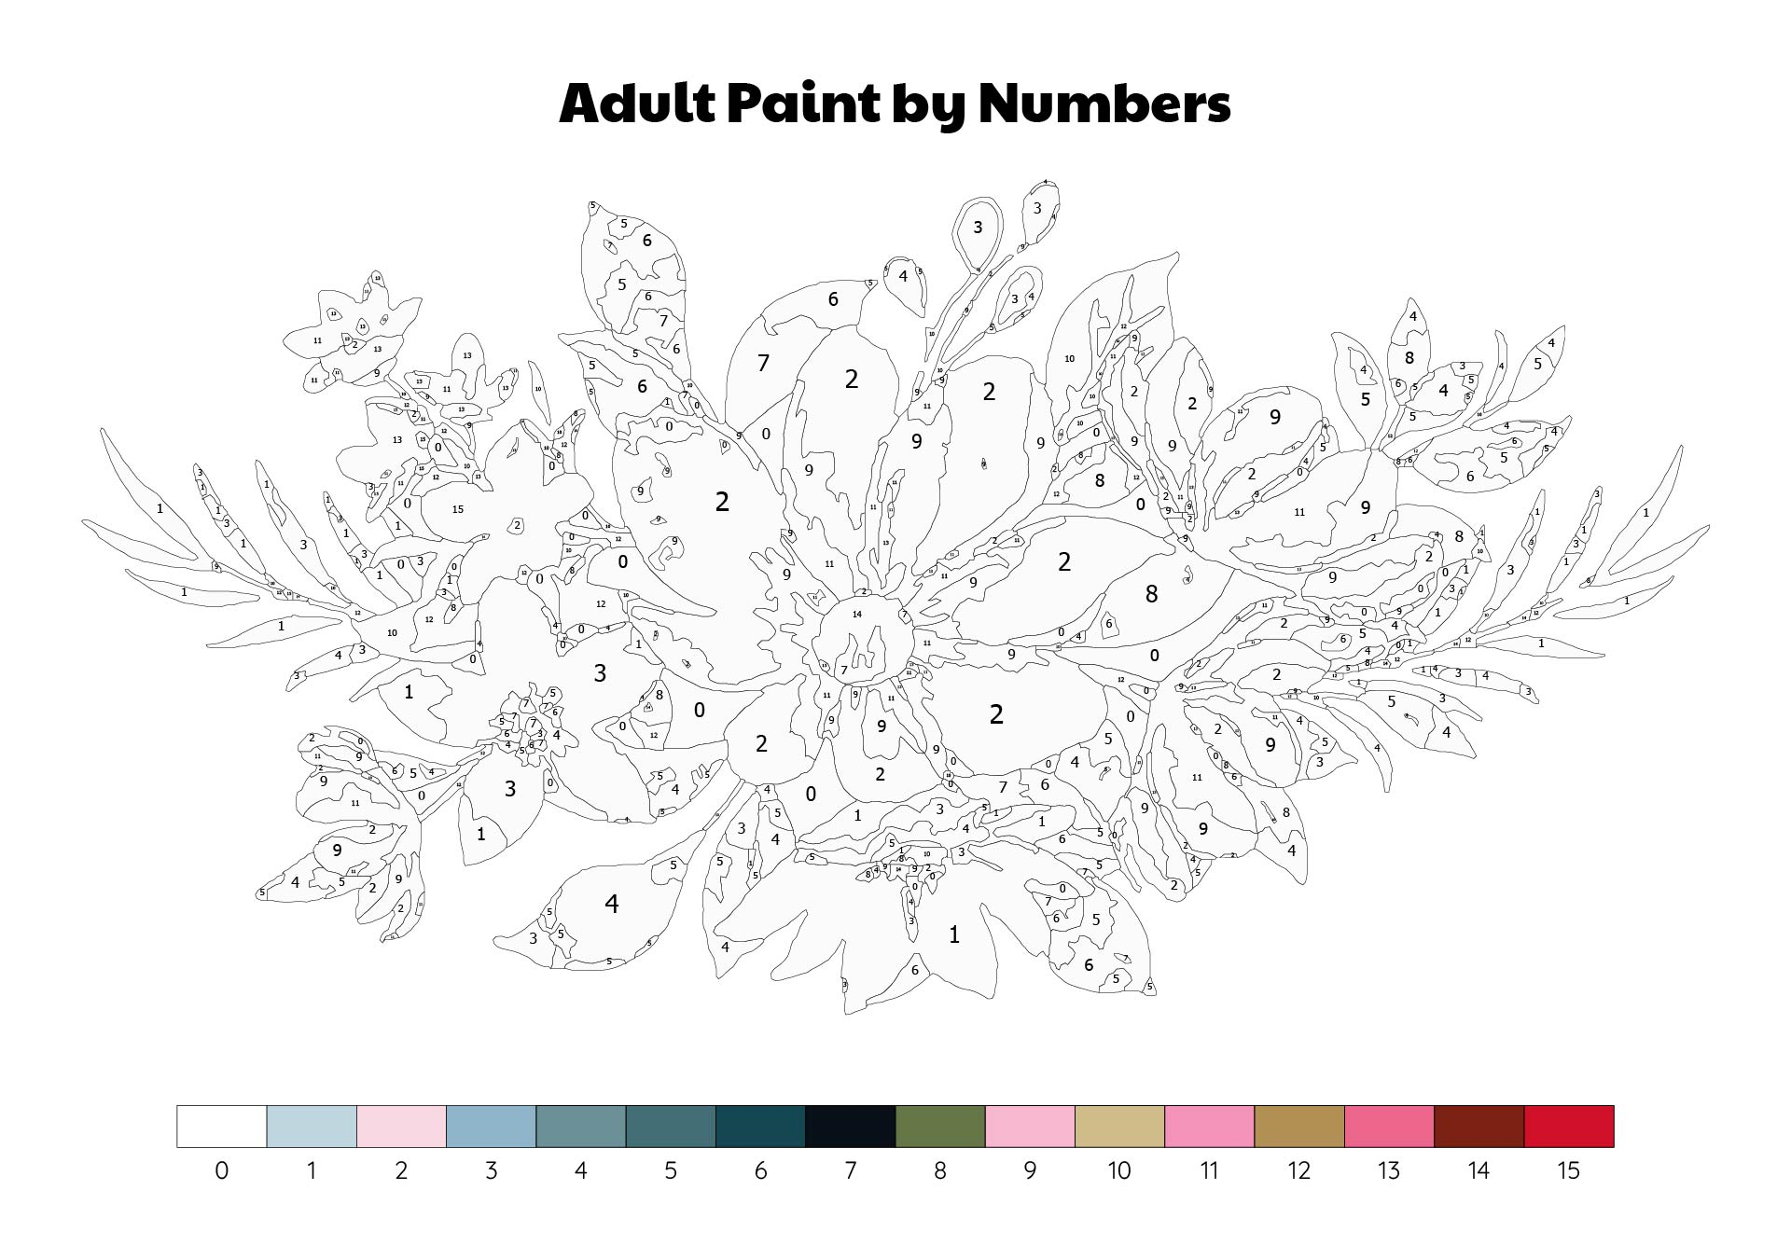
Introduce yourself!
Your name
Your academic program
A number that is meaningful to you in some way

Slide 8

What is standards-based grading?
Notes:
How did you do in a class?
Depends on the grade? What if there’s not a grade … how you did is more about what you learned, what you did,

Slide 9
In this course:
Modules and lab assignments are aligned with course leaning goals
Labs graded and complete or incomplete based on demonstrating competency
Opportunities for revision or alternative pathways

Slide 10
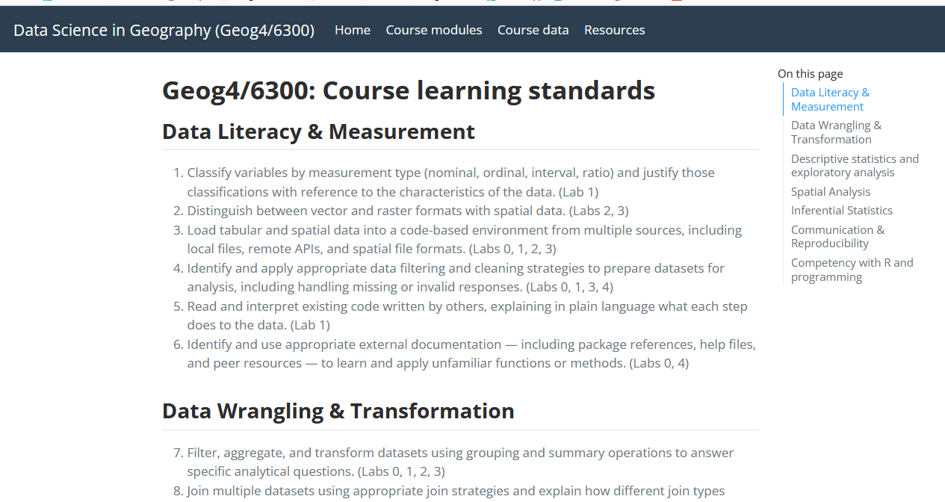
Course learning standards
https://communitymaplab.github.io/geog4300_datascience/learning_standards.html

Slide 11
Course grading rubric
 | A | B | C | D
Labs submitted | All submitted | All submitted | At least five submitted | At least three submitted
Labs marked complete | All complete | At least five complete | At least three complete | NA
Lab “graces” (1 revision and/or 2 lates) | No more than three | No more than four | No more than five | NA
Attendance | >75% of classes | >65% of classes | >50% of classes | >40% of classes
Challenge items | Complete three or more | Complete one or more | Not required | Not required
Notes:
7 labs.
Come to Class.
That’s a B
You can raise it by completing a ‘challenge’ section.
You can focus on some parts or others to raise your grade if labs aren’t your thing.
Lets go to the syllabus:

Slide 12
What does an “A” look like for you?
Do NOT use good grades, but focus on what those grades would show about you. For example, you could finish one or more of the following statements:
“I would understand how…”
“I would be able to…”
“I would learn…”
“I could explain…”
Notes:
Raster data
Comprised of raster cells—all the same size and all with a value
This data is always continuous and there are no discrete units—a single point or area.
Disclaimer: most of my work has been with vector based data
Common raster maps? Temperature data (interpolated), land cover, classified remote sensing imagery
Questions you could ask of a land cover map—what percentage of an area is covered by various land cover types. What’s the relationship between type of land cover and other characteristics: elevation, proximity to certain features, etc.?

Slide 13
What are your thoughts?
In groups:
One thing you’re looking forward to
One thing that makes you nervous
One question you have

Slide 14
What else should you do?
Download the required software:
R and Rstudio
Git
Github Desktop
Create a Github account

