Slide 1
Working with data
GEOG4300 /6300: Intro to data science (Lecture 2)
Fall 2026
Dr. Jerry Shannon

Slide 2
Plan for the day
This week: Read R for Data Science, Chapter 3 (Data transformation).
Concepts:
Working with online datasets
Methods of re-organizing datasets to get them into a desired format for analysis
1) Finish S01-3: APIs and online data
2) Talk about Lab 0
3) Start on S02 scripts: You should continue to work through these on Thursday.

Slide 3
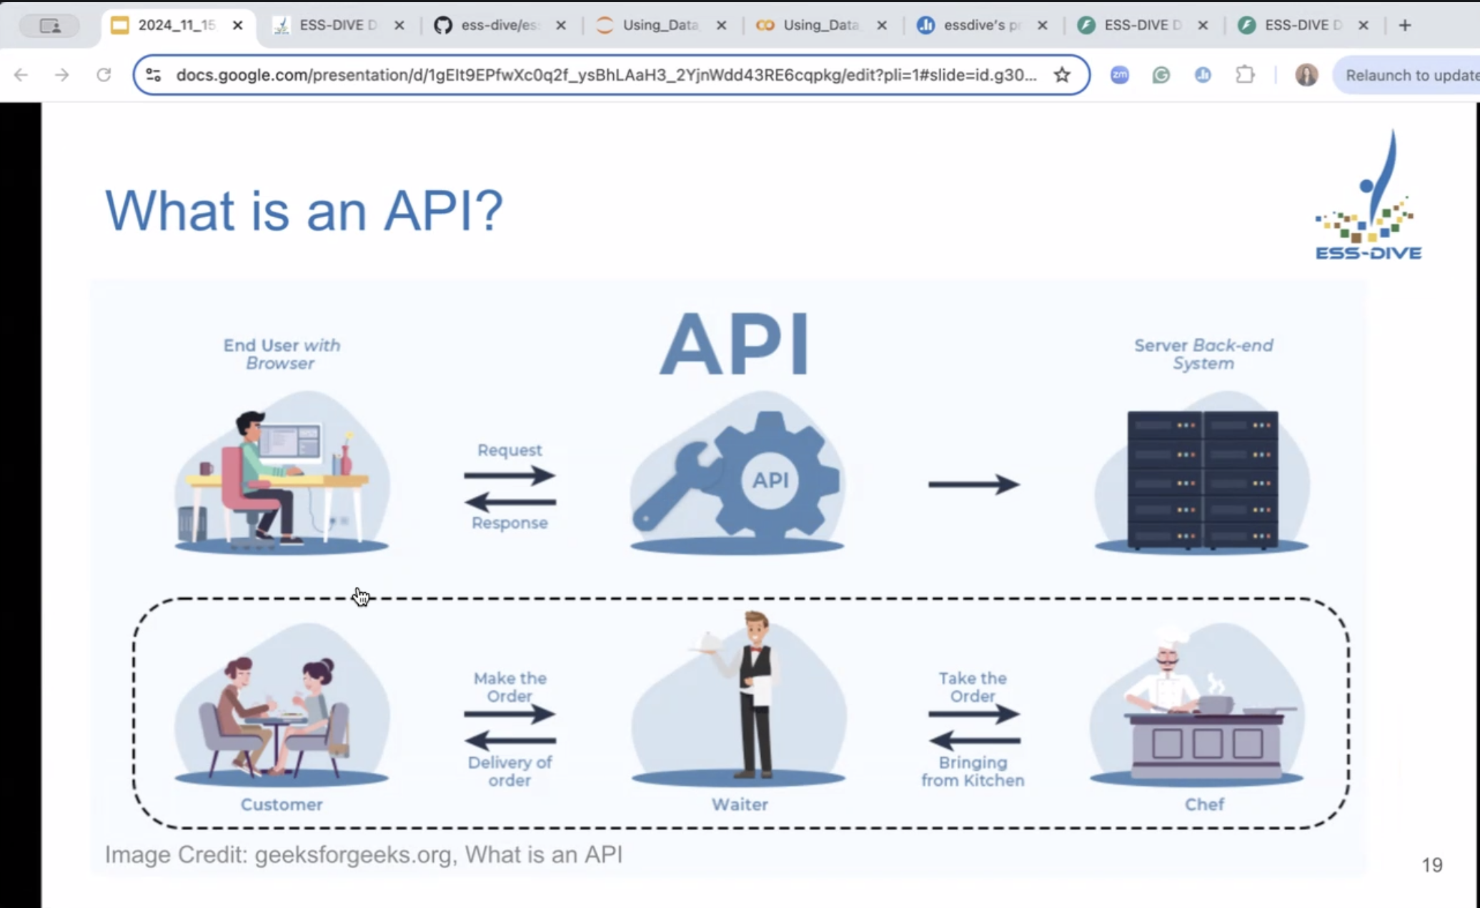
API
Application programming interface
Notes:
Think of it as a bridge that connects two systems—such as a client and a server—and enables them to work together seamlessly.
To understand it better, imagine you're at a restaurant: the waiter (API) takes your order (request), gives it to the chef (server), and then brings the prepared food (response) back to your table. Similarly, when you search for a course on a website, your request goes through an API, which then fetches the data from the database and sends it back as a response.
APIs work in a simple step-by-step process:
Request: A client (user) sends a request through the API's URI (Uniform Resource Identifier).
Processing: The API forwards the request to the server.
Response: The server processes the request and sends the response back to the API.
Delivery: The API returns the server's response to the client.

Slide 4
Think of it as a bridge that connects two systems—such as a client and a server—and enables them to work together seamlessly.
To understand it better, imagine you're at a restaurant: the waiter (API) takes your order (request), gives it to the chef (server), and then brings the prepared food (response) back to your table. Similarly, when you search for a course on a website, your request goes through an API, which then fetches the data from the database and sends it back as a response.
APIs work in a simple step-by-step process:
Request: A client (user) sends a request through the API's URI (Uniform Resource Identifier).
Processing: The API forwards the request to the server.
Response: The server processes the request and sends the response back to the API.
Delivery: The API returns the server's response to the client.
Geeksforgeeks.org: What is an API?

Slide 5
API
Sometimes you need to access data from a website, rather than storing it directly on your computer.
An API communicates with a server’s backend system, rather than you having to go into that computer yourself.
Daymetr is an example of an API

Slide 6
Libraries we’ll use today
daymetr: used to download and work with Daymet data
sf: ‘simple features’ used for reading and working with spatial data
tmap: used for mapping of spatial data
tidycensus: working with US census data
load_variables
get_acs

Slide 7
FYI about census data: Estimates
Every year over 3.5 million housing unit addresses are contacted by the US Census Bureau to participate in the American Community Survey which is also abbreviated as the ACS. The information obtained from this sample is then used to estimate characteristics about the total population in a timely and a cost-effective manner. However, these estimates differ from those that would be obtained in a Census where every household in the nation is contacted. So, in other words, we can't be 100% confident that the sample is truly representative of the entire nation and this results in an element of uncertainty in the data. Users who are interested in more information about the ACS sample design should see the ACS Design and Methodology report. The URL is on the screen and will also be included at the end.
https://www.census.gov/content/dam/Census/programs-surveys/acs/guidance/training-presentations/20180418_MOE_Webinar_Transcript.pdf

Slide 8
FYI about census data: MOE
Put simply, the margin of error or MOE, is a measure of the possible variation of an estimate around the population value. Margins of error allow data users to be certain that at a given level of confidence, the estimate and the actual population value differ by no more than the value of the MOE. The Census Bureau uses a 90% confidence level as its standard. All ACS estimates published on AFF have margins of error calculated at this 90% confidence level. It's also important to note that margins of error provided by the Census Bureau have the same units as their respective estimates. So, for instances, a percent estimate will have a margin of error which is a percent and a median estimate for income will have a margin of error in dollars.
https://www.census.gov/content/dam/Census/programs-surveys/acs/guidance/training-presentations/20180418_MOE_Webinar_Transcript.pdf

Slide 9
Review some functions we worked with in S01 scripts
How do you install and then call a package (for ex. tidyverse)?
ggplot
mutate
group_by
summarise
Read_csv
?
Names, str, head, tail
%>%
Filter
Table, view
How are filter and select different?
Chunk
API
What else?
Notes:
Filter: keep rows that match a condition
Select: keep or drop columns using their names and types

Slide 10
Lab 0: Basic Instructions
Go to github.com --> jshannon75/geog4300. Click link to Lab 0.
Be sure you’ve linked your github account to our classroom.
You should have accepted the assignment by now.
You need a personal access token.
Pull code to your local computer
Make some changes (e.g. enter your name)
Knit
Submitting your changes back to your repository requires:
Stage
Commit
Push
Notes:
If you haven’t done steps 2-4 yet, let’s keep going, and you’ll need to do it either later today or you can get help on Thursday.

Slide 11
Up next
Week 3 (next week): Data cleaning and visualization
Read R for Data Science Ch 1: Data visualization, Ch 5: Data tidying.
Lab 0 due on 9/4
Jerry covering on both days
Week 4 (w/c 9/8): Loading and visualizing vector and raster data in R
Read McGrew (Introduction to Statistical Problem Solving in Geography, 4e) Chapter 3.
Lab 1 is due on 9/11

