Slide 1
Reading data in R
GEOG4300 /6300: Intro to data science
Prof. Jerry Shannon

Slide 2
Things to be aware of
Lab 0 is due Friday September 4
We’ll start on this on Friday.

Slide 3
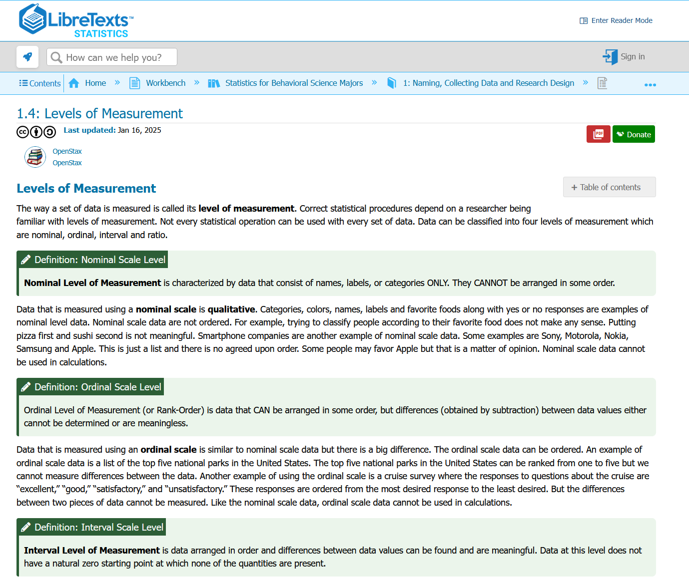
Assigned reading
Locate a csv dataset on our course data page. Download and open it.
Classify each column as nominal, ordinal, interval, or ratio.

Slide 4
R variable types
For these variables, how do you think R would read them?
Abbreviation | Type
chr | character
int | integer
dbl | double (numeric with decimals)
lgl | logical (TRUE/FALSE)
fct | factor
date | Date
dttm | date-time (POSIXct)
time | time (hms)
list | list column

Slide 5
R variable types pt 2
For these variables, how do you think R would read them?
Abbreviation | Type
chr | character
int | integer
dbl | double (numeric with decimals)
lgl | logical (TRUE/FALSE)
fct | factor
date | Date
dttm | date-time (POSIXct)
time | time (hms)
list | list column
Try it out!
Use `read.csv` to load this data into R.
Use `str` or `glimpse` to inspect them
Do the abbreviations match your predictions?

Slide 6
Besides csv, how many file types can you name?
Full name of the file type
Its extension (e.g., “.csv”)
What it’s used for

Slide 7
How many file types can you name?
Full name of the file type
Its extension (e.g., “.csv”)
What it’s used for

Slide 8
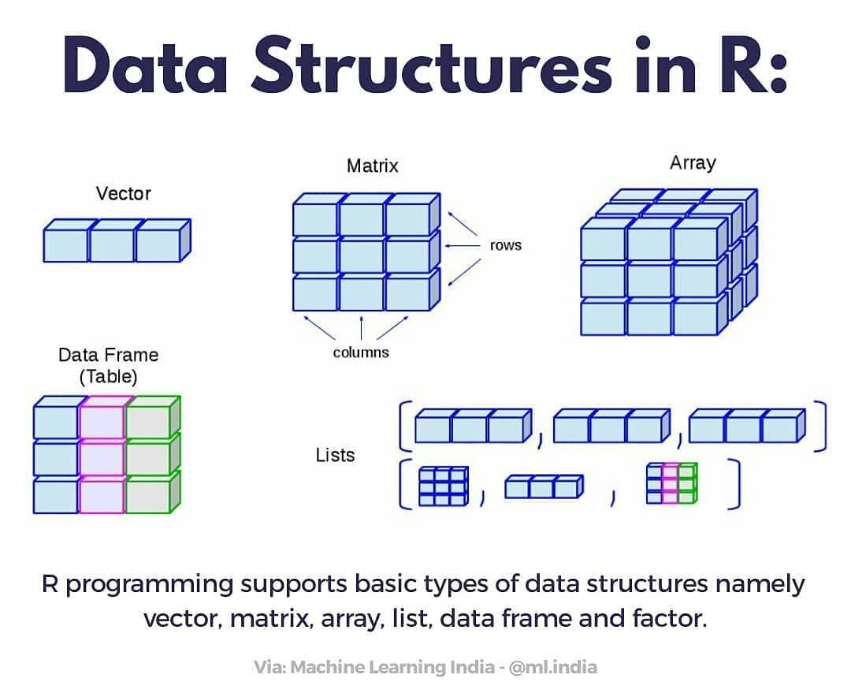
R Data structures

Slide 9
R Data structures
Data transformations
Open the dataset you download in Excel/Google Sheets
How could you extract a vector from this data?
How could you extract a matrix from this data?
How might this data become an array?

Slide 10
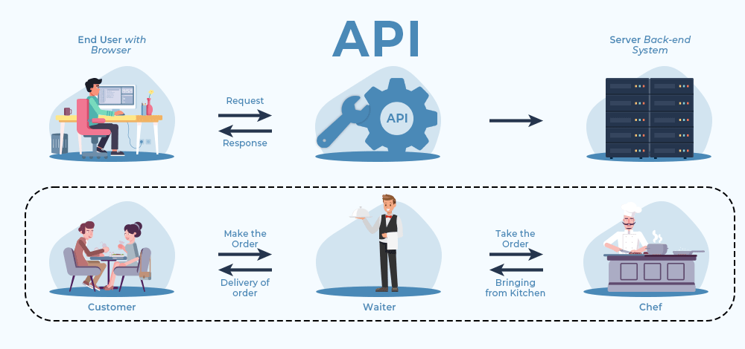
What is an “API”?
Application programming interface
https://www.geeksforgeeks.org/web-tech/terminologies-of-web-development/
Notes:
Think of it as a bridge that connects two systems—such as a client and a server—and enables them to work together seamlessly.
To understand it better, imagine you're at a restaurant: the waiter (API) takes your order (request), gives it to the chef (server), and then brings the prepared food (response) back to your table. Similarly, when you search for a course on a website, your request goes through an API, which then fetches the data from the database and sends it back as a response.
APIs work in a simple step-by-step process:
Request: A client (user) sends a request through the API's URI (Uniform Resource Identifier).
Processing: The API forwards the request to the server.
Response: The server processes the request and sends the response back to the API.
Delivery: The API returns the server's response to the client.

Slide 11
APIs work in a step-by-step process
Request: A client (user) sends a request through the API's URI (Uniform Resource Identifier).
Processing: The API forwards the request to the server.
Response: The server processes the request and sends the response back to the API.
Delivery: The API returns the server's response to the client.
Sometimes you need to access data from a website, rather than storing it directly on your computer. An API communicates with a server’s backend system, rather than you having to go into that computer yourself.

Slide 12
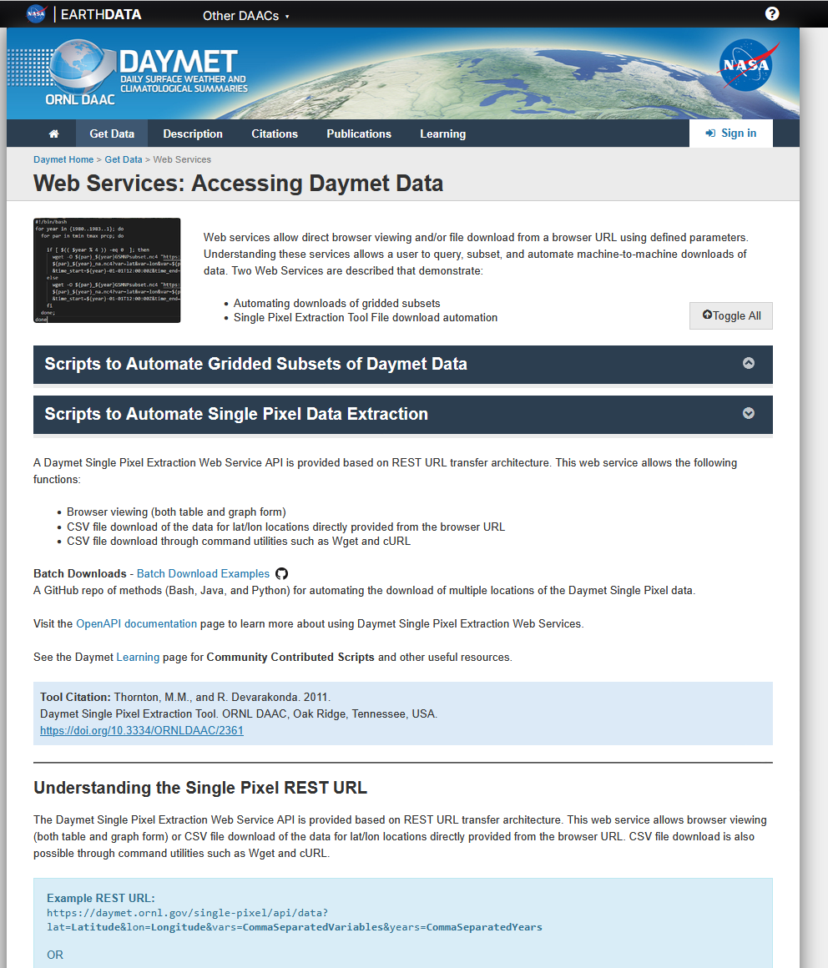
Example: Daymet
Gridded climate data from 1980-present
Uses a “REST” API:
https://daymet.ornl.gov/single-pixel/api/data?lat=Latitude&lon=Longitude&vars=CommaSeparatedVariables&years=CommaSeparatedYears
Try it for the Geography Building:
Lat: 33.948716, Long: -83.3754414
Variables: tmax, tmin, prcp (Max and min temperatures and precipitation in mm)
Years: 1990, 2000, 2010
https://daymet.ornl.gov/web_services

Slide 13
Practice!
Adapt this to the location, years, and variables of your choosing.
Then load the csv you download into R.
tmax - maximum temperature
tmin - minimum temperature
srad - shortwave radiation
vp - vapor pressure
swe - snow-water equivalent
prcp - precipitation
dayl - daylength
https://daymet.ornl.gov/single-pixel/api/data?lat=Latitude&lon=Longitude&vars=CommaSeparatedVariables&years=CommaSeparatedYears

Slide 14
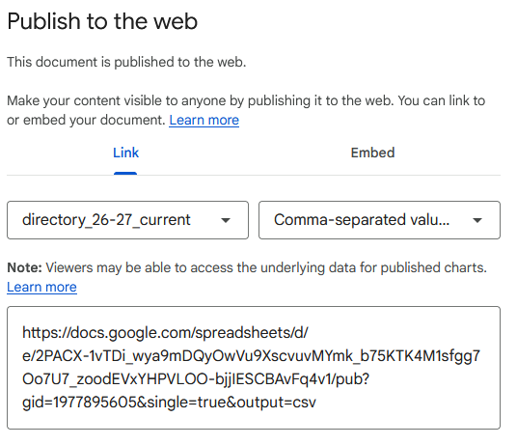
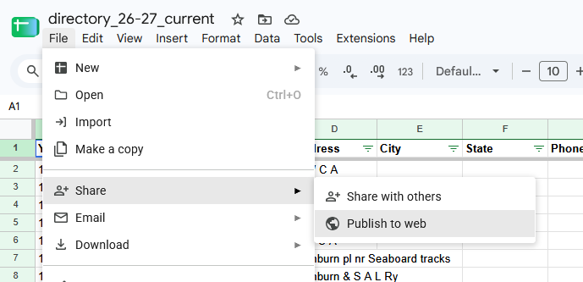
You can also load csv’s directly from websites
Example: Google Drive

