Slide 1
Spatial data
GEOG4300 /6300: Intro to data science
Prof. Jerry Shannon

Slide 2
Things to be aware of
Lab 0 is due Friday September 4
We’ll start on this on Friday.

Slide 3
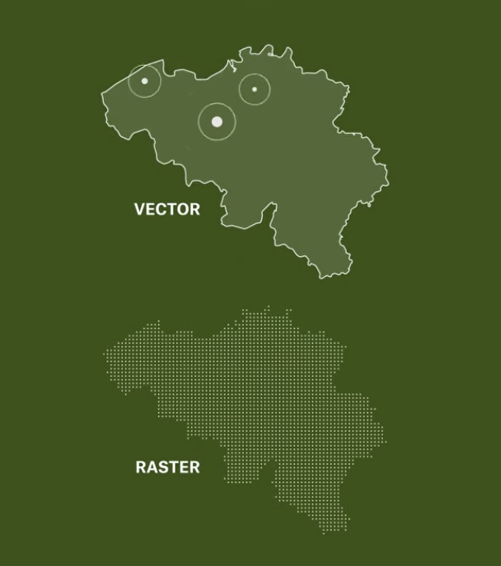
GIS data formats: Vector vs raster
Assigned video:
https://www.youtube.com/watch?v=N-3zF10LbHg

Slide 4
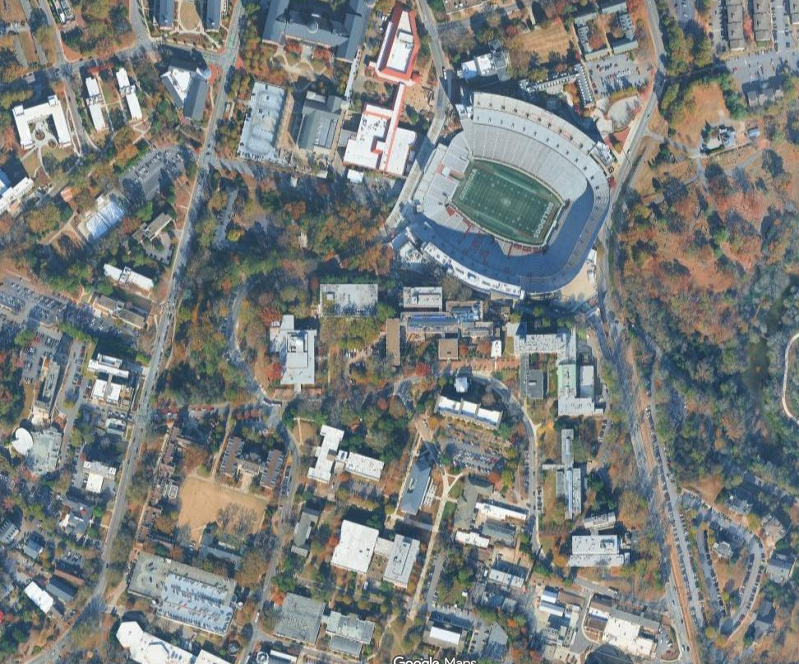
Vector data: points, lines, polygons
This is just a photo
made up of pixels,
but what objects do
you see?

Slide 5
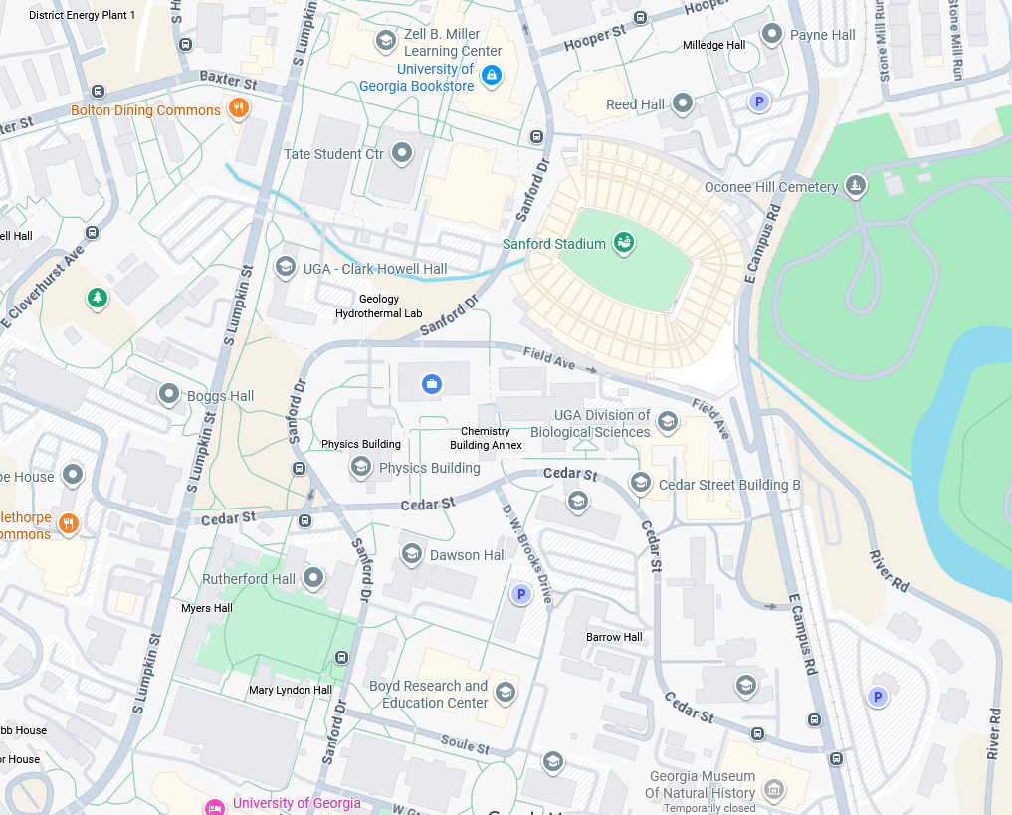
Vector data: points, lines, polygons
How is this view different?

Slide 6
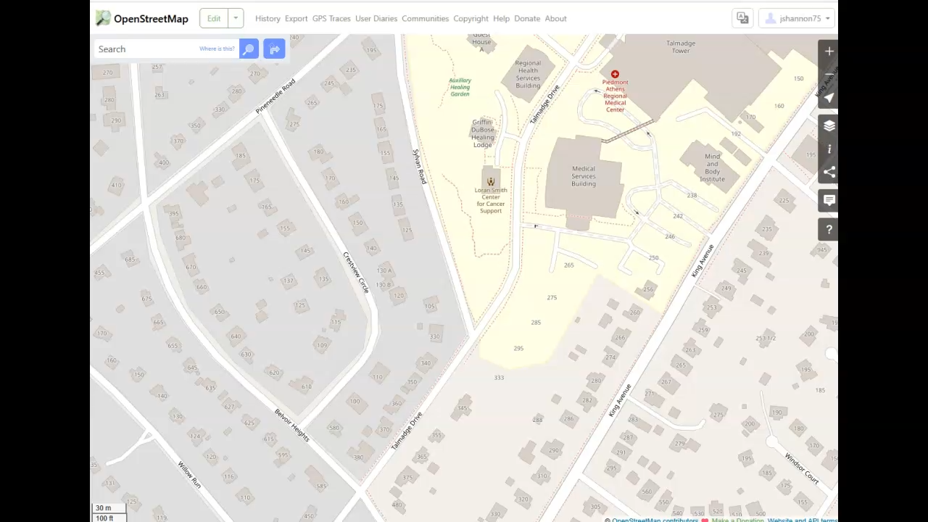
Under the hood: OpenStreetMap
Digitizing an image means creating points, lines, or polygons that represent real world features.

Slide 7
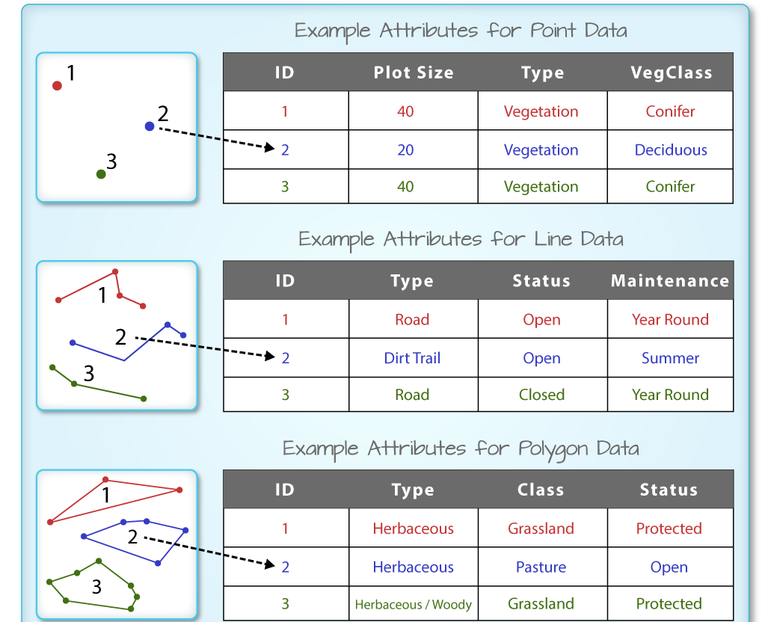
Vector data has attributes
A table that is connected to the spatial features
https://www.neonscience.org/resources/learning-hub/tutorials/dc-shapefile-attributes-r

Slide 8
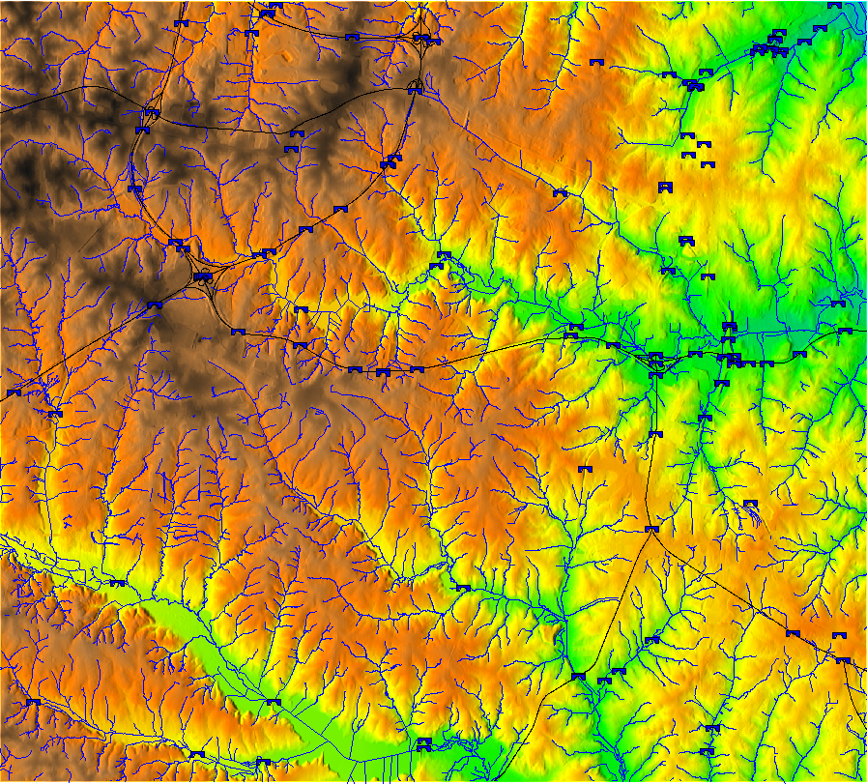
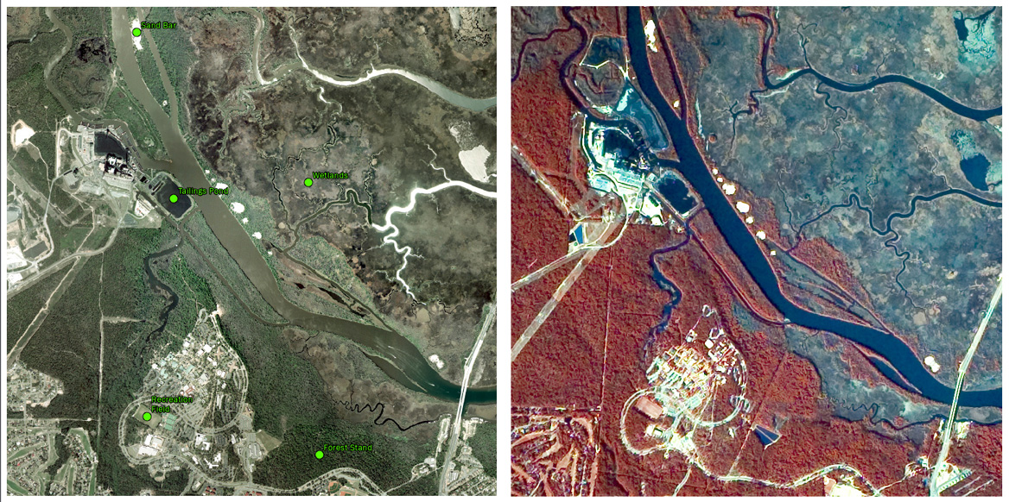
Raster data is fuzzy
No “objects”, just pixels with a value
Light wavelength/color
Elevation
Some other value (e.g., proximity to a point)

Slide 9
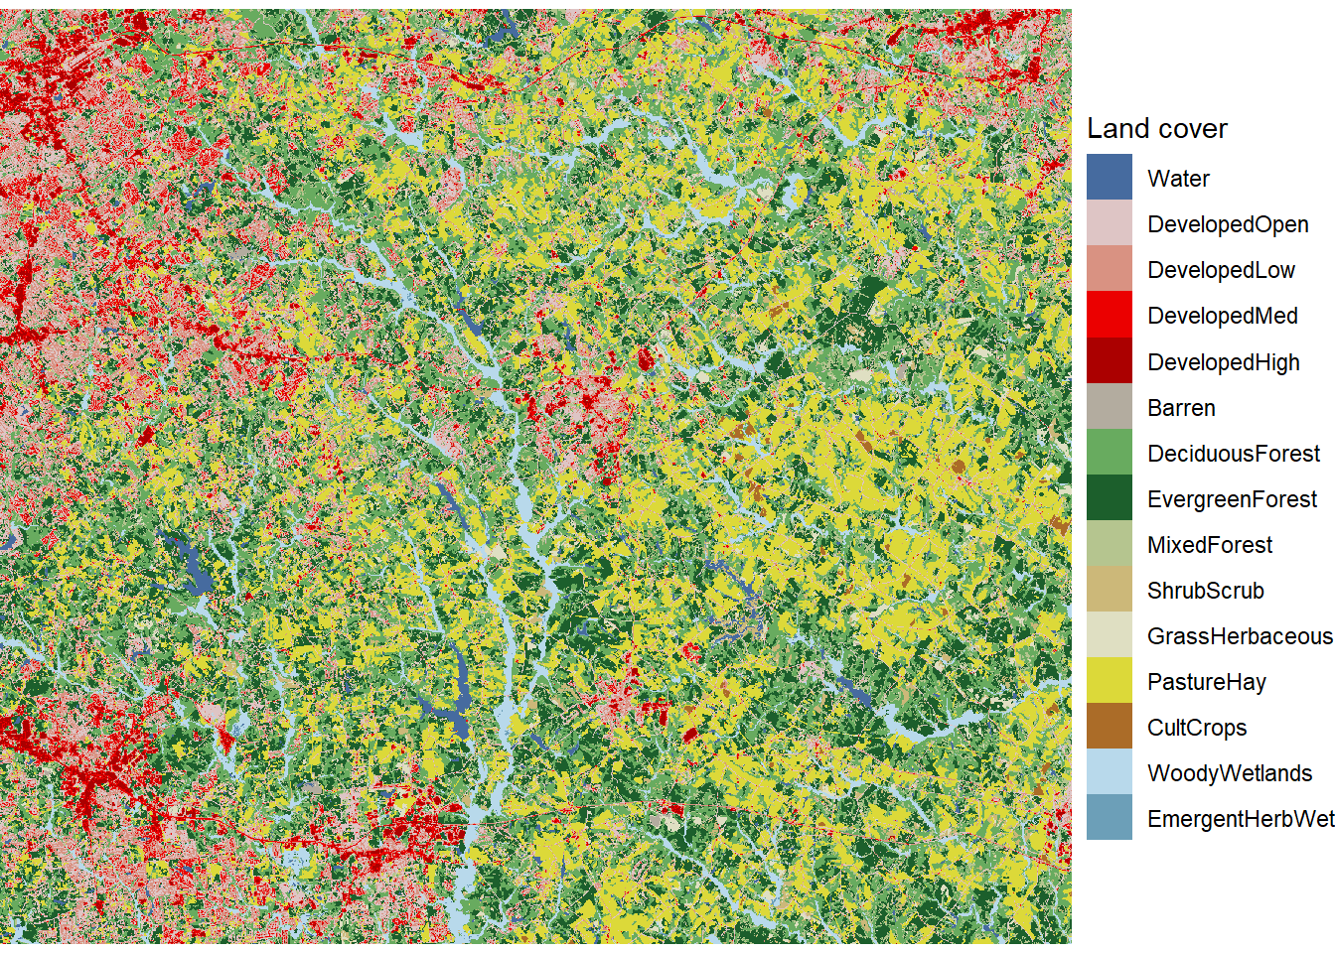
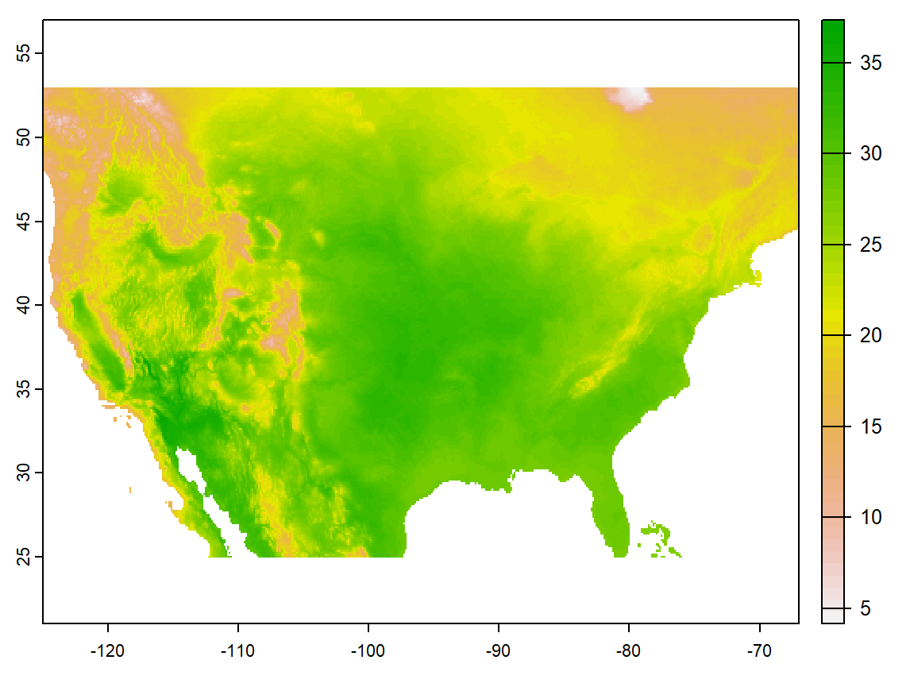
Raster data comes in many forms
Categorical-
Land use
Data can be nominal/categorical or continuous
Continuous-
Temperature

Slide 10
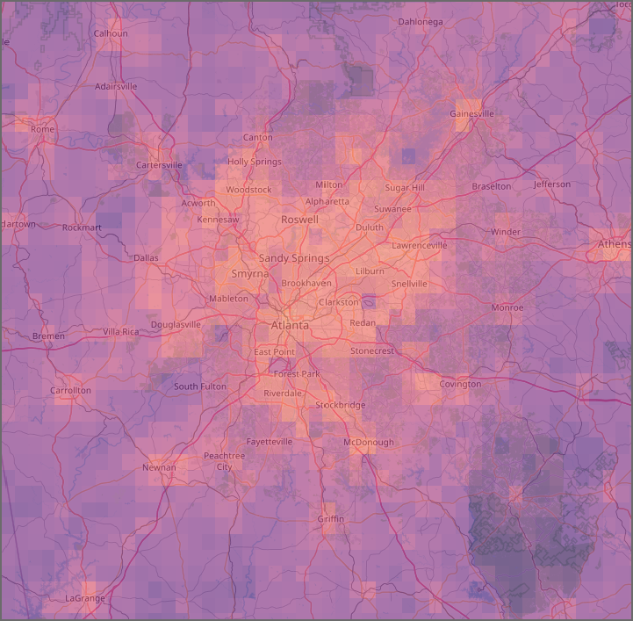
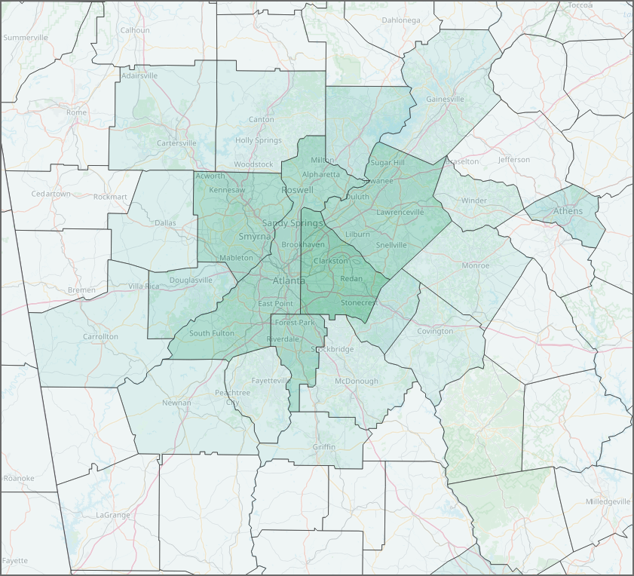
Comparing raster and vector
Two maps of population density
Notes:
Vector data:
Geometric shapes: Points, lines, and polygons.
Defined by vertices
Usually irregular in shape.

Slide 11
Spatial file types
Vector:
Shapefile, GeoJSON, KML, Geopackage, CSV, XLX, etc.
Raster:
GeoTIFF, GRID, NetCDF, etc.
Notes:
GeoTIFF: TIFF image with coordinates attached.

Slide 12
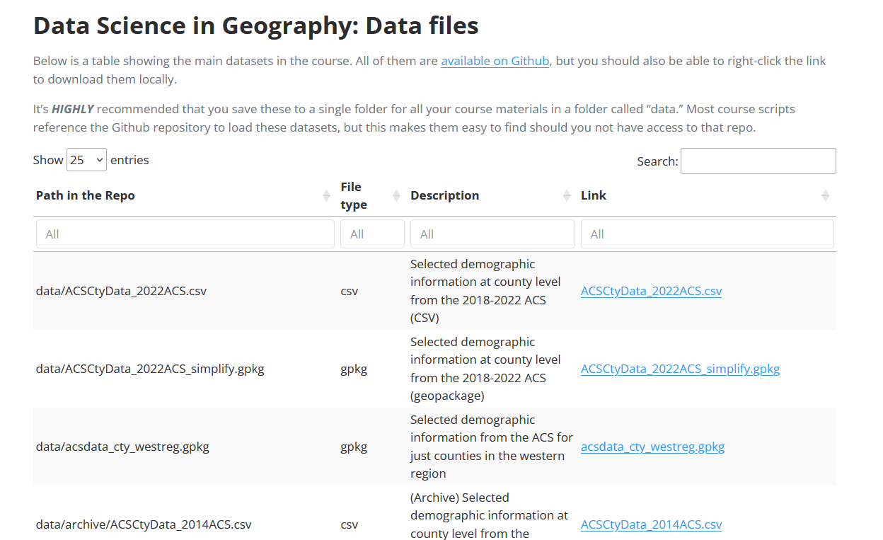
Check our class data
How many different vector and raster file types do you see?
Notes:
GeoTIFF: TIFF image with coordinates attached.

Slide 13
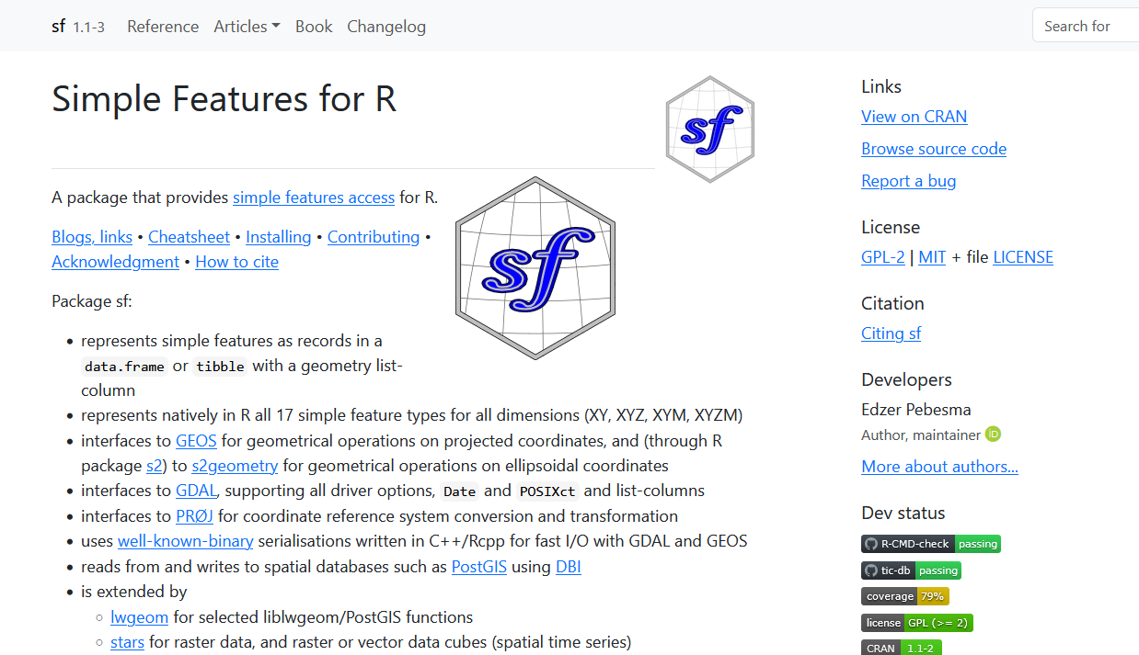
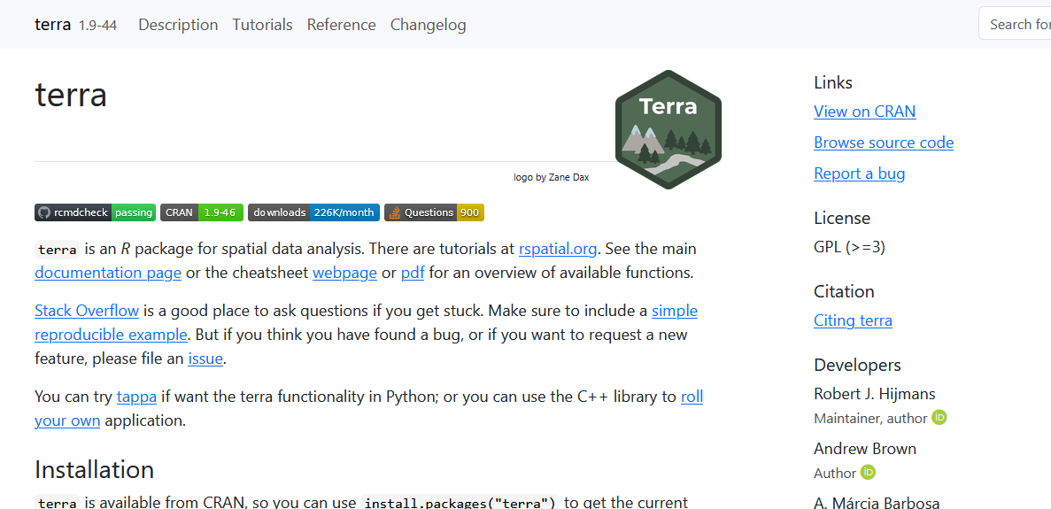
In R: sf and terra
https://rspatial.github.io/terra/
https://r-spatial.github.io/sf/
Notes:
GeoTIFF: TIFF image with coordinates attached.

