Slide 1


Technology Partner
Bank of Baroda Hackathon - 2022
Commutatus
We build awesome digital products
Aditya Tiwari, Gauri Kapse, Laasya Kanuru
Date : 20th September 2022

Slide 2
Problem statement
Customers interact with contact centers for a variety of services fulfilment, information about products and services, complaints, feedback, etc.
For enhancing contact center service levels, customer interactions need to be analyzed and mapped with customer satisfaction.
The bank wants to automate the analysis with AI based techniques to measure and monitor various KPIs such as customer sentiment, customer satisfaction, call center efficiency, etc.

Slide 3
Methodology
With the help of the ML building blocks offered by Azure Cognitive Services, we plan to create a workflow that can derive analysis from call recordings to our dashboard.
Although AI has the potential to become one of the most powerful paradigms in tech, we believe that when supplemented with direct statistical analysis, it can have the largest business impact.
Our dashboard will depict some KPIs that are derived through AI techniques like sentiment analysis, and some KPIs that can directly be calculated using call logs.
We plan to build a dashboard using Power BI.

Slide 4
KPIs
The KPIs we will consider are divided into efficiency metrics and customer satisfaction metrics. They include the following:
Average Wait Time: how long a customer has to hold until transferred to an agent
Average Handle Time: how long a customer stays on call (wait time + service time)
Average Age of a Query: how long it takes for a query to be resolved, on average
% calls requiring callbacks: percent of callers who will need to call again to resolve the issue
Service Level: percent of callers served, ie, percent calls answered
Hourly Traffic: a histogram depicting the fraction of calls per hour over a 24 hour period
% calls blocked: the percentage of calls dropped due to the queue length being maxed out
CSAT Score: this will be calculated based on a speech to text transcription followed by sentiment analysis
CES per product
Call Abandonment Rate: the fraction of calls abandoned by callers
Language Distribution: a chart depicting the distribution of callers who avail services in English, Hindi or any other regional language

Slide 5
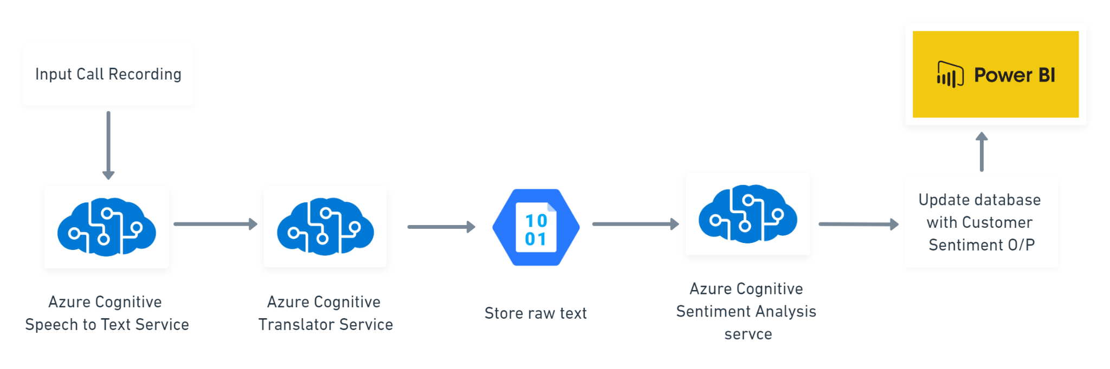
Technical Architecture (based on Azure Tools and Resources)

Slide 6
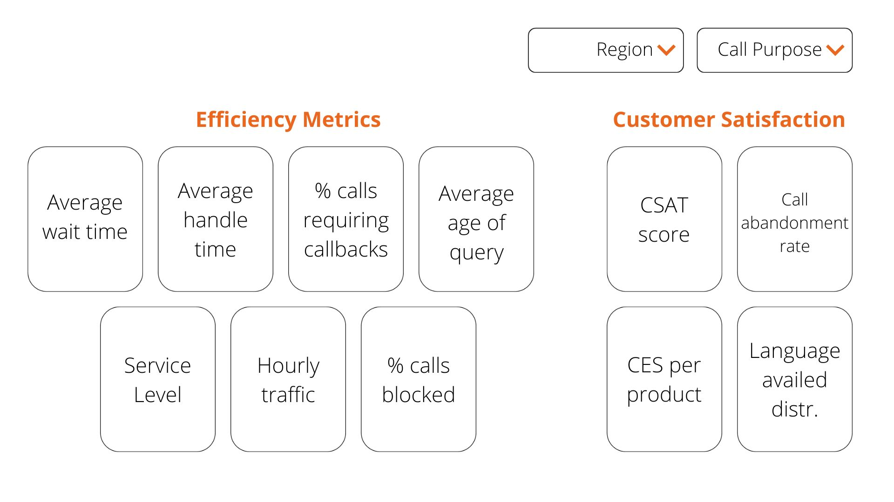
Wireframe of Final Dashboard

Slide 7
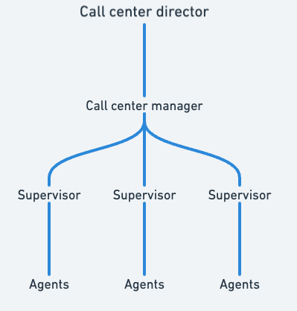
User Segment
Through this dashboard, we intend to cover the requirements of all the user segments described on this chart-

Slide 8
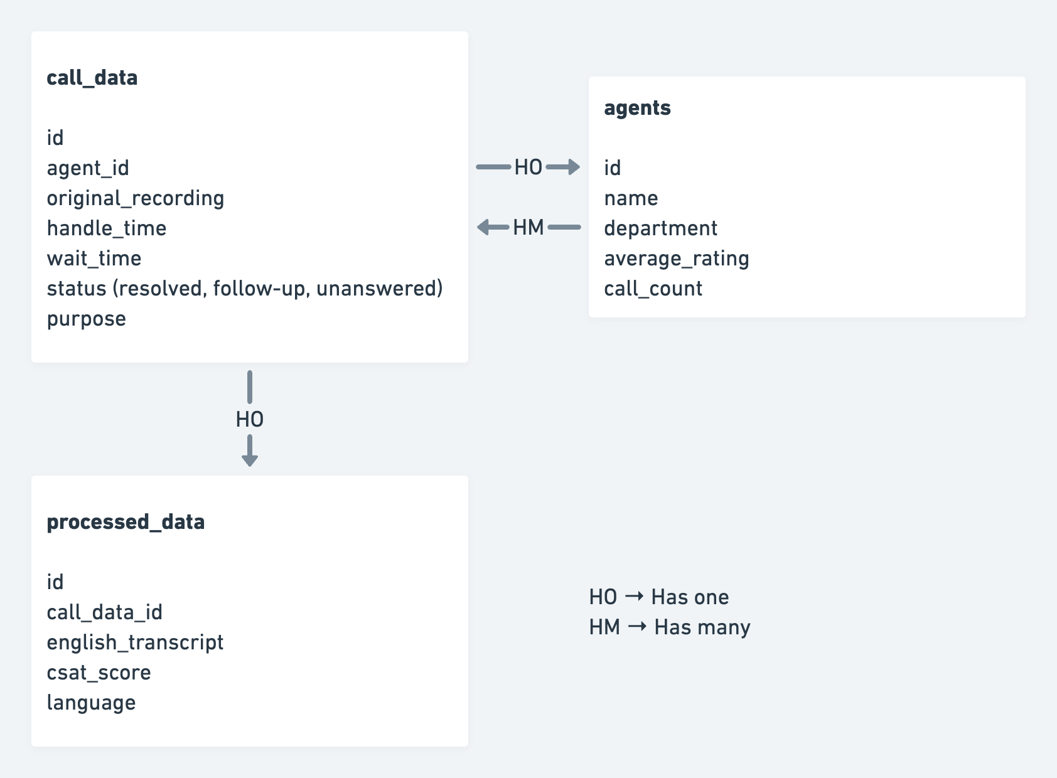
Database Structure

Slide 9
Limitations, Way Forward and Key Differences
Limitations:
No existing dataset to fine tune the model
Unaware of the accuracy of the zero shot models available on Azure for our requirement
Way Forward post product development
Fine tune the model on relevant datasets
Human intervention in sentiment analysis model output to retrain the model for higher accuracy
Restructure the KPIs based on the possibilities of analysis offered by the sentiment analysis model.
Key Differences
We plan to accommodate multiple languages by leveraging the Translation service offered by Azure Cognitive Services.

Slide 10
Thank You

