Slide 1
進度報告
140221
王海慧

Slide 2
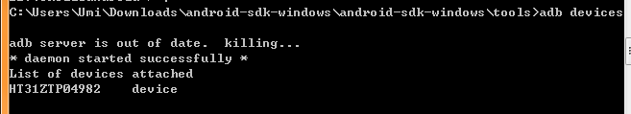
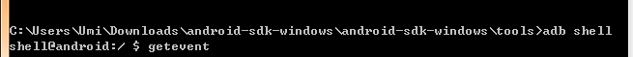

adb shell
找到device
輸入 adb shell 再輸入 getevent

Slide 3
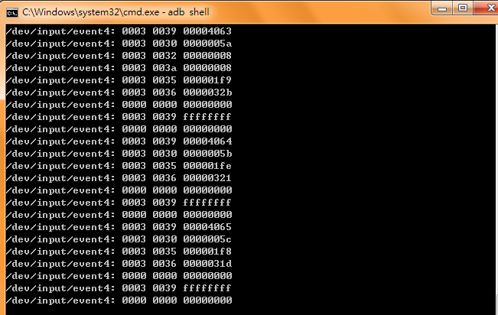
adb shell

Slide 4
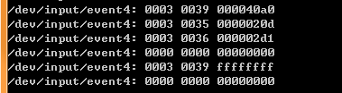
單點觸控 event4
type = #define EV_KEY 0x01
code = #define KEY_MENU 139
value = 1按下，0放開。
/linux/include/linux/input.h

Slide 5
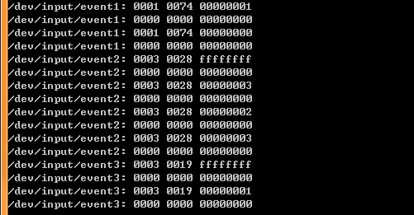
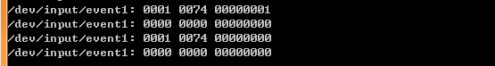
開螢幕 event1->event2->event3
鎖螢幕 event1

Slide 6
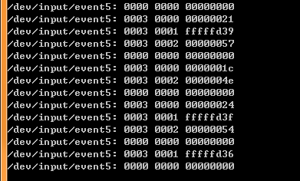
閒置 event5

Slide 7
Reference
Adb shell
http://zuoshu.iteye.com/blog/1775606 --detailed
http://gfans.bryan.tw/2010/11/30/1361 --setup
http://www.mobile01.com/topicdetail.php?f=423&t=1699087
http://forum.xda-developers.com/showthread.php?t=867416
http://style77125tech.pixnet.net/blog/post/17556680-%5Bandroid%5D-%E4%BD%BF%E7%94%A8adb%E6%8C%87%E4%BB%A4
http://my.eoe.cn/zouzhenglu/archive/5351.html
Linux
http://www.cs.fsu.edu/~baker/devices/lxr/http/source/linux/include/linux/input.h?v=2.6.11.8

Slide 8

E
N
D
Thanks for listening

