Slide 1
Android手機遠端即時操控系統 Android Mobile Phone Real-time Remote Control System
2014 03 21
黃騰嶢

Slide 2
Contents
實作新連線架構
狀態+畫面控制+音訊
電腦與手機剪貼簿功能實作
尋找手機音訊取得辦法
尋找手機音訊寫入方式

Slide 3
實作新連線架構(1/3)
//===============Socket_Status Start===============
private class Status implements Runnable{
DataInputStream DIS; DataOutputStream DOS;
public Status(Socket SC){ try {
DIS = new DataInputStream(new BufferedInputStream(SC.getInputStream()));
DOS = new DataOutputStream(new BufferedOutputStream(SC.getOutputStream()));
} catch (IOException e) {e.printStackTrace();}}
@Override
public void run() {
while(isConnected){try {
String status = DIS.readUTF();
if(status == "Initialize"){
}else if(status == "Information"){
}else if(status == ""){}
} catch (IOException e) {e.printStackTrace();}}}
public void sendStatus(String S){
if(isConnected){
try {
DOS_status.writeUTF(S);
} catch (IOException e) {
e.printStackTrace();
}
}
}
}
//===============Socket_Status Stop===============

Slide 4
實作新連線架構(2/3)
//===============Socket_PicCtrl Start===============
private class PicCtrl implements Runnable{
DataInputStream DIS;DataOutputStream DOS;
public PicCtrl(Socket SC){try {
DIS = new DataInputStream(new BufferedInputStream(SC.getInputStream()));
DOS = new DataOutputStream(new BufferedOutputStream(SC.getOutputStream()));
} catch (IOException e) {e.printStackTrace();}}
@Override
public void run() {
while(isConnected){try {
if(DIS.readUTF().equals("START")){
ByteArrayOutputStream BAOS = new ByteArrayOutputStream(2048);
byte[] buf = new byte[2048];
int num = DIS.read(buf);
while (num < 2048) { BAOS.write(buf,0,num); num = DIS.read(buf); }
BAOS.flush();
PT.PF.I = Toolkit.getDefaultToolkit().createImage(BAOS.toByteArray());
}
} catch (IOException e) {
e.printStackTrace();}}}
public void sendControl(String S){
if(isConnected){
try {
DOS.writeUTF(S);
} catch (IOException e) {
e.printStackTrace();
}
}
}
}
//===============Socket_PicCtrl Stop===============

Slide 5
實作新連線架構(3/3)
private class Audio_catch implements Runnable{
BufferedInputStream IS;
public Audio_catch(Socket SC){try {
IS = new BufferedInputStream(SC.getInputStream());
} catch (IOException e) {e.printStackTrace();}}
@Override
public void run() {
while(!isConnected){try {
byte tempBuffer[] = new byte[2048];
int len = IS.read(tempBuffer, 0, tempBuffer.length);
if(len > 0) playAudio(tempBuffer, 0, len);
} catch (IOException e) {e.printStackTrace();}}
}
int playAudio(byte[] b,int start,int stop){
return 0;
}
}
//===============Socket_Audio Stop===============
//===============Socket_Audio Start===============
private class Audio_send implements Runnable{
BufferedOutputStream OS;
public Audio_send(Socket SC){try {
OS = new BufferedOutputStream(SC.getOutputStream());
} catch (IOException e) {e.printStackTrace();}}
@Override
public void run() {
while(!isConnected){try {
byte tempBuffer[] = new byte[2048];
byte[] tempBuffer = readAudio(tempBuffer, 0, tempBuffer.length);
if(len > 0) OS.write(tempBuffer, 0, len);
} catch (IOException e) {e.printStackTrace();}}
}
byte[] readAudio(byte[] b,int start,int stop){
return null;
}
}

Slide 6
電腦端剪貼簿
public void setClipboardContents(String aString) {
StringSelection stringSelection = new StringSelection(aString);
Clipboard clipboard = Toolkit.getDefaultToolkit().getSystemClipboard();
clipboard.setContents(stringSelection, this);
}
public String getClipboardContents() {
String result = "";
Clipboard clipboard = Toolkit.getDefaultToolkit().getSystemClipboard();
Transferable contents = clipboard.getContents(null);
boolean hasTransferableText = (contents != null)
&& contents.isDataFlavorSupported(DataFlavor.stringFlavor);
if (hasTransferableText) {try {
result = (String) contents.getTransferData(DataFlavor.stringFlavor);
} catch (UnsupportedFlavorException | IOException ex) {
System.out.println(ex);
ex.printStackTrace();
}}
return result;
}

Slide 7
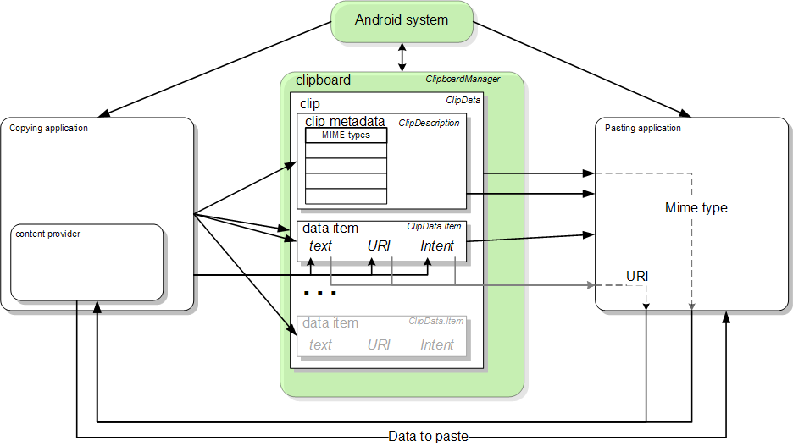
手機端剪貼簿
protected void onCreate(Bundle savedInstanceState) {
super.onCreate(savedInstanceState);
setContentView(R.layout.activity_main);
ET = (EditText)findViewById(R.id.editText1);
B = (Button)findViewById(R.id.button1);
TV = (TextView)findViewById(R.id.textView1);
final ClipboardManager CM = (ClipboardManager)getSystemService(Context.CLIPBOARD_SERVICE);
B.setOnClickListener(new OnClickListener() {
public void onClick(View v) {
ClipData C = ClipData.newPlainText("text",ET.getText());
CM.setPrimaryClip(C);
TV.setText(get(CM));
}});
}
private String get(ClipboardManager CM){
ClipData.Item CI = CM.getPrimaryClip().getItemAt(0);
return CI.getText().toString();
}

Slide 8
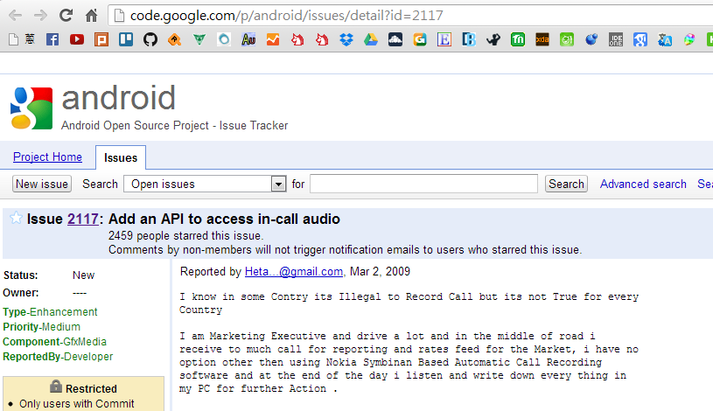
手機音訊取得辦法
In native code (AudioRecord.h), the values are ..
44 enum input_source {
45 DEFAULT_INPUT =-1,
46 MIC_INPUT = 0,
47 VOICE_UPLINK_INPUT = 1,
48 VOICE_DOWNLINK_INPUT = 2,
49 VOICE_CALL_INPUT = 3,
50 NUM_INPUT_SOURCES
51 };
Now, if you look at AudioFlinger, any input source, whose value of stream type is >= NUM_INPUT_SOURCES (i.e., 4),
we will get an "invalid stream type".
Because of the mismatch of the enums, the Java API sets the value of VOICE_CALL stream type as 4.
So, the check fails and we get the failure.
Fix: Set the values of the stream types to be the same in the Java and c++ code.
In Java MediaRecorder AudioSource, the values are ..
120 public final class AudioSource {
124 private AudioSource() {}
125 public static final int DEFAULT = 0;
127 public static final int MIC = 1;
128
130 public static final int VOICE_UPLINK = 2;
131
133 public static final int VOICE_DOWNLINK = 3;
134
136 public static final int VOICE_CALL = 4;
137 }

Slide 9
AudioTrack
public voidtestSetStereoVolumeMax() throwsException {
final String TEST_NAME= "testSetStereoVolumeMax";
final int TEST_SR =22050;
final int TEST_CONF =AudioFormat.CHANNEL_CONFIGURATION_STEREO;
final int TEST_FORMAT= AudioFormat.ENCODING_PCM_16BIT;
final int TEST_MODE =AudioTrack.MODE_STREAM;
final intTEST_STREAM_TYPE = AudioManager.STREAM_MUSIC;
// --------initialization --------------
/*Step1.*/
int minBuffSize = AudioTrack.getMinBufferSize(TEST_SR, TEST_CONF, TEST_FORMAT);
/*Step 2.*/
AudioTrack track = newAudioTrack(TEST_STREAM_TYPE, TEST_SR, TEST_CONF, TEST_FORMAT, 2 *minBuffSize,TEST_MODE);
byte data[] = newbyte[minBuffSize];
// -------- test--------------
track.write(data, OFFSET_DEFAULT, data.length);
track.write(data, OFFSET_DEFAULT, data.length);
track.play();
float maxVol =AudioTrack.getMaxVolume();
assertTrue(TEST_NAME, track.setStereoVolume(maxVol, maxVol) == AudioTrack.SUCCESS);
// -------- tear down--------------
track.release();
}
http://blog.csdn.net/xuesen_lin/article/details/8805168

Slide 10

E
N
D
Thanks for listening

