Slide 1
Android手機遠端即時操控系統 Android Mobile Phone Real-time Remote Control System
2014 04 11
黃騰嶢

Slide 2
Contents
Remote Display
VNC software
Key/Touch Event

Slide 3
Remote Display
WiFi-Miracast
ChromeCast

Slide 4
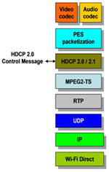
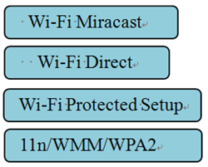
WiFi-Miracast
Miracast is a peer-to-peer wireless screencasting standard formed via Wi-Fi Direct connections in a manner similar to Bluetooth.
Android 4.2 or later
Can't Control
Features：
Cross-platform
Video + Audio

Slide 5
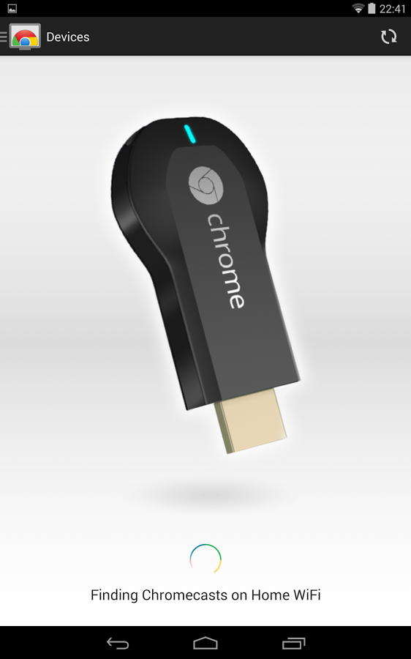
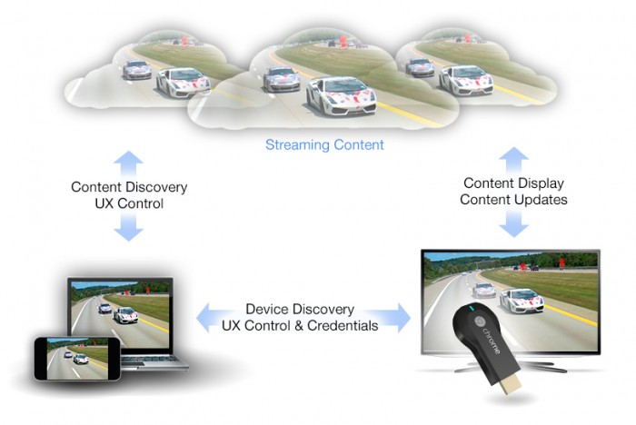
Chromecast
Wi-Fi
Needs a hardware device
Can't Control

Slide 6
VNC software
RFB protocol
Features of VNC

Slide 7
RFB protocol
Remote FrameBuffer
Display Protocol
put a rectangle of pixel data at a given x,y position
Input protocol
Input events are simply sent to the server by the client whenever the user presses a key or pointer button, or whenever the pointing device is moved.

Slide 8
Features of VNC
Virtual Network Computing
Thin Client
VNC Server ←--→ VNC Client(Viewer)
TCP/IP
Cross-platform Viewer
(Server not include)
Through network speed to change fps

Slide 9
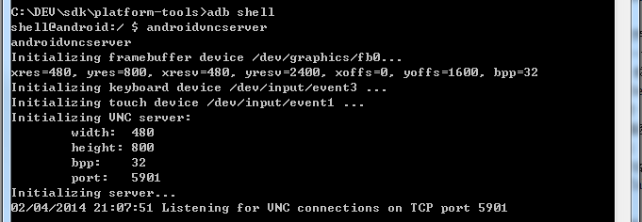
VNC DEMO
http://youtu.be/BwHkg1rOEWM

Slide 10
Key/touch event

Slide 11
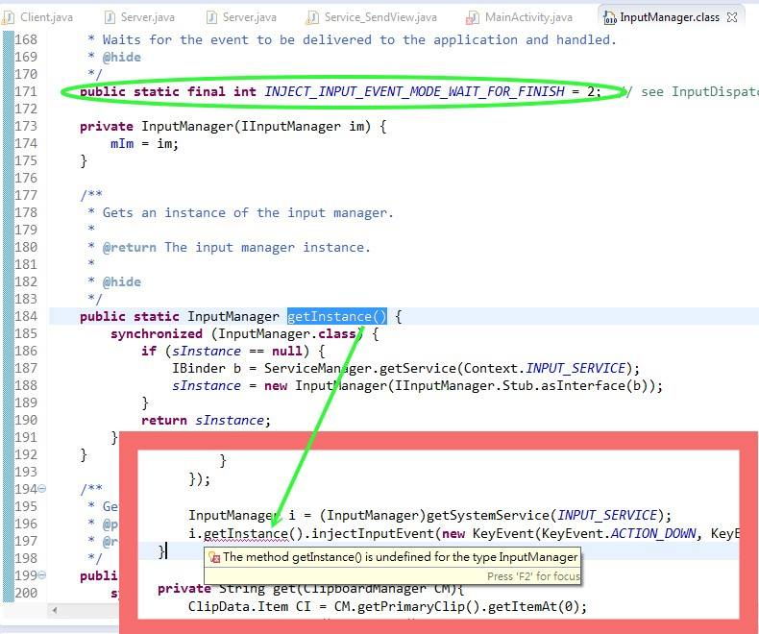
Key/Touch Event
Java @Hide
http://droidparadise.blogspot.tw/2011/11/java-reflectionhideapi.html

Slide 12
Key/Touch Event
Android Source
Base/cmds/input
input
InputManagerService
Compile & Run
System/bin/input
https://android.googlesource.com/platform/frameworks/base/+/master/cmds/input/src/com/android/commands/input/Input.java
https://android.googlesource.com/platform/frameworks/base/+/master/services/java/com/android/server/input/InputManagerService.java

Slide 13

E
N
D
Thanks for listening

