Slide 1
嶢海龍
進度報告
7/10
Linux Operating System
Introduction

Slide 2
Contents
Real mode & Protected mode
Endian order
Linux source code tree
Memory Map During Booting Procedure
Execution Mode & Address Space
Transitions between User and Kernel Mode

Slide 3
Real mode & Protected mode
Power up / reset
All system uses protected mode
System starts on real mode
Switching to protected mode

Slide 4
Endian order
Little Endian
Base Address+0 Byte0
Base Address+1 Byte1
Base Address+2 Byte2
Base Address+3 Byte3
Big Endian
Base Address+0 Byte3
Base Address+1 Byte2
Base Address+2 Byte1
Base Address+3 Byte0

Slide 5
Linux source code tree
/
sbin
usr
bin
home
root
…
local
bin
src
…
Linux-2.6.11
…
Documentation
arch
drivers
fs
include
init
ipc
kernel
lib
mm
net
scripts
Makefile Readme …

Slide 6
Directories
Makefile
Defines useful variables and rules
Documentation/
Information about configuring the kernel
arch/
Architecture specific code
drivers/
Code to run peripheral device

Slide 7
Directories
fs/
Code for visual file system
include/
Header files
init/
Contains the files main.c, version.c
ipc/
Inter process communication

Slide 8
Directories
kernel/
Generic kernel level code
lib/
Routine to all kernel code
mm/
Memory management
net/
Networking

Slide 9
Memory Map During Booting Procedure
uncompressed Kernel image
kernel/head.s – startup_32()(protected mode code)
compressed Kernel image
compressed/head.s – starup_32()(protected mode code)
0x00100000 (1 MB)
setup.S (real mode code)
change to protected mode
0x90000
bootsect.S (real mode code)
0x7c00
bootsect.S (real mode code)
BIOS Data

Slide 10
Execution Mode & Address Space
User Mode & user address space
Stored in the user address space for the process
A process could access these entities in user mode/kernel mode
Kernel Mode & kernel address space
Stored in kernel address space
Could only be accessed when a process is in kernel mode

Slide 11
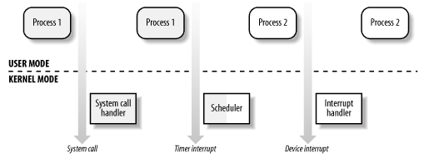
Transitions between User and Kernel Mode

Slide 12
Schedule for next week
Introduction and Memory Addressing Segmentation Unit

