Slide 1
專題進度報告
講者：彭俊龍
組員：黃騰嶢、王海慧

Slide 2
Contents
This week
Memory Addressing
Memory Address
Segmentation Unit
Next week
Memory Addressing
The Paging Unit

Slide 3
Memory Address
Local Addresses
segment base address + offset
Linear Addresses
unsigned 32-bit integer
Physical Addresses

Slide 4
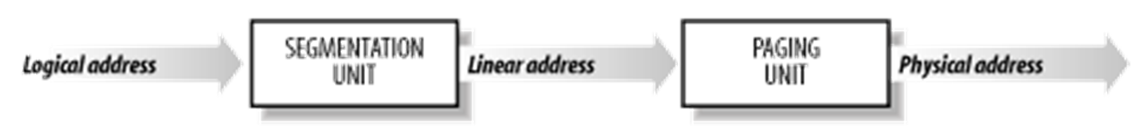
Address Transformation
Segmentation Unit
Paging Unit

Slide 5
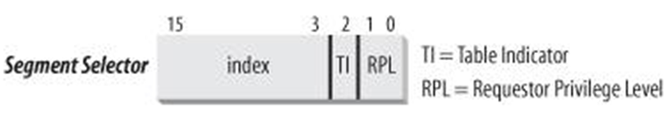
Segmentation Unit
Segment Selectors
Segment Registers
cs, ss, ds, es, fs, gs
Segment Descriptors
Global Descriptor Table (GDT )
Local Descriptor Table (LDT ).

Slide 6
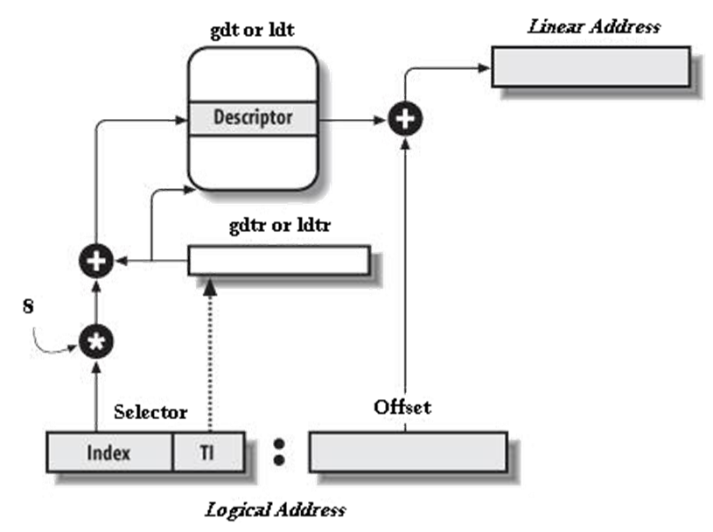

Slide 7


