Slide 1

1307-3進度報告
嶢海龍

Slide 2
預期進度
學習Android-元件使用(TextView,EditText,Button,ImageButton,ToggleButton,RadioButton,RadioGroup,CheckBox)
完成並測試SIP基礎程式
閱讀Linux作業系統(第四章)

Slide 3
SIP(Session Initiation Protocol)
會話發起協議
SIP的設計目標之一是提供類似公用交換電話網中呼叫處理功能的擴展集。在這個擴展集中，實現類似日常電話的操作：撥號，振鈴，回鈴音或者忙音，只是實現方式和術語有所不同。

Slide 4
SIP網路單元
用戶代理(User Agent)
SIP用戶代理是一個SIP邏輯網路端點，用於創建、發送、接收SIP消息並管理一個SIP會話。
代理伺服器(Proxy)
SIP代理伺服器(PROXY)在網路上位於SIP UAC和UAS之間，用於幫助UAC和UAS間的消息路由。
註冊伺服器(Register)
SIP註冊伺服器用於接收SIP註冊請求，並保存發送註冊請求的UA的位置信息。

Slide 5
SIP(Session Initiation Protocol)
Class/Interface | Description
SipAudioCall | Handles an Internet audio call over SIP.
SipAudioCall.Listener | Listener for events relating to a SIP call, such as when a call is being received ("on ringing") or a call is outgoing ("on calling").
SipErrorCode | Defines error codes returned during SIP actions.
SipManager | Provides APIs for SIP tasks, such as initiating SIP connections, and provides access to related SIP services.
SipProfile | Defines a SIP profile, including a SIP account, domain and server information.
SipProfile.Builder | Helper class for creating a SipProfile.
SipSession | Represents a SIP session that is associated with a SIP dialog or a standalone transaction not within a dialog.
SipSession.Listener | Listener for events relating to a SIP session, such as when a session is being registered ("on registering") or a call is outgoing ("on calling").
SipSession.State | Defines SIP session states, such as "registering", "outgoing call", and "in call".
SipRegistrationListener | An interface that is a listener for SIP registration events.

Slide 6
SIP(Session Initiation Protocol)
Requirements and Limitations
You must have a mobile device that is running Android 2.3(Ginger Bread-API level 9) or higher.
SIP runs over a wireless data connection, so your device must have a data connection (with a mobile data service or Wi-Fi). This means that you can't test on AVD—you can only test on a physical device.

Slide 7
SIP(Session Initiation Protocol)
截止至2013年6月3日，不同的Android作業系統版本的用戶比例。
版本名稱 | API level | 用戶分佈
4.2.x Jelly Bean 果凍豆 | 17 | 4.0%
4.1.x Jelly Bean 果凍豆 | 16 | 29.0%
4.0.x Ice Cream Sandwich 冰淇淋三明治 | 14-15 | 25.6%
3.x.x Honey Comb 蜂巢 | 11-13 | 0.1%
2.3.x Ginger Bread 薑餅 | 9-10 | 36.5%
2.2 Froyo 霜凍優格 | 8 | 3.2%
2.1 Eclair 閃電泡芙 | 7 | 1.5%
1.6 Donut 甜甜圈 | 4 | 0.1%

Slide 8
SIP(Session Initiation Protocol)
Creating the Manifest V
Creating a SipManager V
Registering with a SIP Server V
Making an Audio Call
Receiving Calls

Slide 9
SIP(Session Initiation Protocol)
Permissions
android.permission.USE_SIP
android.permission.INTERNET
android.permission.ACCESS_WIFI_STATE
android.permission.ACCESS_NETWORK_STATE

Slide 10
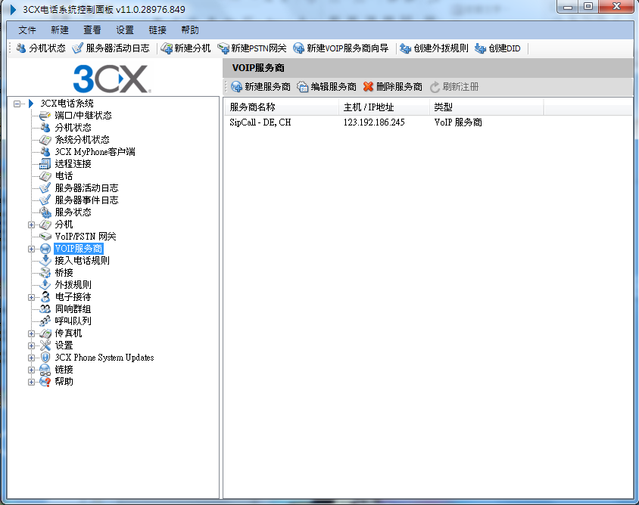

SIP Server

Slide 11
Get IP address in Android
public static String getIPAddress(Context context) {
WifiManager wm = (WifiManager) context.getSystemService( Context.WIFI_SERVICE);
WifiInfo wifiInf = wm.getConnectionInfo();
long ip = wifiInf.getIpAddress();
if( ip != 0 )
return String.format("%d.%d.%d.%d",(ip & 0xff),(ip >> 8 & 0xff),(ip >> 16 & 0xff),(ip >> 24 & 0xff));
try {
for (Enumeration<NetworkInterface> en = NetworkInterface.getNetworkInterfaces();
en.hasMoreElements();){
NetworkInterface intf = en.nextElement();
for (Enumeration<InetAddress> enumIpAddr = intf.getInetAddresses();
enumIpAddr.hasMoreElements();){
InetAddress inetAddress = enumIpAddr.nextElement();
if (!inetAddress.isLoopbackAddress())
return inetAddress.getHostAddress().toString();
}
}
} catch (Exception e) {
}
return "0.0.0.0";
}

Slide 12
SIP in Android
try {
SipManager SM = null;
if(SM==null){
SM = SipManager.newInstance(this);
}
SipProfile SP = null;
SipProfile.Builder builder;
builder = new SipProfile.Builder("yaohailong","192.192.122.203:5060");
builder.setPassword("123456");
SP = builder.build();
TV1.setText("Connect Success!!!");
} catch (Exception e) {
TV1.setText("Connect Fail!!!");
e.printStackTrace();
}

Slide 13


