Slide 1

1308-1進度報告
嶢海龍

Slide 2
預期進度
學習Android-選單功能表使用(OptionMenu,SubMenu,ContextMenu)
閱讀Linux作業系統(第四章)
閱讀Linux作業系統(第五章)
閱讀Linux作業系統(第七+八章)
繼續完成SIP程式

Slide 3
Memory Addressing
Paging Unit
Translates linear addresses into physical ones.
Pages
Contiguous linear addresses.
Page Frame
Equals to the size of a page.

Slide 4
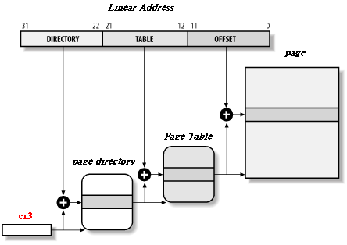
Paging by 80x86 Processors

Slide 5

Structures of Page Directories And Page Tables
Both Page Directory entries and Page Tables have the same structure.
Present flag
Field containing the 20 most significant bits of a page frame physical address.
Access flag
Dirty flag
Read/write flag
User/Supervisor flag
PCD and PWT flags
Page size flag
Global flag

Slide 6
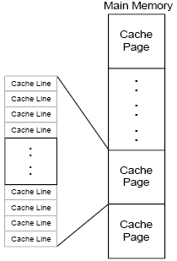
Relationship between Cache Pages and Cache Lines

Slide 7
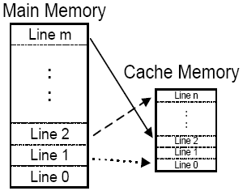
Fully Associative
a memory line can be stored at any cache line.

Slide 8
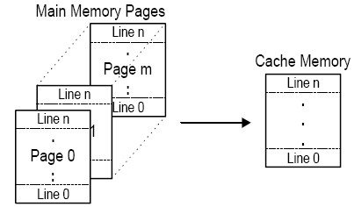
Direct Mapped
a memory line is always stored at the same cache line.

Slide 9
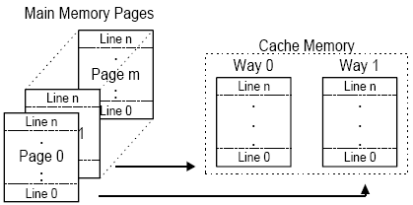
Degree N-way Set Associative
Cache lines are divided into N sets, a memory line can be in any set of the N sets. But inside a set, the memory line is stored into the same cache line.

Slide 10


