Slide 1
專題進度報告
講者：彭俊龍
組員：黃騰嶢、王海慧

Slide 2
Contents
This week
Process
Doubly Linked Lists
Relationships among Processes
Next week
Wait Queue and Process Switch

Slide 3
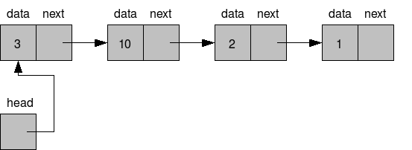
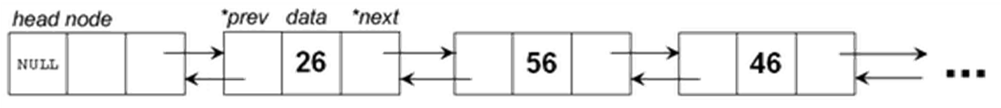
Doubly Linked Lists
Linked Lists
Doubly Linked Lists
Lisk_head

Slide 4
Lisk_head
data structure 1
data structure 2
data structure 3
list_head
list_head
list_head
list_head
next
next
next
next
prev
prev
prev
prev
4

Slide 5
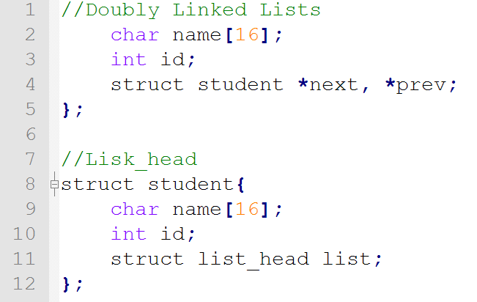
Doubly Linked Lists VS Lisk_head

Slide 6
Doubly Linked Lists
The Process List
Init_task
process 0 or swapper
TASK_RUNNING Processes
runqueue

Slide 7
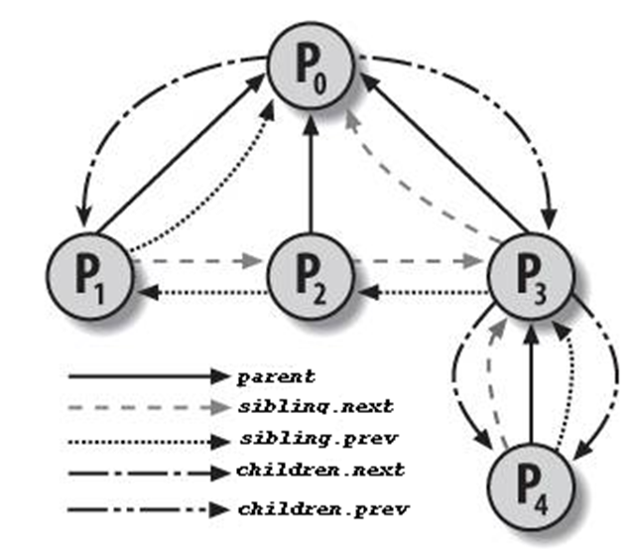
Relationships among Processes

Slide 8


