Slide 1

1308-4進度報告
嶢海龍

Slide 2
預期進度
學習Android-6.
使用已知方法取得IP,並做出apk程式
閱讀Linux作業系統(第10章)
閱讀Linux作業系統(第10-1 + 11章)

Slide 3
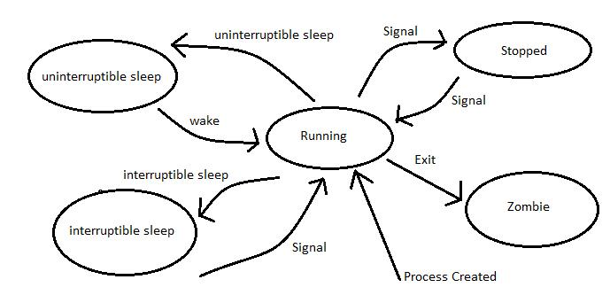
Process Life

Slide 4
等待佇列(Wait Queue)
中斷事件處理,行程同步,計時(Timing)
雙向鏈結串列(Double Linked Lists)
<<wait_queue_head_t>>
struct __wait_queue_head {
spinlock_t lock;
struct list_head task_list;
};
typedef struct __wait_queue_head wait_queue_head_t;

Slide 5
等待佇列(Wait Queue)
<<wait_queue_t>>
struct __wait_queue {
unsigned int flags;
struct task_struct * task;
wait_queue_func_t func;
struct list_head task_list;
};
typedef struct __wait_queue wait_queue_t;

Slide 6
disk_wait_queue
lock
task_list next
prev
process
descriptor
process
descriptor
flags
task
func
task_list next
prev
flags
task
func
task_list next
prev
disk_wait_queue
lock
task_list next
prev

Slide 7
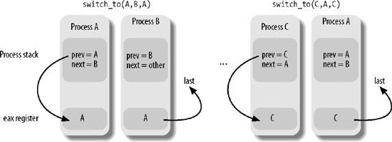
行程切換(Process Switch)
schedule()
context_switch()
switch_to(prev,next,last)

Slide 8
Get IPAddress
新的權限
android.permission.WAKE_LOCK
android.permission.ACCESS_COARSE_LOCATION
android.permission.INTERNET
android.permission.ACCESS_WIFI_STATE
android.permission.CHANGE_WIFI_STATE
android.permission.ACCESS_NETWORK_STATE
舊的權限
android.permission.USE_SIP
android.permission.INTERNET
android.permission.ACCESS_WIFI_STATE
android.permission.CHANGE_WIFI_STATE
android.permission.ACCESS_NETWORK_STATE

Slide 9

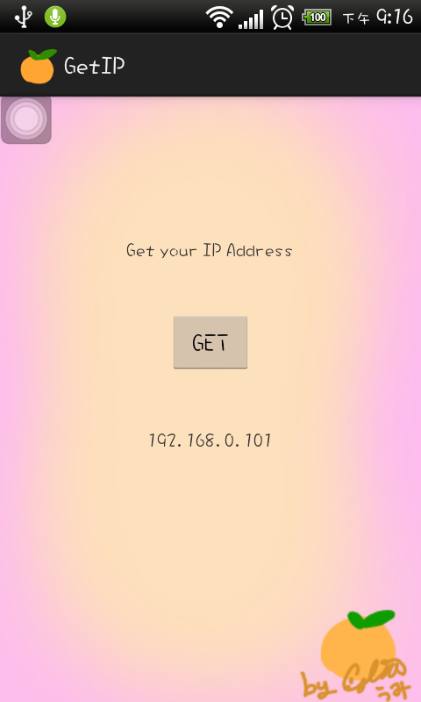
Get IPAddress

Slide 10

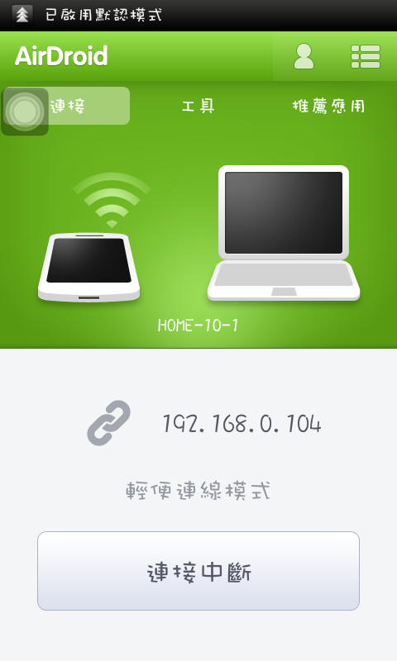

Slide 11


Slide 12
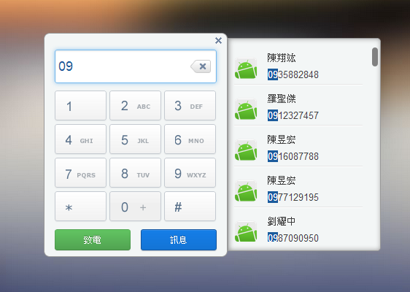


Slide 13
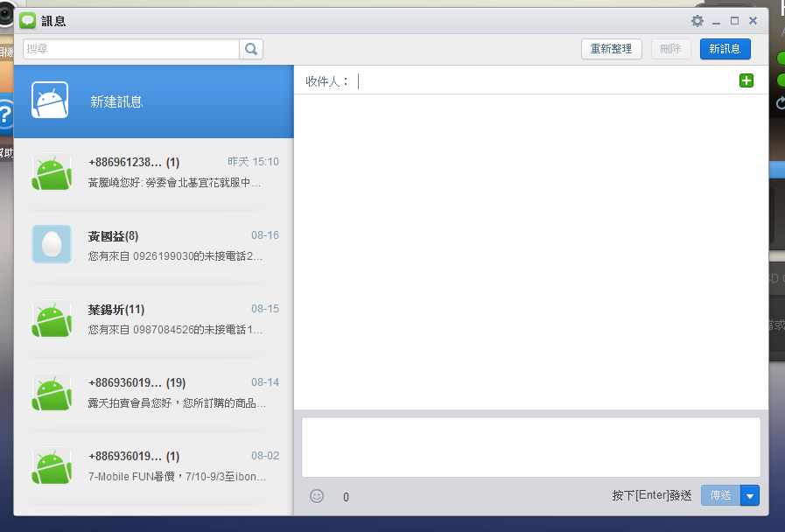

Slide 14
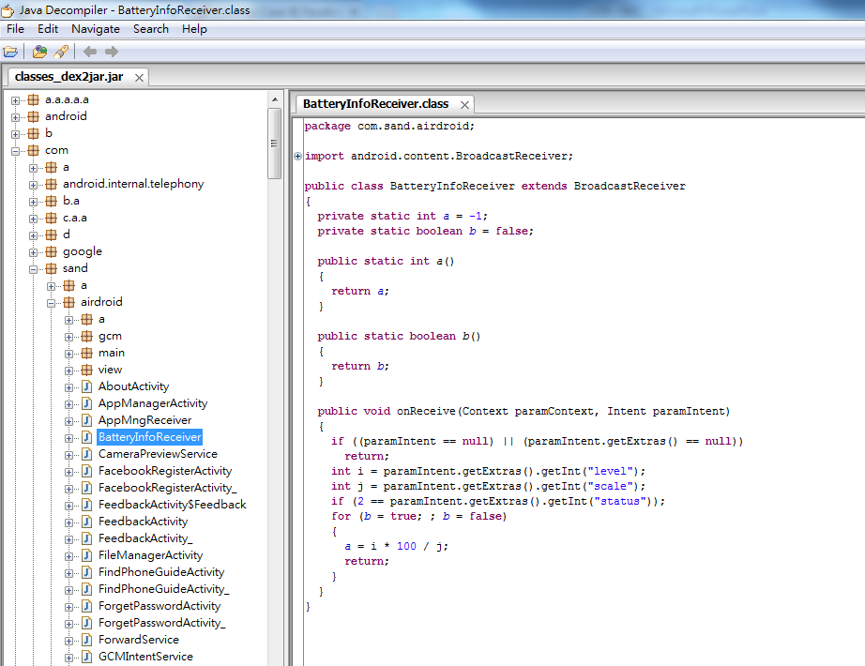

Slide 15
下周預期
閱讀Linux作業系統(12-do_fork())
閱讀Linux作業系統(13&14-System Call)

Slide 16


