Slide 1

1309-1進度報告
嶢海龍

Slide 2
預期進度
閱讀Linux作業系統(第十二章)
閱讀Linux作業系統(第十三+十四章)

Slide 3
Process
Copy on write
Per process
vfork()

Slide 4
Kernel thread
Process 0
The ancestor of all processes, the swapper process
Process 1
initializes all the data structures needed by the kernel

Slide 5
POSIX APIs & System Call
API
function definition that specifies how to obtain a given service
System Call
an explicit request to the kernel made via a software interrupt

Slide 6
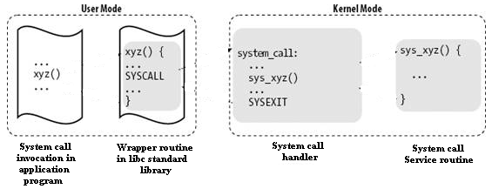
Control Flow Diagram of a System Call

Slide 7
下周進度
閱讀Linux作業系統(第十五+十六章)
閱讀Linux作業系統(第十七章)

Slide 8


