Slide 1


Reaction Mechanism Generator
Team CoMoChEng
Chris Blais, Chao Xu, Sevy Harris, Su Sun, Nora Khalil

Slide 2
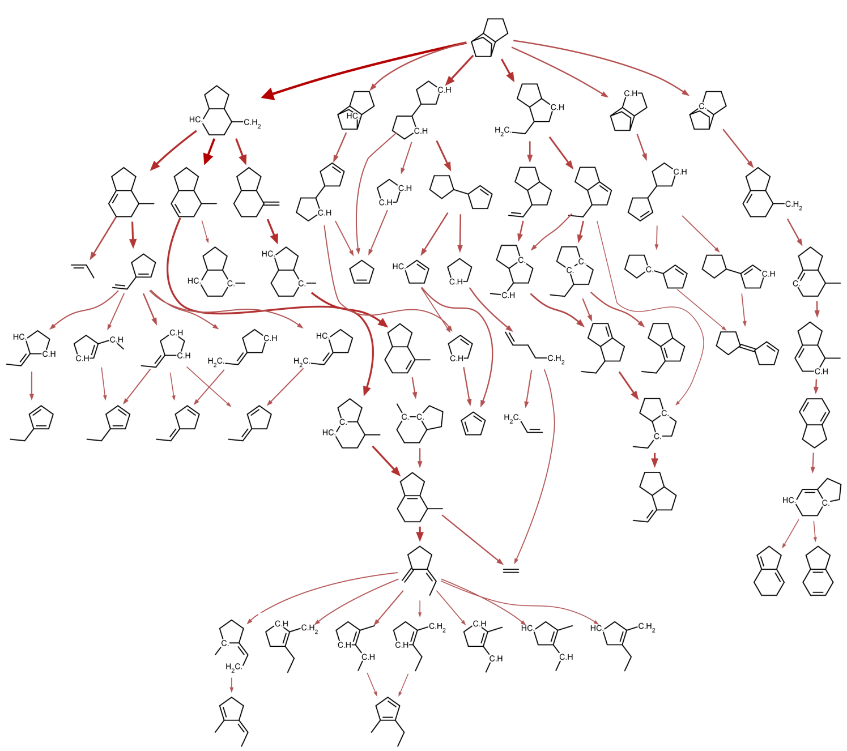
Reaction Mechanism Generator
A predictive tool for reacting chemical systems
constructs comprehensive models consisting of elementary reactions
estimates unknown kinetics and thermochemistry data
Large open source package under active development, includes many tools for building/solving/analyzing kinetic models for broad range of systems
Databases & methods for estimating all the parameters in the models
C.W. Gao, J.W. Allen, W.H. Green, R.H. West, Comput. Phys. Commun. 203 (2016) 212–225
slides courtesy of https://rmg.mit.edu/resources

Slide 3
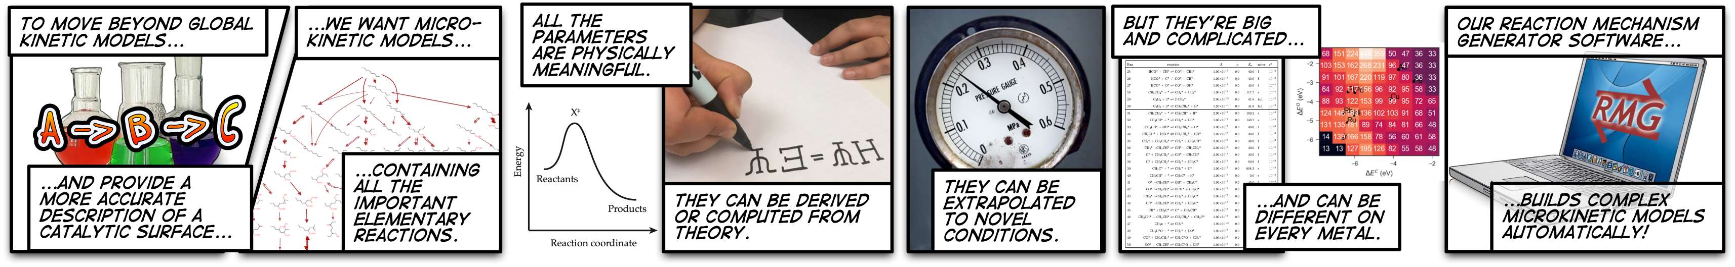
Why Microkinetic Modelling?
Notes:
Microkinetic models are important because they constitute a “universal truth” about a system, by nature of all steps being elementary
sufficiently large mechanisms are often not practical to generate the “old fashioned way”, so we have constructed a computer program to do it for us.

Slide 4
Purpose of RMG
RMG aims to predict the reactive chemistry of a given system by automatically determining the relevant species and reactions under the specified conditions.
+ Reduce the human effort needed to construct a useful kinetic model, so make it more practical to build good models.
+ Current version of RMG is particularly useful for pyrolysis & combustion, but it can be applied to other systems (e.g. gas-surface catalysis, liquid phase).
slides courtesy of https://rmg.mit.edu/resources

Slide 5
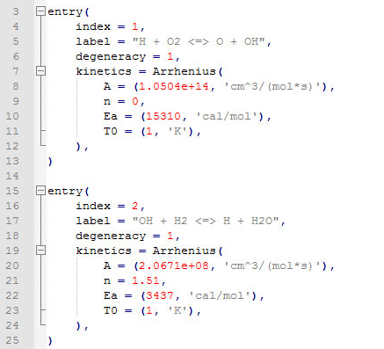


How RMG Works
Inlet conditions and composition (T, P, X)
Kinetic and thermodynamic libraries
Kinetic model
Tolerances
Termination criteria
(time, conversion)
RMS
slides courtesy of https://rmg.mit.edu/resources

Slide 6



Reaction Mechanism Generator incrementally grows mechanisms
Example: ethanol oxidation
1000 ppm fuel, stoichiometric O₂, in Ar
at 1500 K, 1 bar
Core
Edge
slides courtesy of https://rmg.mit.edu/resources

Slide 7

















Reaction Mechanism Generator incrementally grows mechanism
Example: ethanol oxidation
1000 ppm fuel, stoichiometric O₂, in Ar
at 1500 K, 1 bar
+
unknown kinetics / thermodynamics
data are estimated
slides courtesy of https://rmg.mit.edu/resources

Slide 8






Reaction Mechanism Generator incrementally grows mechanism
Example: ethanol oxidation
1000 ppm fuel, stoichiometric O₂, in Ar
at 1500 K, 1 bar
+
slides courtesy of https://rmg.mit.edu/resources

Slide 9





















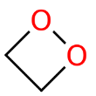




























Example: ethanol oxidation
1000 ppm fuel, stoichiometric O₂, in Ar
at 1500 K, 1 bar
slides courtesy of https://rmg.mit.edu/resources

Slide 10
At termination: core contains our mechanism; edge species classified as negligible
Example: ethanol oxidation
1000 ppm fuel, stoichiometric O₂, in Ar
at 1500 K, 1 bar
Core:
42 species, 592 reactions
Core + Edge: 775 species, 1604 reactions
(tolerance = 1%; termination rate ratio = 0.1%; execution time = 30 min)
slides courtesy of https://rmg.mit.edu/resources

Slide 11
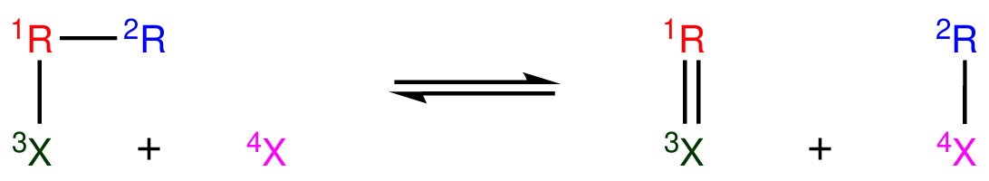
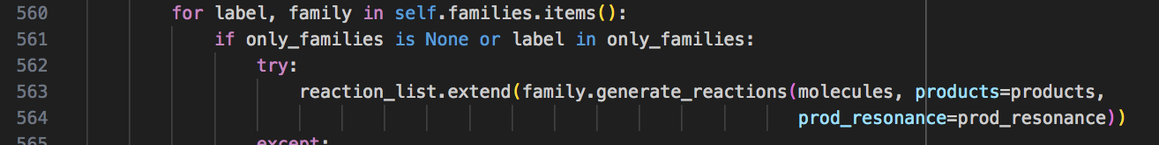
Targets for speedup: Reaction generation (40% of total execution time)
During model enlargement, need to generate new reactions from reaction family templates:
Currently, this is done iteratively over all of the possible species combinations in the mechanism:
and each combination is checked against all of the family templates:

Slide 12
Target for speedup: Reactor Simulation (40% of total execution time)
A simulated batch chemical reactor, written in either Cython code or Julia.
Cython routines slated to be deprecated, so speedup of Julia routines would be preferred.
Step forward
Δt
check species fluxes
Species exceeds flux criteria?
yes
Terminate sim and expand model
initialize reactor
no

Slide 13
Where is Team CoMoChEng at?
what has been done so far
setup development environment in $CFS/ntrain4/comocheng
profiled application using cprofile
made non-gpu speedup improvements (yaml output file generation was using a lot of overhead)
where we could use help
nvidia profiler can give more detailed info, but it is returning an error with the Julia packages
choosing packages for Julia (OpenCL.jl?) and python/cython code speedup

Slide 14
homework
list of subprojects that are semi-independent
2 “prongs” of where we want to work:
simulate routine (call to Julia)
model expansion
do the homework specified in the channel
making a script that runs through one step expanding a mechanism. this is useful for benchmarking. something that can be run quickly.
make script that isolates “simulate” routine as well. could just be done in Julia
maybe ask someone to attend the demo.
nsights gpu issue
talk with team about schedule
take a closer look at the 2 improvement areas to see if it is a Julia based or python based speedup

Slide 15
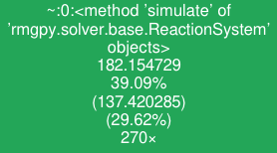
total time in func and all it’s children in seconds
% of total execution time for func and all it’s children
Time spent in function alone in seconds
% of running time spent in this function alone
total number of calls

