Slide 1

Data Mining and Machine Learning Project
Mushroom Classification
Matteo Comini, Giacomo Moro
University of Pisa
Academic Year: 2023-2024

Slide 2
Introduction
Objective: Develop a robust classifier to identify different species of mushrooms from images.
Importance: Differentiating between edible and poisonous mushrooms to ensure safety and aid research.

Slide 3
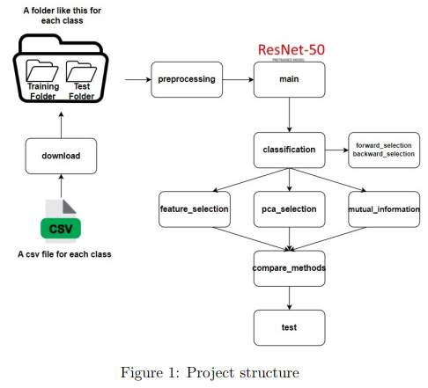
Project Structure

Slide 4
Dataset
Source: iNaturalist platform
Content: 87,000+ RGB images of seven mushroom species.
Variations: Different angles, lighting conditions, and backgrounds.

Slide 5
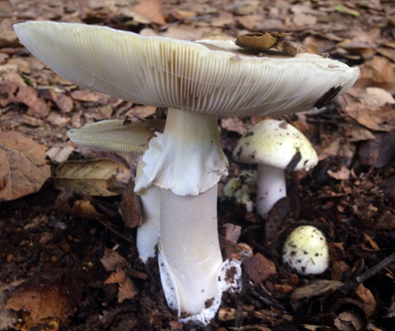
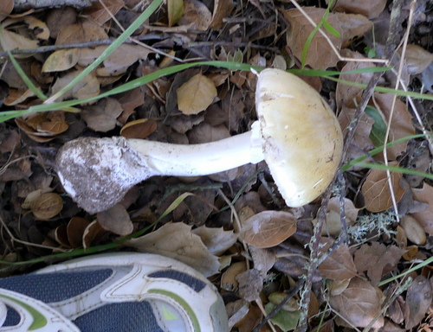
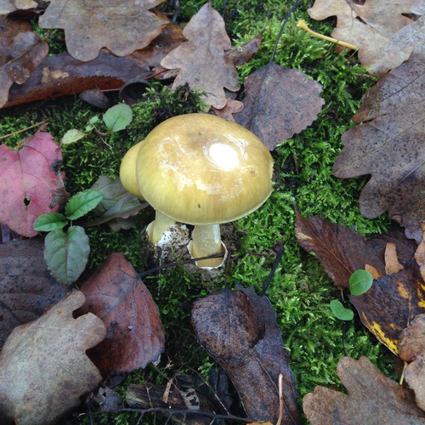
Dataset Visuals
Original Dataset Snippet and Images of Amanita Phalloides

Slide 6
Preprocessing
Steps:
Removed corrupted images.
Cropped central part of the image.
Resized to 224x224 pixels for ResNet50.

Slide 7
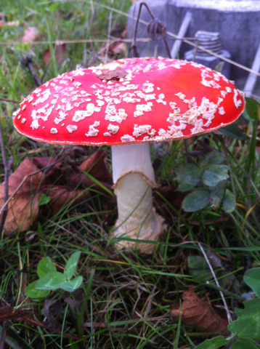
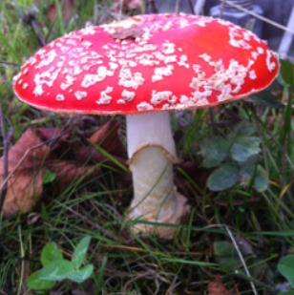
Preprocessing Visuals
Amanita Muscaria original vs preprocessed

Slide 8
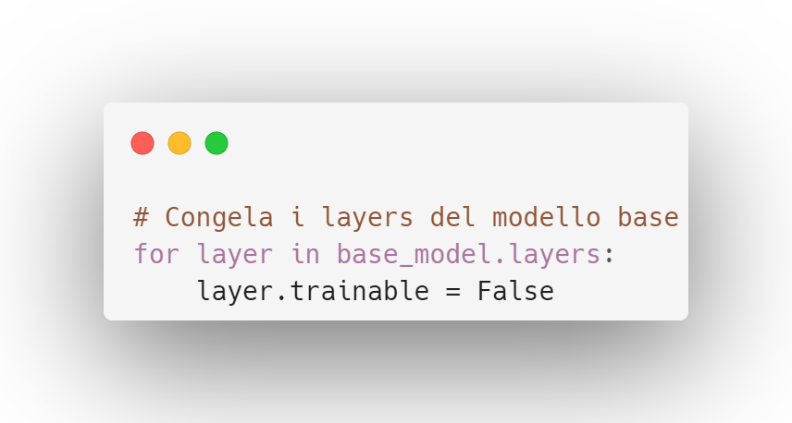
Feature Extraction
Model Used: ResNet50
Process:
Extracted features from the penultimate layer.
Result: 2048-dimension feature vectors.
A lot of features!!!

Slide 9
Feature Reduction Techniques
Purpose: Improve computational efficiency and model performance.
Methods:
PCA: Reduced to 1186 features.
Feature Importance: Top 1000 features.
Mutual Information: Top 500 features.

Slide 10
PCA
Explanation: Transforms features into principal components while preserving variance (95%).
Results: Reduced features to 1186, but correlation with classification task was not perfect.

Slide 11
Feature Importance
Explanation: Uses classifier-provided importance scores.
Results: Reduced to top 1000 features, complemented PCA.

Slide 12
Mutual Information
Explanation: Measures dependency between variables.
Results: Selected top 500 features, limited by the high-level nature of features from ResNet50.

Slide 13
Classifiers Used
List:
Support Vector Machine (SVM)
Random Forest
AdaBoost
XGBoost
Focus: Comparison of accuracy, precision, and recall.

Slide 14
Support Vector Machine (SVM)
Characteristics:
Finds the optimal hyperplane for class separation.
Effective in high-dimensional spaces.
Robust to overfitting with kernel functions.

Slide 15
Random Forest
Characteristics:
Ensemble learning with multiple decision trees (bagging).
Handles large datasets but can be memory-intensive.

Slide 16
AdaBoost
Characteristics:
Sequentially trains weak classifiers.
Focuses on difficult cases by adjusting weights.
Sensitive to noisy data and high dimensionality.

Slide 17
XGBoost
Characteristics:
Optimized gradient boosting with regularization.
Fast and scalable, handles large datasets.

Slide 18
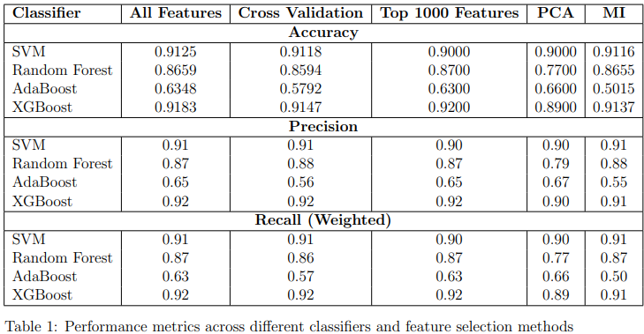
Results and Comparison (1)

Slide 19
Observations
Key Points:
XGBoost and SVM perform the best.
Random Forest performs variably, poorly with PCA.
AdaBoost consistently underperforms.

Slide 20
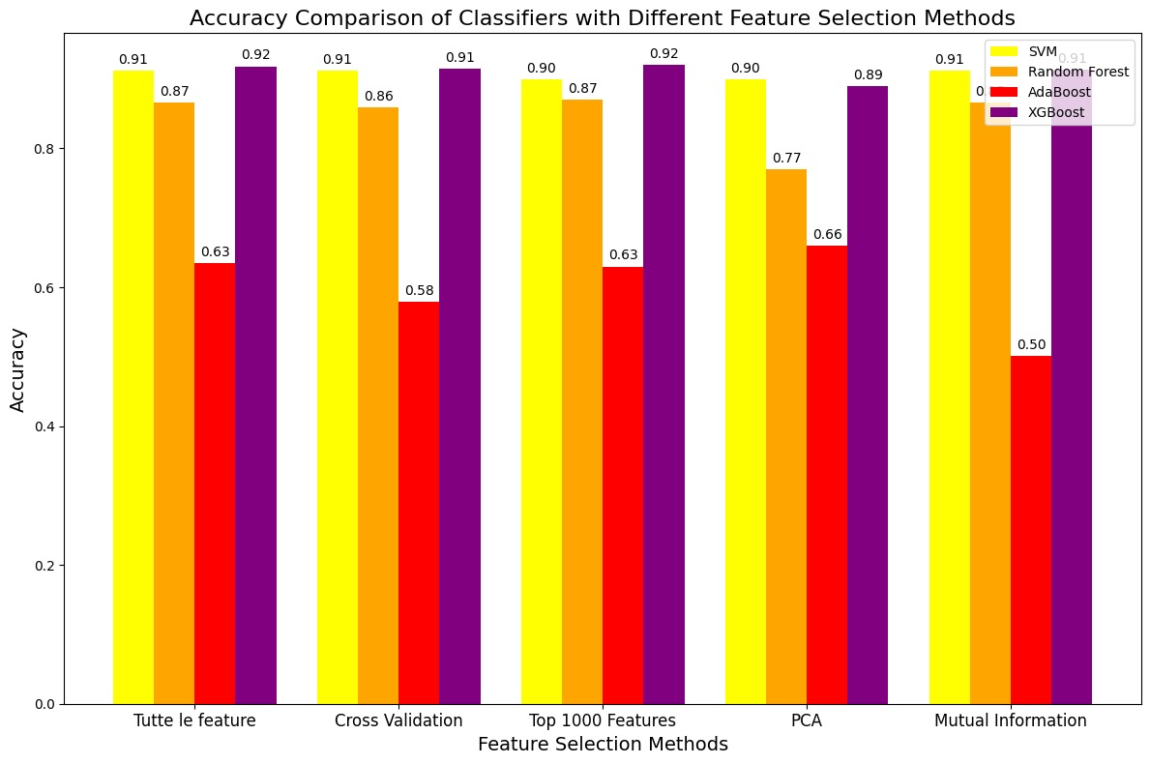
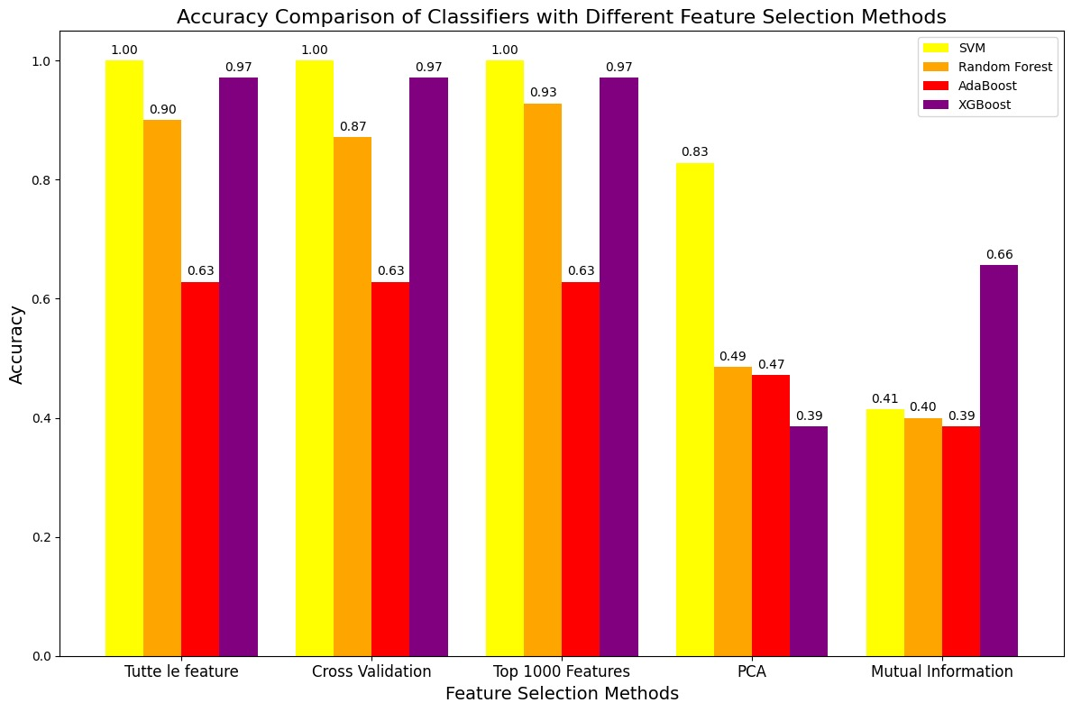
Conclusions
Feature reduction improves efficiency but varies in effectiveness.
Overfitting is a concern with some methods.

Slide 21
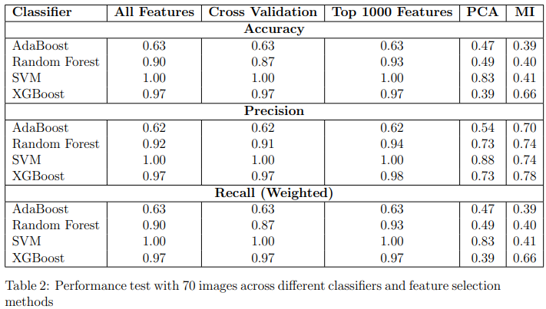
Results and Comparison (2)

Slide 22
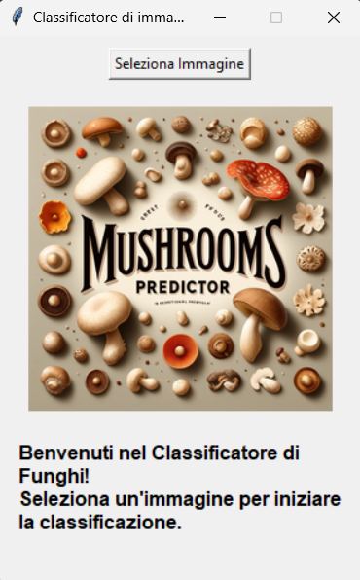
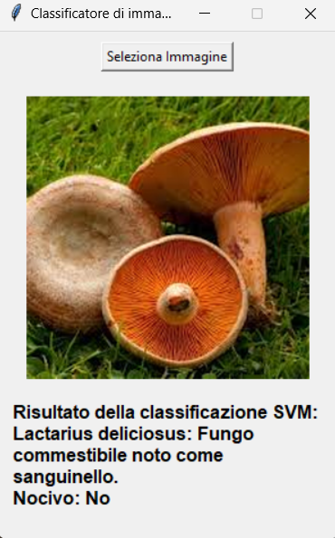
User Interface

Slide 23
Future Work
Enhancements:
Coordinates: Add coordinates attribute to enhance classification.
Advanced preprocessing: Grayscale conversion, background elimination.
Augmentation techniques: Rotation, scaling, flipping, cropping.
Feature selection methods: Recursive Feature Elimination, regularized models.
Hyperparameter optimization: Grid Search, Random Search, Bayesian Optimization.
Expand dataset: Real-world testing.

