Slide 1
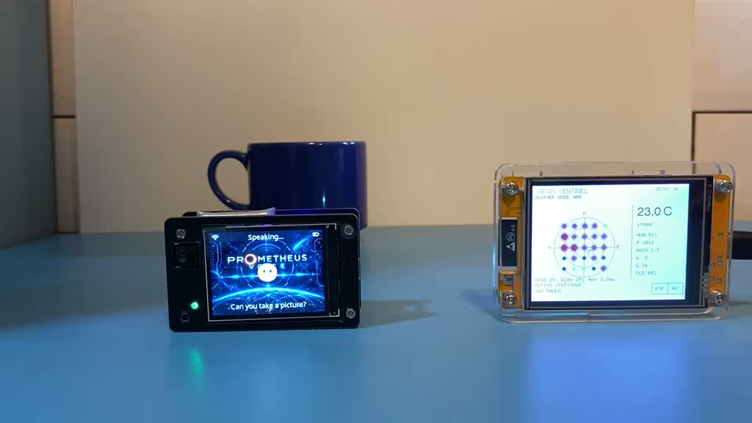
PROMETHEUS
VOICE
Your voice.
Action you can verify.
Marcus Comotti
AssemblyAI Voice Agent Hackathon
PROMETHEUS VOICE
01
Notes:
Marcus Comotti presents PROMETHEUS VOICE, a local prototype built with AssemblyAI. The photographs and screenshots in this deck come from the creator’s September 29, 2026 demo recordings. They show a specific recorded run, not a claim of current telemetry.

Slide 2
The problem: invisible actions
A spoken answer leaves practical questions.
What did the system actually do?
Did I authorize the camera?
Where did that result come from?
For builders and operators who need voice access with visible control.
PROMETHEUS VOICE
02
Notes:
Intended audience: builders and operators of small connected systems. These are product motivations, not claims of measured market demand. The prototype explores how users can retain control while accessing tools through speech.

Slide 3
How the prototype connects
AssemblyAI
Voice sessions, speech and spoken replies
PROMETHEUS VOICE
Tool handoffs, confirmation and the local interface
PROMETHEUS X6
Optional registry, information, telemetry and camera routes
Local calculator
Plan review, bounded arithmetic and evidence records
PROMETHEUS VOICE
03
Notes:
Implementation references: src/prometheus_voice/token_broker.py, static/voice-session.js, xiaozhi_bridge.py, x6_client.py and workflow.py in the accompanying public repository. Browser sessions use temporary credentials. The hardware bridge keeps conversation audio on the AssemblyAI route and proxies MCP camera messages to X6. The local arithmetic executor lives in Voice, not X6.

Slide 4
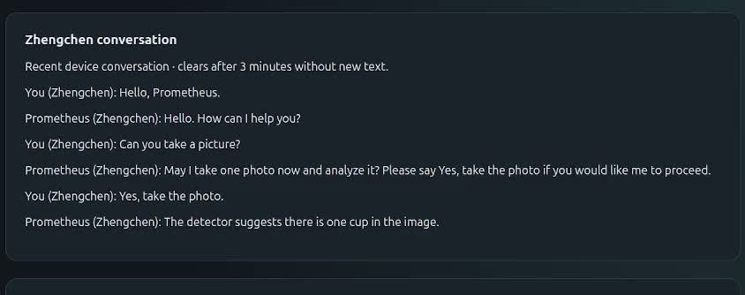
Camera capture with spoken consent
One request. A fresh confirmation. One capture.
The detector suggests a result; it does not establish certainty.
PROMETHEUS VOICE
04
Notes:
Recorded Zhengchen demonstration: the user asks for a picture, the assistant asks permission, the user says Yes, take the photo, and the detector suggests one cup. CameraConsent checks a fresh confirmation after the permission question, within 20 seconds. Consent is single-use, not speaker authentication. Detection can be incorrect. Screenshot from the creator’s recording.

Slide 5
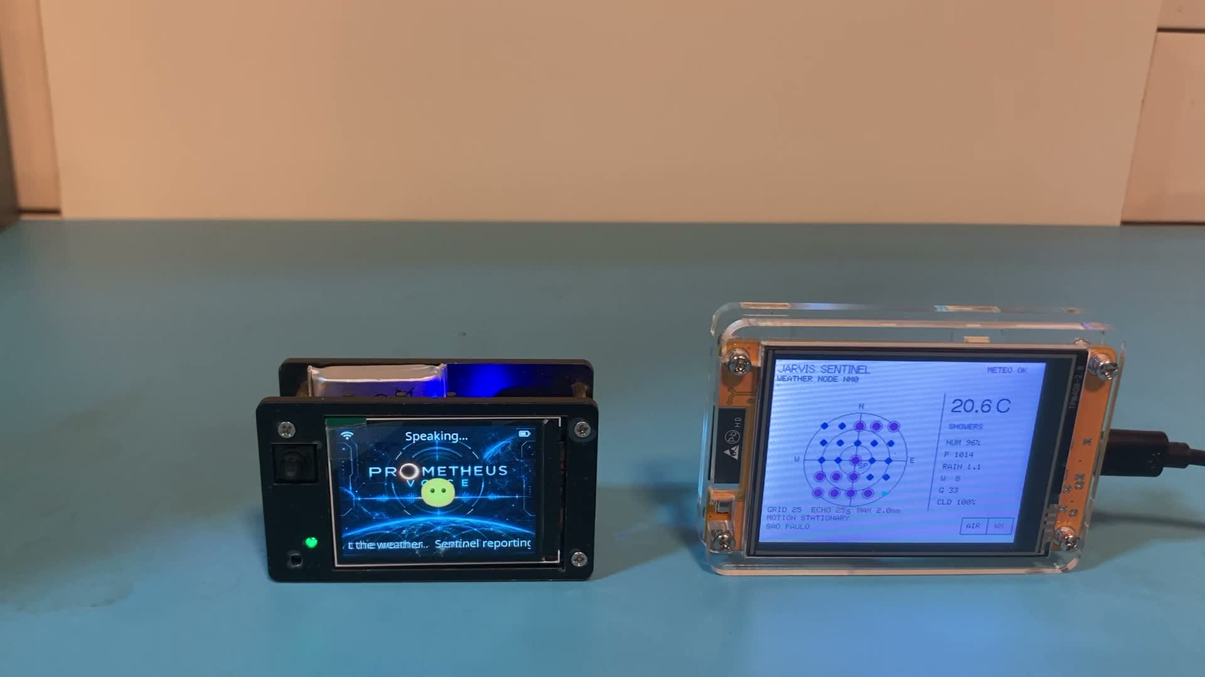
Sentinel observations through voice
8 aircraft targets
Filtered display count
within the configured area
25 weather cells
Recorded maximum: 2 mm
Freshness and source limits matter
Values shown belong to the recorded demonstration.
PROMETHEUS VOICE
05
Notes:
Observed in the recorded demo: eight filtered aircraft targets and a weather summary reporting a maximum of two millimeters across 25 grid cells. These are recorded observations. AIR is limited to 25 nautical miles and 40 display targets. Weather and AIR freshness checks differ. Neither proves physical node identity or transport authenticity. Photo from the creator’s recording.

Slide 6
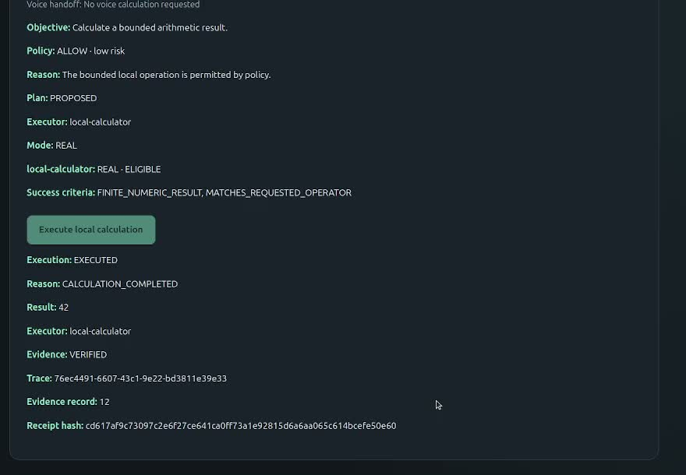
A local result with inspectable evidence
19 + 23 = 42
The user reviews the plan
before execution.
The interface shows the result
and its evidence receipt.
Hash-linked records check consistency, not independent attestation.
PROMETHEUS VOICE
06
Notes:
The demo’s arithmetic sequence is an interface-driven local calculation. It is not presented as voice-initiated or as distributed X6 execution. The screen shows 19 + 23 = 42, EXECUTED and VERIFIED. Verification checks the local result and ledger consistency, not independent physical-world attestation. Screenshot from the creator’s recording.

Slide 7
Implemented scope and next steps
Implemented
Next steps
English voice interaction
Spoken camera confirmation
Sentinel and ShadowBroker queries
Capability registry reads
Human-reviewed local arithmetic
Repeatable hardware setup
Longer reliability evaluation
Explicit service health reporting
More bounded action types
X6, firmware and external services remain separate dependencies.
PROMETHEUS VOICE
07
Notes:
The Voice layer and handoffs integrate pre-existing X6 and device components. The repository does not include private infrastructure, firmware or detector deployment. Additional demonstrated features include sourced ShadowBroker headlines and X6 registry reads. General distributed execution, broad availability checking and production deployment are future work.

Slide 8
Project materials
Demo video and source code
github.com/comottimarcus-dot/prometheus-voice
Run the local arithmetic smoke test without credentials.
Voice requires AssemblyAI access. Hardware features require
compatible external services.
Project website: jarvisprometheus.space
PROMETHEUS VOICE
08
Notes:
The recorded demo has been approved by the creator. The public repository includes source, tests, configuration examples and integration contracts, but no credentials or private core source. Review README.md for optional service requirements. The website is the broader Prometheus project website, not a publicly hosted live Voice application.

