Slide 1
Data Visualization in R with ggplot2
Dr. Chris Bird
Texas A&M University – Corpus Christi

Slide 2
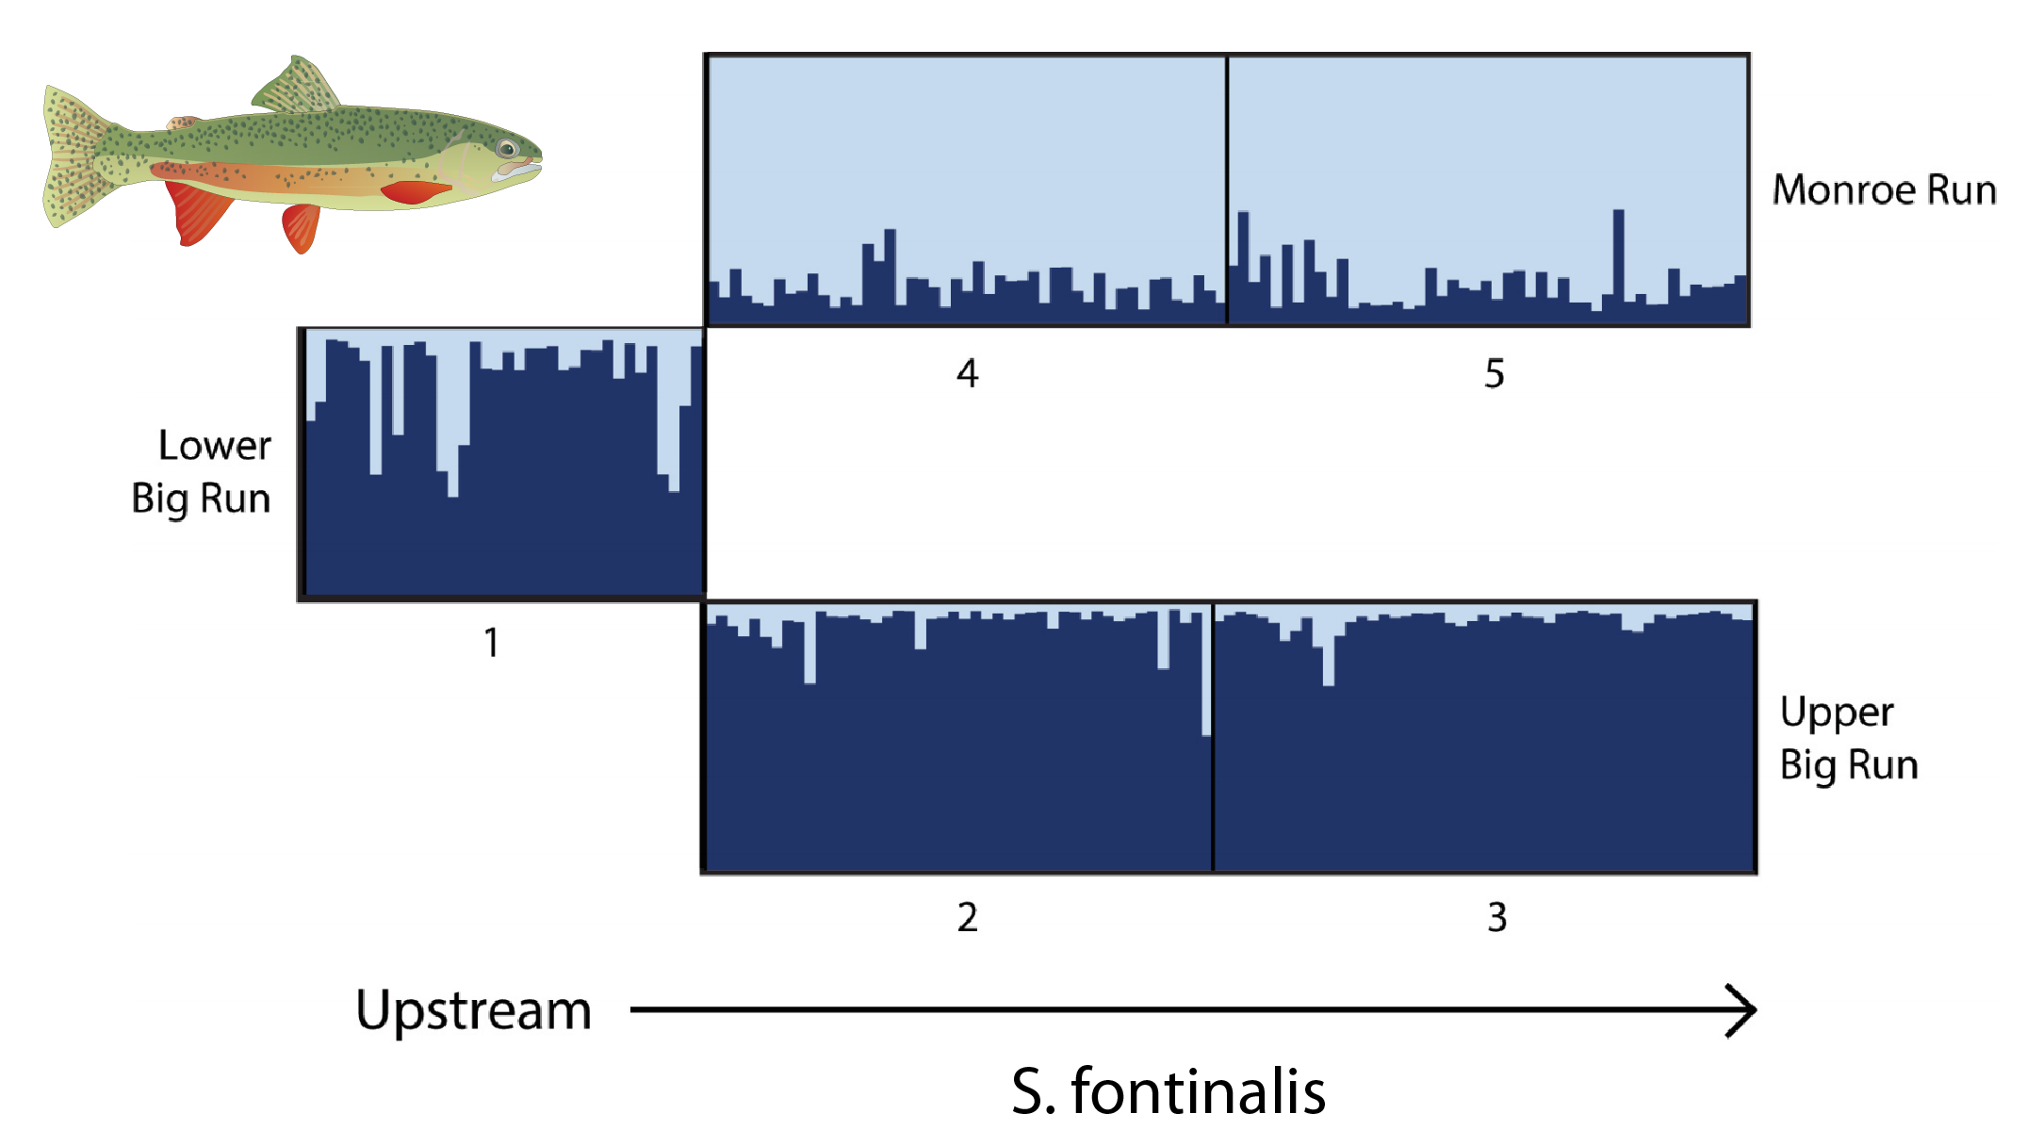
Scientific Visualizations Should be Clear
What is being plotted?
What are the axes?
What do the colors, shapes, & sizes represent?
What is the message you want to convey?
What’s wrong with this figure?

Slide 3
Philosophy of ggplot2
The grammar of graphics (Wilkinson 2006)
  Describe a graph using text
Data – data frame to plot
Aesthetic Mapping (aes)
  which parts of data frame are associated with which parts of plot
    X-axis, Y-axis, colors of points, etc
Geometry (geom_)
  Lines, points, etc
Coordinates
  cartesian, polar
Faceting
  Panels
Statistics
  Fit line, smoothing, etc
Theme
  Adjust look and feel of the graphics

Slide 4
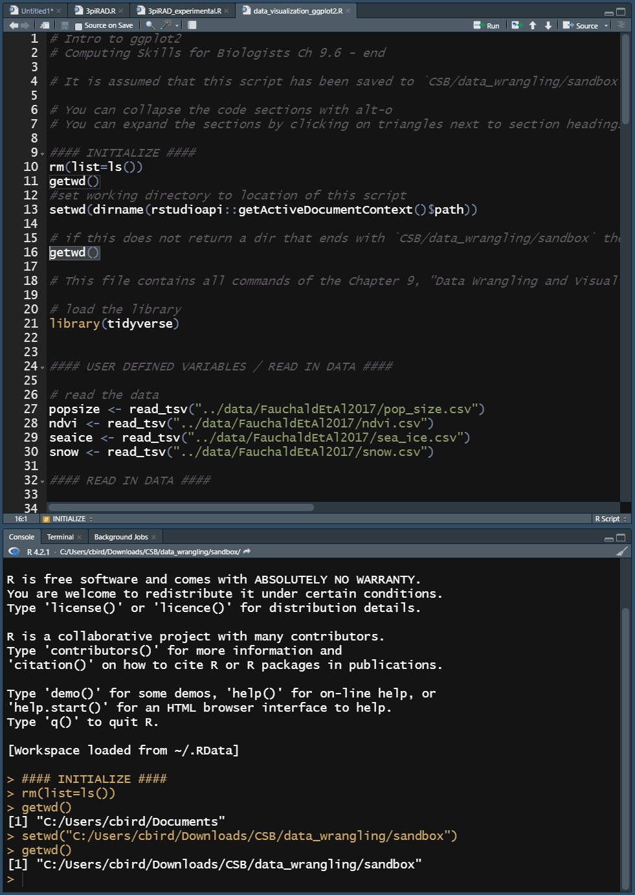
Make Sure You’ve Downloaded The R Script for this Lecture and Saved it Here:
CSB\data_wrangling\sandbox\data_visualization_ggplot2.R
Run the following lines of code
  Clear the environment
    `rm(list=ls())`
  Set the working directory to same location as this R script
    !!! You should remember to copy this useful line of code into your future R scripts !!!
      You’re welcome ☺

Slide 5
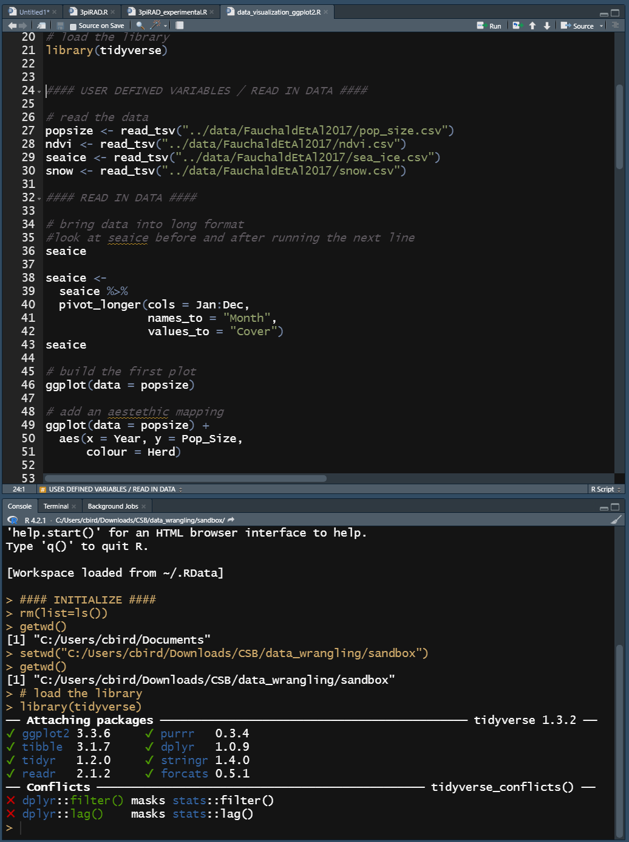
Load Tidyverse
Tidyverse
  A package to manipulate data
  The new commands we are using are part of “the tidyverse” as is ggplot2
  Data frames are called “tibbles”
    popsize, ndvi, seaice, & snow are tibbles
library(NameOfPackage)
  Adds commands to accomplish your tasks

Slide 6
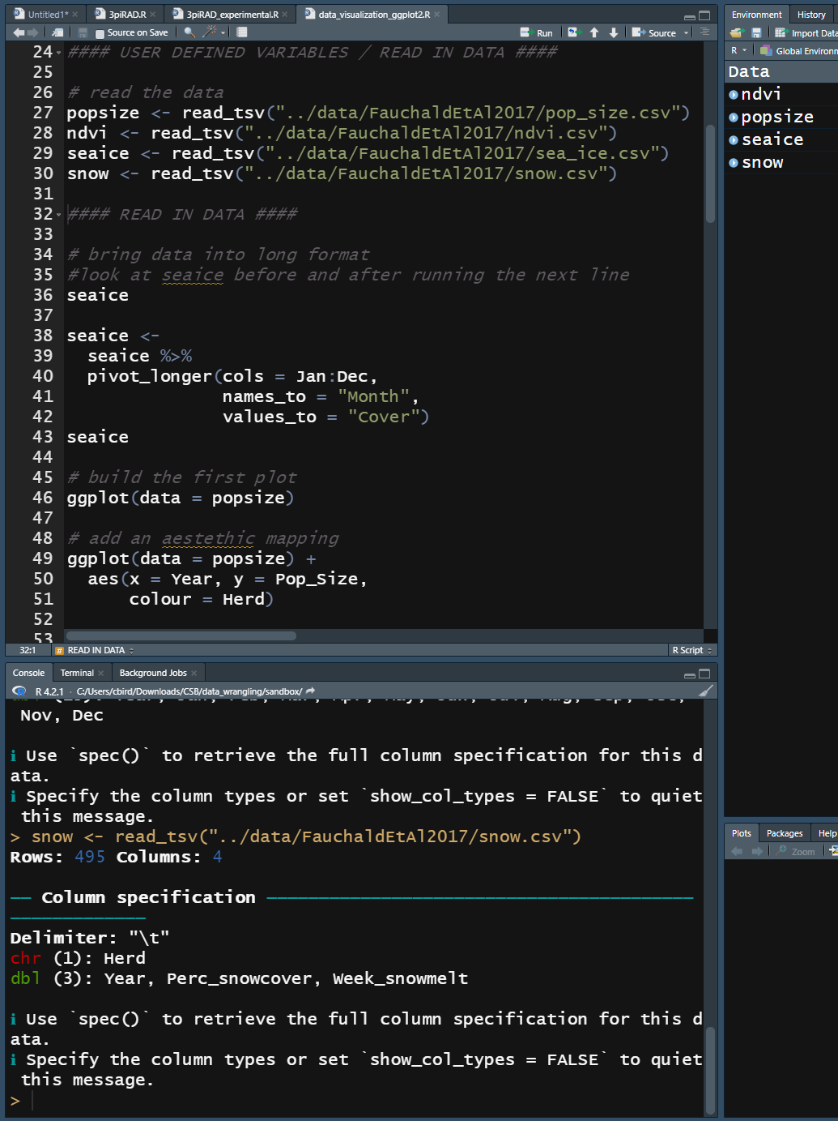
User Defined Variables & Reading in Data
All “hard-coded” variables should be defined in one location near the beginning of the script
  Makes it easier to modify, no hunting for variables you need to change
  Here they specify our input files
New commands
  read_tsv(“path/to/file.tsv”)
    Reads in *.tsv files
    Note the `_`, tidyverse and tidyv-compatible commands tend to use `_`, while non-tidyverse commands tend to use `.`

Slide 7
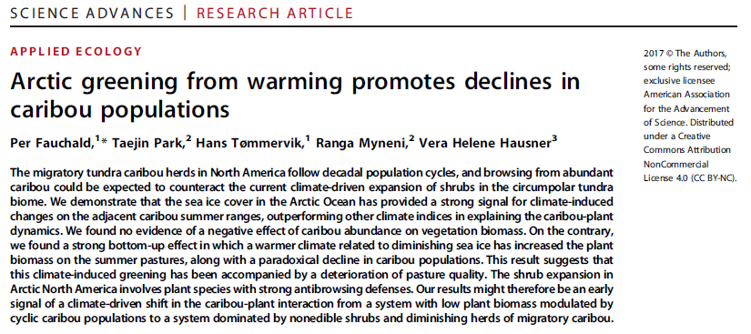
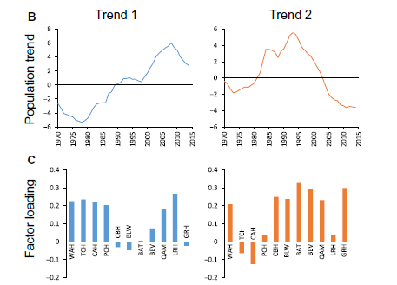
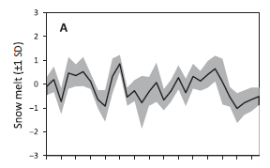
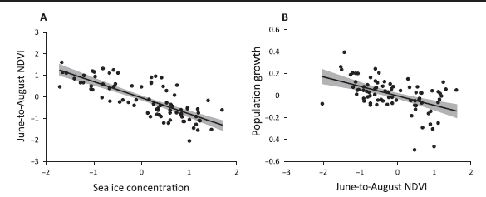

Slide 8
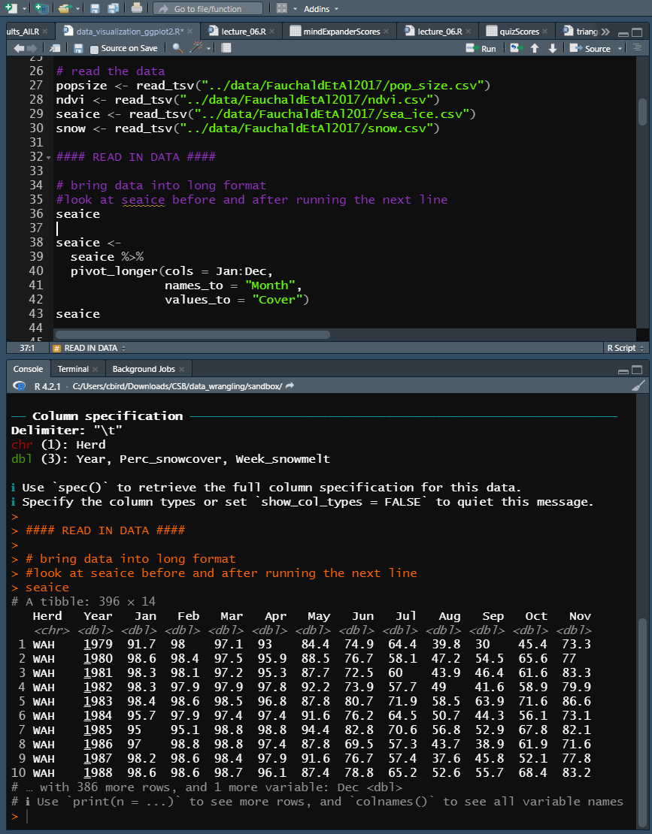
Reading In Data
All “hard-coded” variables should be defined in one location near the beginning of the script
  Here they specify our input files
New commands
  %>% is a data pipe, like | in bash
    |> was added to R 4.1 and above
    %>% only works with tidyverse loaded
  pivot_longer(
  cols=ColsToStack,
  names_to = NewColNameWithGrps,
  values_to = NewColWithValues
  )
    Stacks data columns
    Look at seaice before and after
  pivot_longer()replaced gather()

Slide 9
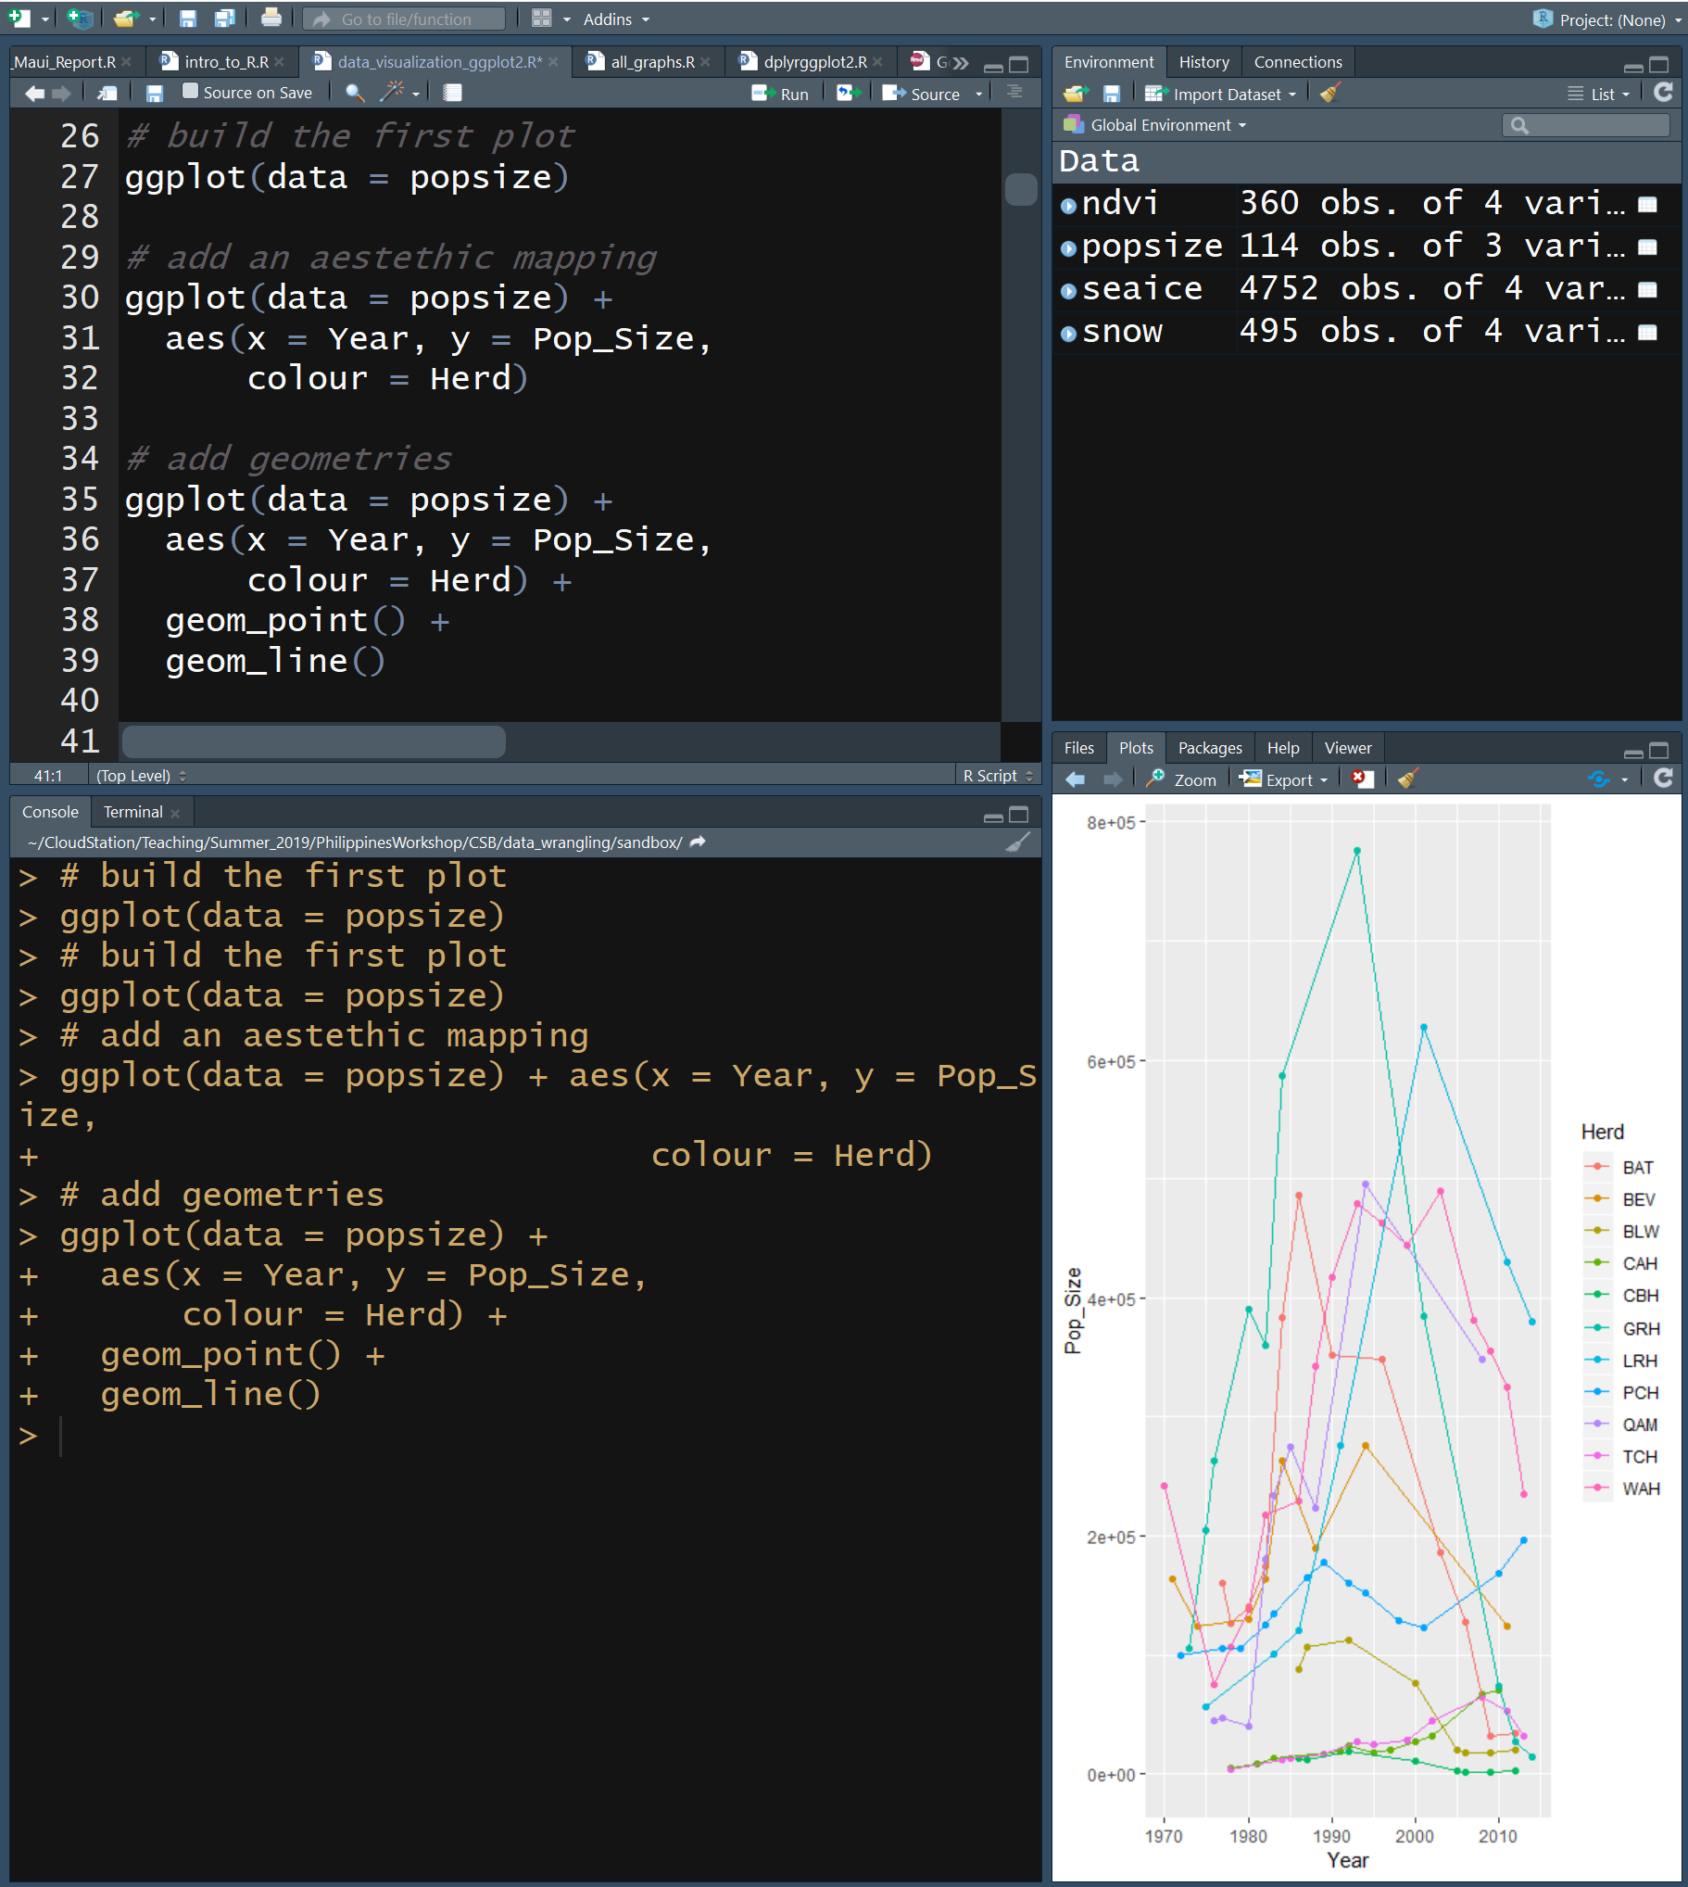
Building a ggplot
Plot Pop_Size vs Year by Herd
Add data
  data = popsize
Add aesthetics (aes)
  x = Year
  y = Pop_Size
  colour = herd
Add data point geometry
  geom_point()
Add line geometry
  geom_line()
Note the use of + to continue the “sentence”

Slide 10
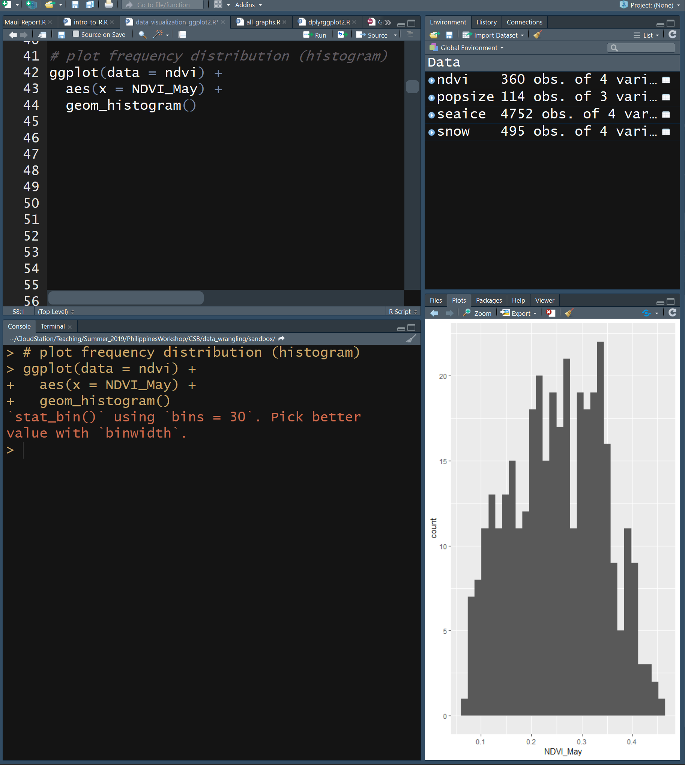
Frequency Distribution
Add data
  data = ndvi
Add aesthetics
  aes(x = NDVI_May)
Add data point geometry
  geom_histogram()
What is NDVI?
Check Fauchald et al

Slide 11
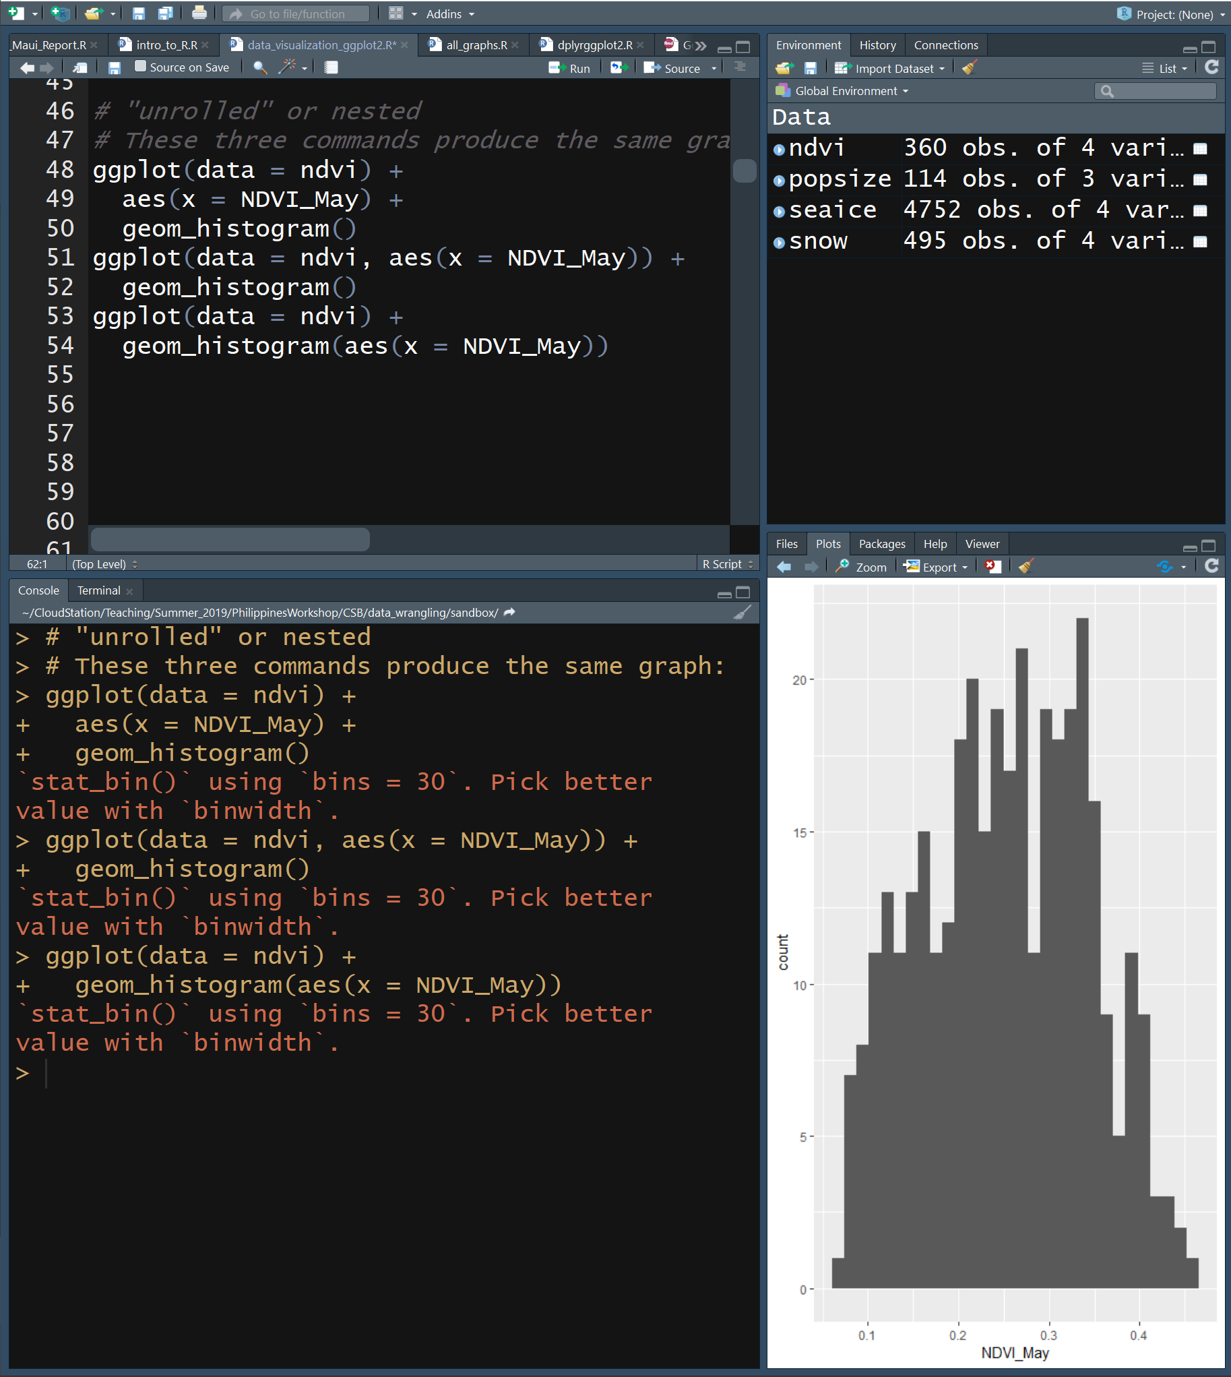
Nested vs Unrolled
The same plot can be made using the same commands arranged in different ways
Nesting
  ggplot(data = ndvi, aes(x = NDVI_May))
Unrolled
  ggplot(data = ndvi) +
  aes(x = NDVI_May) +
  geom_histogram()
Note the use of + to continue the “sentence”

Slide 12
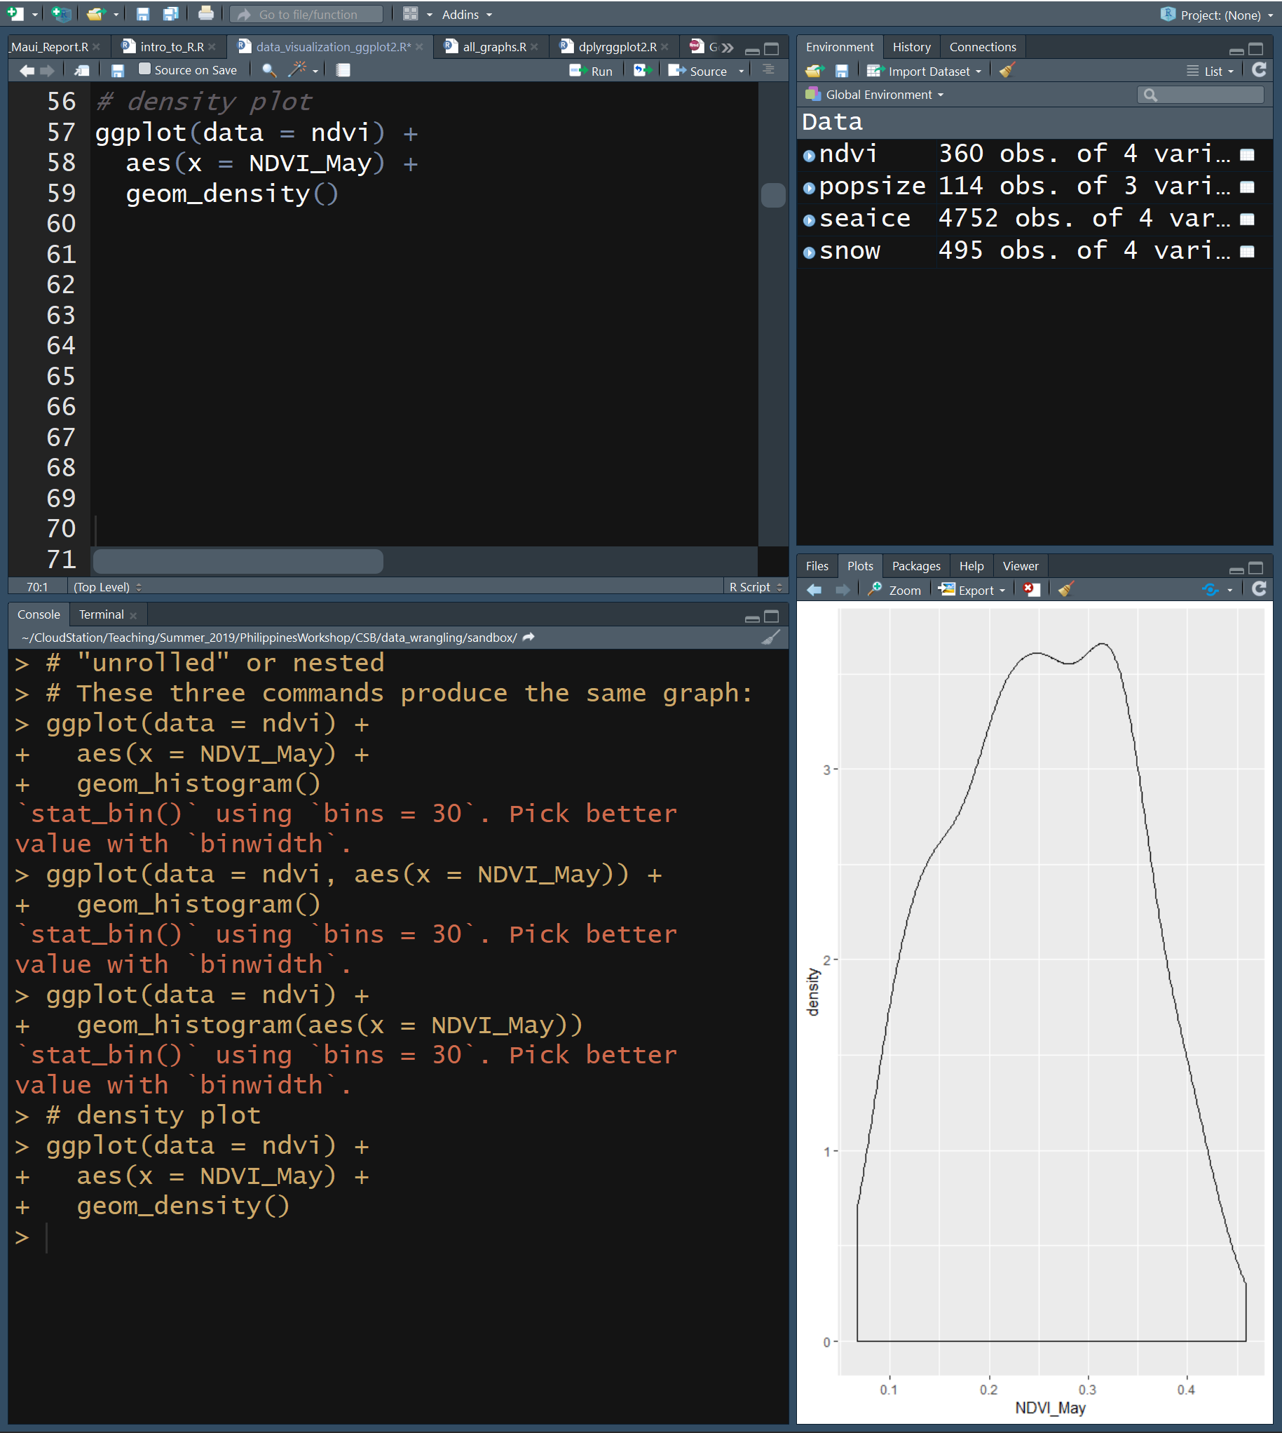
Density Plot
Interpolated from histogram
Note the use of + to continue the “sentence”

Slide 13
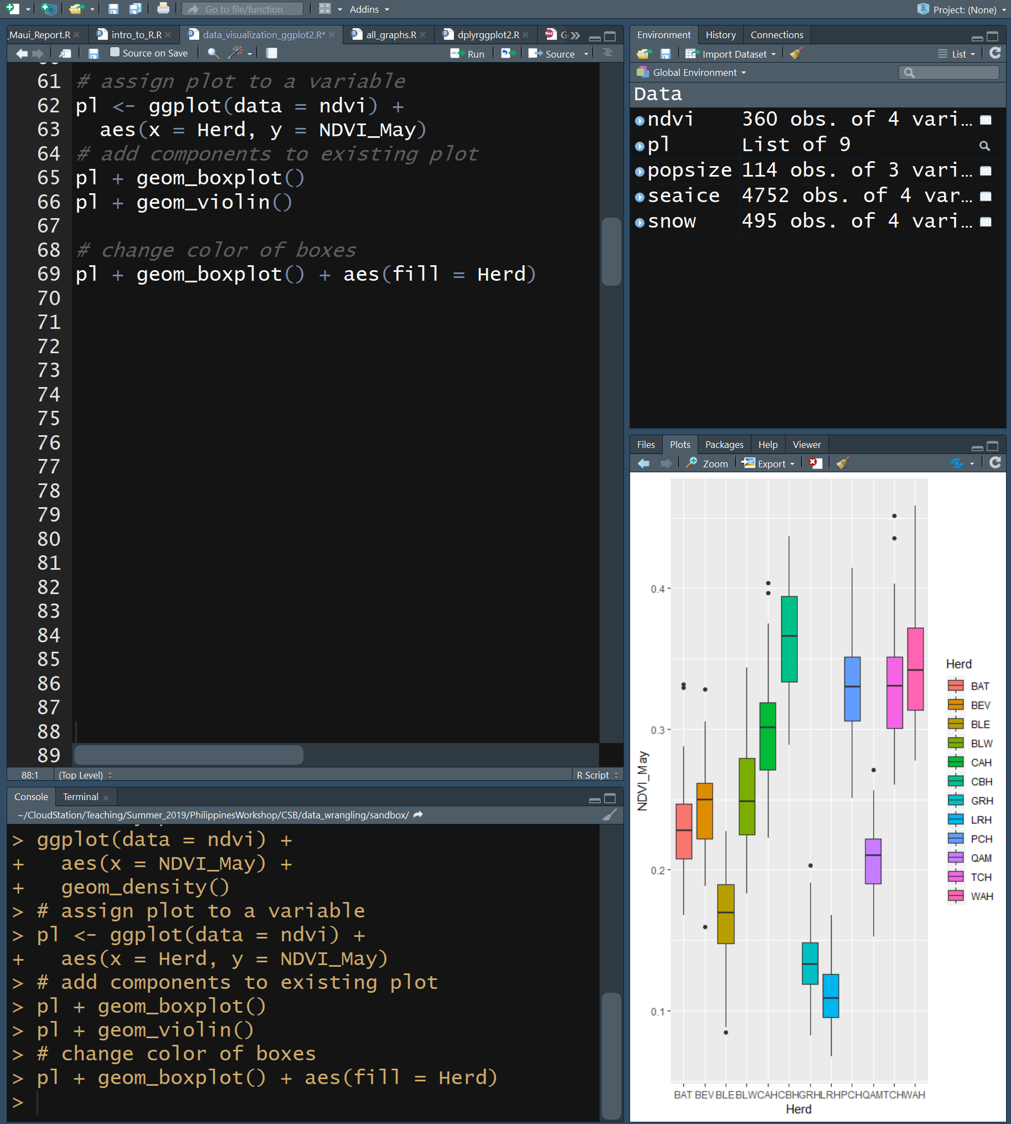
Box & Violin Plots
Provide info on distribution of your data
Box plot
  Box is 25, 50 & 75th percentiles
  Whiskers are interquartile range, 1.5x length of box
  Points are outliers
Violin plot
  Wider = more data points
Plot can be assigned to variable
Color can be added to plots using fill aesthetic
Note the use of + to continue the “sentence”

Slide 14
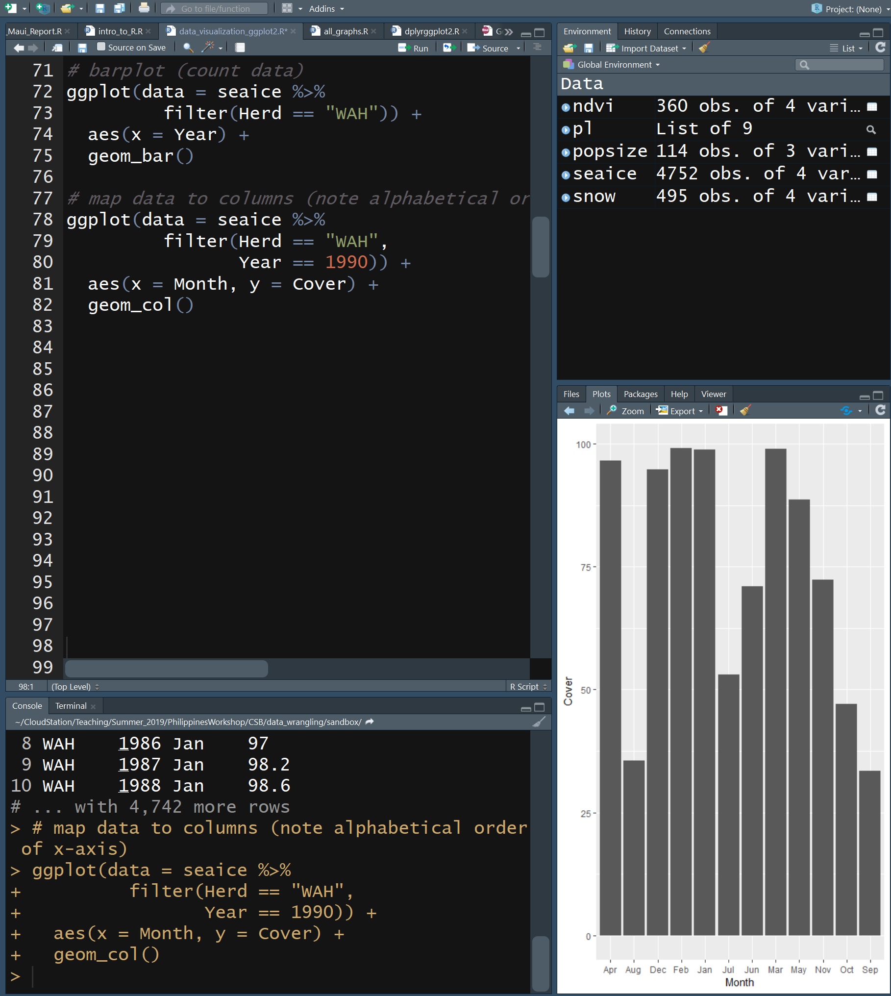
Bar Plots
Use bar plot to check if there’s 12 observations per year at site WAH
  geom_bar()
    counts up the number of times each year occurs
New Tidyverse command
  filter(column == value)
    Subset data by value, results in fewer rows
Plot cover of vegetation for each month in 1990
  geom_col()
    uses y to determine height of bar
Note the use of + to continue the “sentence”

Slide 15
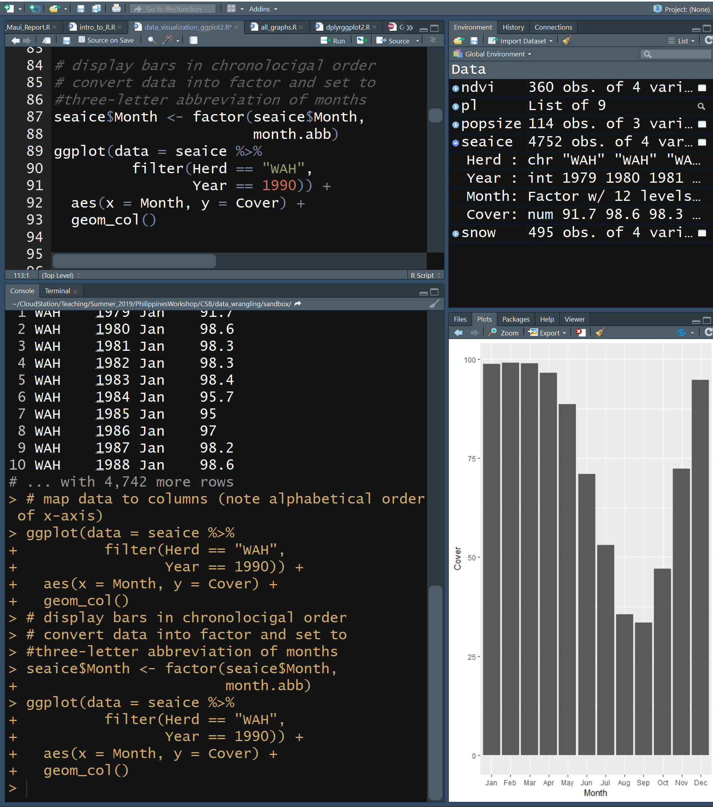
Column Plots
Notice in the last plot that the months are out of order
New Tidyverse command
  mutate(ColName = Something)
    Change or add column values
  factor(column, format)
    Changes data type to factor and has predefined formats
A factor is also an R data type
  categorical variable
Note that colplots use a categorical variable on x axis
Note the use of + to continue the “sentence”

Slide 16
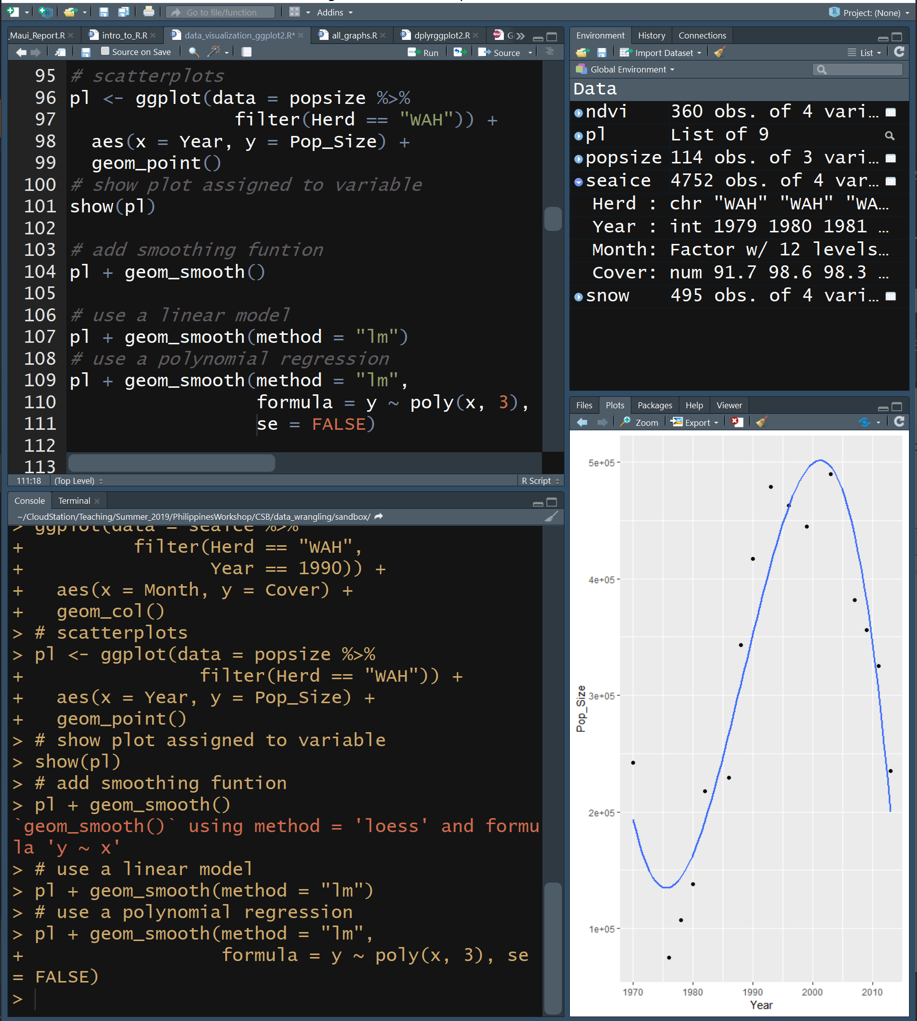
Scatter Plots
Visualize relationship between two continuous variables
We can show plot in variable
  show(plotVarName)
    Displays plot
Fit lines can be added
  geom_smooth()
    Uses loess smoother by default
  geom_smooth(method=“lm”)
    Linear model fit line
  geom_smooth(method=“lm”, formula = y ~ poly(x,3))
    3rd order polymonial model fit line
  geom_smooth(se=FALSE)
    Remove error “ribbon”
Note the use of + to continue the “sentence”

Slide 17
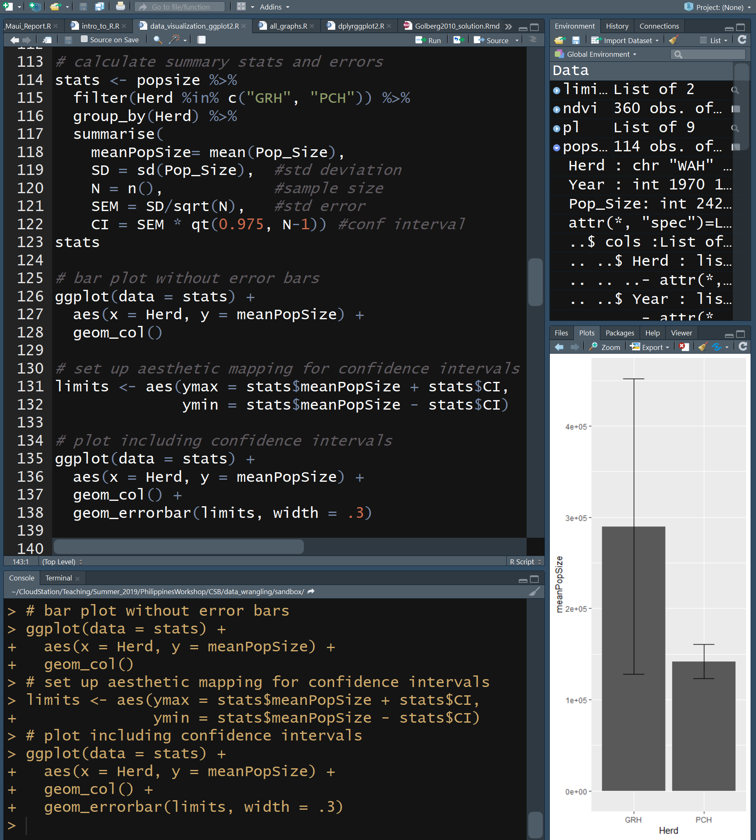
Plotting Experimental Errors
Error bars are typically plotted based upon values that you calculate
New Tidyverse commands
  %in%
    Equals
  group_by(colName)
    Converts tibble into a grouped tibble where operations are performed by group
    See ungroup()
  summarize()
    Returns requested summary stats by group
    Look at stats
Adding error bars
  geom_errorbar(ymax,ymin)
Note the use of + to continue the “sentence”

Slide 18
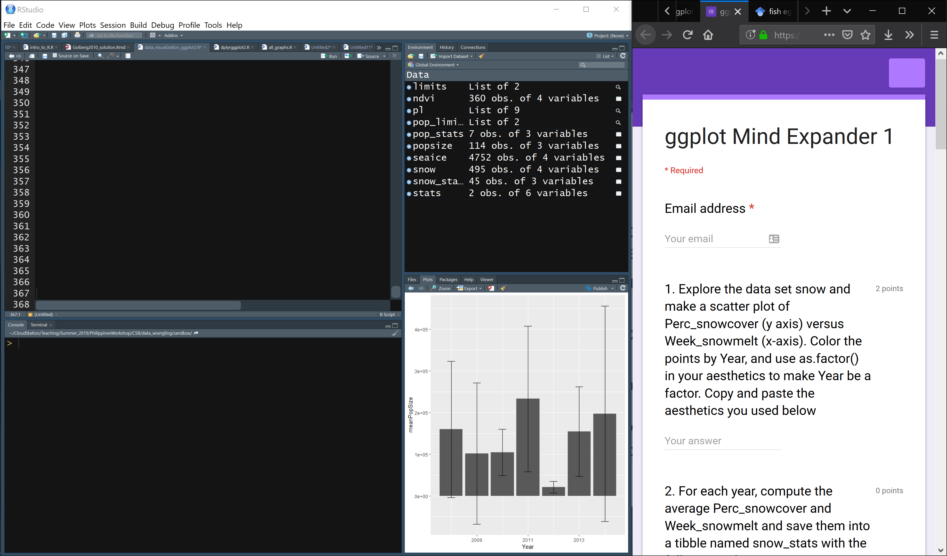

Slide 19
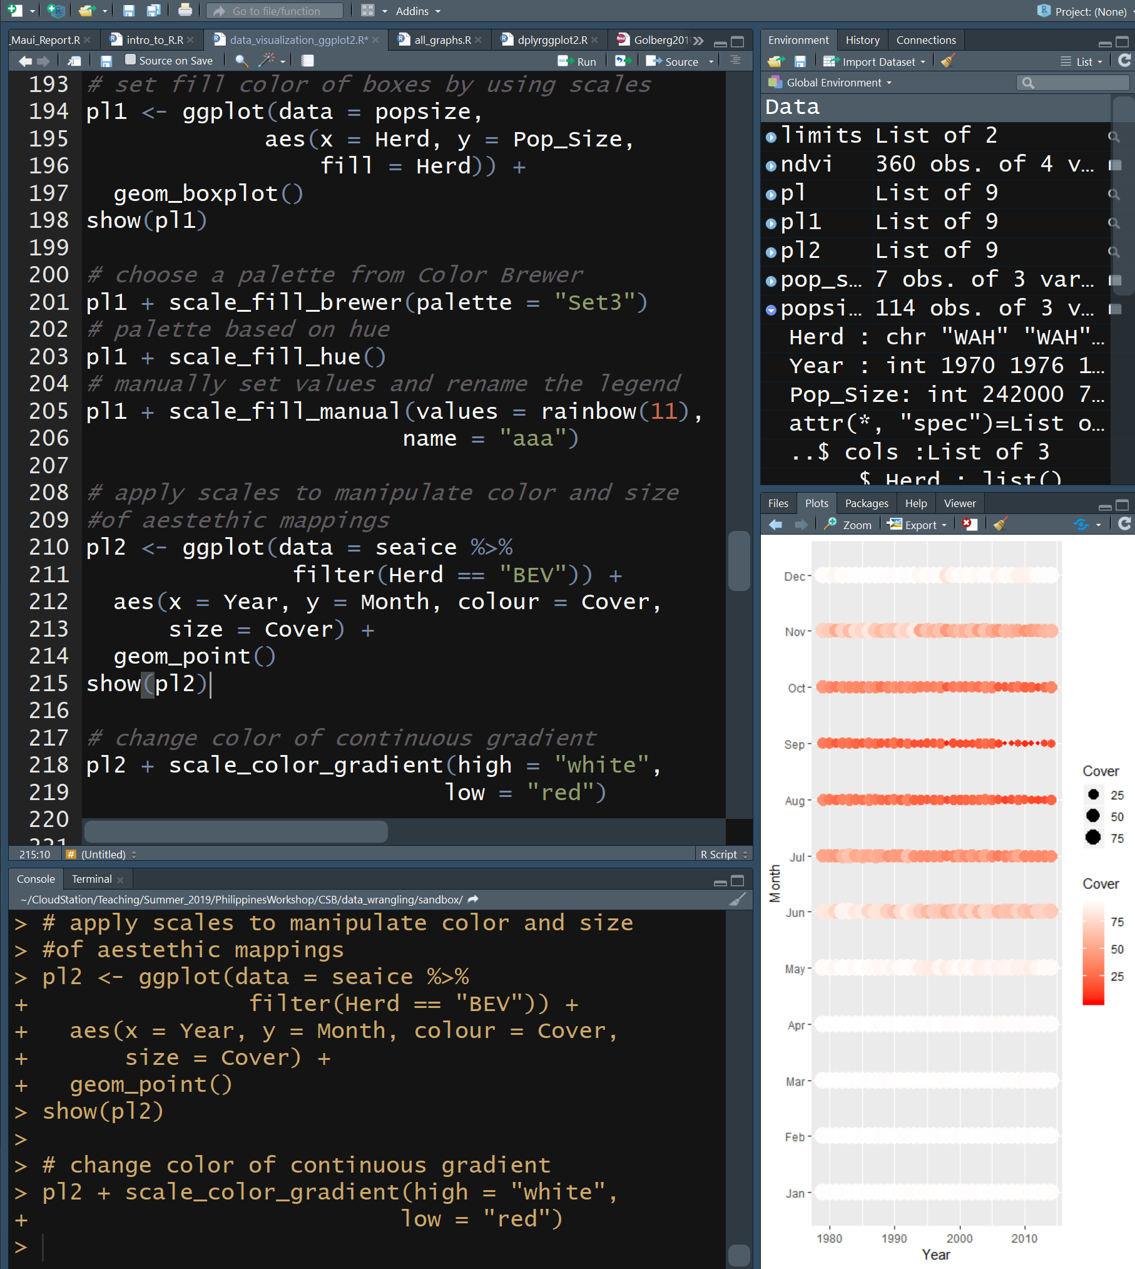
Scales
Modify the x and y axes, & determine how colors, sizes, shapes behave
fill
  Color fill an object
colour
  Color of border of object, point, line
  I highly rec the RColorBrewer pkg
size
  Size of point
shape
  Shape of point
alpha
  Level of transparency of point or bar
Discrete variables get discrete colors, continuous variables get continuous color
  Compare pl1 to pl2
Note the use of + to continue the “sentence”

Slide 20
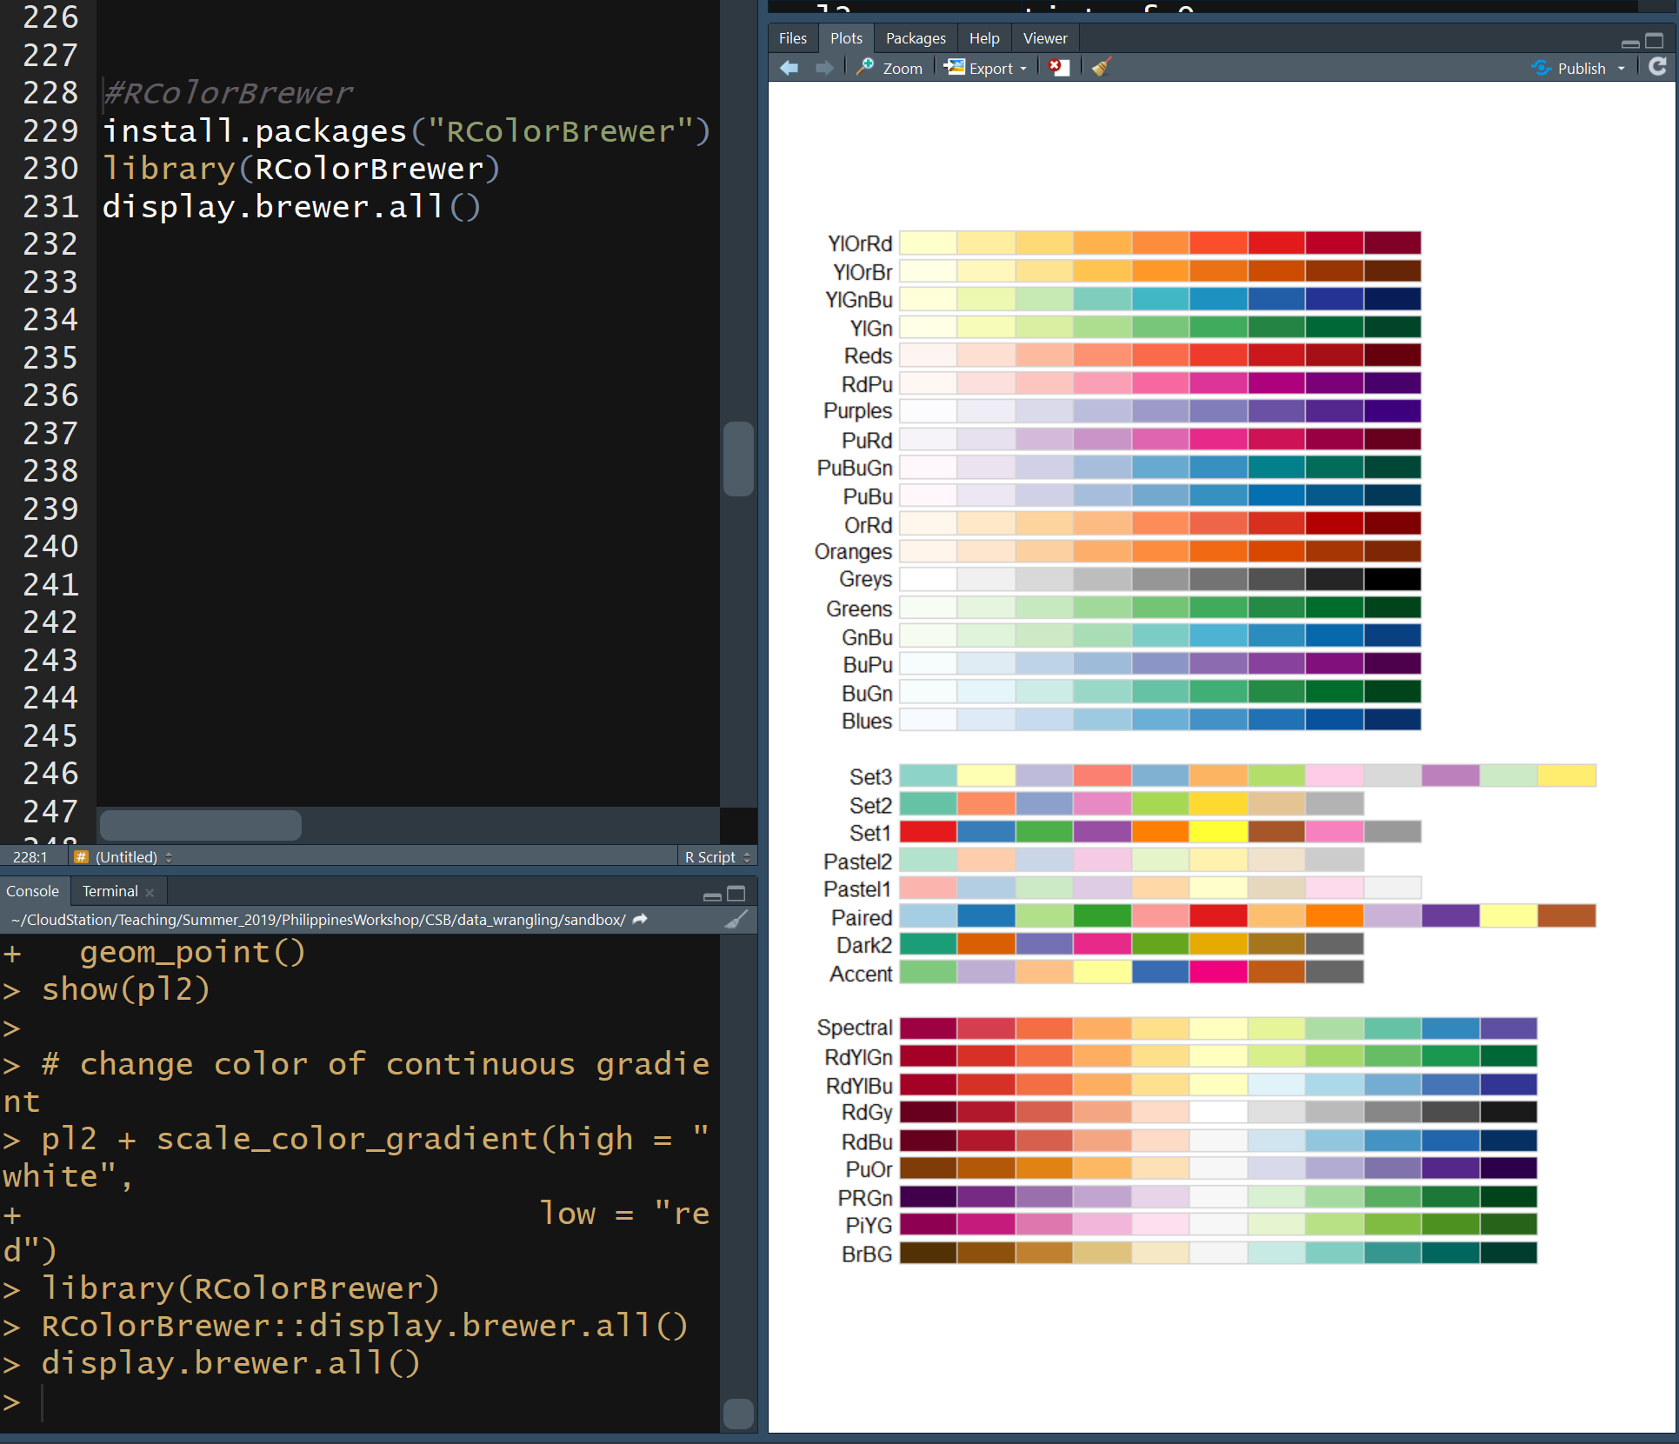
RColorBrewer
Package defining palettes of colors deemed to go together
Note the use of + to continue the “sentence”

Slide 21
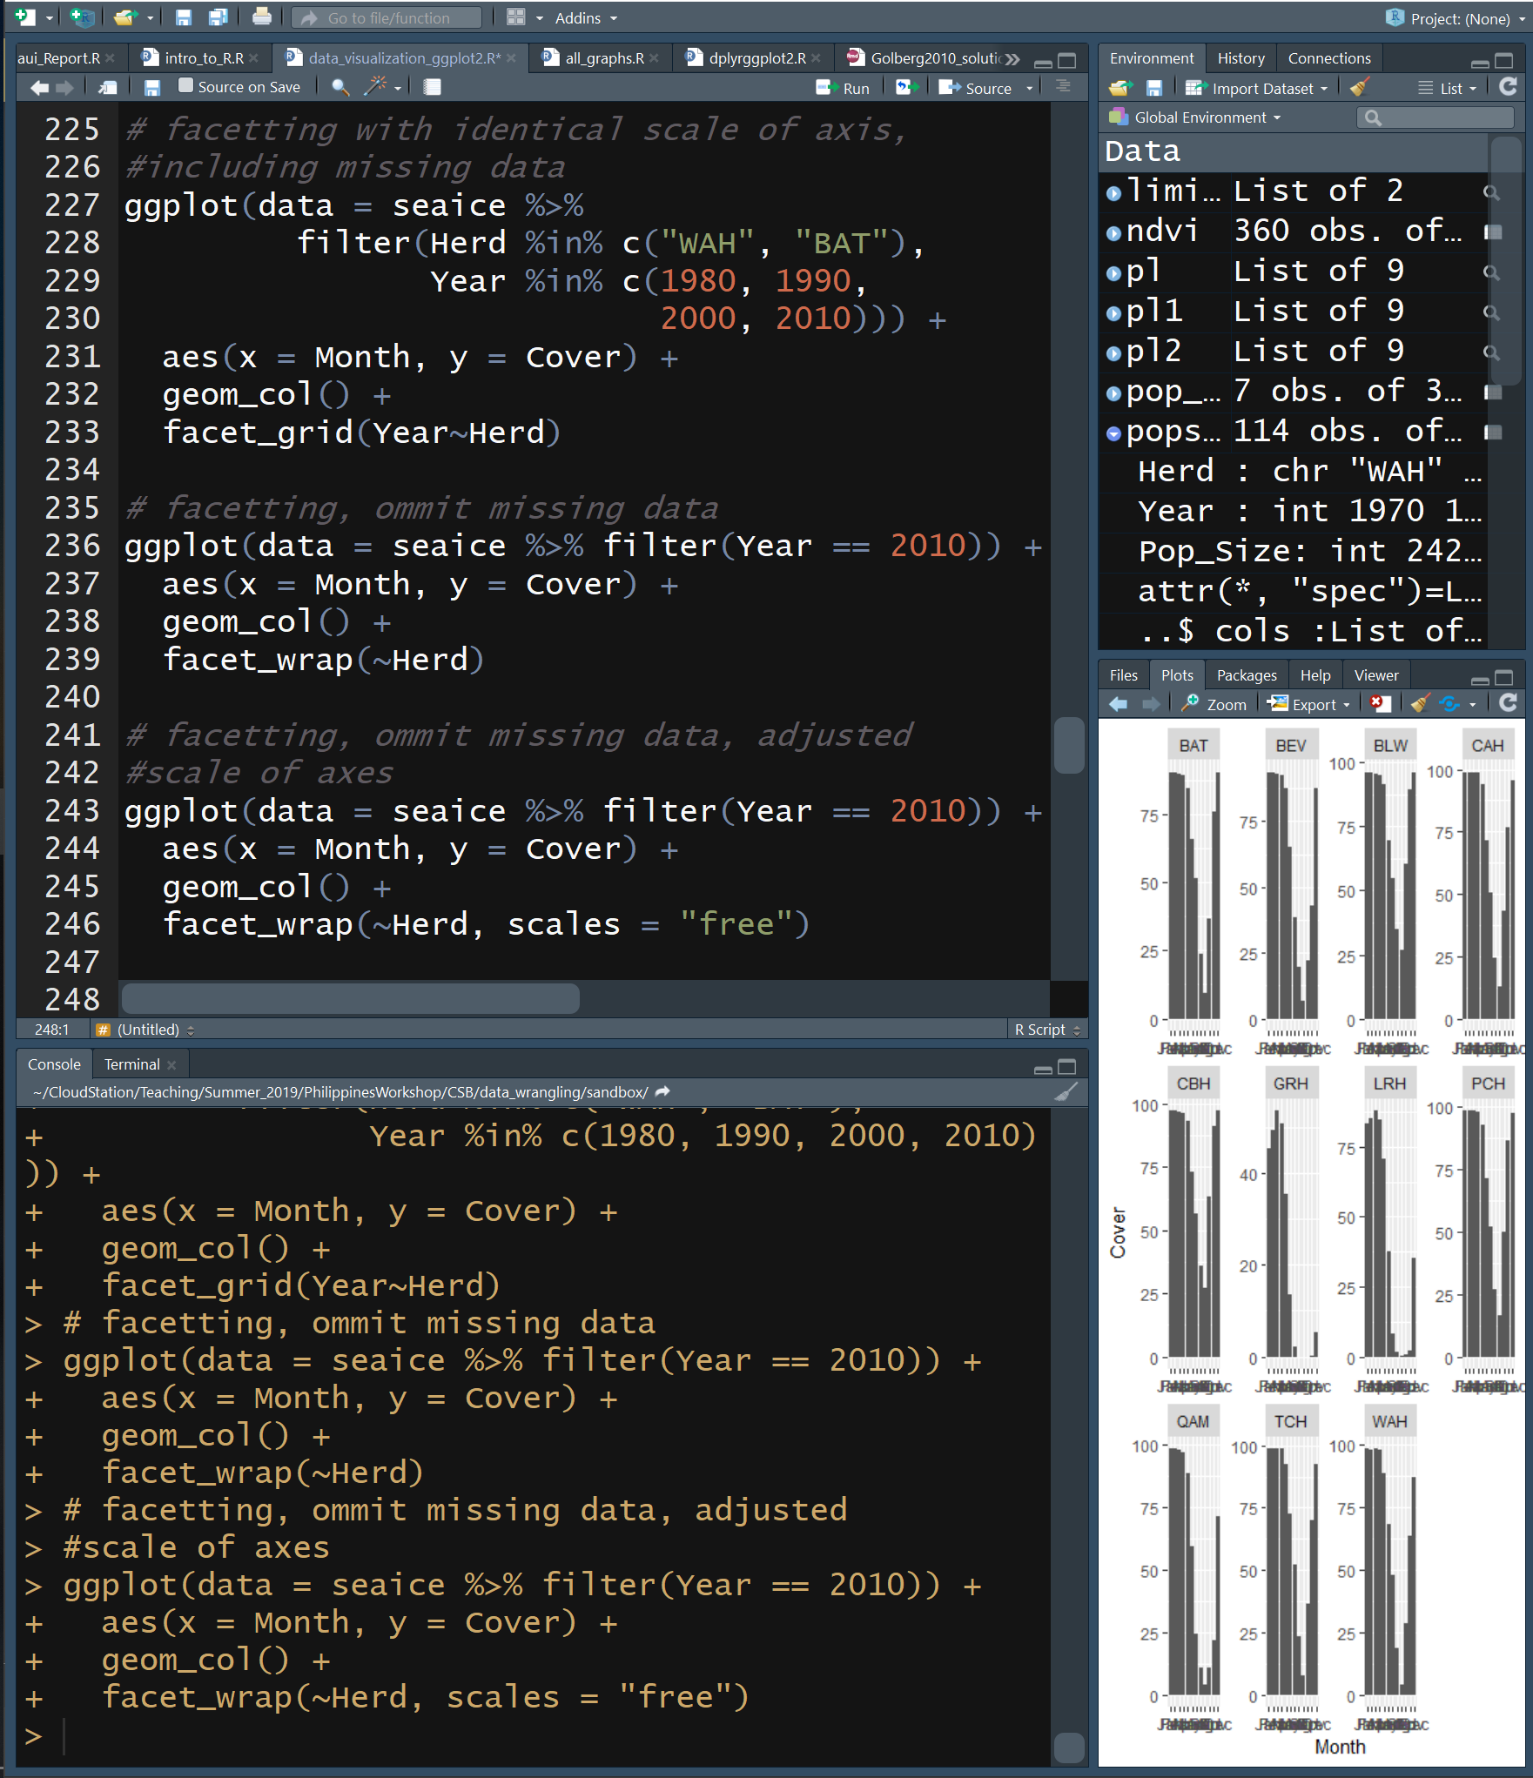
Faceting
Arrange like plots into panels by a categorical variable
facet_wrap(rowVar~colVar)
  Skips empty panels
facet_grid(rowVar~colVar)
  Does not skip empty panels
Make figures to see how ice dynamics have changed through the decades
Note the use of + to continue the “sentence”

Slide 22
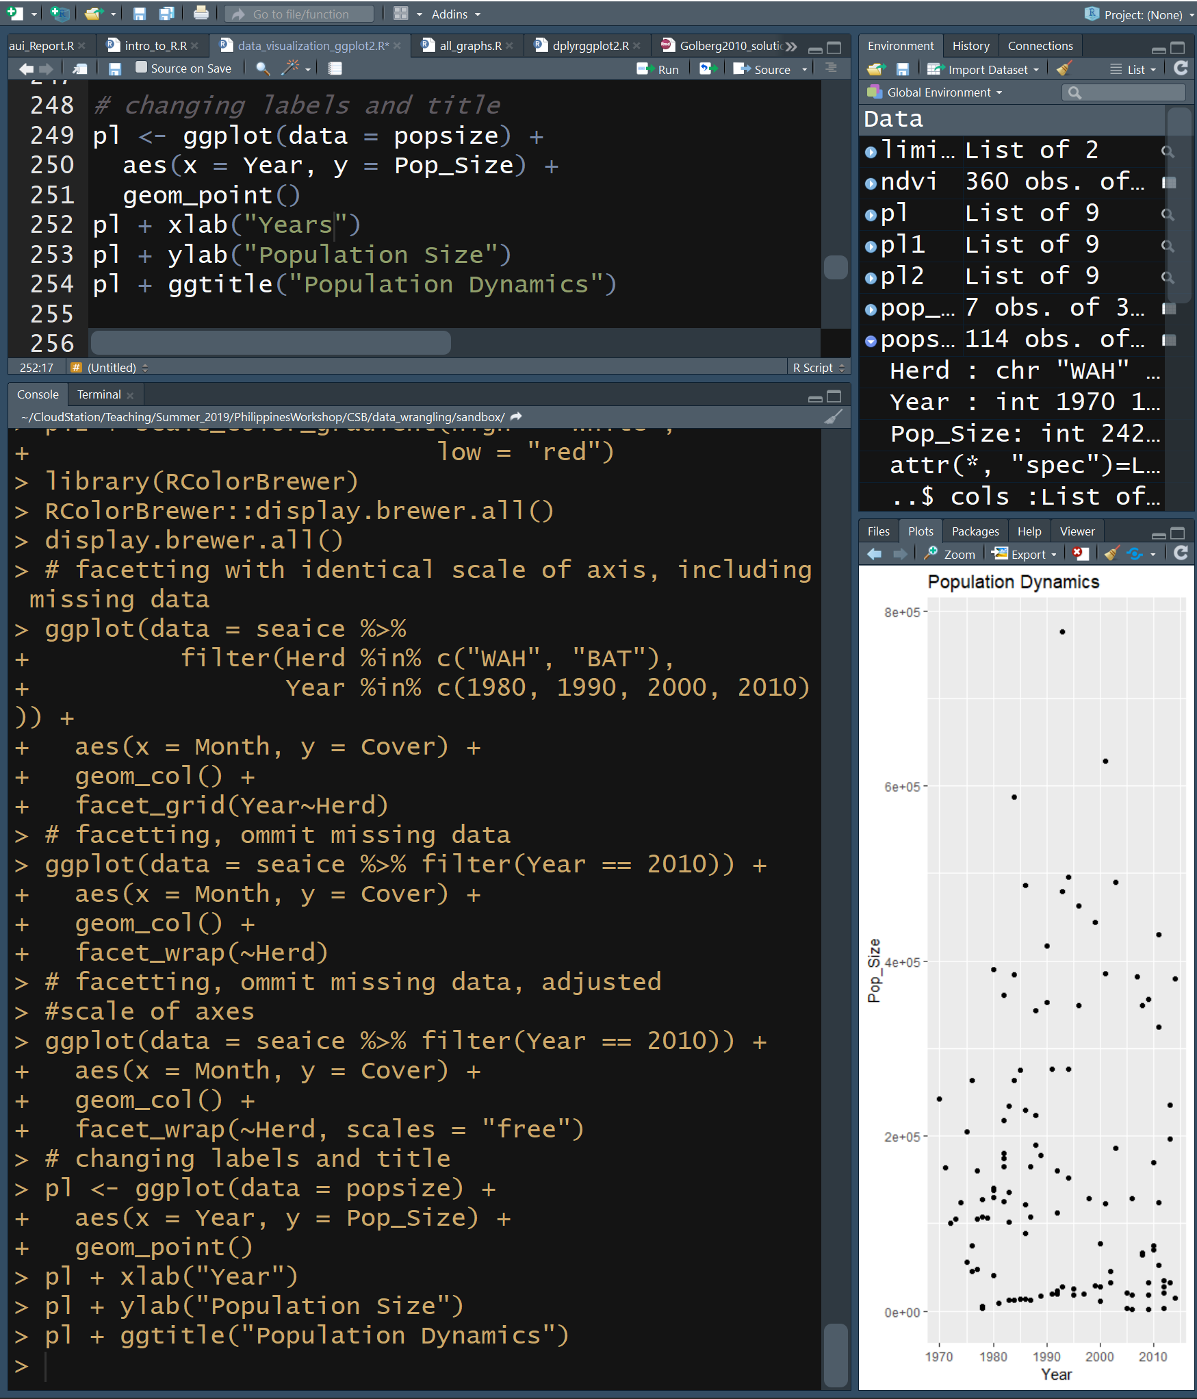
Labels
You can change axis and title labels
xlab(“Text”)
  X axis label
ylab(“Text”)
  Y axis label
ggtitle(“Text”)
  title
Note the use of + to continue the “sentence”

Slide 23
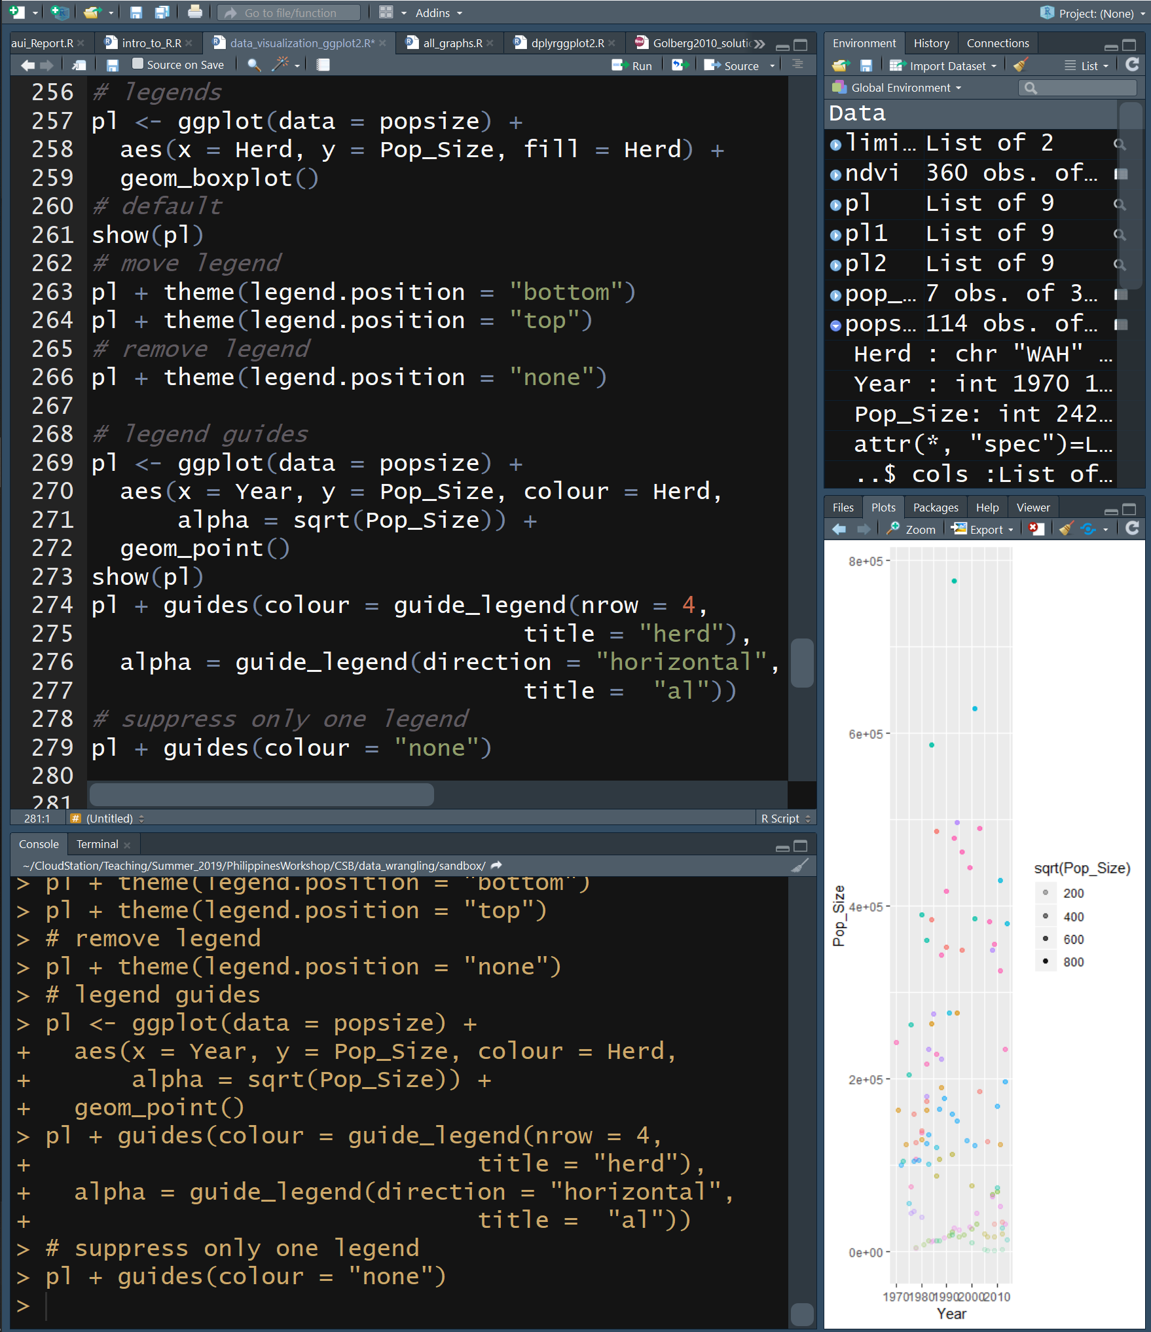
Legends
By default, legends are on the right, but you can control their position
theme(legend.position = “location”)
If the same column is mapped to both size and colour, one legend is made
If different features of the data are mapped into different aesthetics, legends are made for each feature
Each legend has guides() to change the legend title and features
  For more info read documentation on guide_legend
Note the use of + to continue the “sentence”

Slide 24
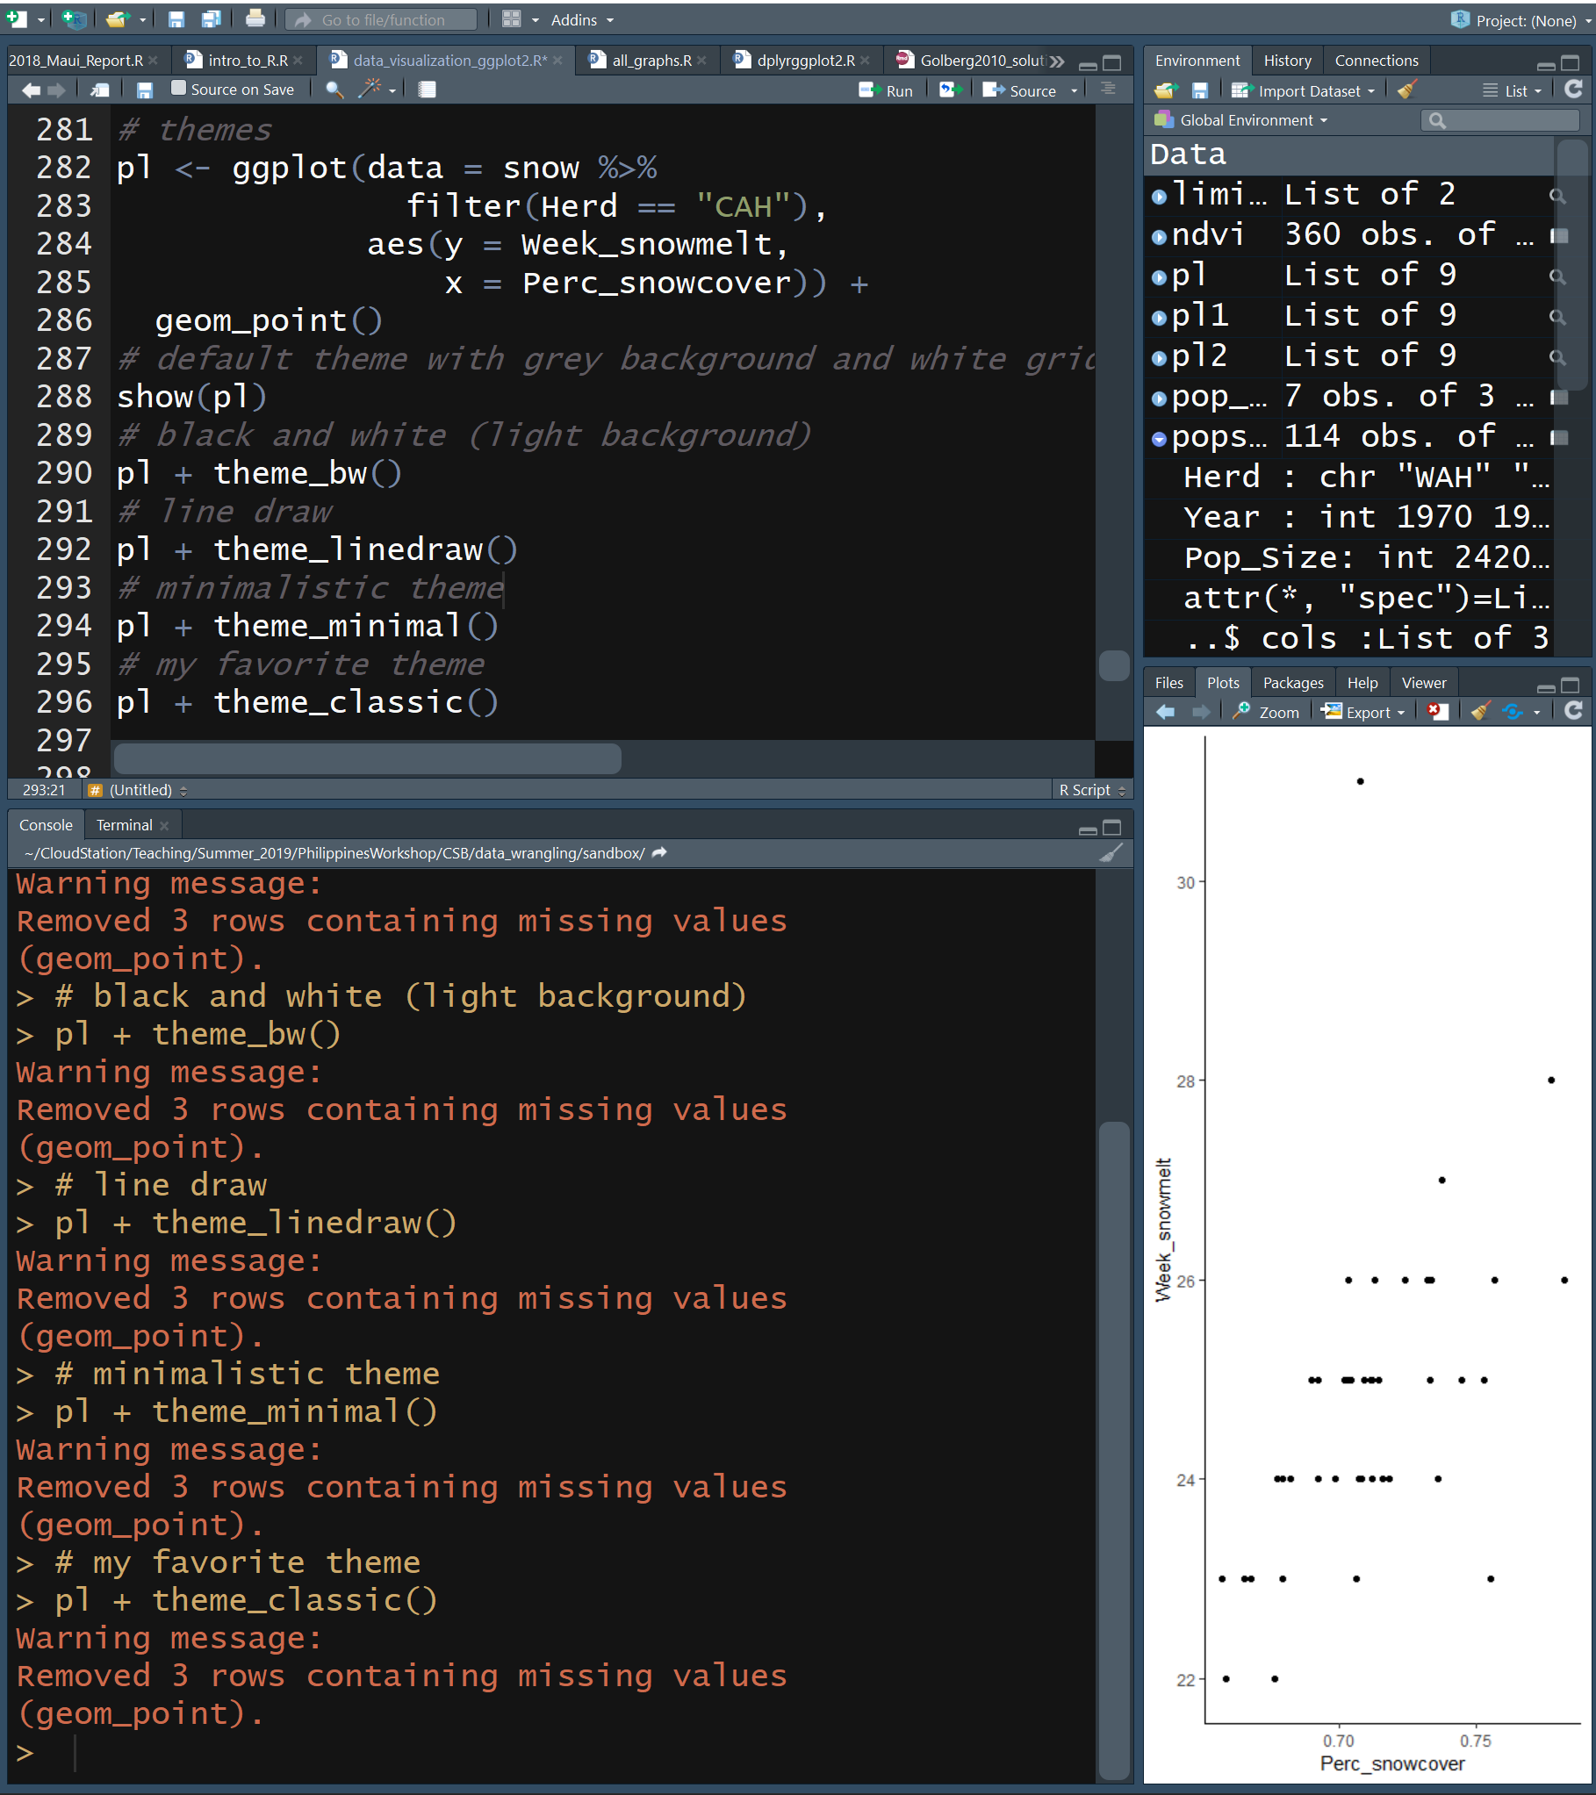
Themes
The general appearance of a plot can be controlled with themes
theme()
  Control each element of theme independently
  See documentation
There are several preset themes
  theme_bw()
  theme_minimal()
  theme_classic()
It’s possible to create your own themes
  See documentation
Note the use of + to continue the “sentence”

Slide 25
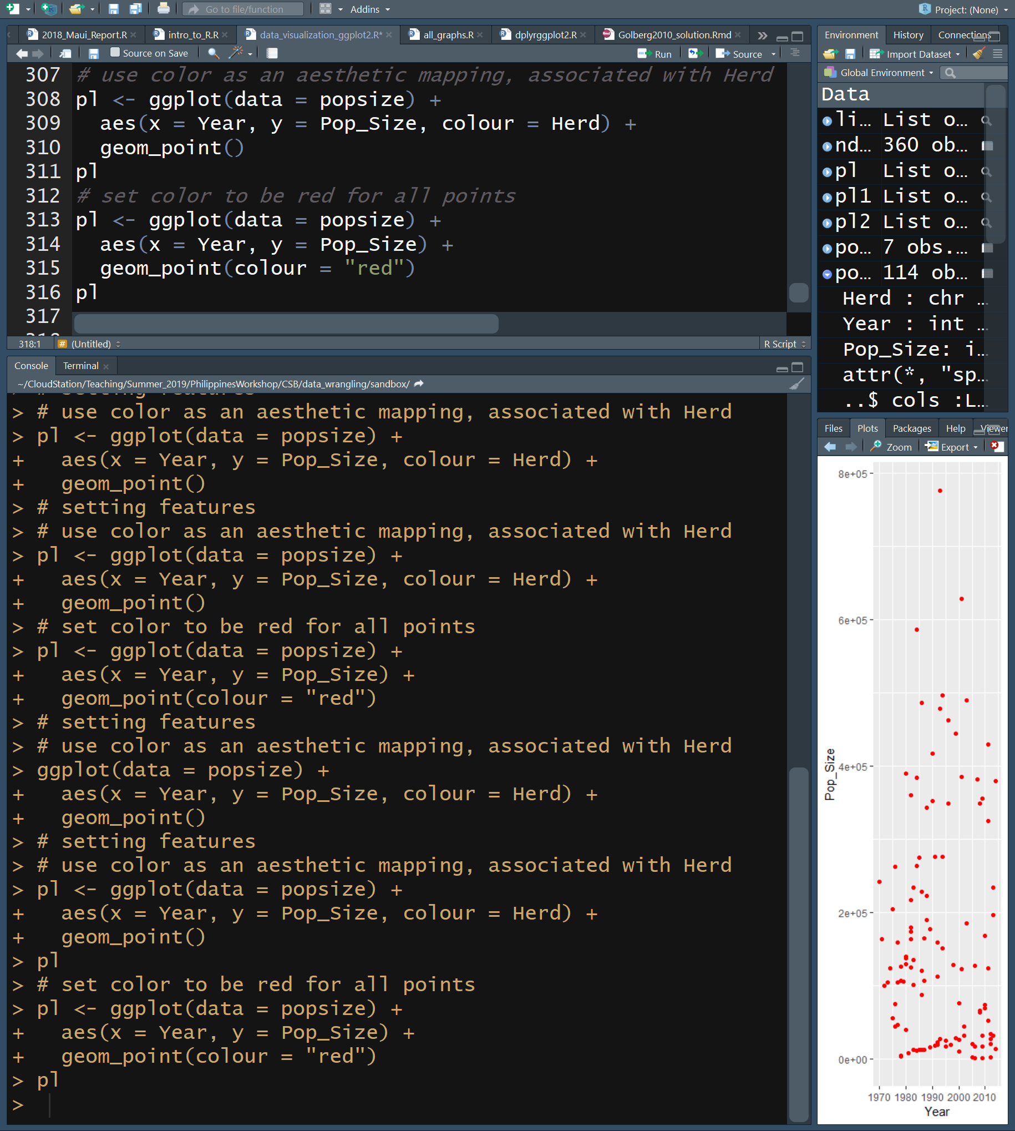
Setting a Feature
You can control the appearance of any and all features using ggplot
  geom_point(colour = “color”)
  Similarly, you can control size, shape, fill, alpha, and many other properties
Note the use of + to continue the “sentence”

Slide 26
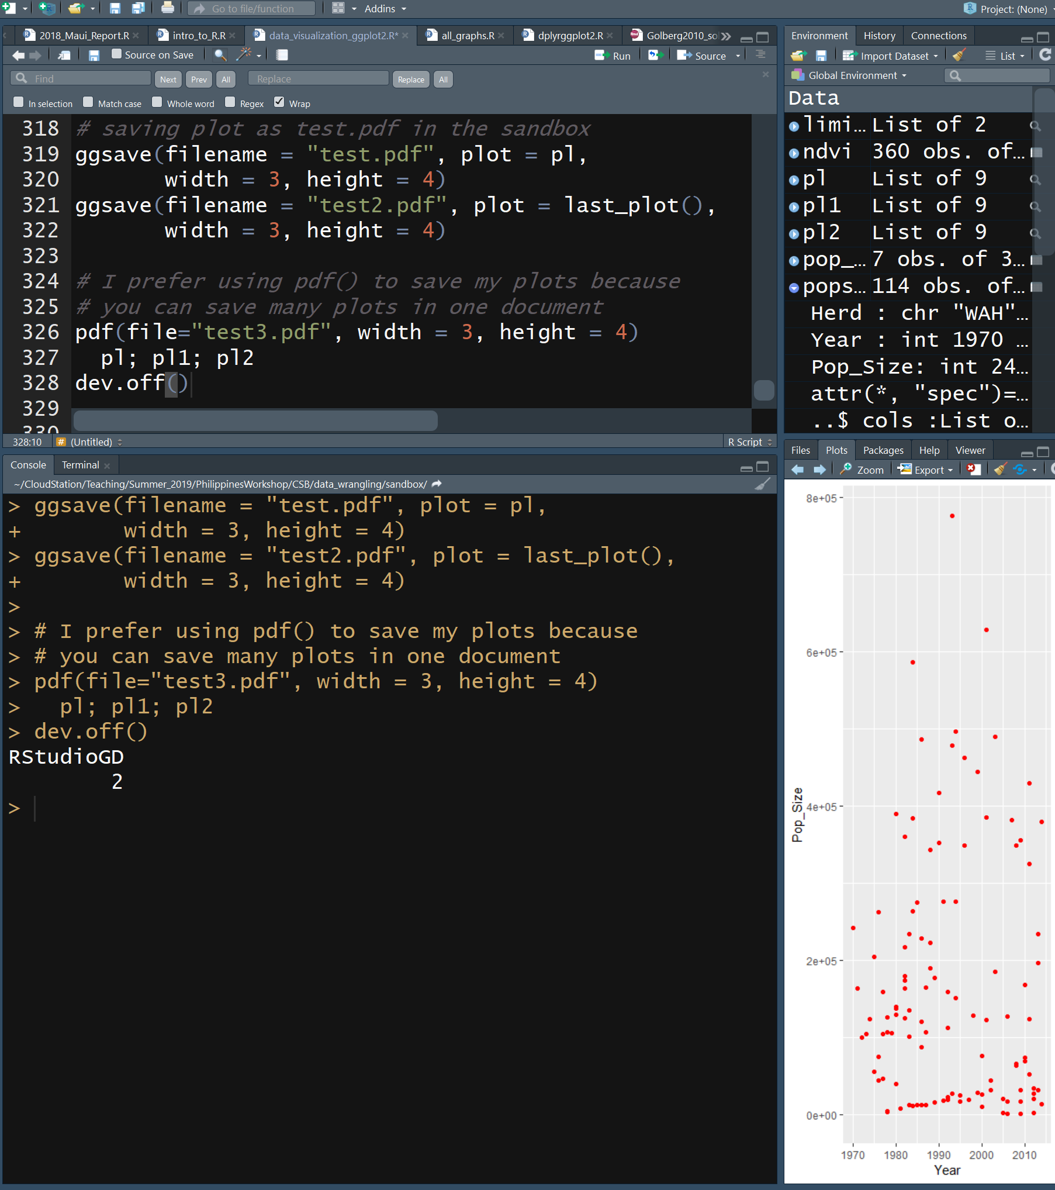
Saving a Figure
You can save your plots to a file with a certain size
ggsave(filename, plot, width, height)
  Control each element of theme independently
  See documentation
To save multiple plots to one file with each page being a different file, use:
  pdf(filename, plot, width, height)
    All plots between pdf() and dev.off() will be included. See documentation
  dev.off()
If you don’t set the size of the figure, it will be scaled by the dimensions of the figure panel in R Studio
Note the use of + to continue the “sentence”

Slide 27
