Slide 1
Code for Climate
File Management

Slide 2
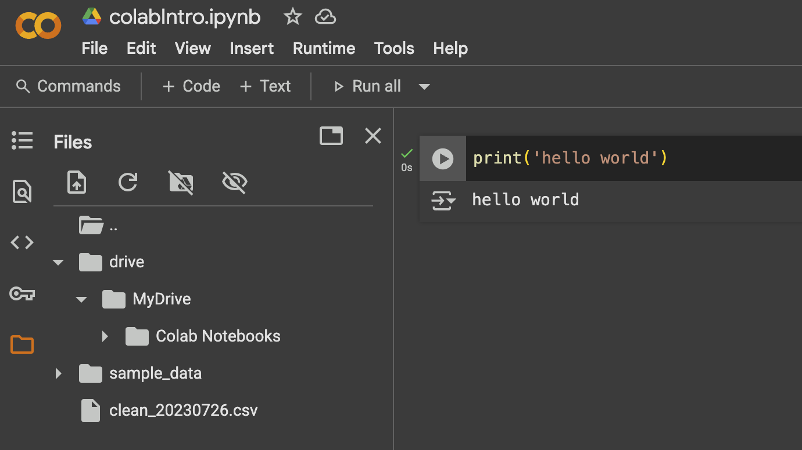
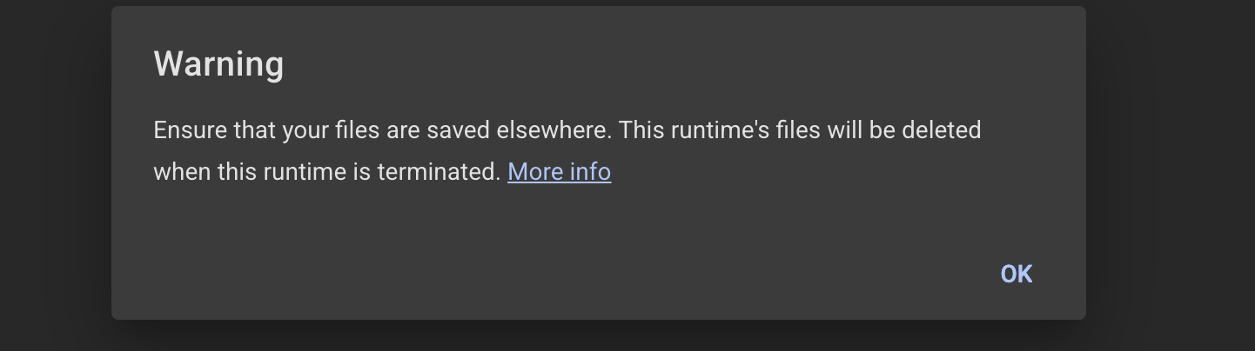
Working with External files
Import files to session storage
Drag and drop the files into the Files tab in the sidebar
Click on the upload icon in the top row of the Files tab and select the file you want to upload from your file manager.
Note: Files uploaded to session storage get deleted when runtime is terminated, ensure you save your files on your computer.

Slide 3
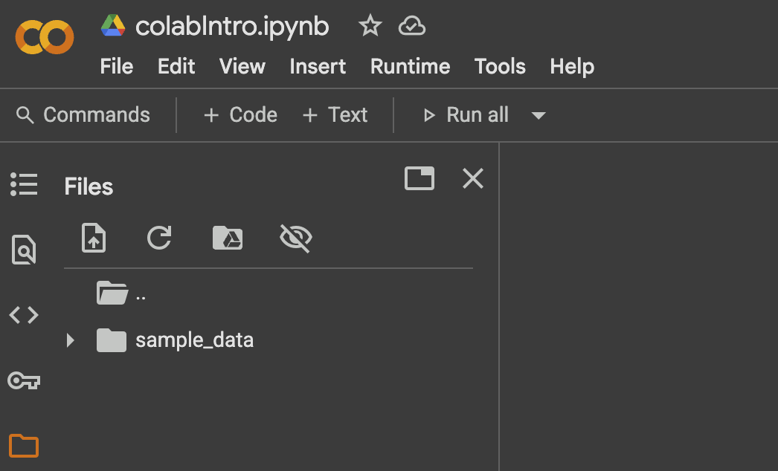
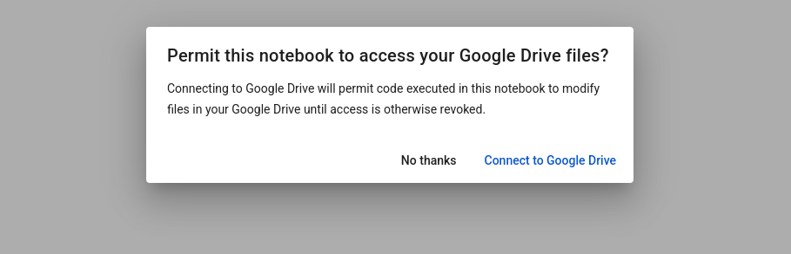
Connect to Google Drive
2
Easily access files
Prevent losing files on runtime disconnection
Best Practice for external files
Connect Google Drive
Add path to the file in your google drive.
1
3

Slide 4
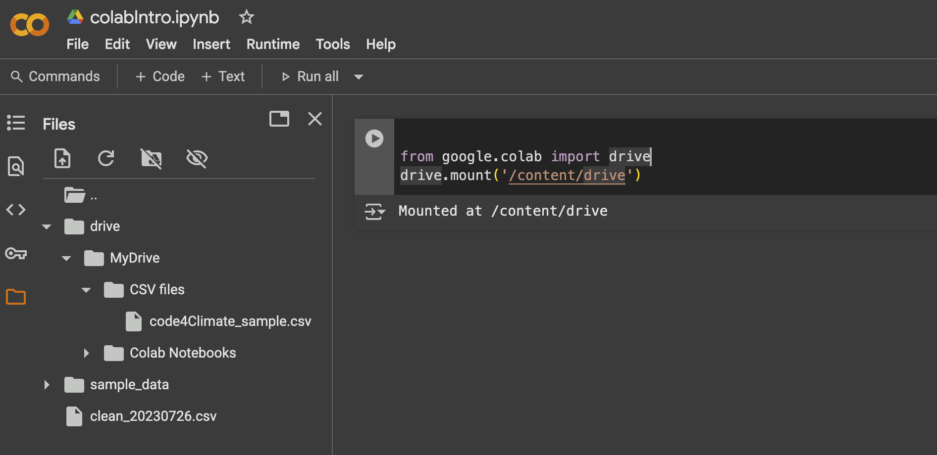
Connect Google drive using code
Best Practice for external files
Connect Google Drive
Add path to the file in your google drive.
from google.colab import drive
drive.mount('/content/drive’)

Slide 5
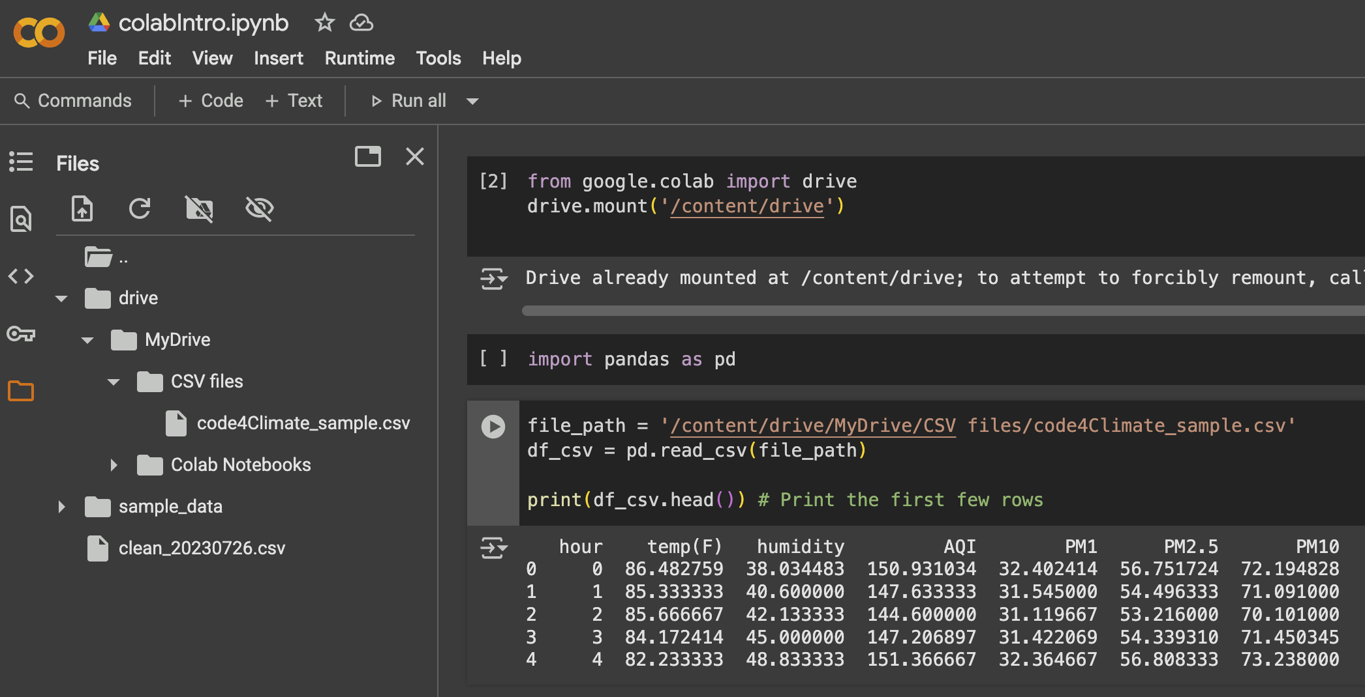
View CSV file
from google.colab import drive
drive.mount('/content/drive’)
file_path = '/content/drive/MyDrive/path\to\folder’
Import pandas as pd
df_csv = pd.read_csv(file_path) print(df_csv.head()) # Print the first few rows
You can view the slide added using pandas

