Slide 1

Closure
We learned about logical operators and conditional statements
We saw how we can store a series of data using lists
We learned to automate using loops
And, we used functions to reduce repetitive works
Tomorrow, we will work with modules (a large set of specific in-built functions that can be used in our code)
And we will see how to visualize our data

Slide 2
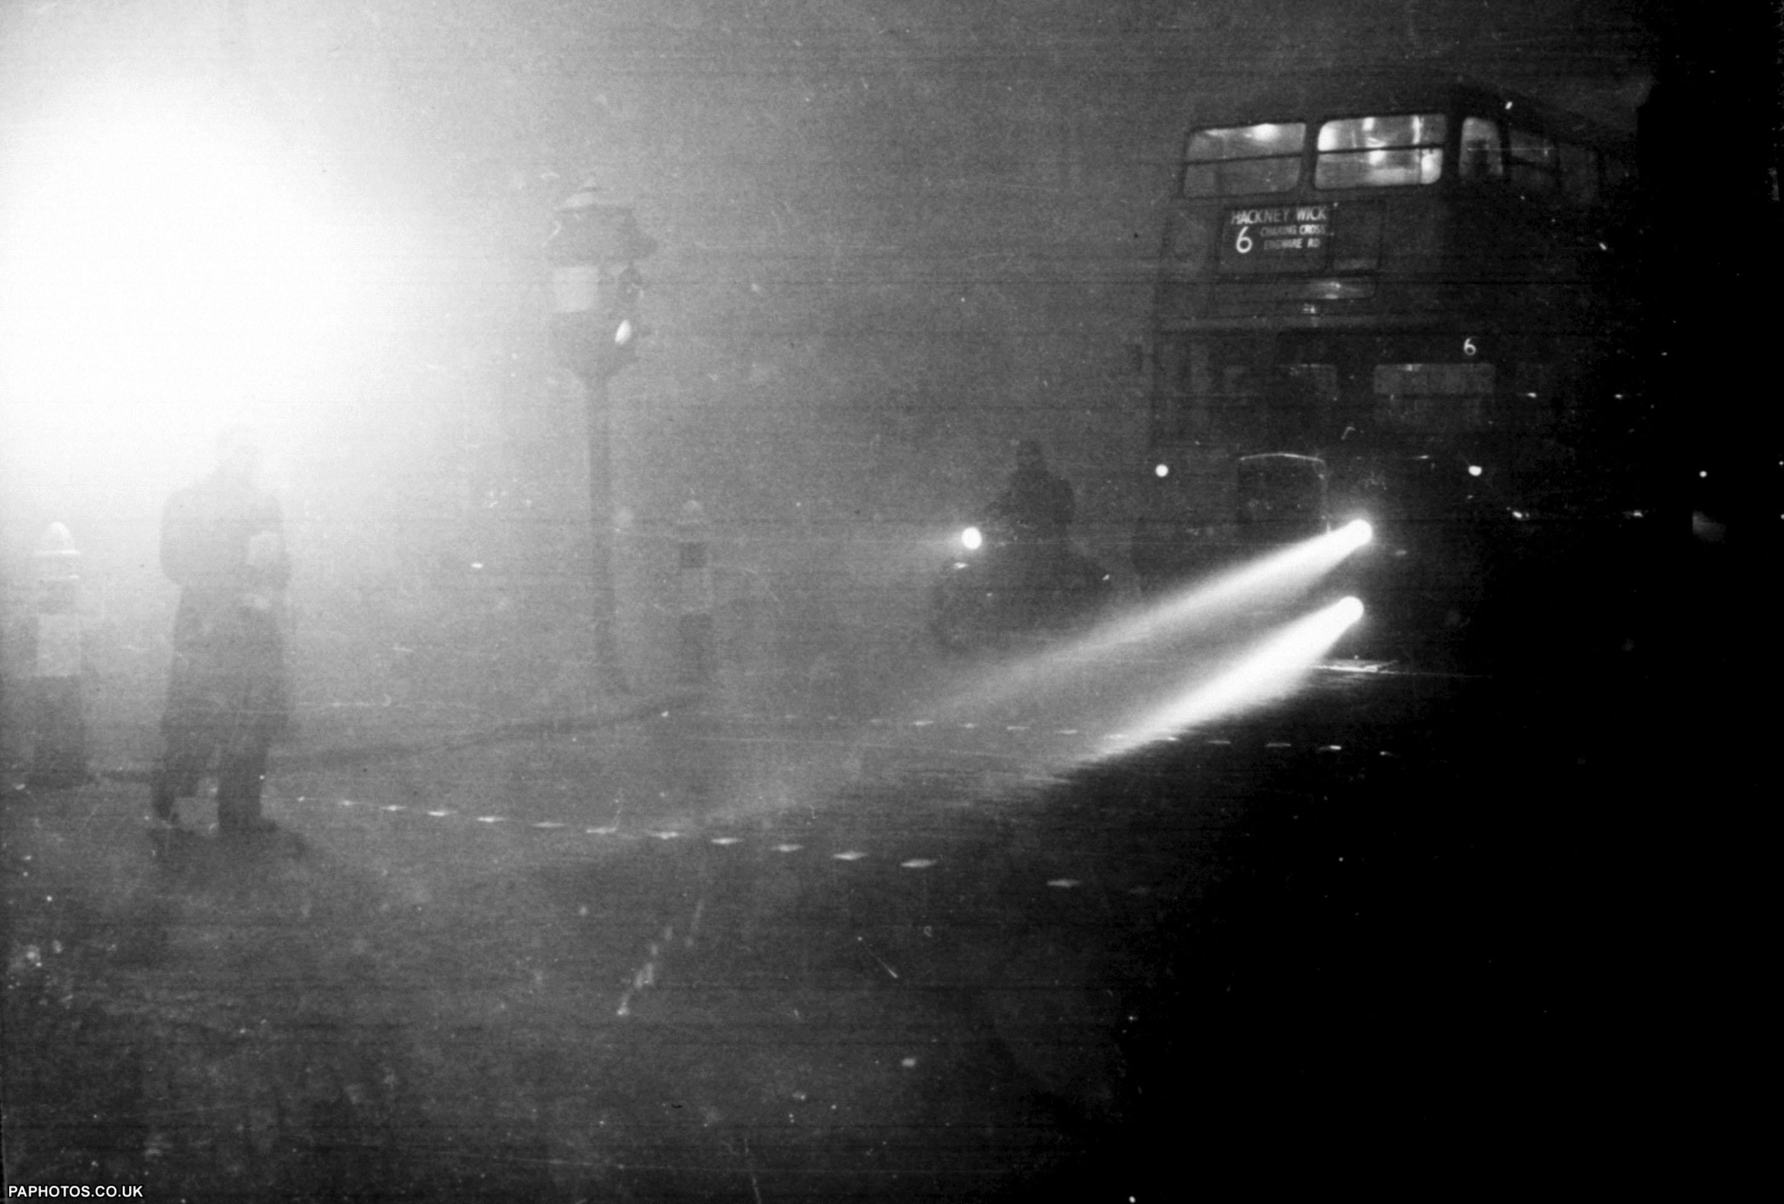
6 Dec 1952, London at 2 pm

Slide 3

Air Quality Index (AQI)
6 Dec 1952, London at 2 pm
Definition
Units of Measure
Reporting
The AQI is an index used to indicate how polluted the air is in a certain location. It takes into account several air pollutants deemed harmful to human health.
AQI values range from 0 to 500. A low number means the air quality is good while a high number indicates serious health risks.
AQI is reported in real-time on environmental agencies' websites and apps, and it's usually color-coded to indicate how hazardous it is.

Slide 4
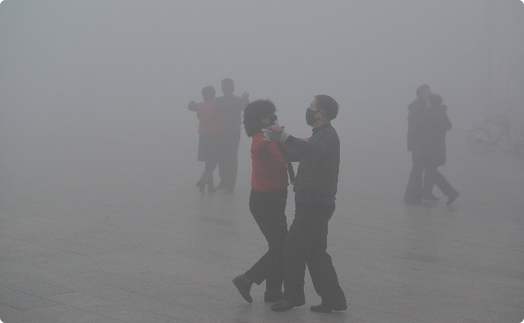


The Importance of AQI
Health
Economic
Environment
AQI is crucial to safeguarding public health as high AQI indicate polluted air and can cause respiratory diseases and other chronic illnesses.
AQI has an immense effect on economies, as polluted cities receive fewer tourists and have higher healthcare costs.
Although AQI is a metric based on public health, it’s connection to pollutants mean high AQI will harm the ecosystem and the climate.

Slide 5
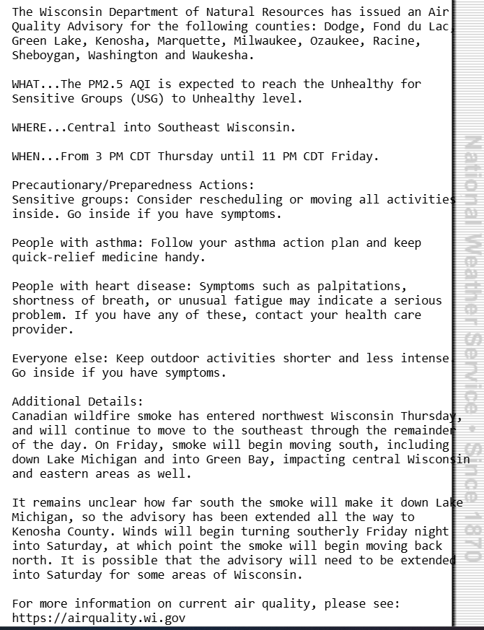
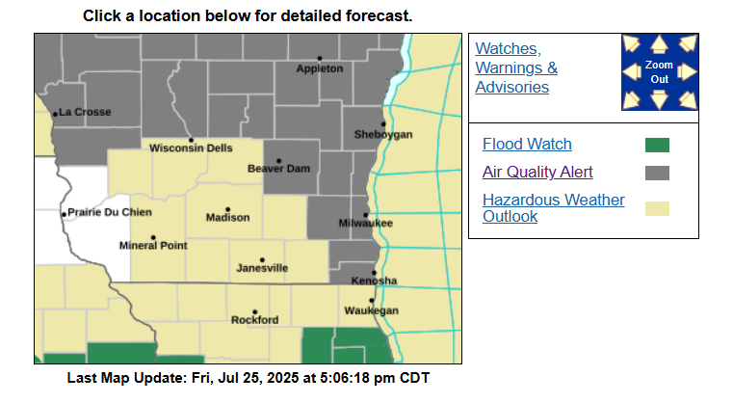
Last week we were under an air quality alert!

Slide 6
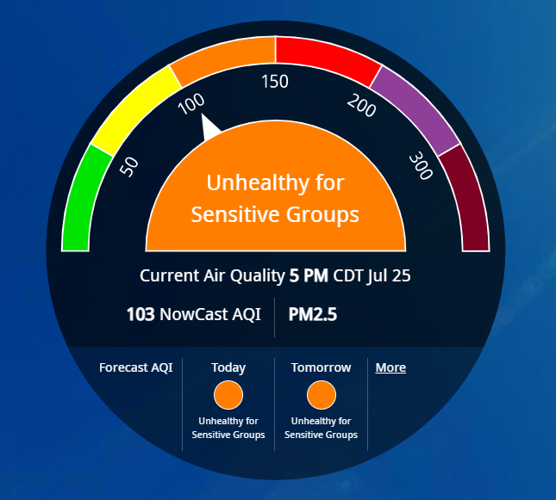
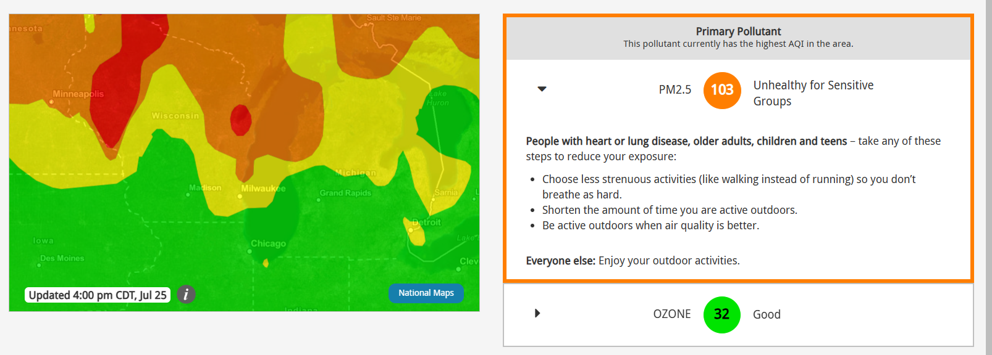
We had a high AQI

Slide 7
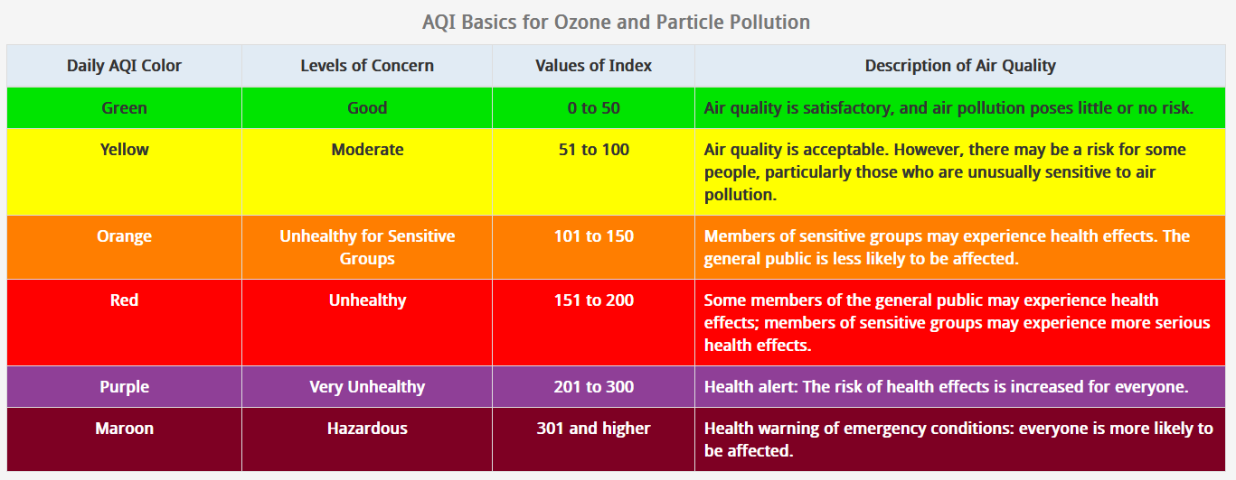

Slide 8
Responsibilities
Stay Informed
Take Action
Spread the Word
Be aware of AQI updates in your area and how they might impact your health and daily routine.
Take steps to reduce your personal contribution to air pollution, such as recycling, using public transport, and running your home energy efficiently.
Help raise awareness about AQI and its impact on human health and the environment.

