Slide 1


Introduction to the course and final project specifications
Silvio Peroni silvio.peroni@unibo.it – https://orcid.org/0000-0003-0530-4305 – @essepuntato
Data Science (A.Y. 2021/2022)
Second Cycle Degree in Digital Humanities and Digital Knowledge
Alma Mater Studiorum - Università di Bologna

Slide 2
Data Science
A preliminary introduction to the basic tools that enable you to start a
project
(and get the final score for the integrated course “Computational Management of Data”)

Slide 3
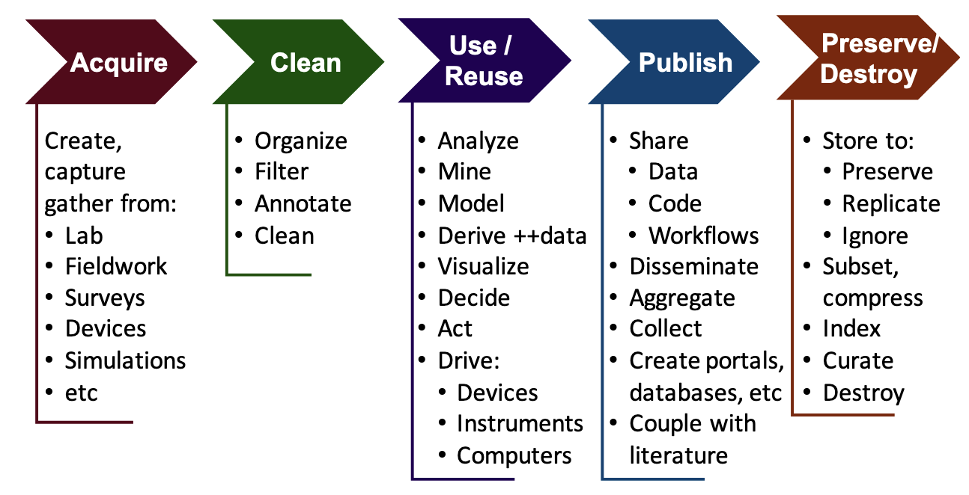
Data Science life cycle (and what we will address)
DHDK
Data
Science
course
(this course)
DHDK
Open
Science
course
(optional 2nd year course)
Berman, F., Rutenbar, R., Hailpern, B., Christensen, H., Davidson, S., Estrin, D., Franklin, M., Martonosi, M., Raghavan, P., Stodden, V., & Szalay, A. S. (2018). Realizing the potential of data science. Communications of the ACM, 61(4), 67–72. https://doi.org/10.1145/3188721

Slide 4

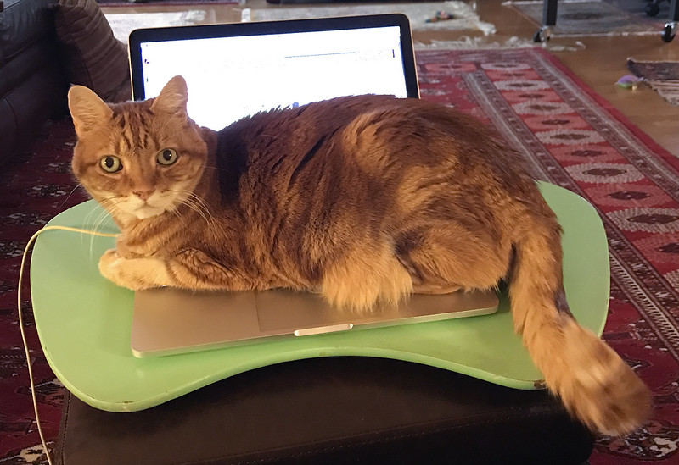
It is a practical course
Computer, your best friend
Gettysburg College, https://www.flickr.com/photos/gettysburgcollege/3082146647/; A.Davey, https://www.flickr.com/photos/adavey/40903187052/

Slide 5
Rules
Let's see the rules of this course:
There are no text books provided: if you have a doubt, google it
Material that will be introduced in the course can be found on the GitHub repository of the course
If you cannot attend, do not attend (even if attendance is highly recommended: you can ask questions)
At least six exam sessions per academic year
Max score one can obtain is 32 (out of 30)

Slide 6
Course material
All the material (including slides) is available in the GitHub repository of the course at https://github.com/comp-data/2021-2022/
Have you found a mistake in the material? Please write me an email at silvio.peroni@unibo.it
Some (partial) suggested (external) material (for Python and data management with Python):
Peroni, S. (2020). Computational Thinking and Programming book. https://comp-think.github.io
Tagliaferri, L. (2018). How To Code in Python. ISBN: 978-0999773017. https://www.digitalocean.com/community/books/digitalocean-ebook-how-to-code-in-python
Walsh, M. (2021). Introduction to Cultural Analytics & Python. https://melaniewalsh.github.io/Intro-Cultural-Analytics/
The Programming Historian. ISSN: 2397-2068. https://programminghistorian.org/en/
Dombrowski, Q. (2020). Jupyter notebooks for digital humanities. https://github.com/quinnanya/dh-jupyter

Slide 7
Communications
We use a Slack discussion group for communicating with each other
Slack is a communication platform offering many IRC-style features, including persistent chat rooms (channels) organized by topic, private groups, and direct messaging, and can be used in any device (it has been developed for mobile and desktop devices)
Invitation link to join the workspace:
https://join.slack.com/t/essepuntato-uni/shared_invite/zt-11x0yju5e-mIRqjP_7dcew~yFDJ4G0vg
Once you entered in the workspace following the previous link, you will be added to the private channel dedicated to the course (“data-science-21-22”) by me (just poke me if I forgot to add you after one day, OK?)
Please, do a Slack account as soon as possible (e.g. during the break) since I will close the invitation link in at the end of this week – and we will start to use it since Wednesday

Slide 8
Interacting
We will use the GitHub repository of the course for a series of activities, such as exercises and raising issues
All questions about coding to ask to either me or your fellows must be asked as new issues
Thus, please, create a new account on GitHub: https://github.com/join
Once logged into GitHub, go to the issue page of the course repository, and then feel free to add and respond to issues there
A very introductory guide to GitHub can be find online

Slide 9
Course organisation
This introductory lecture + a series of
(highly-practical) theoretical lectures (7 lectures, 14 hours), where I provide a theoretical introduction about the specific topic – computer not necessary but you can bring it with you of course
hands-on sessions (7 lectures, 14 hours), where I run a laboratory activity session based on existing tools that enable the experimentation with the topics introduced in the theoretical lectures – computer mandatory
In case you do not have a laptop, there is the possibility to use a remote service using the computers in Aula Affreschi (please contact me in the break if you are in this situation)

Slide 10
Course calendar
All lectures 12:30 - 14:30, lectures in red, hands-on in blue
02/02/2022 | What is a datum and how it can be represented computationally
04/02/2022 | Data formats and methods for storing data in Python
07/02/2022 | Introduction to data modelling
09/02/2022 | Implementation of data models via Python classes
11/02/2022 | Processing and querying the data
14/02/2022 | Introduction to Pandas
16/02/2022 | Database Management Systems
18/02/2022 | Configuring and populating a relational database
21/02/2022 | SQL, a query language for relational databases
23/02/2022 | Configuring and populating a graph database
25/02/2022 | SPARQL, a query language for RDF databases
28/02/2022 | Interacting with databases using Pandas
02/03/2022 | Describing and visualising data
04/03/2022 | Descriptive statistics and graphs about data using Pandas

Slide 11
Exam
The exam consists of
the implementation of a project – yes, you have to write a software, and the specifications will be introduced today
an oral colloquium on the project implemented, for assessing the contribution of each student
It will be assigned maximum 16 points for the correctness of the project – I will run a series of tests aiming at assessing all the code developed
The points above are assigned to all the students that have worked to the project
Other 16 points (maximum) will be assigned to each individual student as result of the oral colloquium

Slide 12
Groups
You have to organise in groups
3-4 people (not less, not more)
You have to choose a name for the group (please, be creative)
Before the next lecture, I will post a link on Slack to subscribe your group
In working on the project, I would strongly suggest to split the work, so as to have a reasonable amount of code to implement

Slide 13
Registering final grade
As you know, this course is just a module of an Integrated Course (I. C.)
Computational Management of Data (Integrated Course)
Module 1: Computational Thinking and Programming (first semester course, done)
Module 2: Data Science (this course!)
You can register only the final grade of the Integrated Course, which is computed as the average of the final scores of the two modules (max. 30L each module)

Slide 14
Evaluation of the course
The last lectures of the course, you will be asked to fill-up a questionnaire on the organisation of the course and related stuff - it is anonymous, of course
Please, do it carefully and honestly, since it is one of the most important inputs I will have to understand what can be improved in the next year course
This is the very first year for this course, and thus it is crucial to have your feedback in order to understand how to improve it for the next year

Slide 15
JupyterLab
JupyterLab is a web-based interactive development environment for notebooks, code, and data
You need to have Python installed to running Jupyter – you can find instruction for installing Python in the first laboratory lecture of the Computational Thinking and Programming course
To install JupyterLab, you can use the command pip as follows:
pip install jupyterlab
It will be used for all the hands-on sessions, thus be sure to have it available on your computer, and the website includes a very good documentation, while a lot of tutorials are available online

Slide 16
The project

Slide 17
Overall goal of the project
Develop a software that enables one
to process data stored in different formats and to upload them into two distinct databases
to query these databases simultaneously according to predefined operations
The software must be accompanied by a document (i.e. a Jupyter notebook) describing the data to process (their main characteristics and possible issues) and how the software has been organised (name of the files, where have been defined the various Python classes, etc.)
Information about the project can be found in the GitHub repository of the course (and will be updated in due course)

Slide 18
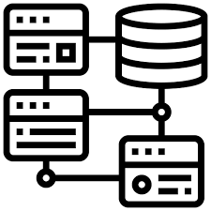

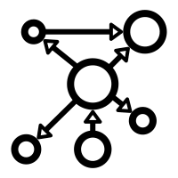
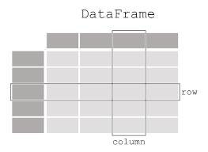


Workflow
Relational
database
Graph
database
RelationalQueryProcessor
GraphQueryProcessor
RelationalDataProcessor
GraphDataProcessor
GenericQueryProcessor
Python objects

Slide 19
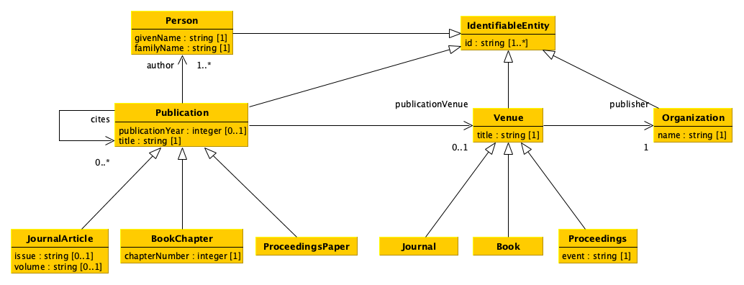
Data model

Slide 20
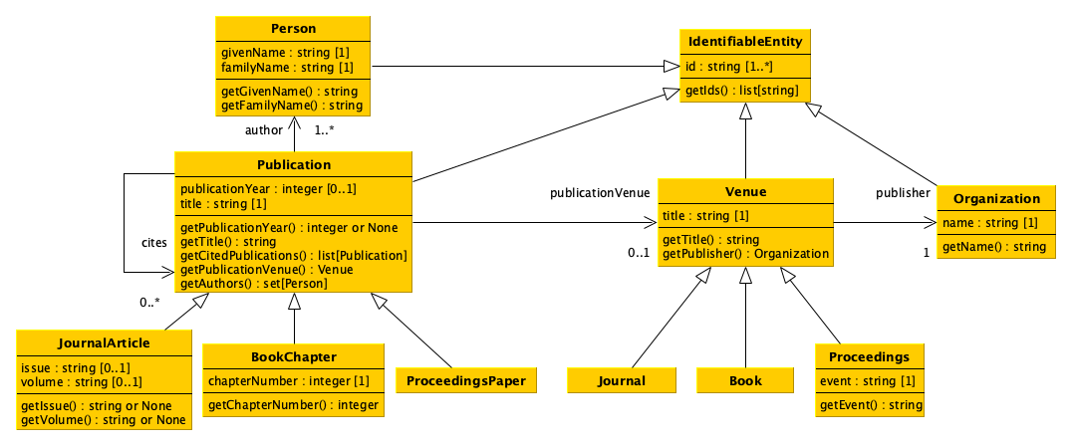
Software: UML diagram (1/2)

Slide 21
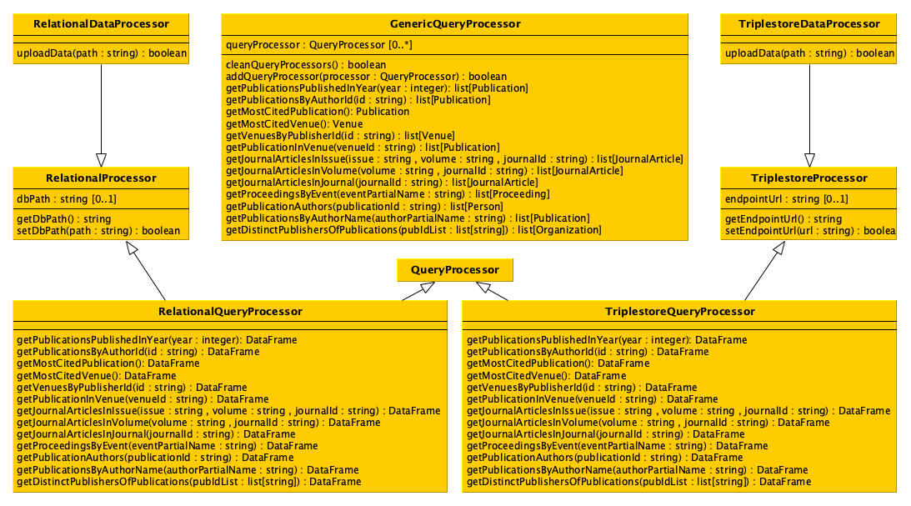
Software: UML diagram (2/2)

Slide 22
Submission of the project
You have to provide all Python files implementing your project, by sharing them in some way (e.g. via OneDrive)
You have to send all the files one week before the exam session you want to take
The schedule of the first four exam sessions are as follows:
16 May 2022, 11:00-16:00
20 June 2022, 11:00-16:00
15 July 2022, 11:00-16:00
5 September 2022, 11:00-16:00

Slide 23
Suggestion: use the test-driven development
You already know what is the test-driven development (TDD) – to refresh your memory, you can look at this slide (and scream…)
I strongly suggest you to systematically adopt this development technique for developing your code
In addition, there is at least a Python library available which has been entirely developed to facilitate the creation of tests, i.e. unittest
Online, you can find several documents describing how to create tests in Python, such as one at the Real Python website

Slide 24
End
Introduction to the course and final project specifications
Silvio Peroni silvio.peroni@unibo.it – https://orcid.org/0000-0003-0530-4305 – @essepuntato
Data Science (A.Y. 2021/2022)
Second Cycle Degree in Digital Humanities and Digital Knowledge
Alma Mater Studiorum - Università di Bologna

