Slide 1


Introduction to data modelling
Silvio Peroni silvio.peroni@unibo.it – https://orcid.org/0000-0003-0530-4305 – @essepuntato
Data Science (A.Y. 2021/2022)
Second Cycle Degree in Digital Humanities and Digital Knowledge
Alma Mater Studiorum - Università di Bologna

Slide 2
Summary of the previous lecture
A datum is a declarative statement subject-predicate-object that, through the predicate, either attributes a literal (i.e. a value such as a string, a number, etc.) to a subject entity or it relates such a subject entity with another entity
Each entity, being used either as subject or object of a statement, is characterised by a unique identifier
The same entity can be used as subject or object in one or more data
An attribute is intrinsically part of the entity to which it is associated
Modifying the value of an attribute affect only the entity to which it refers to
A literal cannot be used as subject in any datum

Slide 3
Any question about the previous lecture?

Slide 4
Predicates for attributes and relations
A predicate can be used either to define relations between a subject entity and an object entity or to specify attributes associated to an entity
However, as anticipated, it is a good practice to use the same predicate only to express one kind of data (either only attributes or only relations) to avoid ambiguities that may become difficult to handle
Question 1 How can we explicitly specify how to use a certain predicate, so as to avoid such ambiguities?

Slide 5
Data correctness
Question 2 Is it possible to computationally claim that a collection of data is correct?
Entity 1
is a
Journal
is part of
Entity 2
is a
Journal article

Slide 6
Data explanation
One of the activity we have to deal with when we have and handle a large collection of data is to explain to possible users and adopters what such data are about
Usual scenario: the person who was in charge of a information system and who handled the data of a company was fired, and has been substituted by a new employee. How can the newcomer to understand what such data are about?
Question 3 Can we explain the shape that data can have in a collection?

Slide 7
Data model
The answer to the three previous questions is that of defining a data model
A data model is an abstract and simplified representation of data of either a system or a real domain
In the context of this course, a data model is usually created through mathematical tools that define kinds of entities, their attributes and their relations
The adoption of such mathematical tools enables a formal definition of such a data model, so as to be used to assess data compliance against the data model through computational and automatic processes (e.g. to check the correctness of the data)

Slide 8
Types of entities
A data model enables the explicit definition the types of the entities described in the data – it is worth mentioning that each entity is assigned to at least one type (i.e. one class of entities)
A class of entities is the representation of a collection of entities compliant with the same description (i.e. set of attributes and relations) defined by such a class, for example:
All of you who are attending this lecture (the entities) are people (the class)
All the people who are enrolled in a course at any Italian university (the entities) are students (the class)
A data model permits the specification of such classes, their attributes and the relations they have with other classes (and, consequently, between the occurrences of such classes, that are the entities having those particular types)

Slide 9
Creating data models with UML
There are various languages that can be used to define a data model that facilitate also its consumption by humans
Among these languages, the Unified Modeling Language (UML) is one of the best well-known examples widely used in Informatics, in particular the class diagram which can be used to define classes, attributes and relations
UML is supported by several visual editors – among those, the yEd graph editor is a viable, flexible and free alternative which is supported by Mac, Windows, and Linux, and already includes a simple palette for UML diagrams

Slide 10
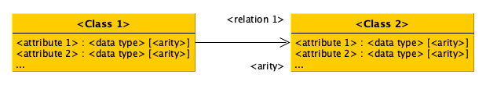
Widgets used in UML class diagrams
Classes are represented by rectangles with an header which represent the name of the class
Such boxes also include (if any) the attributes associated to the related classes, which are defined specifying their name, the data type of the values attributed and the arity of such attributes: exactly one (1), zero or more (0..*), one or more (1..*), zero or one (0-1)
Relations are defined using an arrow from the source class to the target class, accompanied by a label (i.e. the name of the relation) and the related arity

Slide 11
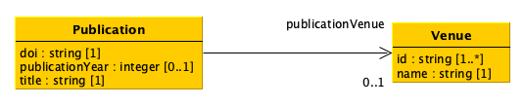
A first example
All publications are identified necessarily by one and only one Digital Object Identifier (DOI), and are characterised by their title and, if known, their publication year. In addition, they may have been published within a particular venue.
Each venue is identified by at least one identifier and have always specified one name

Slide 12
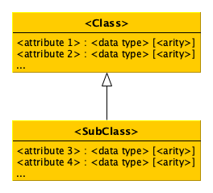
Defining subclasses
It is possible to specify more concrete specification of a given class, i.e. subclasses, by using a special arrow without any label specified on it
The subclass inherits all the attributes and relations defined in the parent class – meaning that they are defined also for all the entities that are occurrences of the subclass
In addition, the subclass may add new attributes and relations that apply only to it

Slide 13
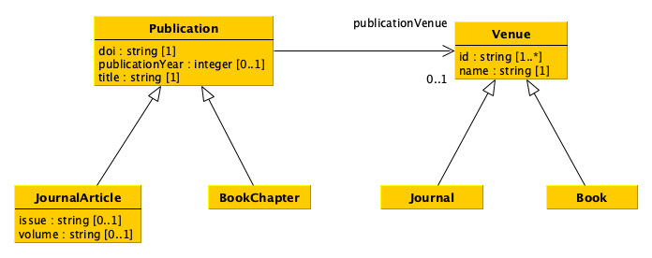
Final example
Among the publications, there are journal articles and book chapters, published in journals and books respectively. Journal articles also may specify the issue number and the volume number in which they have been published.

Slide 14
Laboratory
Material:
An A4 sheet of paper
A pen
(alternatively, https://www.yworks.com/yed-live/ or similar)
Create the data model that enable one to describes the following scenario:
The article entitled “OpenCitations, an infrastructure organization for open scholarship” was published by the journal Quantitative Science Studies in 2020. The authors of this article, i.e. Silvio Peroni and David Shotton, also co-authored another conference paper entitled “The SPAR Ontologies”, that was published in the Proceedings of the Seventeenth International Semantic Web Conference, in 2018.

Slide 15
End
Introduction to data modelling
Silvio Peroni silvio.peroni@unibo.it – https://orcid.org/0000-0003-0530-4305 – @essepuntato
Data Science (A.Y. 2021/2022)
Second Cycle Degree in Digital Humanities and Digital Knowledge
Alma Mater Studiorum - Università di Bologna

