Slide 1


Describing and visualising data
Silvio Peroni silvio.peroni@unibo.it – https://orcid.org/0000-0003-0530-4305 – @essepuntato
Data Science (A.Y. 2021/2022)
Second Cycle Degree in Digital Humanities and Digital Knowledge
Alma Mater Studiorum - Università di Bologna

Slide 2
Summary of the previous lectures (1/2)
A datum is a declarative statement subject-predicate-object that, through the predicate, either attributes a literal (i.e. a value such as a string, a number, etc.) to a subject entity or it relates such a subject entity with another entity
Each entity, being used either as subject or object of a statement, is characterised by a unique identifier
The same entity can be used as subject or object in one or more data, while a literal cannot be used as subject in any datum
An attribute is intrinsically part of the entity to which it is associated – modifying the value of an attribute affect only the entity to which it refers to
A data model is an abstract, simplified and formal representation of some data related to a system or a real domain, and enables us to describe what a data collection is about and to check data correctness
A data model permit one to specify classes of entities, their attributes and relations

Slide 3
Summary of the previous lectures (2/2)
Depending on the structure in which data are stored (or exposed), you need to approach the queries to datasets from a different angle
With tabular data, often you have to combine tables between them to obtain bigger tables which contain the query requirements and the related answer
With graph data, you explore the graph starting from fixed points (i.e. known entities, values, predicates) to find a pattern that is compliant with the query
A database as a collection of data which organised, stored and accessed electronically, which can be created through a database management system (DBMS)
A transaction is a unit of work performed (compliant with ACID properties) within a DBMS against a database and usually represents any change in a database
SQL and SPARQL are a query languages used and designed for managing data in relational and graph-based database management systems respectively, and allows one to create data and to query them

Slide 4
Any question about the previous lecture?

Slide 5
Descriptive statistics
Descriptive statistics are a series of statistics which aim at describing quantitatively a collection of data
Such statistics do not infer new information from a given population, since it does not use probability at all, but it provides measure to summarise data as they are
Often, such statistics are accompanied by visual graphs that enable a reader to understand simply some of the aspects of a collection of data
Different kinds of measures:
measures of central tendency: mean, median, and mode
measures of variability: minimum, maximum, and standard deviation

Slide 6
Mean
In mathematics and statistics, the arithmetic mean or, simply, the mean is the sum of a collection of numbers divided by the count of numbers in the collection
For instance, consider the following years of publication of 10 articles
1962, 2005, 2007, 2011, 2011, 2013, 2014, 2016, 2019, 2022
the mean is
(1962 + 2005 + 2007 + 2011 + 2011 + 2013 + 2014 + 2016 + 2019 + 2022) / 10 =
2008

Slide 7
Median
The median is the value separating the higher half from the lower half of a data sample – it may be thought of as "the middle" value
Basic feature: it is not skewed by a small proportion of extremely large or small values, and therefore provides a better representation of a typical value
How to calculate it:
If the count of numbers n in a collection is odd, the median value is at index (n-1)/2 (starting indexing items from 0, as in Python list)
If the count of numbers n in a collection is even, the median value is the mean of the value at index (n/2)-1 and n/2 (starting indexing items from 0, as in Python list)
1962, 2005, 2007, 2011, 2011, 2013, 2014, 2016, 2019, 2022
0 1 2 3 4 5 6 7 8 9
(n/2)-1 n/2
→ (2011 + 2013) / 2 = 2012

Slide 8
Mode
The mode is the value that appears most often in a set of data values
For instance, consider the following years of publication of 10 articles
1962, 2005, 2007, 2011, 2011, 2013, 2014, 2016, 2019, 2022
the mode is 2011
For a sample where each value occur precisely once, the usual practice is to discretize the data by assigning frequency values to intervals of equal distance, as for making a histogram, effectively replacing the values by the midpoints of the intervals they are assigned to

Slide 9
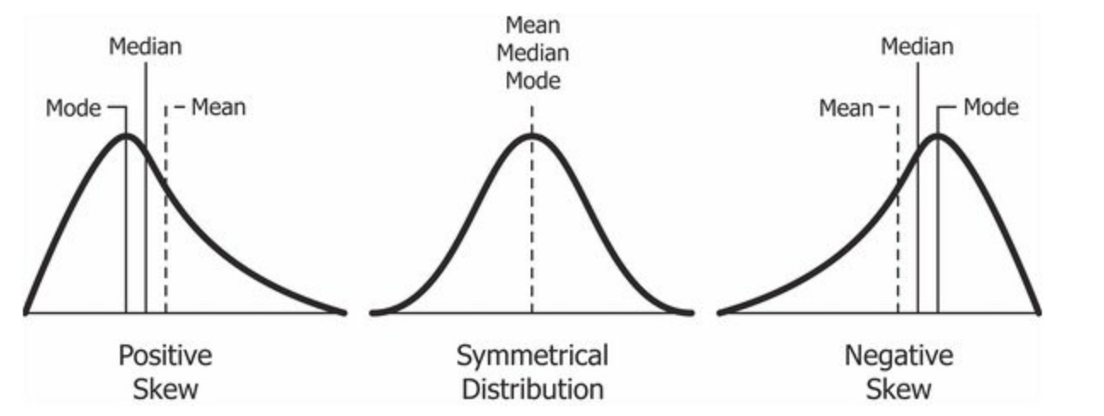
Why mean, median and mode can be different
The mean is largely affected by outliers, i.e. either small or large values that differ significantly from other observations
The median can be used as a measure of location when one thinks extreme values are of minimal or no importance, e.g. because a distribution is skewed
The mode is the same as that of the mean and median in a normal distribution, but it may be very different in highly skewed
Skewness. Wikipedia EN. https://en.wikipedia.org/wiki/Skewness

Slide 10
Minimum and maximum
The maximum and minimum are the values of the greatest and least elements of a collection
For instance, consider the following years of publication of 10 articles
1962, 2005, 2007, 2011, 2011, 2013, 2014, 2016, 2019, 2022
the maximum is 2022 and the minimum is 1962
If the sample has outliers, they necessarily include the sample maximum or sample minimum, or both

Slide 11
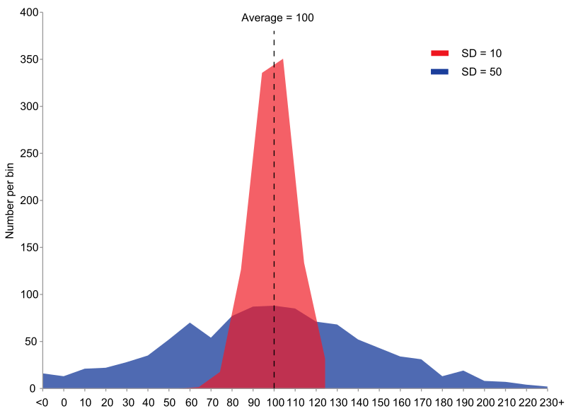
Standard deviation
The standard deviation measures the amount of dispersion of a set of values
Low standard deviation: the values tend to be close to the mean
High standard deviation: the values are spread out over a wider range
Standard deviation. Wikipedia EN. https://en.wikipedia.org/wiki/Standard_deviation

Slide 12
Visualisation
Visualisation techniques are of crucial important to effectively communicate a message to humans
Data visualisation concerns the techniques used to communicate (often statistical) information about data, that can be categorised according to specific labels or shown as an time-oriented evolution of observations
Data visualisation techniques may be combined, when needed, with information visualisation techniques, that are used to represent visually numerical and non-numerical data (e.g. text or geolocated information) to support human comprehension of a phenomenon

Slide 13
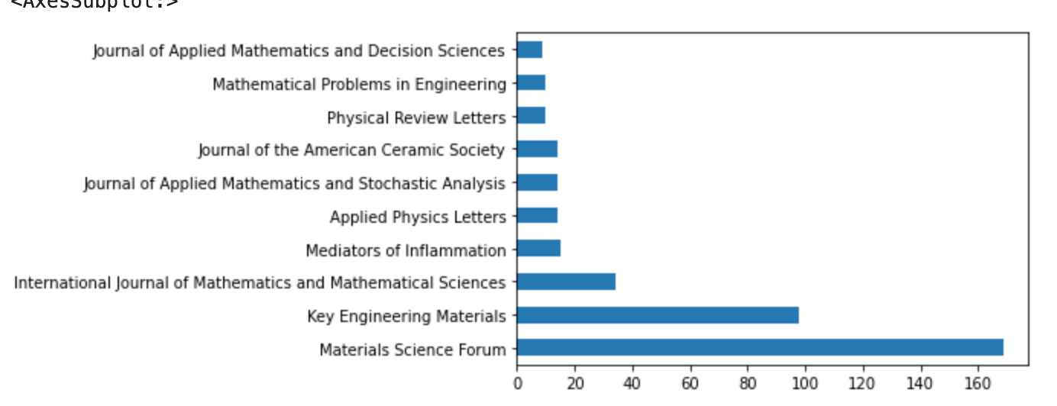
Bar charts
Bar charts are used to present categorical data – i.e. a variable that can take on one of a limited, and usually fixed, number of possible values – with rectangular bars with heights or lengths proportional to the values that they represent
The bars can be plotted vertically or horizontally

Slide 14
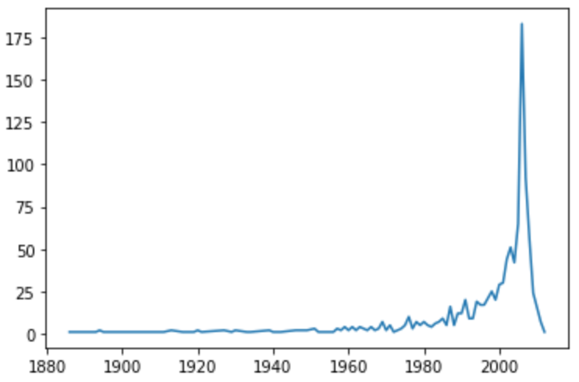
Time series
A time series is a series of data points indexed and ordered according to time, usually depicted as x-axis of a two dimensional graph
Commonly, a time series is a sequence taken at successive equally spaced points in time (e.g. years of publication)
A time series is very frequently plotted via a run chart (which is a temporal line chart).

Slide 15
Continuing working on data

Slide 16
Possible paths after Data Science
Open Science
Reproducibility
FAIR
Tools enabling good science
It requires an active and intensive participation of the students for its entire duration
Optional
second year
Data Science
Data
Data modelling
Database Management Systems
Describing, querying, visualising data
Mandatory
first year
Computational Management of Data
Computational Thinking and Programming
Algorithm
Data structures
Algorithmic techniques
Mandatory
first year

Slide 17
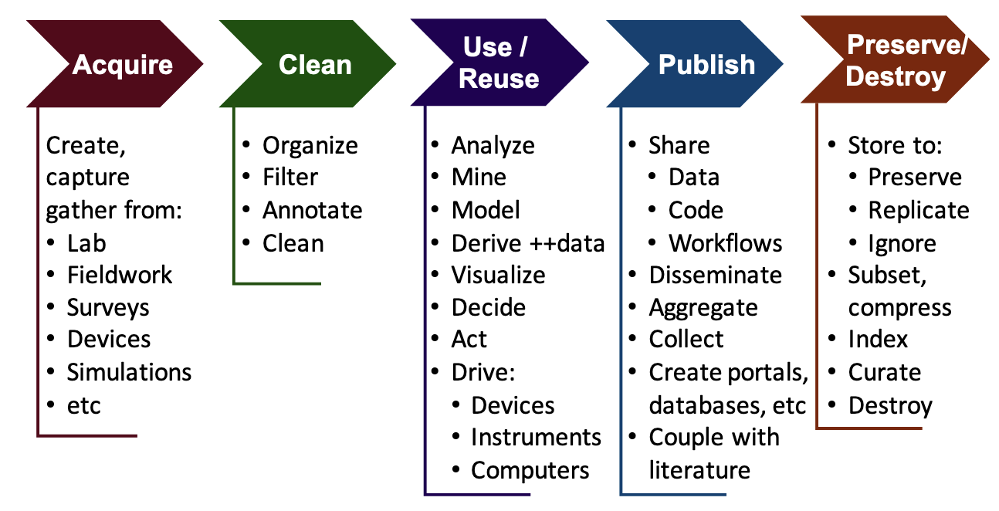
Data Science life cycle (a reprise)
DHDK
Data
Science
course
(this course)
DHDK
Open
Science
course
(optional 2nd year course)
Berman, F., Rutenbar, R., Hailpern, B., Christensen, H., Davidson, S., Estrin, D., Franklin, M., Martonosi, M., Raghavan, P., Stodden, V., & Szalay, A. S. (2018). Realizing the potential of data science. Communications of the ACM, 61(4), 67–72. https://doi.org/10.1145/3188721

Slide 18
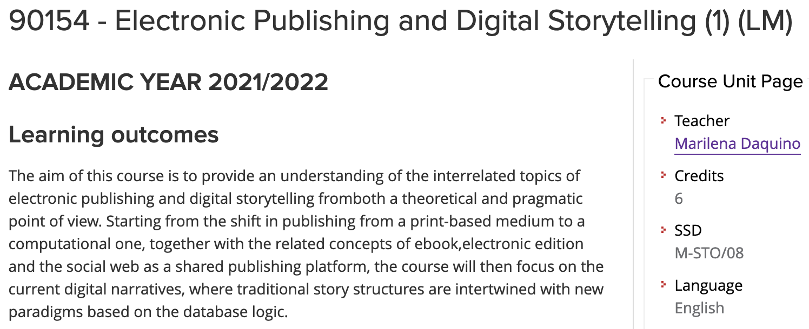
About narratives and visualisations
DHDK course of the second year
It will change name in Information Visualisation

Slide 19
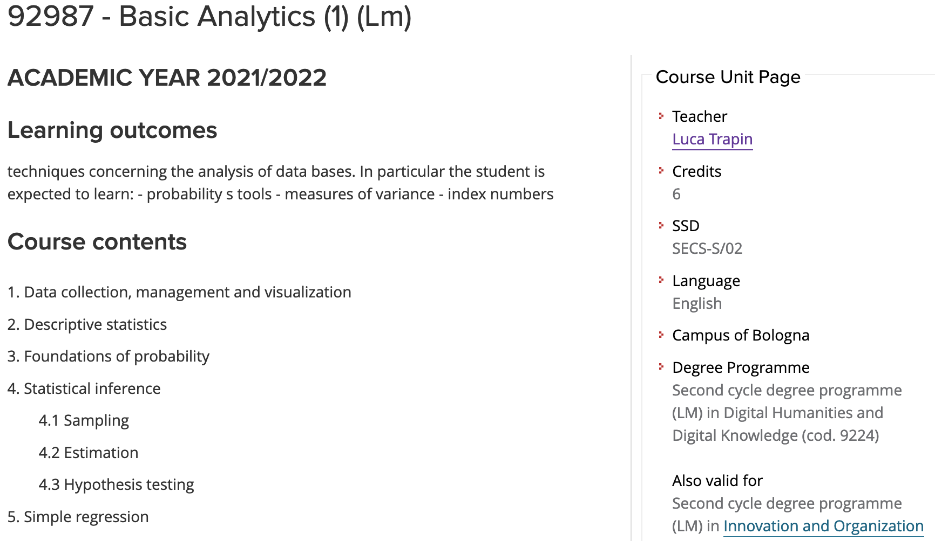
Descriptive and inference statistics
DHDK course of the second year
Crucial also for having an appropriate introduction to descriptive statistics…
… but, in particular, for having tools about probability and inference from an existing sample

Slide 20
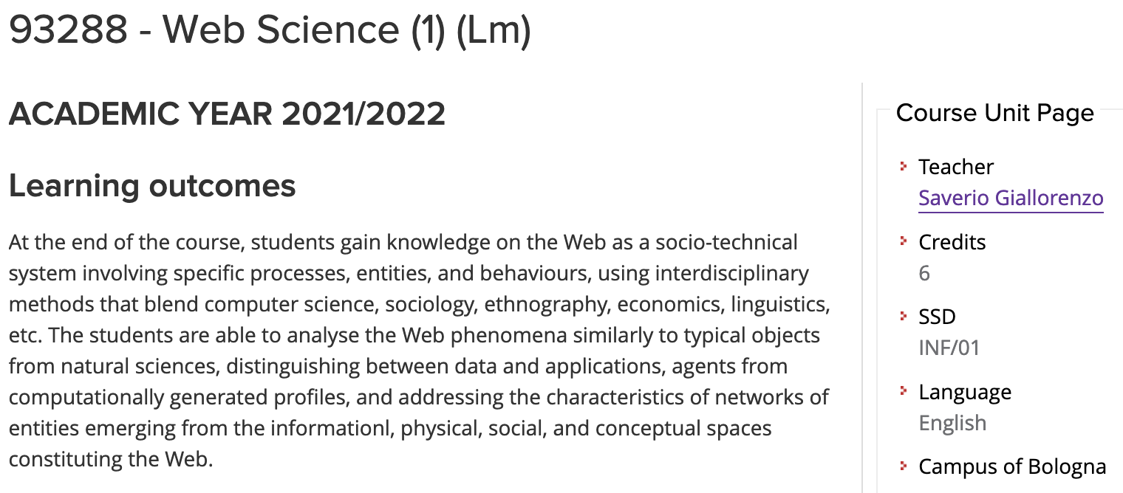
Studying networks (i.e. data)
DHDK course of the second year
It will change name in Network Analysis

Slide 21
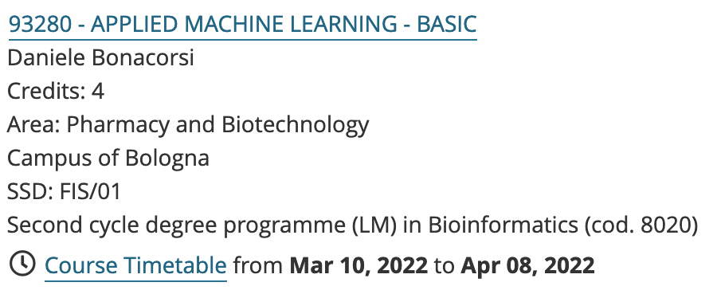
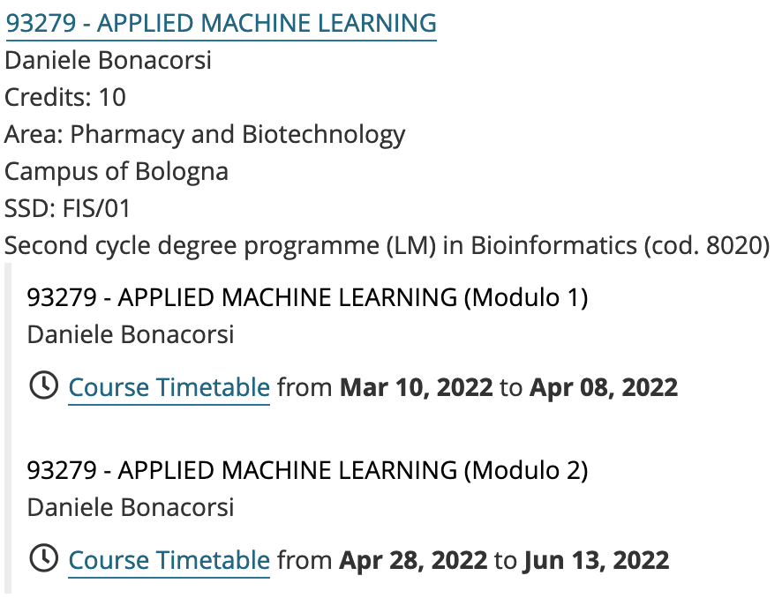
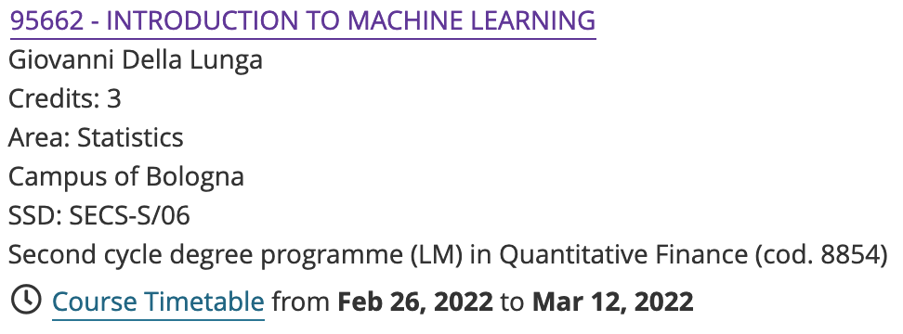
Machine learning
There are several course in UNIBO (external to DHDK) dedicated to machine learning, that you may include in your CV

Slide 22
Ask a thesis

Slide 23
Main topic
Semantic publishing: the latest revolution in scholarly publishing
The term has been introduced for the very first time by David Shotton, and concerns the enhancement of scholarly publications by the use of modern web standards to improve interactivity, openness and usability, including the use of ontologies to encode rich semantics in the form of machine-readable RDF metadata

Slide 24
What is an open citation
Citation: conceptual directional link from a citing entity to a cited entity
The citation data related to a particular citation must include:
the representation of such a conceptual directional link
the basic metadata of the citing entity and the cited entity, i.e. sufficient information to create or retrieve textual bibliographic references
A bibliographic citation is an open citation when the data needed to define the citation are: structured, separate, open, identifiable, available
Paper A
cites
Paper B
citation
Peroni, S., & Shotton, D. (2018). Open Citation: Definition. Figshare. https://doi.org/10.6084/m9.figshare.6683855

Slide 25

OpenCitations
OpenCitations is an infrastructure organization for open scholarship dedicated to the publication of open citation data as Linked Open Data using Semantic Web technologies, thereby providing a disruptive alternative to traditional proprietary citation indexes
Currently, OpenCitations’ Index is COCI, that contains
1,271,360,867 citations
71,337,645 bibliographic resources
Peroni, S., & Shotton, D. (2020). OpenCitations, an infrastructure organization for open scholarship. Quantitative Science Studies, 1(1), 428–444. https://doi.org/10.1162/qss_a_00023

Slide 26
Opportunities
Plenty of – and open to new – ideas and new developments in terms of infrastructure (i.e. programming), and also in terms of analytical studies (i.e. bibliometrics and scientometrics), theoretical analysis (i.e. understanding the functions of citations), and modelling (i.e. SPAR Ontologies)
The Research Centre for Open Scholarly Metadata and the Digital Humanities Advanced Research Centre allow students to do internships in this fascinating and challenging domain, working on one of the most cited and used Open Science projects of the past two years

Slide 27
End
Describing and visualising data
Silvio Peroni silvio.peroni@unibo.it – https://orcid.org/0000-0003-0530-4305 – @essepuntato
Data Science (A.Y. 2021/2022)
Second Cycle Degree in Digital Humanities and Digital Knowledge
Alma Mater Studiorum - Università di Bologna

