Slide 1


Database Management Systems
Silvio Peroni silvio.peroni@unibo.it – https://orcid.org/0000-0003-0530-4305 – @essepuntato
Data Science (A.Y. 2022/2023)
Second Cycle Degree in Digital Humanities and Digital Knowledge
Alma Mater Studiorum - Università di Bologna

Slide 2
Summary of the previous lectures (1/2)
A datum is a declarative statement subject-predicate-object that, through the predicate, either attributes a literal (i.e. a value such as a string, a number, etc.) to a subject entity or it relates such a subject entity with another entity
Each entity, being used either as subject or object of a statement, is characterised by a unique identifier
The same entity can be used as subject or object in one or more data, while a literal cannot be used as subject in any datum
An attribute is intrinsically part of the entity to which it is associated – modifying the value of an attribute affect only the entity to which it refers to
A data model is an abstract, simplified and formal representation of some data related to a system or a real domain, and enables us to describe what a data collection is about and to check data correctness
A data model permit one to specify classes of entities, their attributes and relations

Slide 3
Summary of the previous lectures (2/2)
Depending on the structure in which data are stored (or exposed), you need to approach the queries to datasets from a different angle
With tabular data, often you have to combine tables between them to obtain bigger tables which contain the query requirements and the related answer
With graph data, you explore the graph starting from fixed points (i.e. known entities, values, predicates) to find a pattern that is compliant with the query

Slide 4
Any question about the previous lecture?

Slide 5
What is a database (DB)
When thinking about the world of computing, we define a database as a collection of data which organised, stored and accessed electronically
All data in a database are organised according to database model, that defines the particular structure used to organise the data (e.g. relational and graph-based)
To design a database, one has to pass through a series of steps:
To define the data model describing a kinds of data to handle
To create the database structures (dependent on the particular database model in consideration) used to map the data model objects (i.e. classes, attributes and relations)
To upload data into the database according to the related database structures

Slide 6
What is a database management system (DBMS)
The creation of the database structures, the mechanism to upload new data into the database, and all the facilities for querying database data, are enabled by the database management system (DBMS)
A DBMS is the software which enables actors (users, applications, software agents) to interact with the database itself, and makes available tools to query and manage the database
In particular, a DBMS allows one to:
Create, modify, and remove the structures that define the organisation of the data
Insert, modify, and delete data in/from the database
Retrieve the data that can be returned to the user either in the form as they are stored in the database or according to new formats
Register users, monitor and maintain performance and data integrity, and recovering corrupted information

Slide 7


Standalone vs embedded DBMS
Application 2
Application 1
Application 3
Most of the DBMS available are actually developed as standalone applications – thus, acting as servers that store data and execute queries when requested by one or more client applications
Embedded DBMS, instead, are particular software providing tools for creating and managing databases that are directly embedded within applications – and, thus, can be considered proper libraries of such applications
Database
(server)
Application
Database
(embedded)

Slide 8
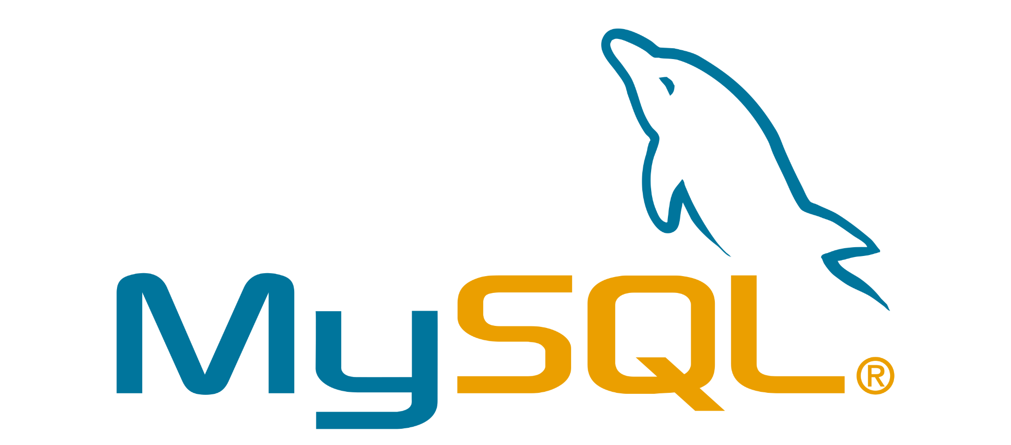


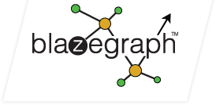


DB and DBMS: some examples
DB
DBMS
Blazegraph: https://blazegraph.com
MySQL: https://www.mysql.com
OpenCitations: http://opencitations.net
Rfam: https://rfam.org
Wikibase: https://wikiba.se
Wikidata: https://www.wikidata.org

Slide 9
Transactions
A transaction is a unit of work performed within a DBMS against a database
Usually, it represents any change in a database
Every transaction is composed by one or more operations – e.g. think about a money transfer from a bank account to another (subtract the amount from the source bank adding it to the second bank)
Transactions are one of the main components that enables the integrity of data, being them executed fully or causing a rollback of the database

Slide 10
ACID properties
Any transaction is compliant with the following four properties:
Atomicity – a transaction is irreducible and indivisible sequence of operations on a database such that either all occurs or nothing occurs
Consistency – a transaction must change a database accordingly to all defined rules and constraints the database defines
Isolation – it enables the correct execution of concurrent transactions, thus leaving the database in the same state that would have been obtained if the transactions were executed sequentially
Durability – a transaction that has been committed will survive permanently even in the case the system crashes

Slide 11
Relational database
A database is relational when it is based on the relational model of data
A relational data model structures data using tables of columns and rows, where each row (or record) is identified by a unique key
Usually, each table represents one type of entity (e.g. publication or venue), while
its rows indicates instances of that type of entity (e.g. the article with DOI “10.1162/qss_a_00023” or the venue “Quantitative Science Studies”)
its columns representing values attributed to that instance
A table may specify that certain columns act as keys for entities
A primary key is one or more columns that uniquely identify an entity in a table
A foreign key is one or more columns that refer to the primary key of another table

Slide 12
Example of primary and foreign keys
Foreign key
Publication
internalId | doi | title | publicationYear | publicationVenue
Entity 1 | “10.1016/s1367-5931(02)00332-0” | “In vitro selection…” | 2002 | Entity 2
Primary key
Venue
internalId | id | name
Entity 2 | “1367-5931” | “Current Opinion…”
Primary key

Slide 13
List of Relational DBMS
Oracle Database – https://www.oracle.com/it/database/
MySQL – https://www.mysql.com
Microsoft SQL Server – https://www.microsoft.com/en-gb/sql-server
PostgreSQL – https://www.postgresql.org/
IBM Db2 – https://www.ibm.com/uk-en/analytics/db2
SQLite – https://www.sqlite.org
MariaDB – https://mariadb.org/

Slide 14
Graph database
A database is graph-based when it uses a graph structure for representing data
Data are represented as a collection of nodes and edges, where the edges represent the relationships between the nodes (entities)
Graph databases defines data as they are defined conceptually, where
nodes represent entities (publications, venues, etc.)
edges are the mechanism to connect nodes, and can be undirected or directed depending on the particular approach adopted by the database
properties are information associated to nodes

Slide 15
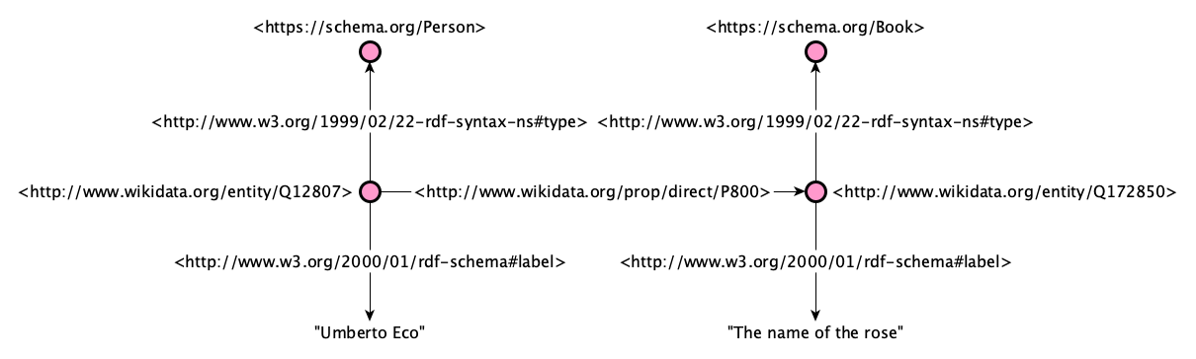
Resource Description Framework (RDF)
RDF is a data model based on triples subject-predicate-object called statements and used in several graph databases

Slide 16
List of graph databases
AllegroGraph – https://allegrograph.com/
Blazegraph – https://blazegraph.com/
Fuseki – https://jena.apache.org/documentation/fuseki2/
MarkLogic – https://www.marklogic.com/
Neo4j – https://neo4j.com/
Ontotext GraphDB – https://graphdb.ontotext.com/
OpenLink Virtuoso – https://virtuoso.openlinksw.com/

Slide 17
End
Database Management Systems
Silvio Peroni silvio.peroni@unibo.it – https://orcid.org/0000-0003-0530-4305 – @essepuntato
Data Science (A.Y. 2022/2023)
Second Cycle Degree in Digital Humanities and Digital Knowledge
Alma Mater Studiorum - Università di Bologna

