Slide 1


SPARQL, a query language for RDF databases
Silvio Peroni silvio.peroni@unibo.it – https://orcid.org/0000-0003-0530-4305 – @essepuntato
Data Science (A.Y. 2022/2023)
Second Cycle Degree in Digital Humanities and Digital Knowledge
Alma Mater Studiorum - Università di Bologna

Slide 2
Summary of the previous lectures (1/2)
A datum is a declarative statement subject-predicate-object that, through the predicate, either attributes a literal (i.e. a value such as a string, a number, etc.) to a subject entity or it relates such a subject entity with another entity
Each entity, being used either as subject or object of a statement, is characterised by a unique identifier
The same entity can be used as subject or object in one or more data, while a literal cannot be used as subject in any datum
An attribute is intrinsically part of the entity to which it is associated – modifying the value of an attribute affect only the entity to which it refers to
A data model is an abstract, simplified and formal representation of some data related to a system or a real domain, and enables us to describe what a data collection is about and to check data correctness
A data model permit one to specify classes of entities, their attributes and relations

Slide 3
Summary of the previous lectures (2/2)
Depending on the structure in which data are stored (or exposed), you need to approach the queries to datasets from a different angle
With tabular data, often you have to combine tables between them to obtain bigger tables which contain the query requirements and the related answer
With graph data, you explore the graph starting from fixed points (i.e. known entities, values, predicates) to find a pattern that is compliant with the query
A database as a collection of data which organised, stored and accessed electronically, which can be created through a database management system (DBMS)
A transaction is a unit of work performed (compliant with ACID properties) within a DBMS against a database and usually represents any change in a database
SQL is a query language used and designed for managing data in a relational database management system, and allows one to create tables, to populate them, and finally to query them using a particular syntax

Slide 4
Any question about the previous lecture?

Slide 5
SPARQL
The SPARQL Protocol and RDF Query Language (SPARQL, and yes: it is a recursive name) is a query language used and designed for managing RDF data, as those available in an RDF triplestore
It is a standard that is implemented in all RDF-based triplestore, and allows one to populate and query them using a particular syntax
The full specification of the language is a W3C Recommendation and it is entirely available at https://www.w3.org/TR/sparql11-query/
A good tutorial is available at: https://docs.data.world/tutorials/sparql/primer_intro.html

Slide 6
Basic SPARQL syntax for queries
SELECT <variables>
A space-separated list of ?x variables to have as result of the query (“*” means all the variables)
WHERE { }
A series of conditions involving the ?x variables above used in one or more…
<triple pattern 1> . <triple pattern 2> . …
… triple patterns S P O where:
S can be a <url> resource or a ?x variable
P can be a <url> property or a ?x variable
O can be a <url> resource, a "literal" or a ?x variable
Questions to remind for designing a query:
Which resources are known?
Which literals are known?
Which properties are known?

Slide 7
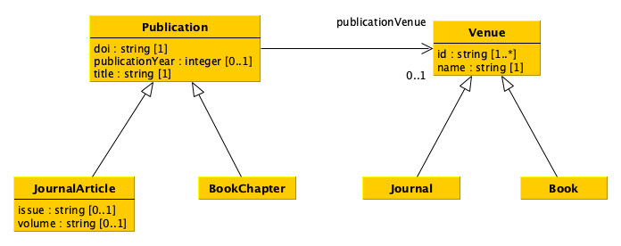
Exemplar classes and properties for queries
We used only these classes, by remind of the inheritance of attributes and relations
Remind that we used strings to store years of publication instead of integers

Slide 8
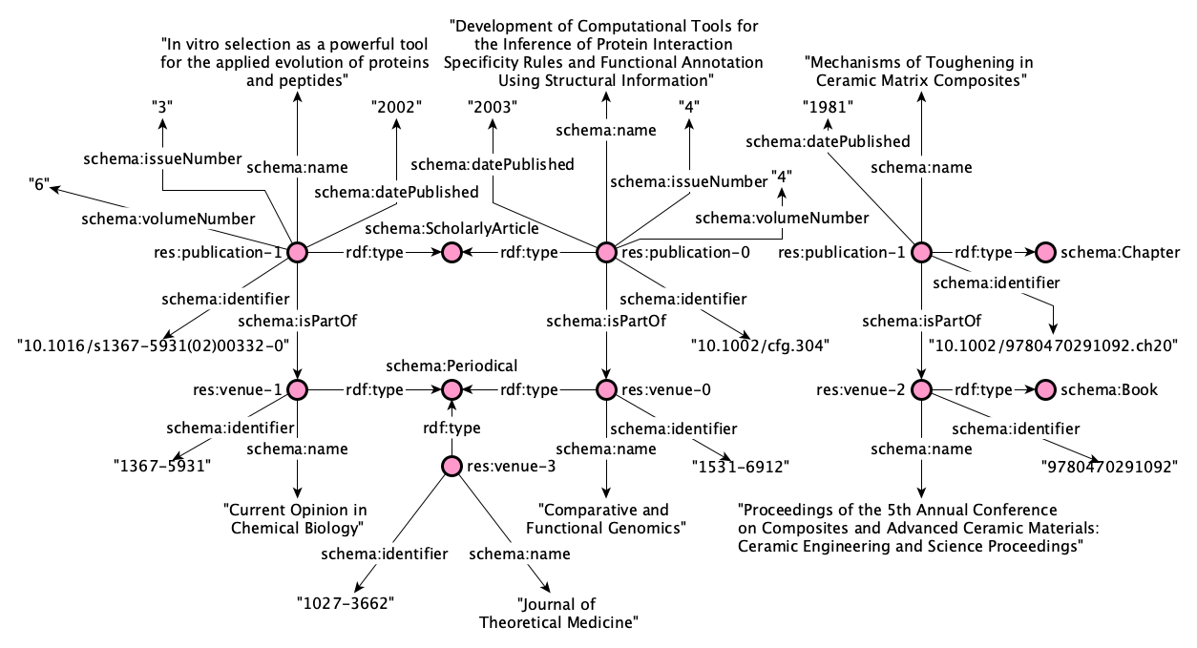
Data in the RDF graph
Prefixes
PREFIX res: <https://comp-data.github.io/res/>
PREFIX rdf: <http://www.w3.org/1999/02/22-rdf-syntax-ns#>
PREFIX schema: <https://schema.org/>

Slide 9
Queries
Retrieve complete information about all journal articles
Retrieve the titles of all journal articles
Retrieve the title of the journal article with DOI “10.1016/s1367-5931(02)00332-0”
Retrieve the title of the publication with DOI “10.1016/s1367-5931(02)00332-0”
Return the name of the journal of the article with DOI “10.1016/s1367-5931(02)00332-0”
Return the id and name of the journal of the article with DOI “10.1016/s1367-5931(02)00332-0”

Slide 10
Query 1
?o
?o
?o
?o
?o
?o
?p
?p
?p
?p
?o
?p
Retrieve complete information about all journal articles
Which resources are known?
Which literals are known?
Which properties are known?
?p
?o
?p
?p
?s
?o
?s
?p
?p
?p
?p
?p
?o
?o
?p
?o
?o
SELECT *
WHERE {
?s rdf:type
schema:ScholarlyArticle .
?s ?p ?o .
}

Slide 11
Query 2
?title
?title
Retrieve the titles of all journal articles
Which resources are known?
Which literals are known?
Which properties are known?
?s
?s
SELECT ?title
WHERE {
?s rdf:type
schema:ScholarlyArticle .
?s schema:name ?title .
}

Slide 12
Query 3
?title
Retrieve the title of the journal article with DOI “10.1016/s1367-5931(02)00332-0”
Which resources are known?
Which literals are known?
Which properties are known?
?s
SELECT ?title
WHERE {
?s rdf:type
schema:ScholarlyArticle .
?s schema:name ?title .
?s schema:identifier "10.1016/s1367-5931(02)00332-0" .
}

Slide 13
Query 4
?title
Retrieve the title of the publication with DOI “10.1016/s1367-5931(02)00332-0”
Which resources are known?
Which literals are known?
Which properties are known?
?s
?type
?type
SELECT ?title
WHERE {
VALUES ?type {
schema:ScholarlyArticle schema:Chapter }
?s rdf:type ?type .
?s schema:name ?title .
?s schema:identifier "10.1016/s1367-5931(02)00332-0" . }

Slide 14
Query 5
Return the name of the journal of the article with DOI “10.1016/s1367-5931(02)00332-0”
Which resources are known?
Which literals are known?
Which properties are known?
?s
?journal
?name
SELECT ?name
WHERE {
?s rdf:type schema:ScholarlyArticle .
?s schema:identifier "10.1016/s1367-5931(02)00332-0" .
?s schema:isPartOf ?journal .
?journal schema:name ?name . }

Slide 15
Query 6
Return the id and name of the journal of the article with DOI “10.1016/s1367-5931(02)00332-0”
Which resources are known?
Which literals are known?
Which properties are known?
?s
?journal
?id
SELECT ?name ?id
WHERE {
?s rdf:type schema:ScholarlyArticle .
?s schema:identifier "10.1016/s1367-5931(02)00332-0" .
?s schema:isPartOf ?journal .
?journal schema:name ?name .
?journal schema:identifier ?id . }
?name

Slide 16
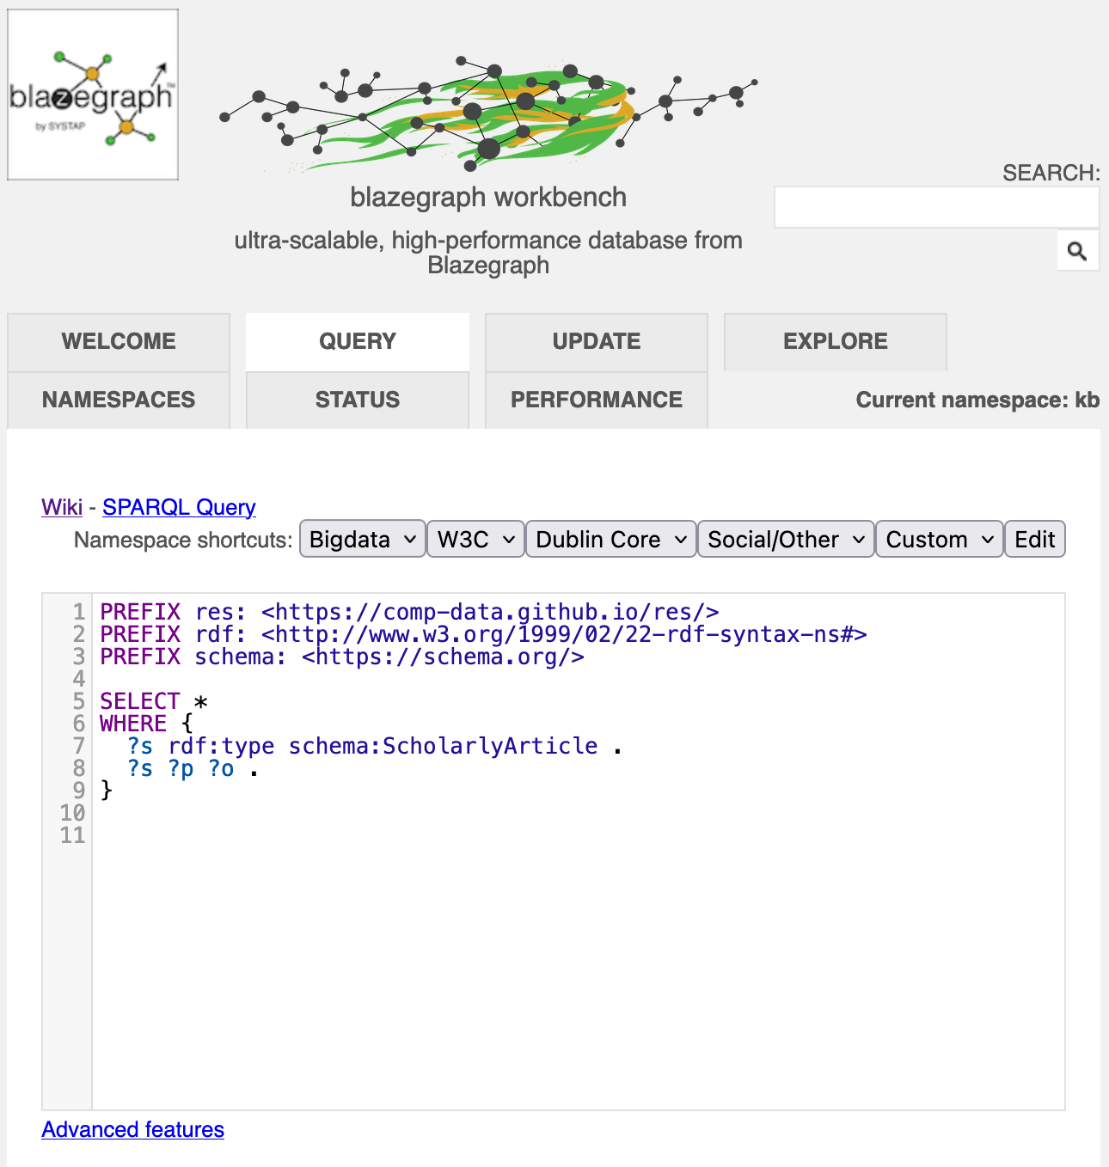
Do you want to try them with real data?
You should have already downloaded the .jar file of Blazegraph for the previous lecture (https://github.com/comp-data/2021-2022/tree/main/docs/handson/05)
Start Blazegraph from the terminal with java -server -Xmx1g -jar blazegraph.jar
Open your browser and go to http://127.0.0.1:9999/blazegraph/
Select the tab “Query” and write and execute SPARQL queries (remember the prefixes if you want to use them in the query)
Close Blazegraph from the terminal pressing CTRL+C on your keyboard

Slide 17
End
SPARQL, a query language for RDF databases
Silvio Peroni silvio.peroni@unibo.it – https://orcid.org/0000-0003-0530-4305 – @essepuntato
Data Science (A.Y. 2022/2023)
Second Cycle Degree in Digital Humanities and Digital Knowledge
Alma Mater Studiorum - Università di Bologna

