Slide 1
Data, Data, Data
JOUR479D/779D
University of Maryland

Slide 2
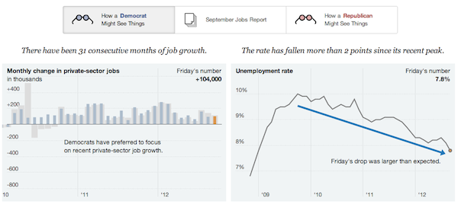
Data
From Latin, datum, dare = to give
Something given, the premise
Data are not facts; False data is still data
http://www.nytimes.com/interactive/2012/10/05/business/economy/one-report-diverging-perspectives.html
Notes:
It’s important to recognize and remember that data does not equal truth. It’s rhetorical by definition and can be used for truth finding or truth hiding. Being vigilant in how you develop arguments from data and showing the context that leads to the interpretation you make can only help raise the credibility of your data-driven story.

Slide 3
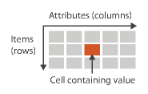
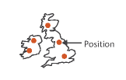
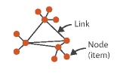



Dataset Types
Tables (items + attributes)
Geometric (2D or 3D)
Networks (graphs)
Trees (hierarchies)
Temporal + Time varying
Texts
Image Credit: T. Munzner. Visualization Analysis & Design
Notes:
Networks and trees have items (nodes), links, and attributes
Temporal is when time is an attribute (e.g. horse race and the duration of the run); time varying is where location varies which each time point

Slide 4




Data Types
Nominal or Categorical (labels)
e.g. Giraffe, Monkey, Snake; can be ordered but not intrinsically. Can’t take average.
Ordinal (ranked)
Day of week: Monday, Tuesday, Wed
Restaurant Inspection Grade: A, B, C
Small, Medium, Large
Survey results often ordinal (agree ←→ disagree)
Interval (arbitrary zero point)
Only differences can be compared, but not ratio
Temperature, e.g. 20 C is not twice as warm as 10C
Time is another example
Ratio (fixed zero point)
Counts of things like age, money
Physical measurements, e.g. 6 feet is twice as long as 3 feet, age
Image Credit: T. Munzner. Visualization Analysis & Design
Notes:
Cyclic e.g. is time; Diverging would be something like elevation or temperature where there is a clear zero point
What often determines the data type is how the data are collected.
Consider the variable age. Age is frequently collected as ratio data, but can also be collected as ordinal data. This happens on surveys when they ask, “What age group do you fall in?”
The general rule is that you can go down in level of measurement but not up.

Slide 5
Data Formats
JSON
Javascript Object Notation
http://learnxinyminutes.com/docs/json/
Delimited Text, e.g. CSV
Comma separated value
X , Y, Z
10, 8, 5
Other specialized formats
XML: Extensible Markup Language
KML: for map geometry
SPSS: proprietary format but still used by gov’t
Converters
http://www.convertcsv.com/json-to-csv.htm
http://shancarter.github.io/mr-data-converter/

Slide 6
Data Acquisition
Finding
https://research.google.com/tables
http://www.data.gov/
http://enigma.io/
Government Agencies; TIGER, FRED, OECD, UN
Companies
Surveys
Ask experts: officials, professors, industry insiders
Gathering
Scraping, e.g. Kimono, Import.io, ScraperWiki
APIs; programmatic collection
FOIA; knowing what to ask for to get a DB (JOUR 472/772)
Notes:
Point out the need to be aware of the conditions around which data was acquired especially if by someone else, and if you’re doing it yourself you need to think about the methodology.
It can be VERY time consuming looking for data.

Slide 7

Scraping
Kimono Chrome extension
https://www.kimonolabs.com
Let’s set up a scraper to gather press releases
http://norton.house.gov/
Notes:
http://norton.house.gov/
Go to the press releases and scrape the title, date, and text
Then add the multi page support under crawl setup where you have to add a page=X param to the url generator

Slide 8
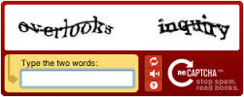
Scraping Caveats
Badly formatted webpages won’t work
Authentication systems with CAPTCHA
Be considerate (use rate)

Slide 9
APIs (Application Programming Interfaces)
What are they?
Bits of software that sit in-between other software
What are they used for?
Sharing data systematically, abstraction and component building
Why do people even have them?
Data platforms, 3rd party innovation, ease of use in sharing
For Data Collection Consider
Comprehensiveness, rate limits, filters, legal liability, sampling strategy
Notes:
Application Programming Interfaces – easy access to lots of data

Slide 10
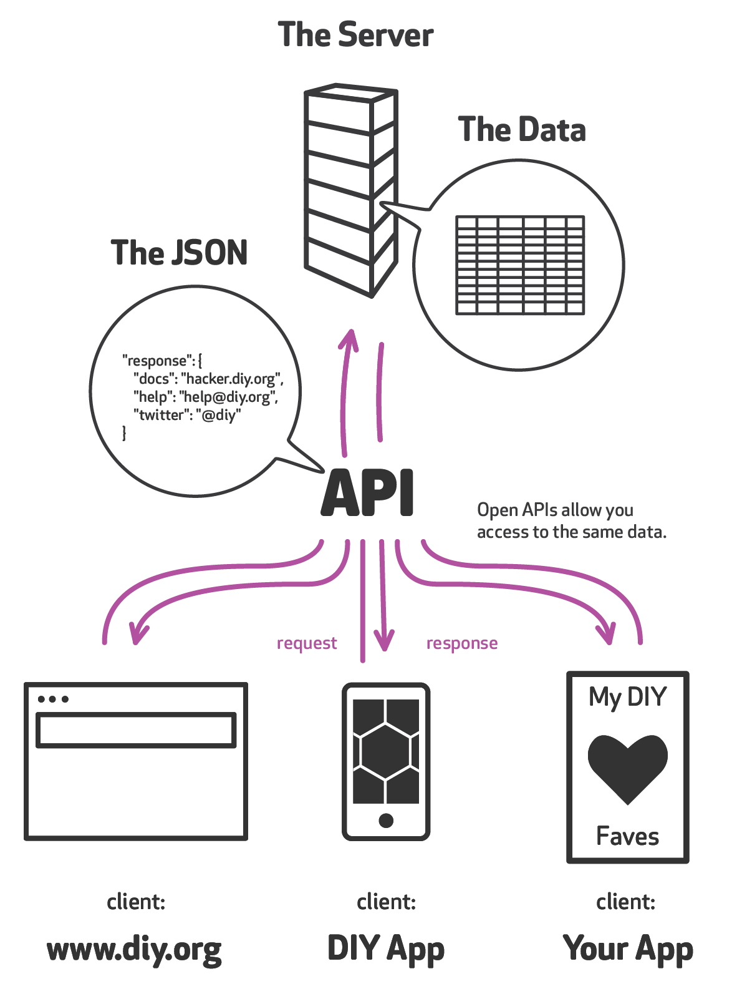
Diagramatically

Slide 11
Where are APIs?
Lots of APIs out there
Twitter: https://dev.twitter.com/rest/public
Guardian: http://open-platform.theguardian.com/
Yelp: https://www.yelp.com/developers/documentation/v2/overview
New York Times API
http://developer.nytimes.com/docs
http://developer.nytimes.com/docs/community_api/
Article search, campaign finance, community api, event listings etc.
Test console: http://developer.nytimes.com/io-docs
Notes:
Demo the NYT API with article search, e.g. “refugees” and limited to september articles.

Slide 12
API Caveats
Design
Some queries are easy, others not possible at all
Tension between what’s there and what you ideally want
Sometimes can’t get enough volume due to rate limits
Combinations
Sometimes you need more than one API to get all the data you need

Slide 13
CSVKit
Command Line tool for working with data
https://csvkit.readthedocs.org
csvcut – splicing just some columns out
csvjson – output the JSON version
csvstat – basic descriptive statistics on columns (e.g. date ranges, min / max, sums, means, etc)
csvclean – can identify “bad rows”, e.g. wrong # of values
Notes:
Last point about csvclean leads right into the issue of data cleaning / wrangling, or as I call it data editing
csvsql --query "select * from data where myindex < 5;" --table data norton_subset.csv

Slide 14
Data Editing
Who collected the data?
Who produced it? What was their intent? Is it a reputable source? What are motives of data producer, are they an advocate or industry group? Is this data PR?
Call the creator.
Do additional research.
Corroborate figures from multiple sources.
Notes:
Also relates to wider idea of data literacy: The ability to consume, produce, and think critically about data

Slide 15
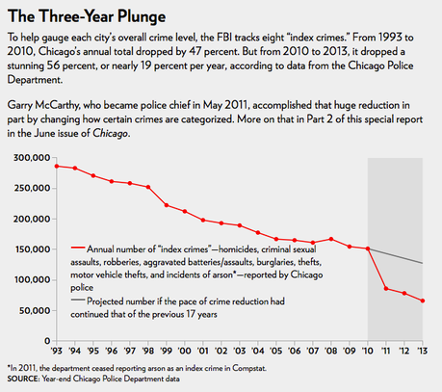
Data Editing
When was the data collected?
Measurements can change over time
Definitions or interpretations can change over time
Is the data recent, and how much does that matter to the insight you want to convey
Notes:
Great exmple of the chicago crime stats being redefined in 2011 which changed how certain crimes were categorized

Slide 16
Data Editing
What is in the data, is it reliable?
What exactly is measured? Is this precisely defined? How was data sampled from the world?
Does the data actually help answer the questions you have? … a data set can only answer questions for which it has the right records and the proper variables
Is the data comprehensive, or missing pieces? Has the data been cropped or filtered?
What errors or other uncertainties may have been introduced into data? (e.g. Optical Character Recognition, OCR errors)
http://chronicle.nytlabs.com/?keyword=Internet&format=count
Has the data been aggregated or transformed by some algorithm?
Notes:
Show the chronicle example of “internet” as an example where they digitized and OCRed an archive and you still get false positive recognitions on words. This is a typical issue with big data types of applications.

Slide 17
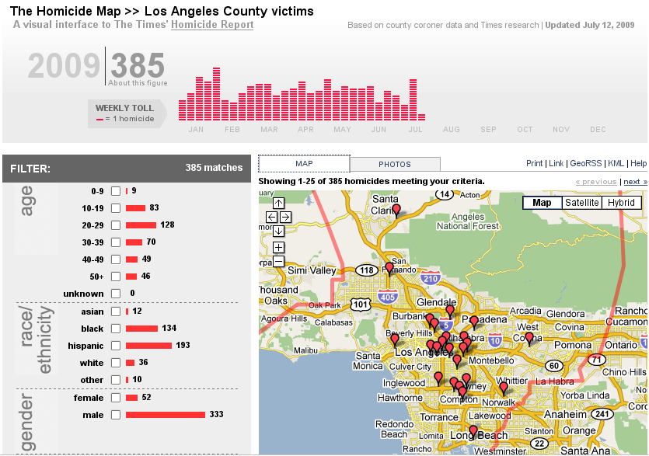
LA Times Crime Mapping
Notes:
The Los Angeles Times began publishing their Homicide Map in the Spring of 2008, along with a blog devoted to the city's murders. It fits in the city crime genre, but doesn't cover all crime, just murder.

Slide 18
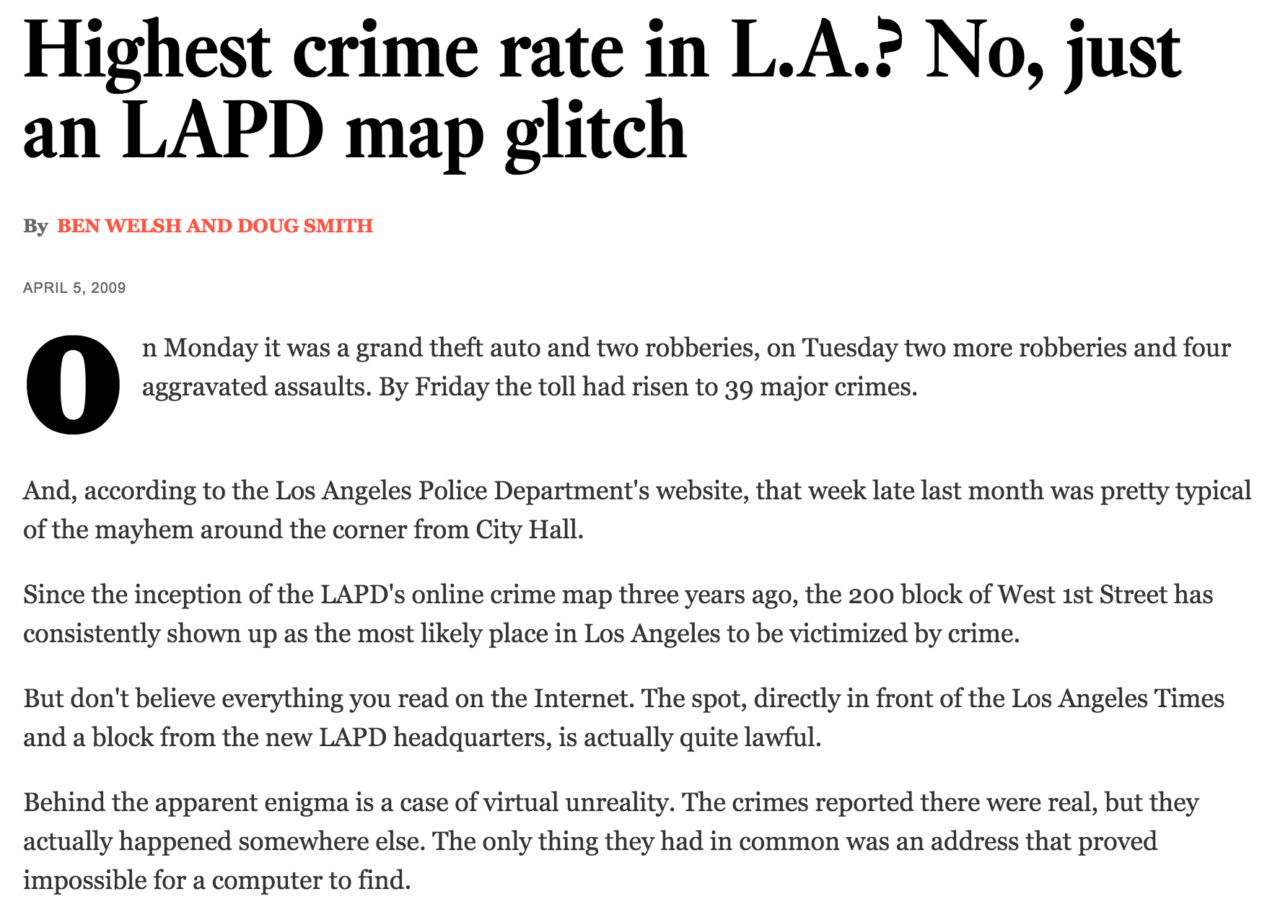
Data Transform Errors
Notes:
Cautionary tale about geocoding … computational process that can be error prone … incomplete addresses or ambiguities.

Slide 19
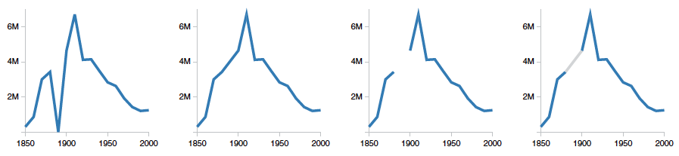
Data Cleaning / Wrangling
Missing Data Values
e.g. wrong number of columns for a given row; zero or default value; redactions (e.g. private info from gov’t data)
Missing context
Data dictionary and code lookups, definitions, method of creation
Unresolved Duplicates
Nicholas Diakopoulos vs. Nicholas A. Diakopoulos
Image credit: Sean Kandel et al. Research Directions in data wrangling … Information Visualization. 2011.
Notes:
Graph is alternative representations of missing data: US census counts of people working as farm laborers, values from 1980 are missing to do record loss; missing data treated as zero; missing data is ignored and interpolated, missing data is omitted from chart, missing data is interpolated by rendered in gray
Data dict includes things like definitions, data types

Slide 20
Data Cleaning / Wrangling
Inconsistent Encodings
Normalizing dates, ages, categorical variables like gender (e.g. Male, Female, M, F, 1, 0, MALE, FEMALE)
Transformations
Splitting fields, normalizing date formats, merging / grouping, zip code to GPS
“Typos” in Data Entry
Or errors and drift in automated sensors
Outliers
What constitutes an outlier and should you remove it? In data you found have outliers already been removed?

Slide 21
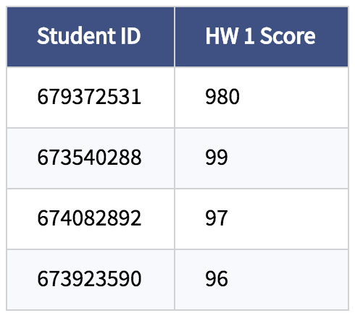
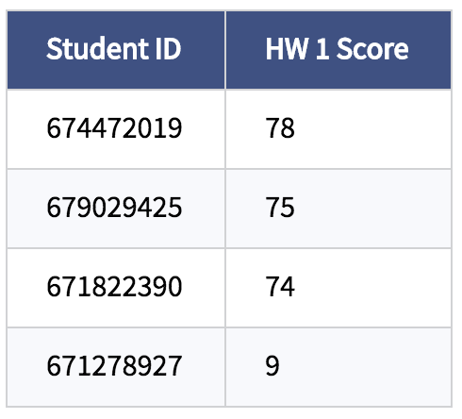
Data Cleaning / Wrangling
Range Checks
Are any values outside the acceptable range? Sort them and example…
Spell Checks
Regular expressions
Email addresses, phone numbers, other patterns can be flagged.

Slide 22
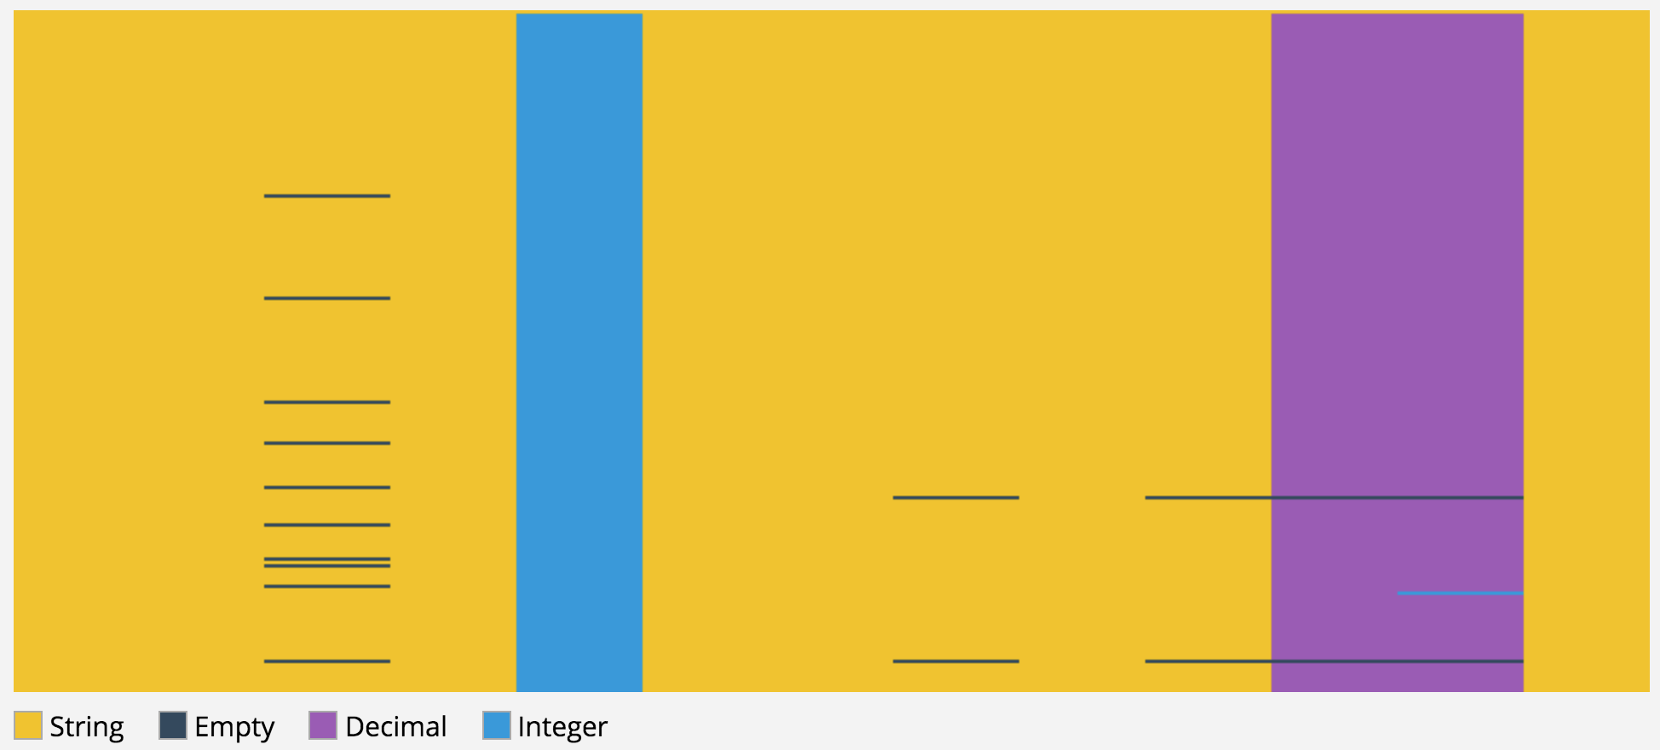
Tools
CSV Fingerprint
http://setosa.io/blog/2014/08/03/csv-fingerprints/

Slide 23
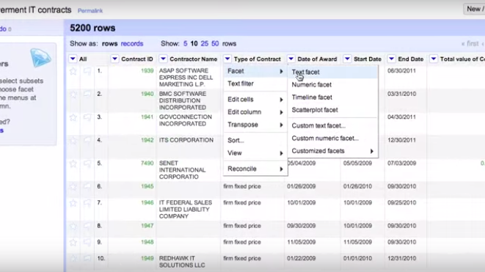
Tools
Google Refine
http://openrefine.org/
https://www.youtube.com/watch?t=78&v=B70J_H_zAWM

Slide 24
Questions?

