Slide 1
Week 5: Neural Networks
Matthew Caldwell
COMP0088 Introduction to Machine Learning • UCL Computer Science • Autumn 2026

Slide 2
Admin
Coursework
Office hour tomorrow: 1600-1700
No labs, lectures or office hour next week

Slide 3
Week 5 Recap
Safety in Numbers

Slide 4
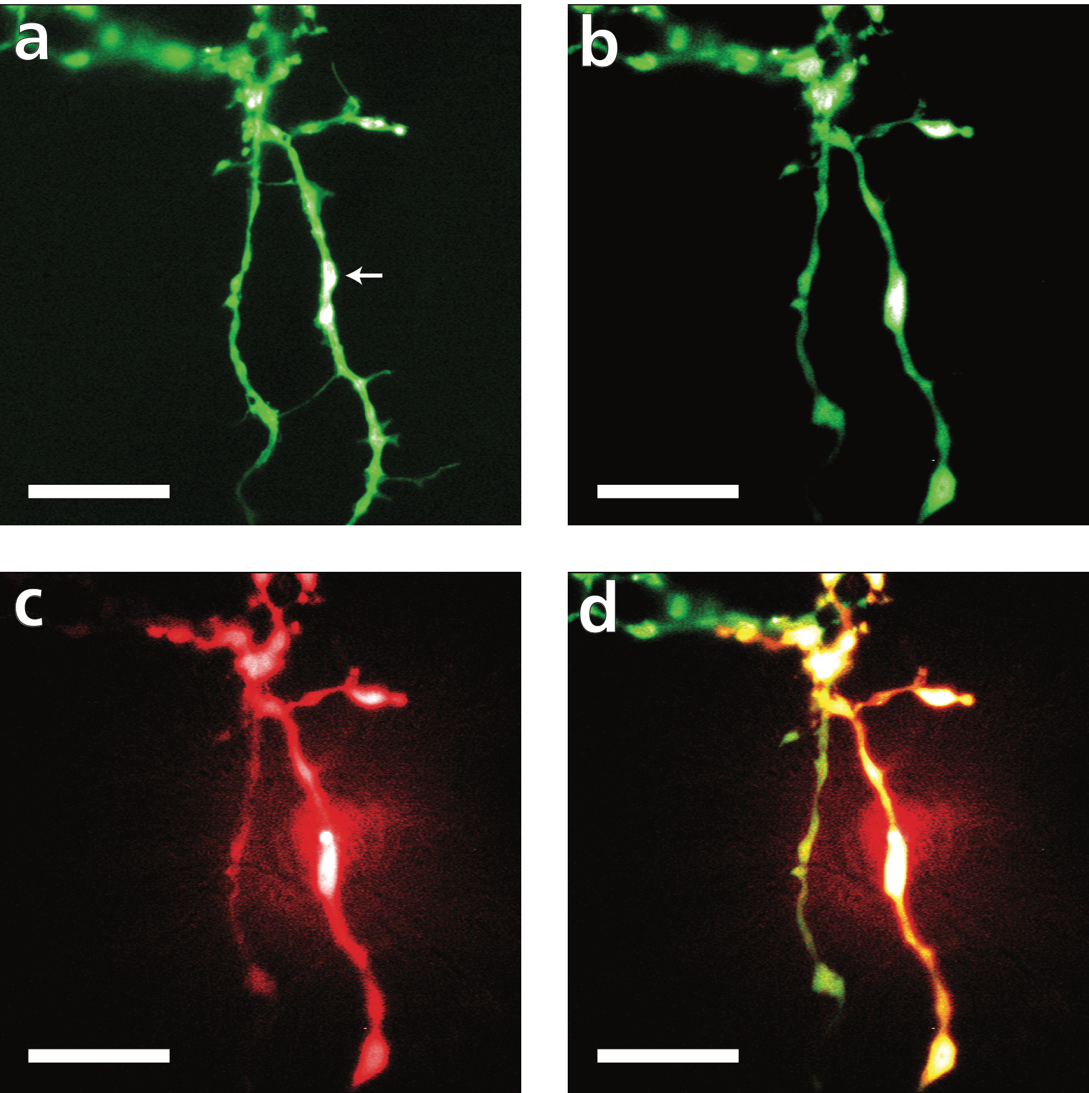
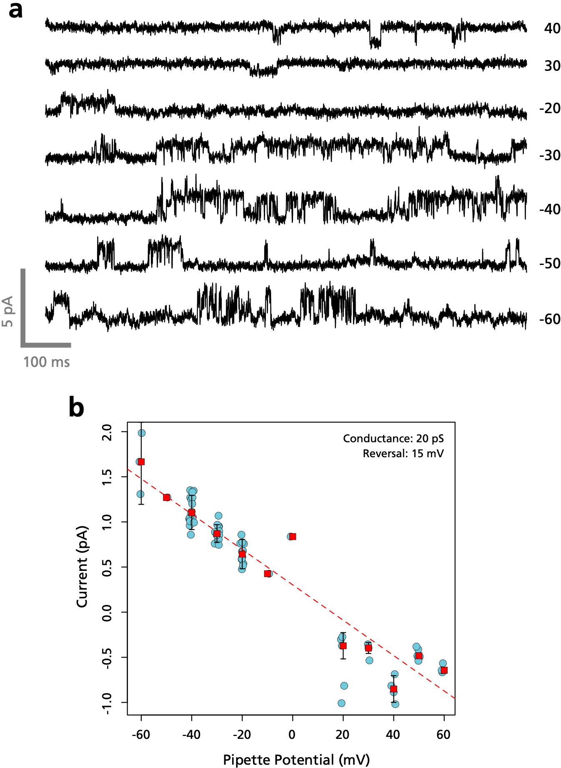

Slide 5
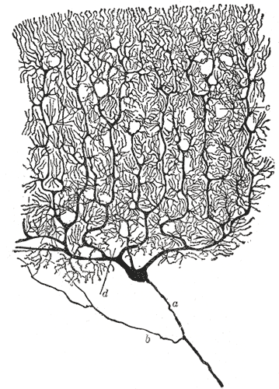
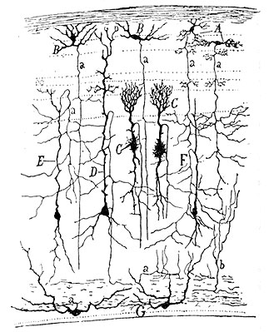
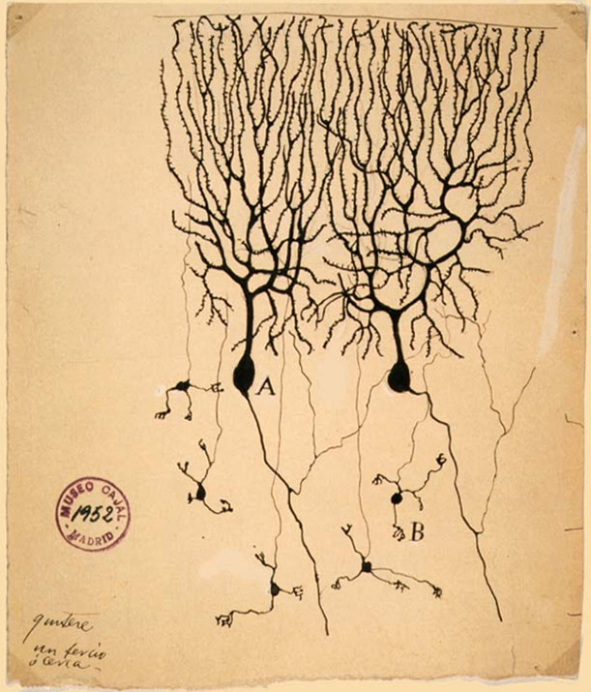

Slide 6
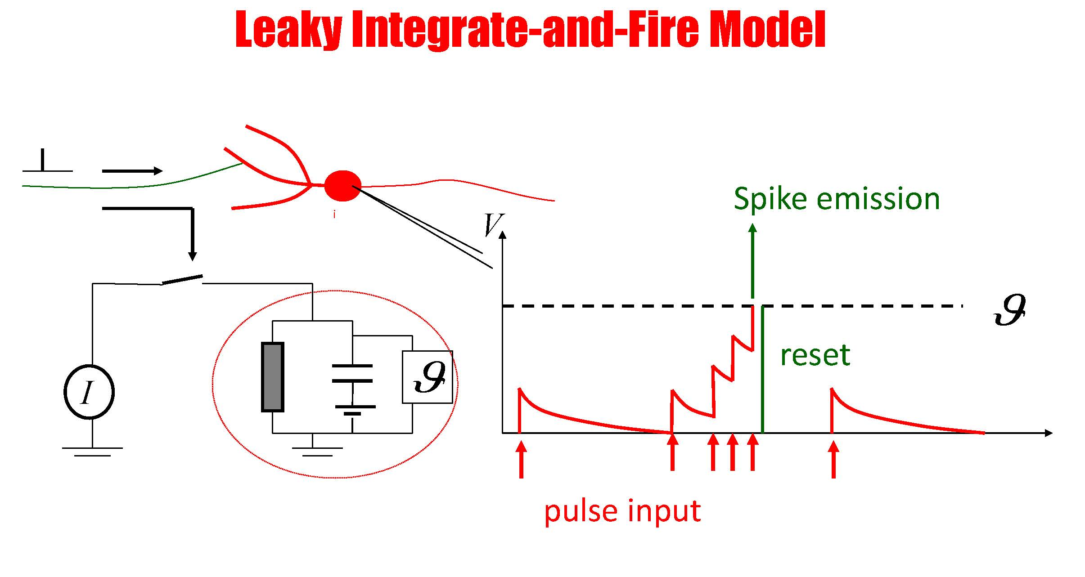

Slide 7
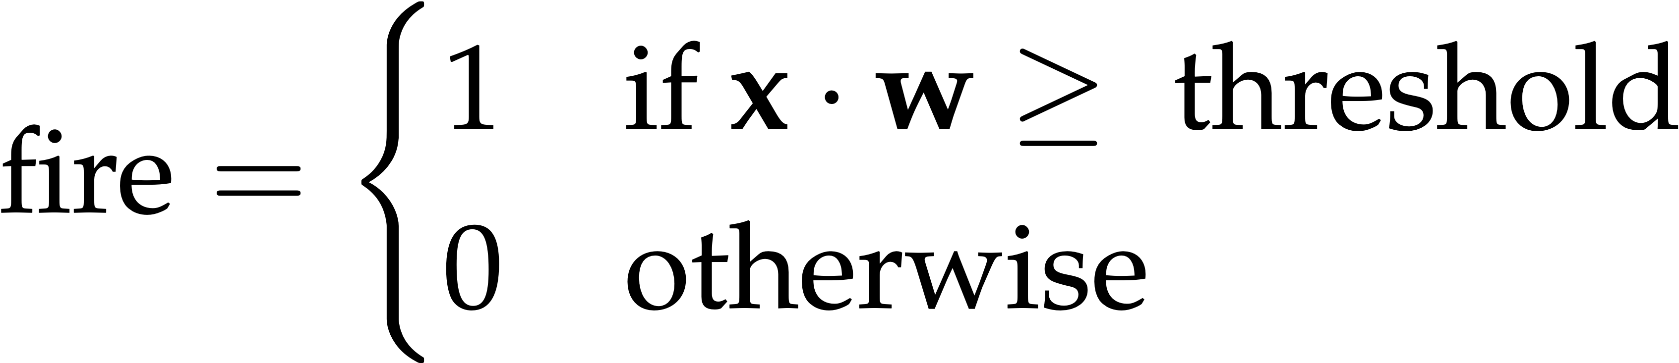

Slide 8
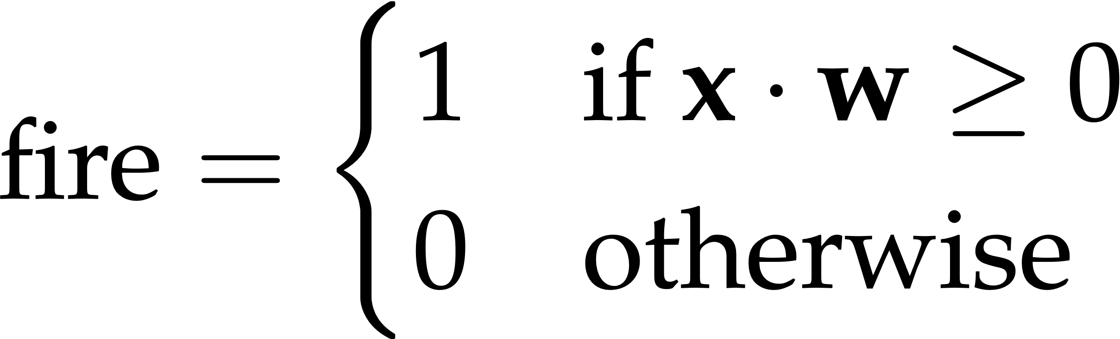

Slide 9
≠

Slide 10
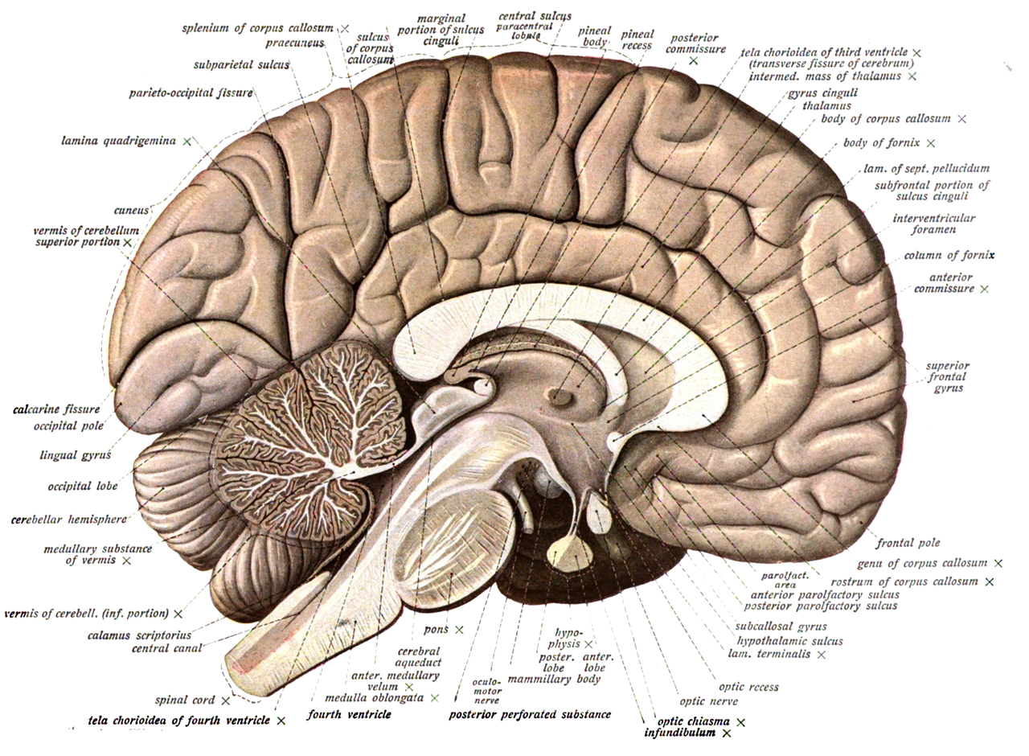

≠

Slide 12
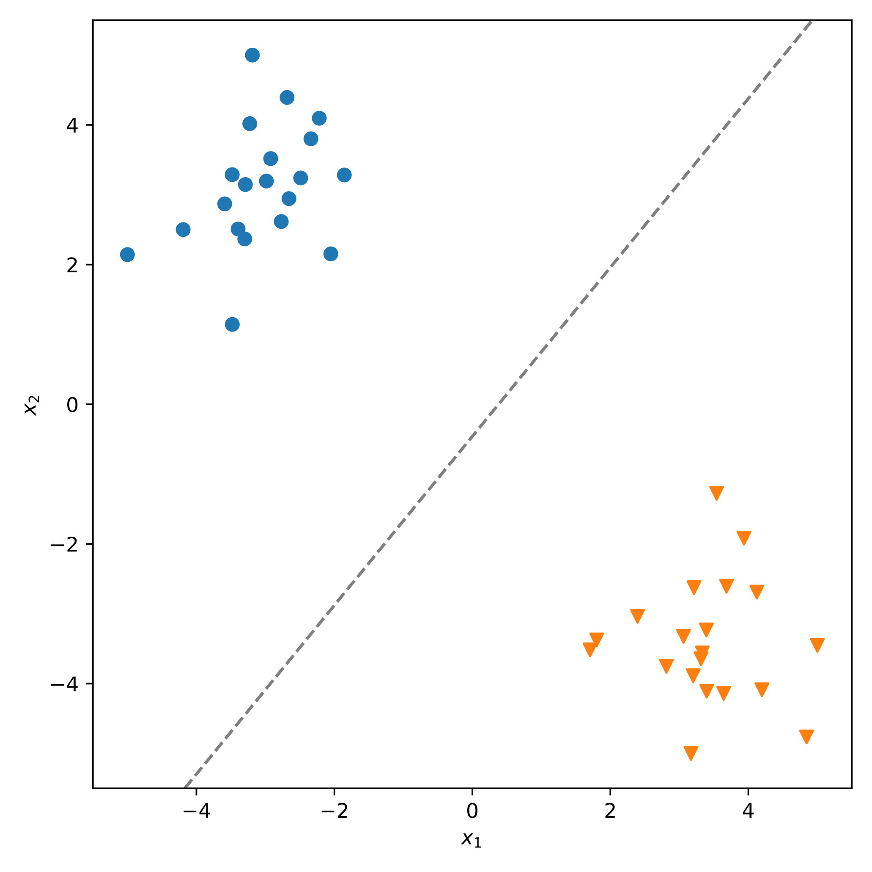

Slide 13
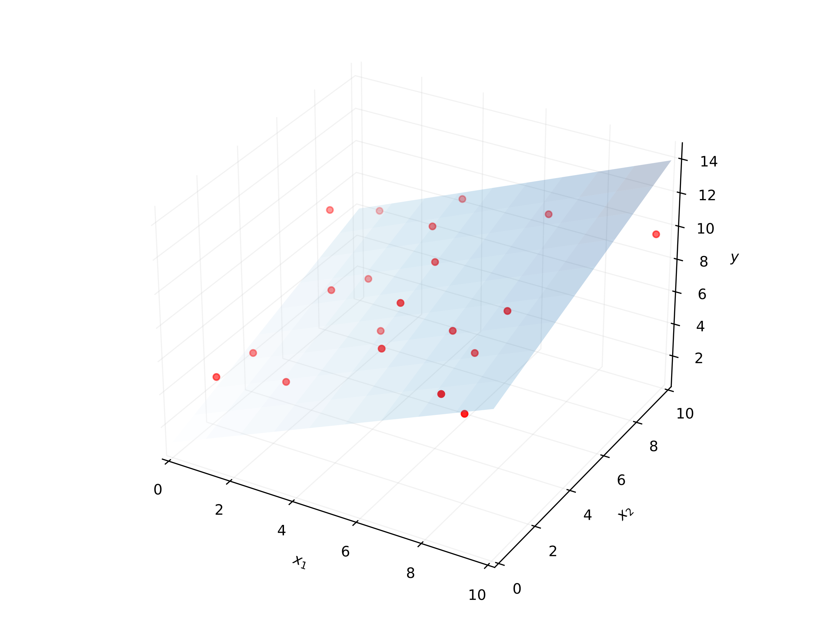
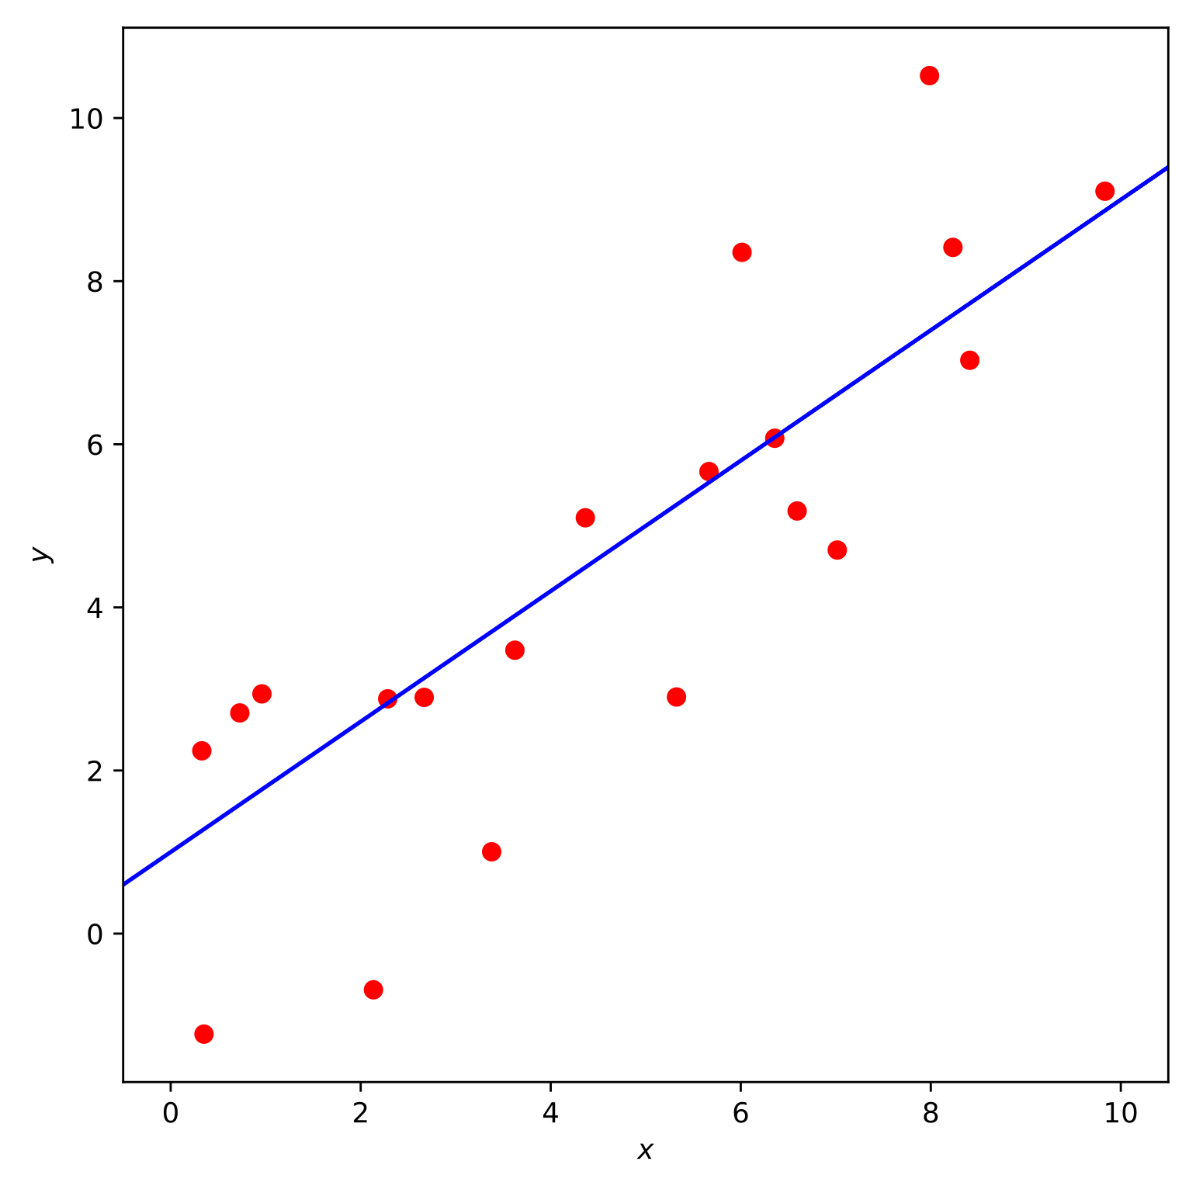

Slide 14
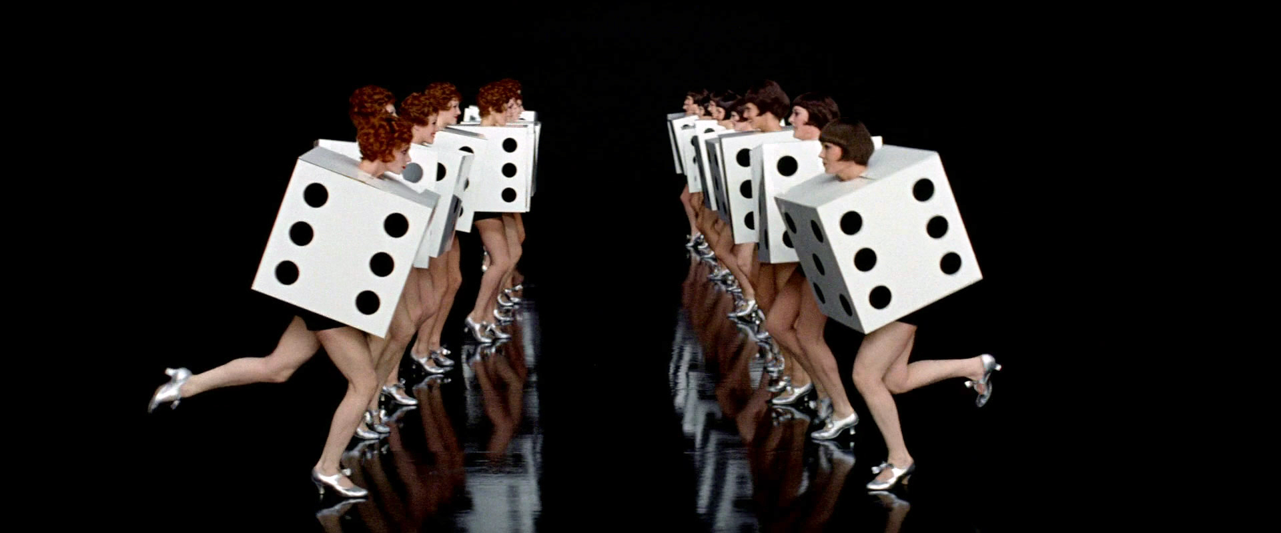

Slide 15
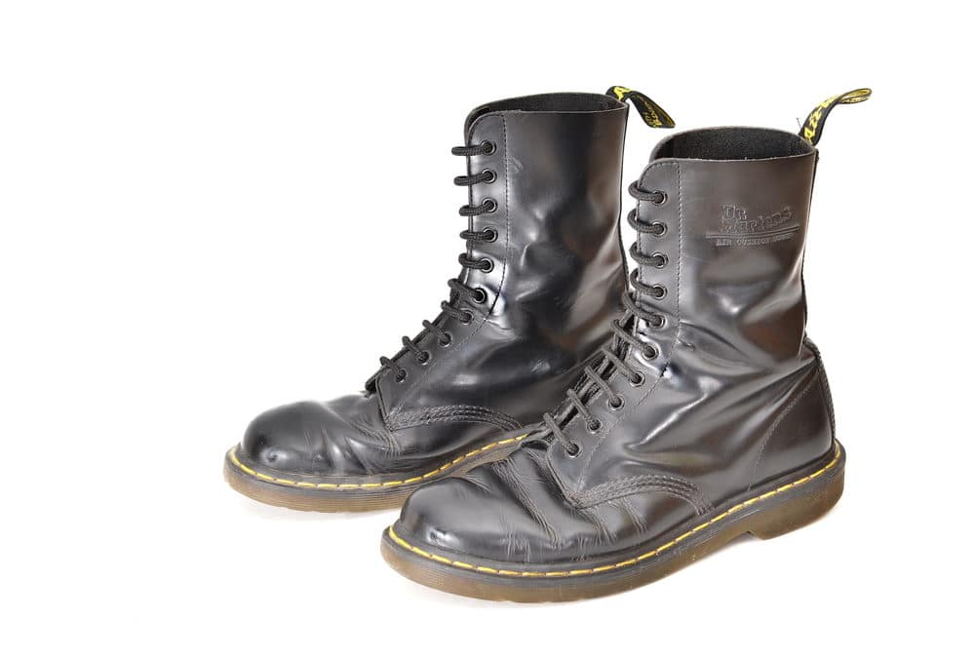
Notes:
bagging: independent models trained in parallel from different randomised starts, to probe problem from different angles
boosting: dependent models trained sequentially to construct more complex decision boundaries that fit (or potentially overfit) the data better

Slide 16
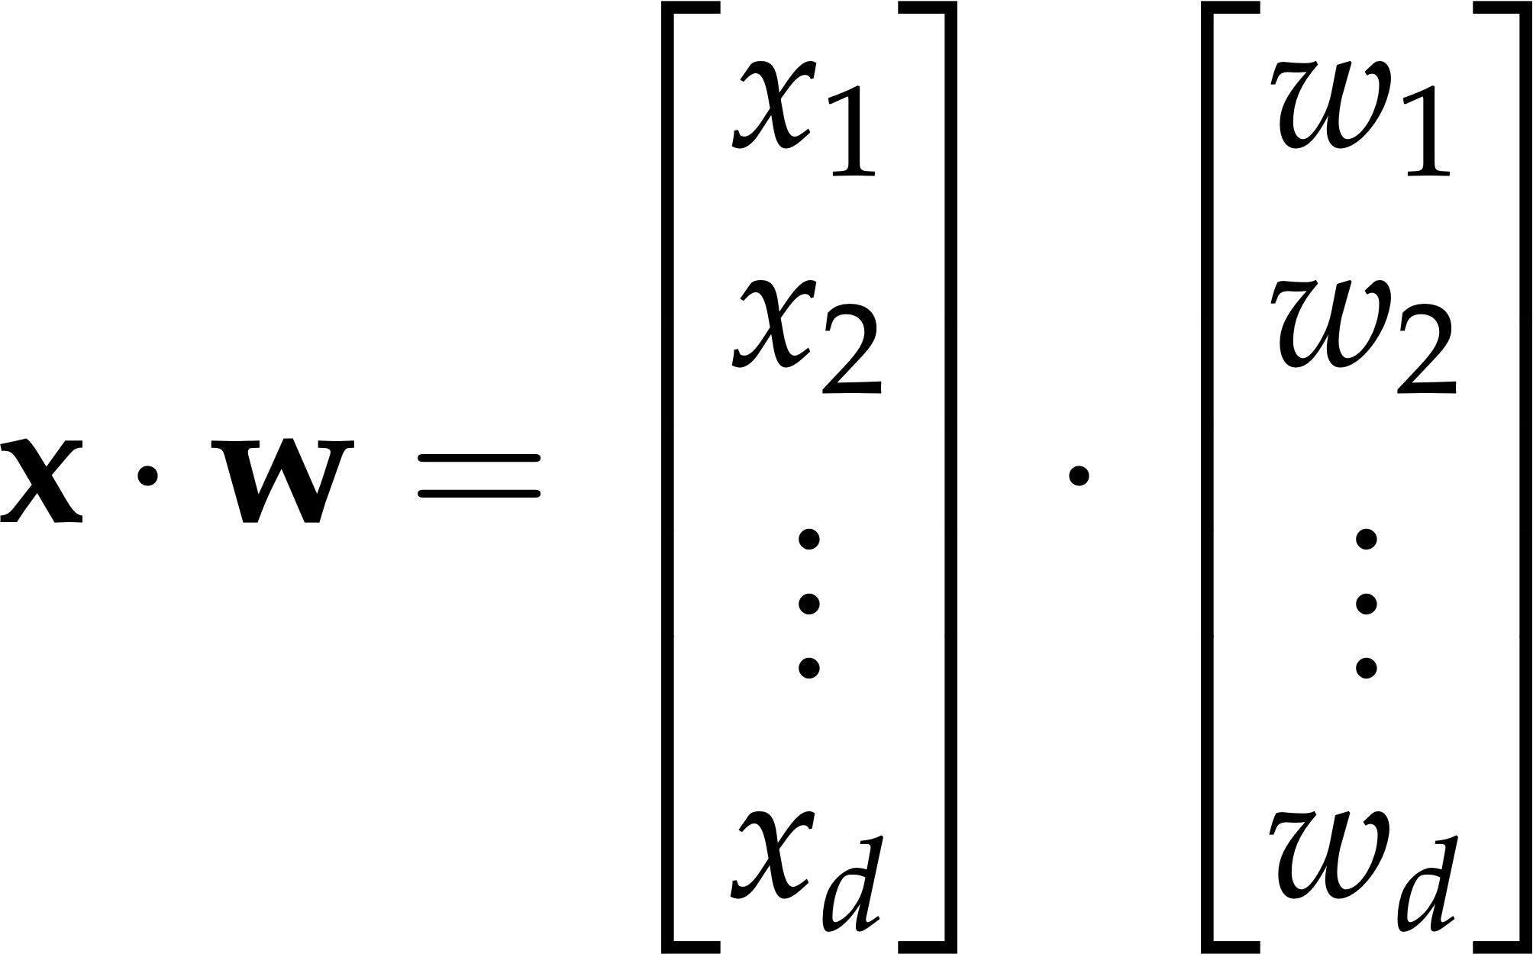

Slide 17
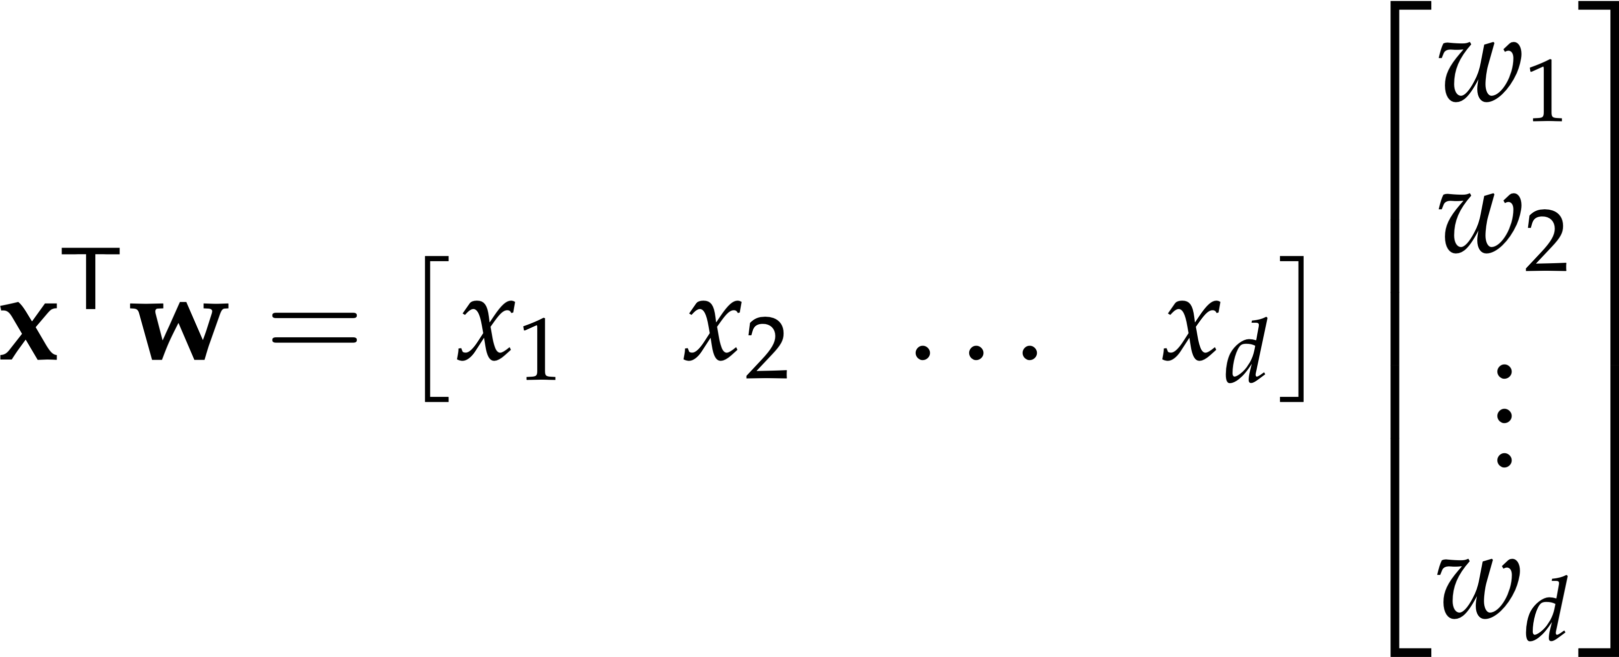

Slide 18
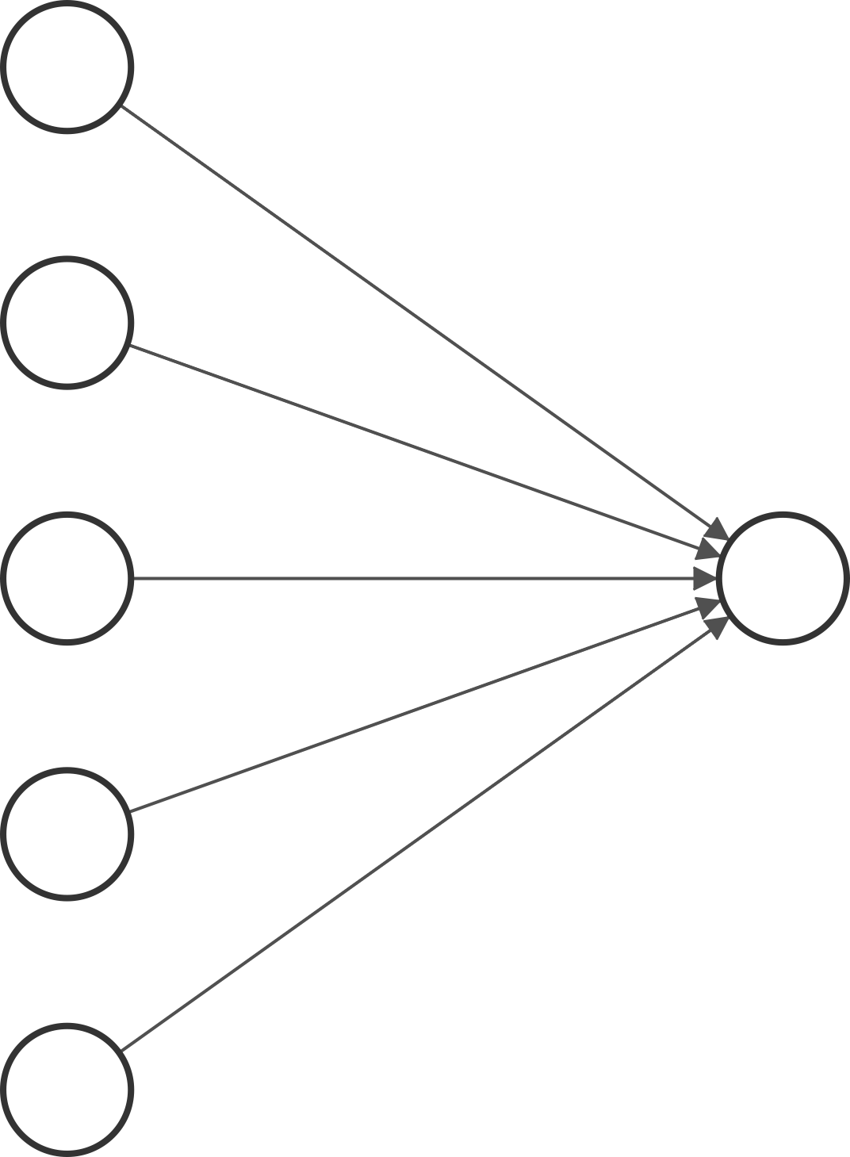

Slide 19
x

Slide 20
x1
x2
x
x3
x4
x5

Slide 21
w
x1
x2
x
x3
x4
x5

Slide 22
w
x1
w1
x2
w2
x
w3
x3
w4
w5
x4
x5

Slide 23

w
x1
w1
x2
w2
x
w3
x3
w4
w5
x4
x5

Slide 27
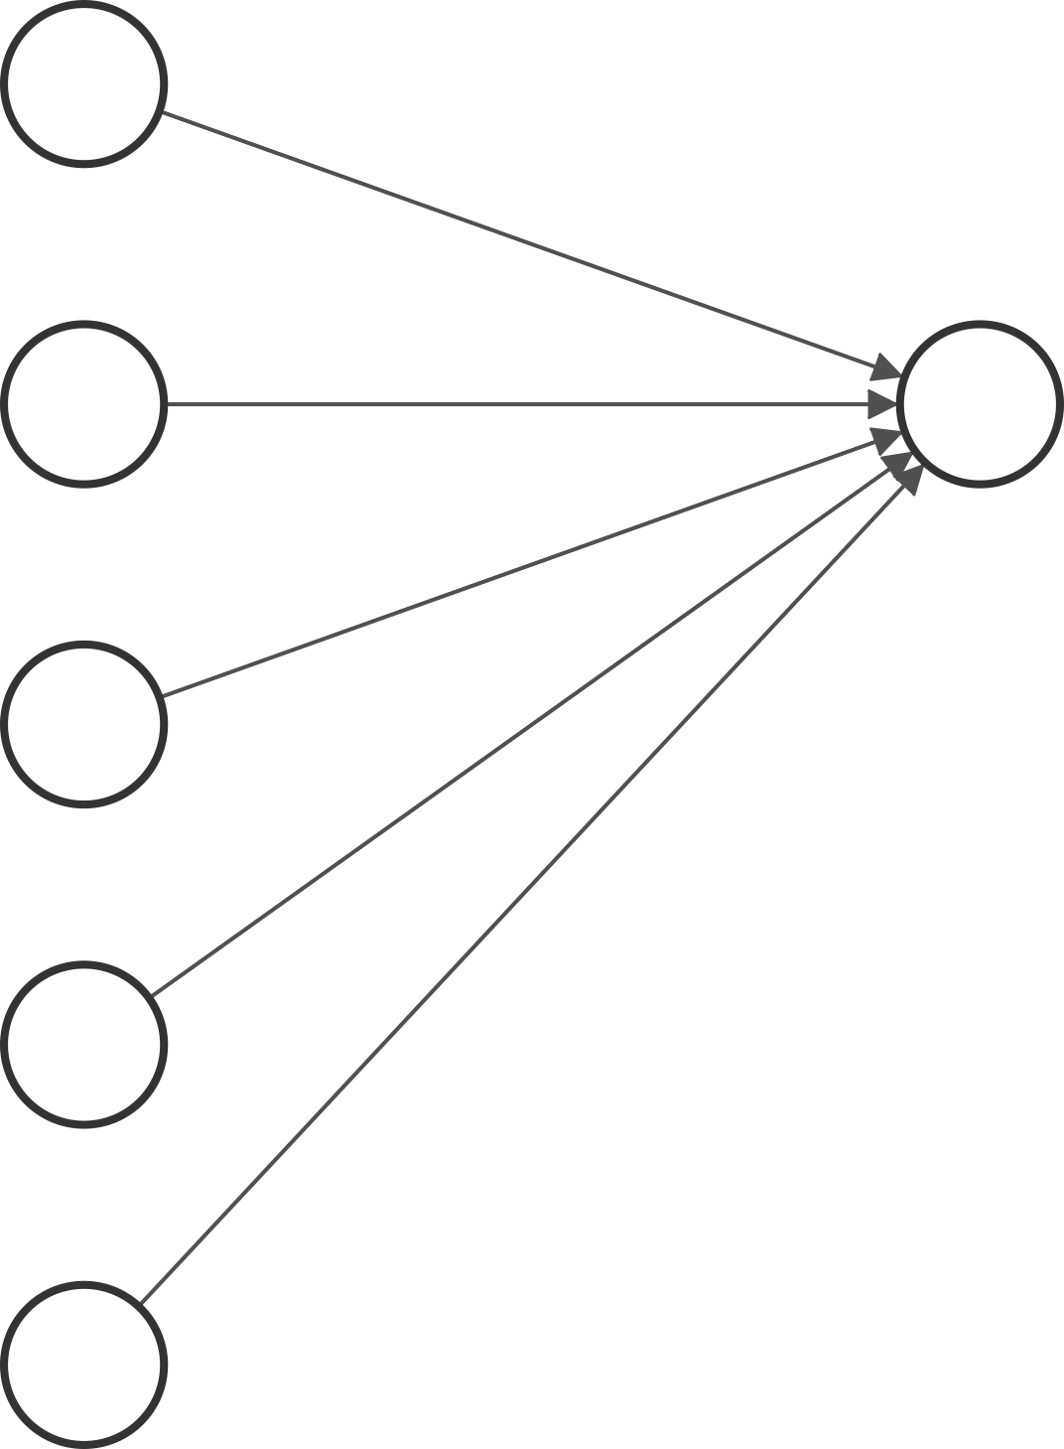

Slide 28
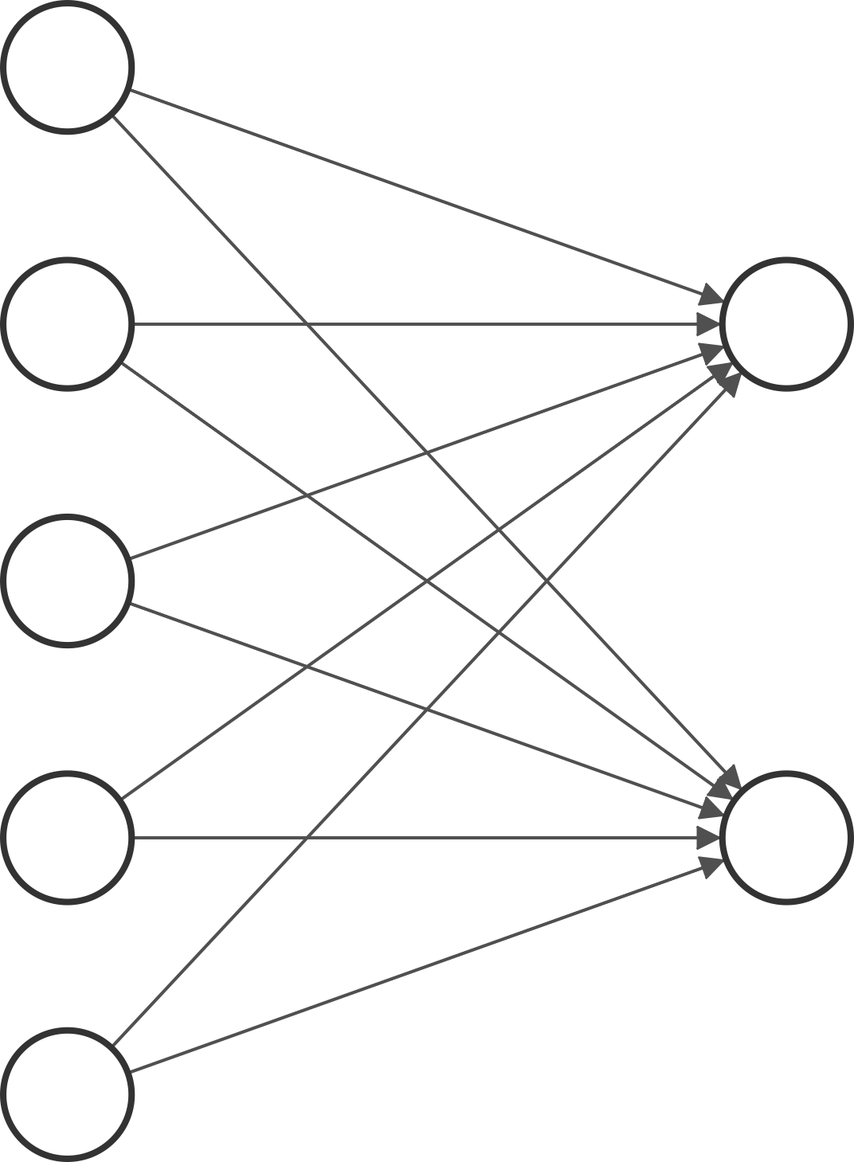

Slide 29
x

Slide 30
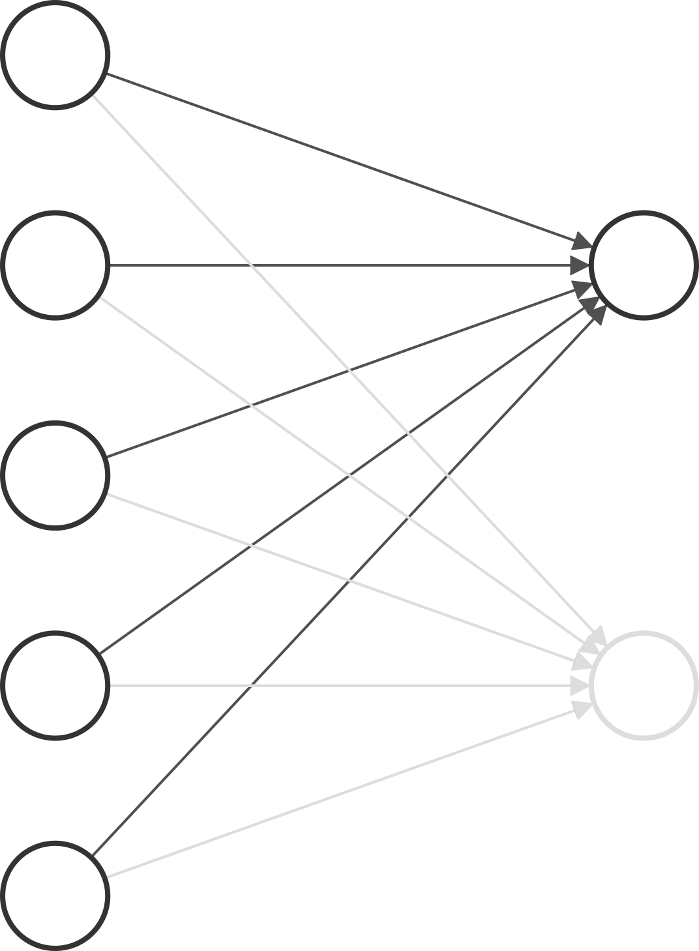
w1
x

Slide 31
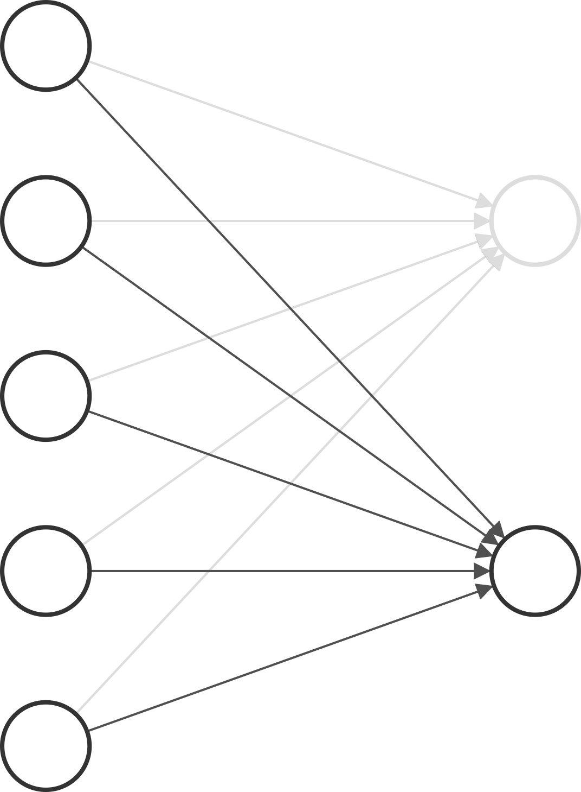
w1
x
w2

Slide 32
w1
x
w2

Slide 34
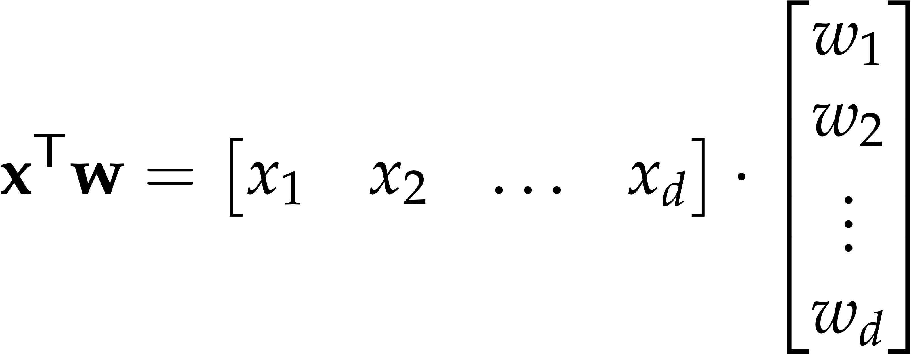

Slide 35
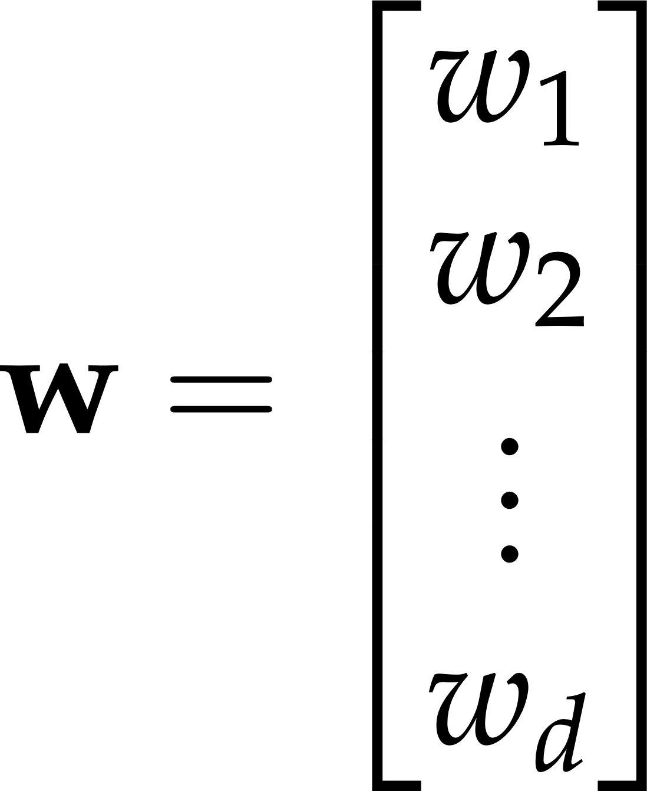

Slide 36


Slide 37
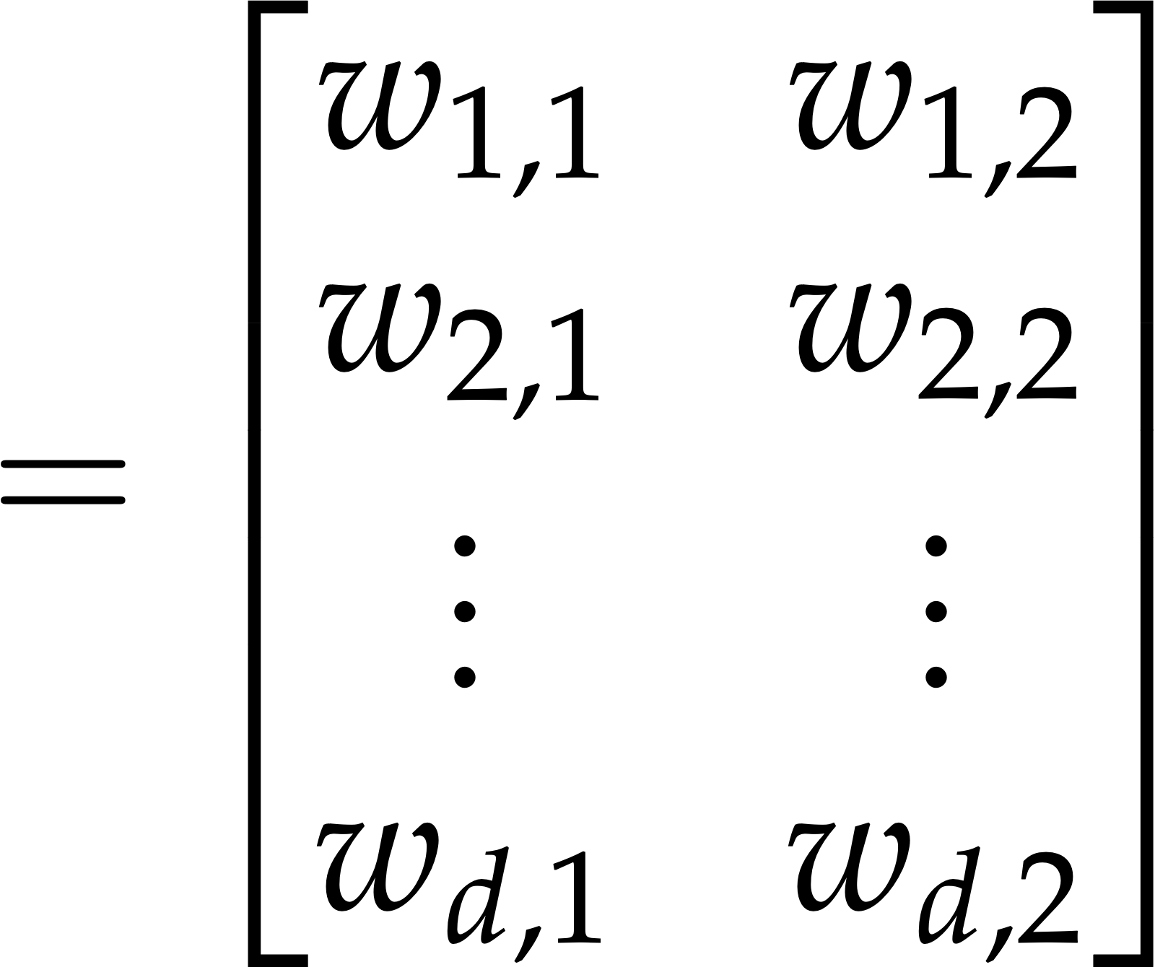

Slide 38
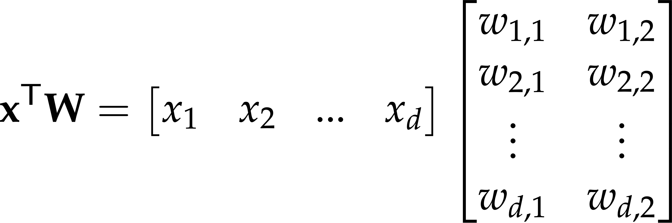

Slide 39
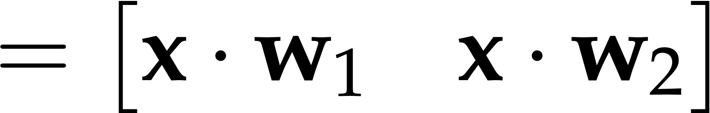

Slide 41
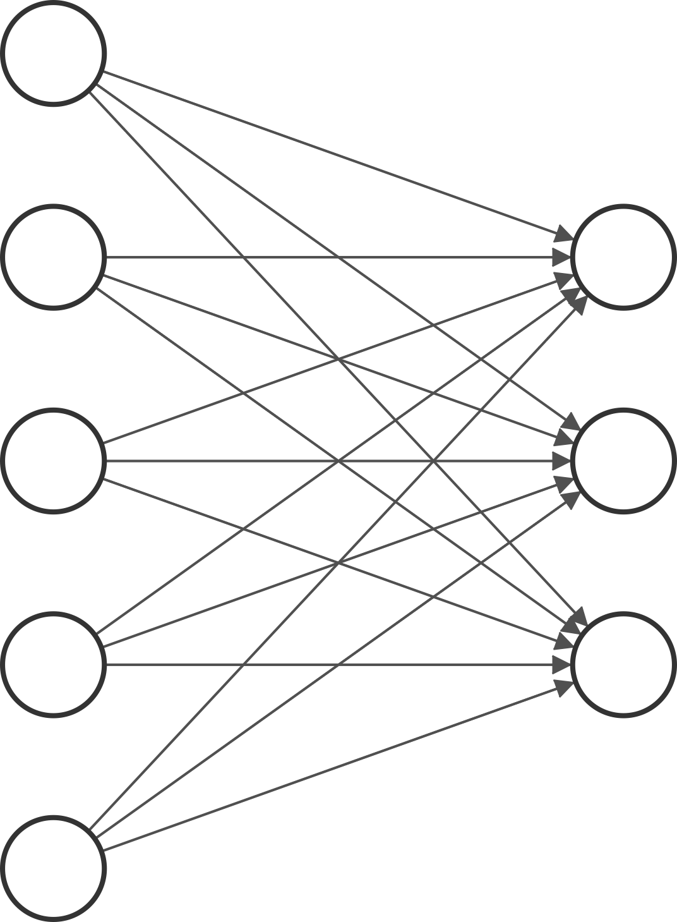
d
k

Slide 42
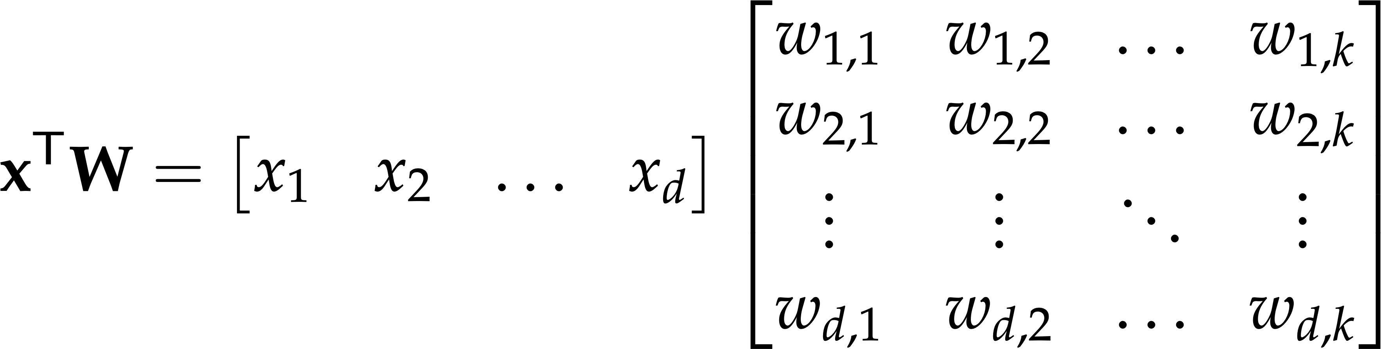

Slide 43
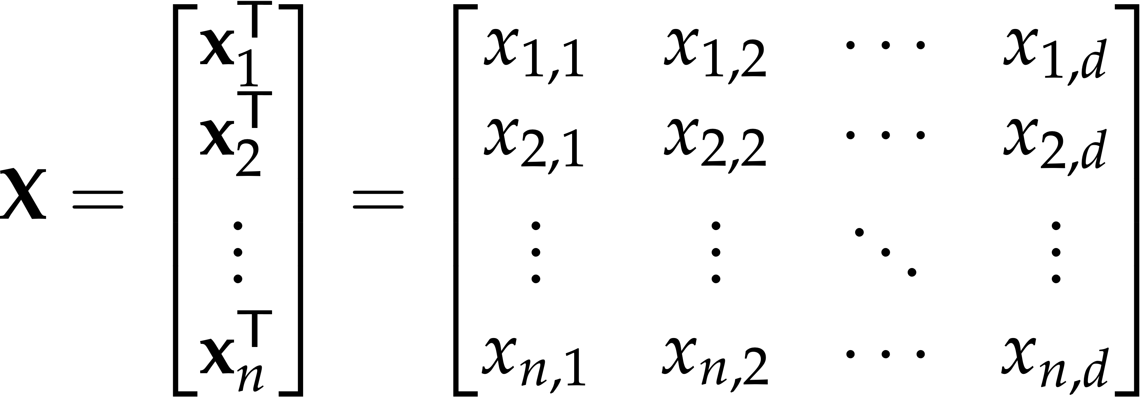
↓ Feature dimensions ↓
↓ Samples ↓

Slide 44
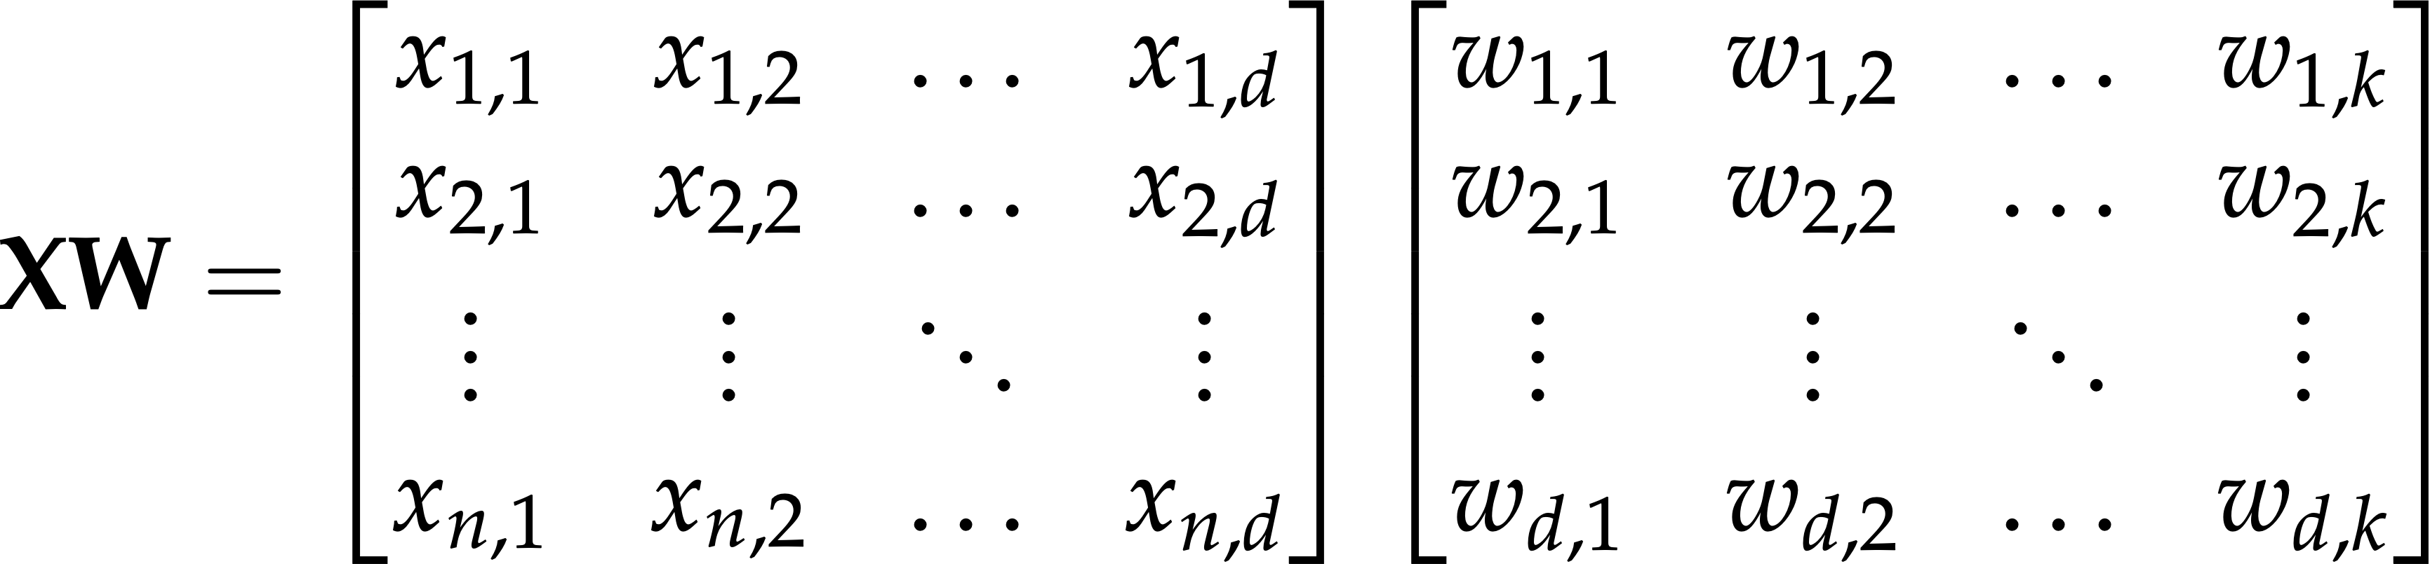

Slide 45
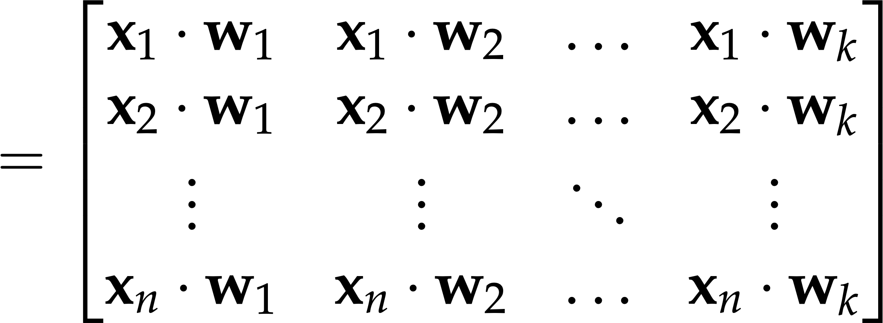

Slide 46
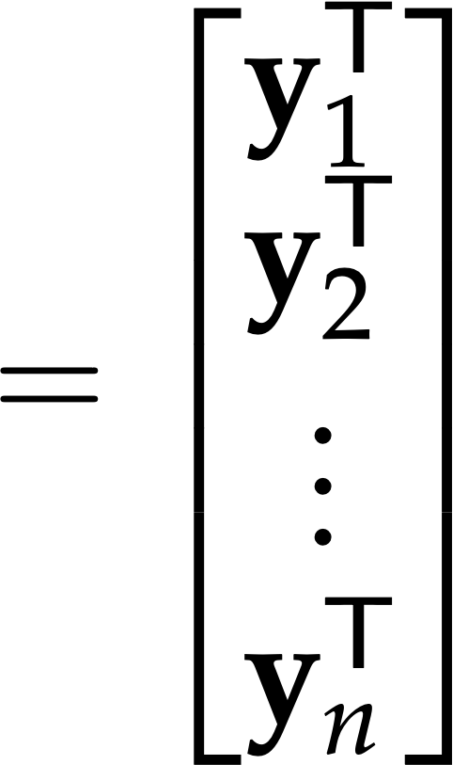

Slide 47
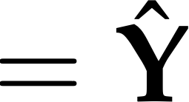

Slide 48


Slide 49
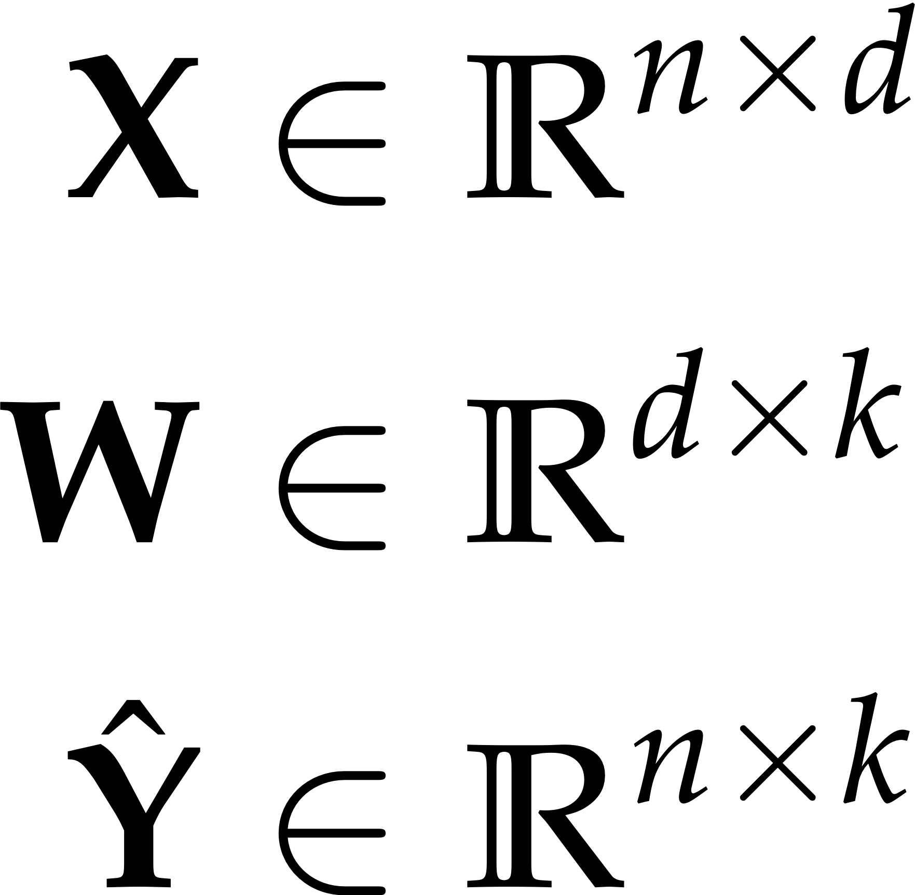

Slide 50
d
fan_in
k
fan_out

Slide 51


Slide 52


Slide 53


x

Slide 54
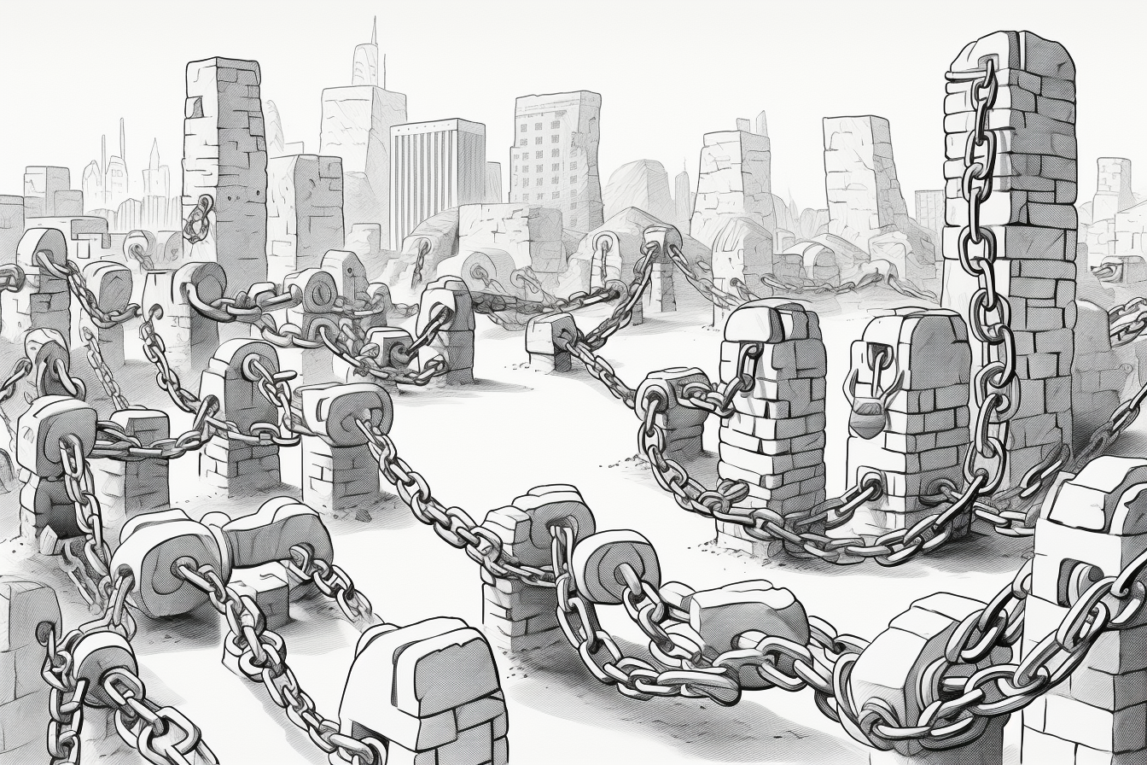

Slide 55
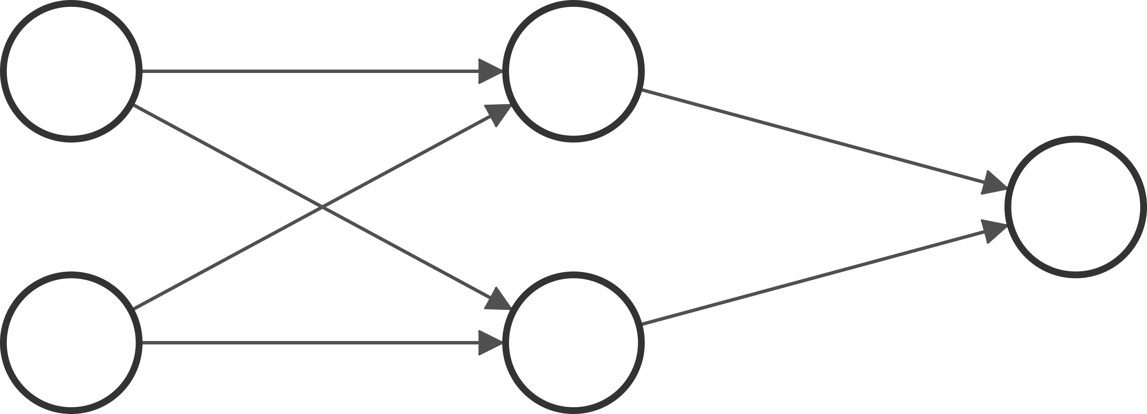
w1
x1
w5
w2
w3
x2
w6
w4

Slide 56
x1w1+x2w3
w1
x1
w5
w2
w3
x2
w6
w4
x1w2+x2w4

Slide 57
w5(x1w1+x2w3)
+
w6(x1w2+x2w4)
x1w1+x2w3
w1
x1
w5
w2
w3
x2
w6
w4
x1w2+x2w4

Slide 58

w5(x1w1+x2w3)
+
w6(x1w2+x2w4)
x1w1+x2w3
w1
x1
w5
w2
w3
x2
w6
w4
x1(w1w5+w2w6)
+
x2(w3w5+w4w6)
x1w2+x2w4

Slide 59
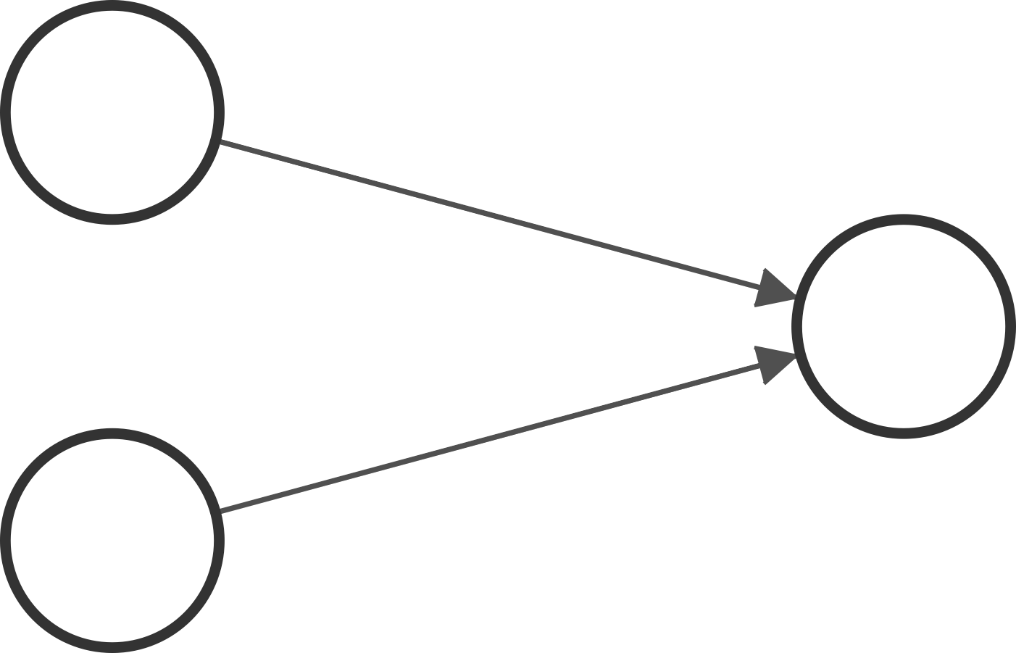
w1w5+w2w6
x1
x2
w3w5+w4w6

Slide 61
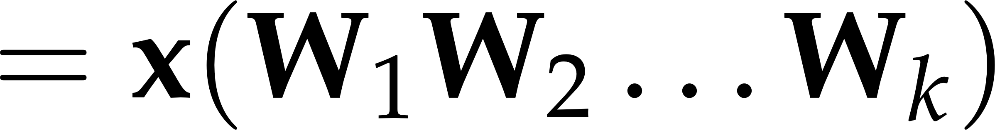

Slide 62


Slide 65
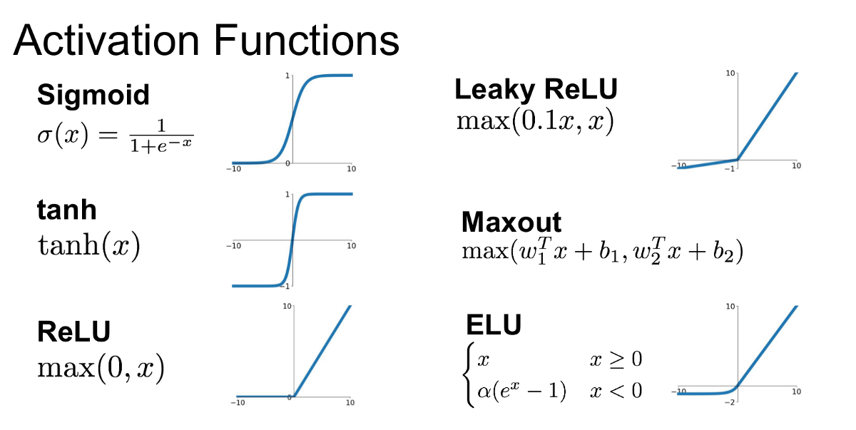

Slide 66
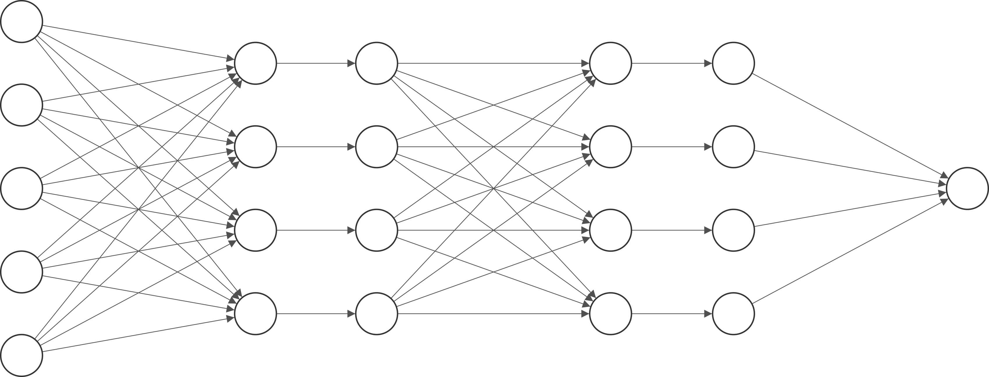
linear combo
linear combo
non-linear activation
non-linear activation

Slide 67
integrate
integrate
fire
fire

Slide 68
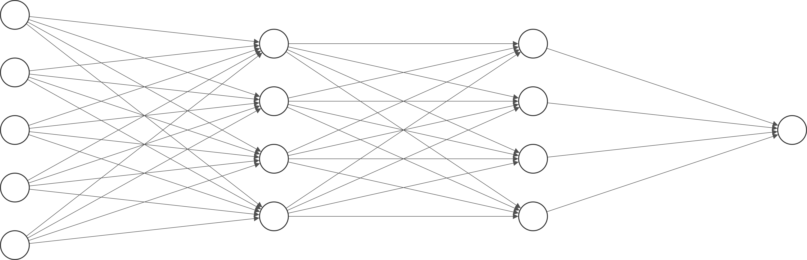

Slide 69
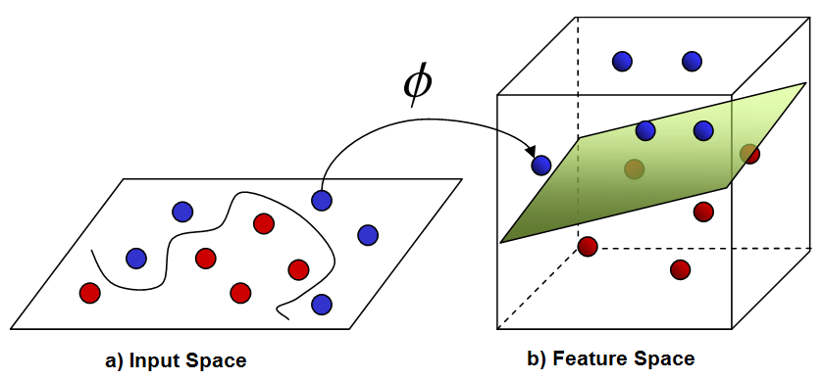

Slide 73
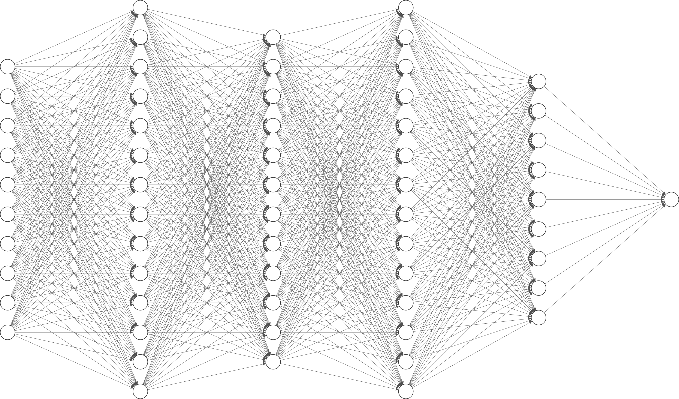

Slide 74
10
14
12
14
9
1
611
140
168
168
126
9

Slide 76
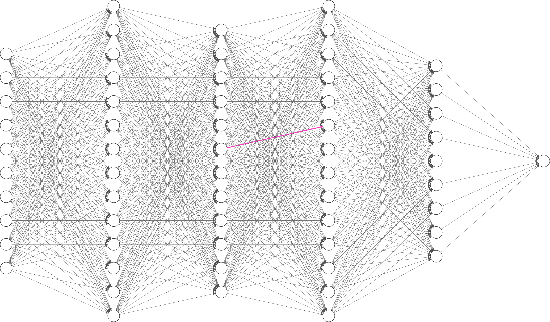

Slide 77
analytic vs numerical

Slide 78

analytic optimisation
numerical optimisation

Slide 79
analytic optimisation
numerical optimisation

Slide 80
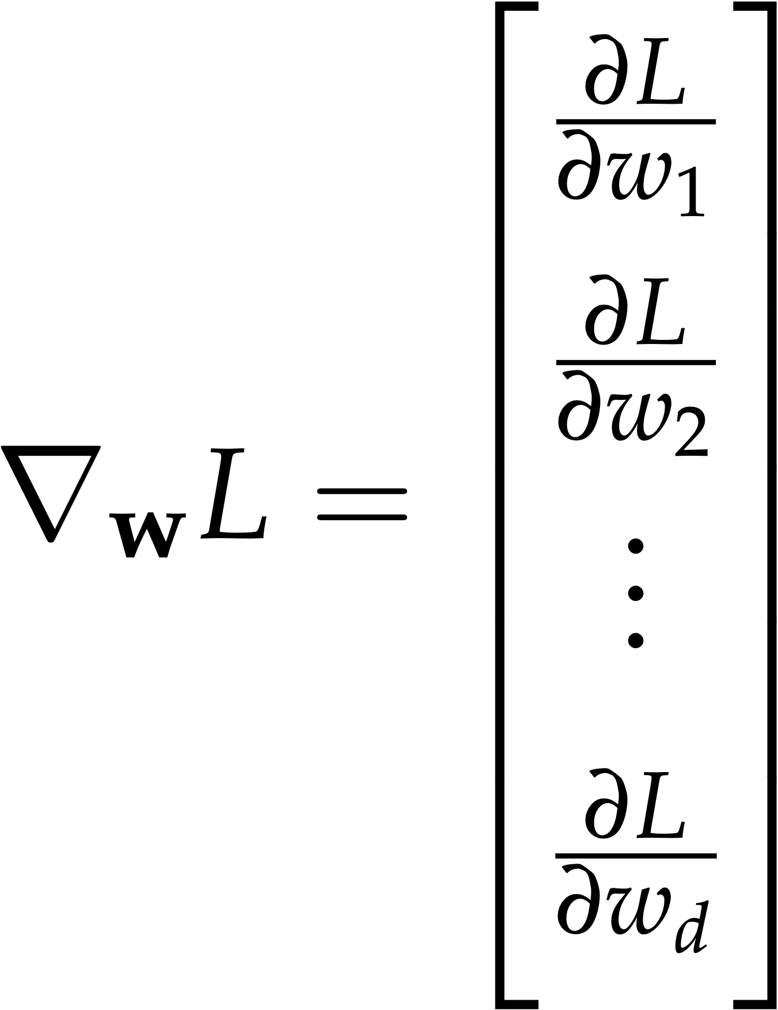

Slide 81
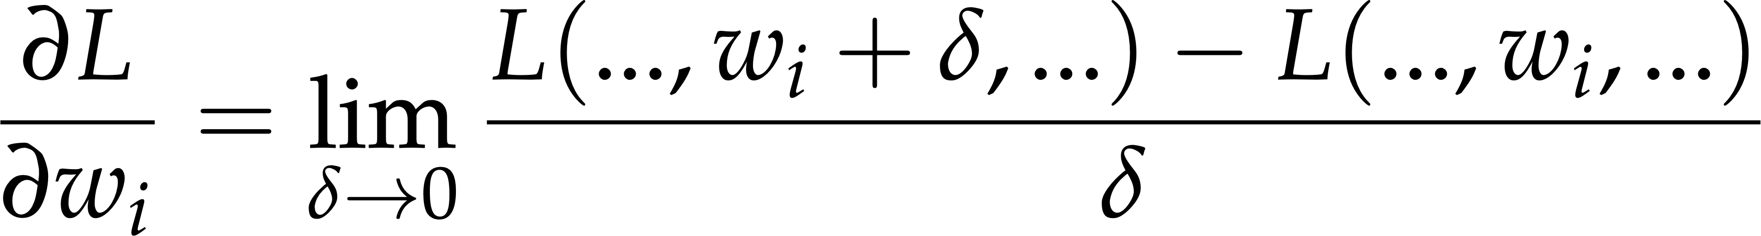

Slide 82
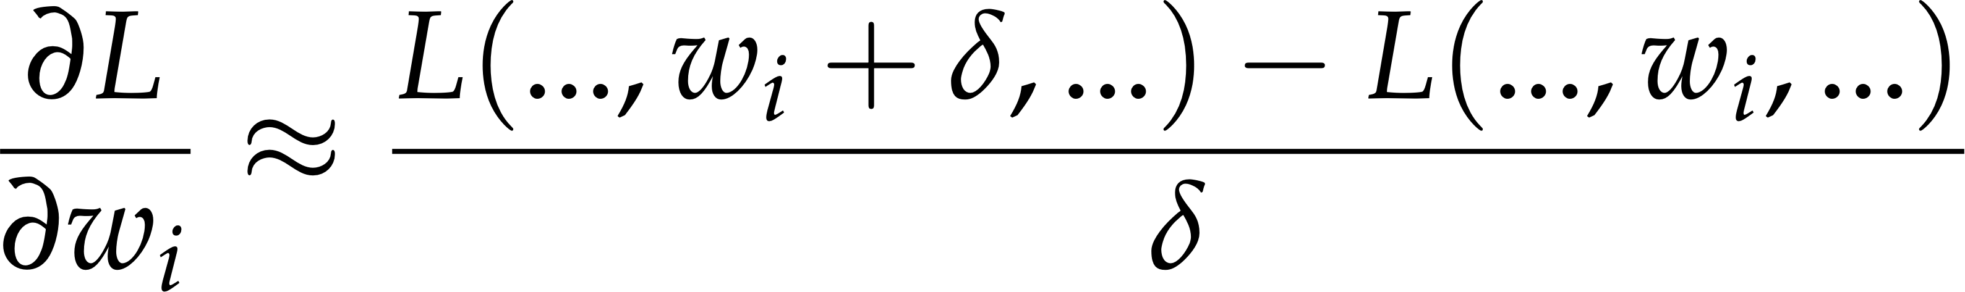
numerical gradient

Slide 83
analytic gradient

Slide 84
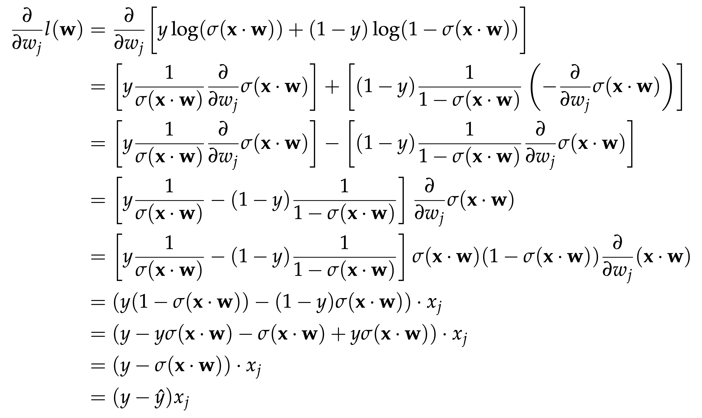

Slide 85
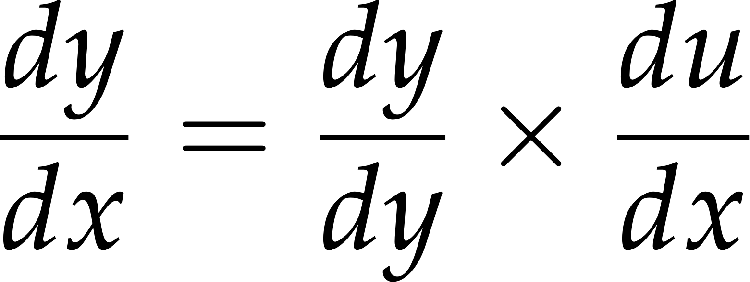
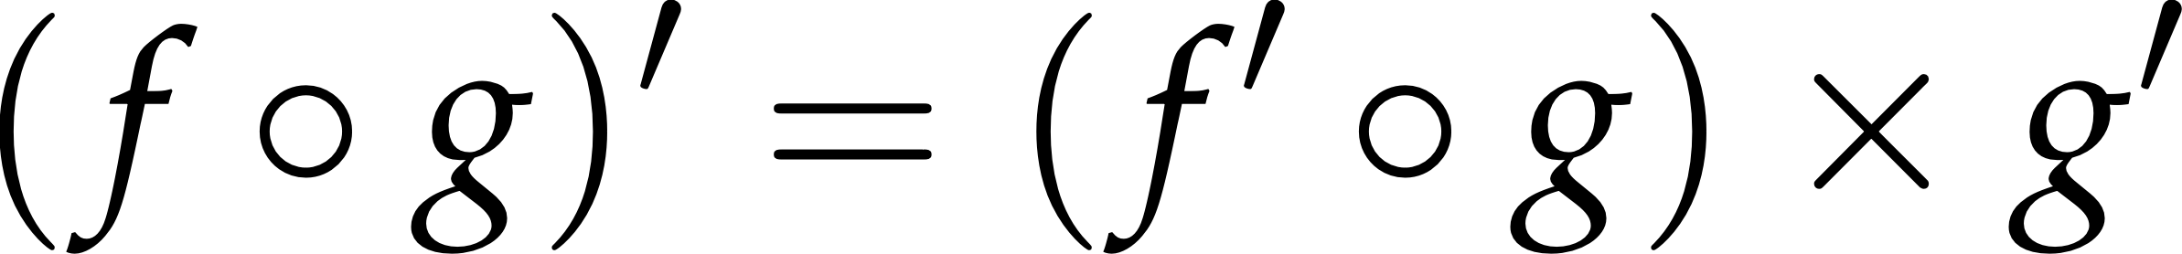
the chain rule

Slide 86
the chain rule
gradients multiply

Slide 87


Slide 88


Slide 89

x
f(x)
g(f(x))
f
g
×
f’(x) g’(f(x))
f’(x)
g’(f(x))

Slide 90
x
-x
exp(-x)
1+exp(-x)
(1+exp(-x))⁻¹
*-1
exp
+1
1
.
×
[
]
1
-(1+exp(-x))⁻²
×
[
]
exp(-x)
-(1+exp(-x))⁻²
[
]
×
-exp(-x)
-1
(1+exp(-x))²
exp(-x)
(1+exp(-x))²

Slide 91
gradients are just numbers!

Slide 92
1.5
-1.5
0.22
1.22
0.82
*-1
exp
+1
1
.
×
[
]
1
-0.67
×
[
]
0.22
-0.67
[
×
]
-1
-0.15
0.15

Slide 93
out1 = f1(x)
out2 = f2(out1)
out3 = f3(out2)
out4 = f4(out3)
loss = f5(out4)
dloss_out4 = df5(out4)
dloss_out3 = df4(out3) * dloss_out4
dloss_out2 = df3(out2) * dloss_out3
dloss_out1 = df2(out1) * dloss_out2
dloss_x = df1(x) * dloss_out1

Slide 94
out1 = f1(x)
out2 = f2(out1)
out3 = f3(out2)
out4 = f4(out3)
loss = f5(out4)
dloss_out4 = df5(out4)
dloss_out3 = df4(out3) * dloss_out4
dloss_out2 = df3(out2) * dloss_out3
dloss_out1 = df2(out1) * dloss_out2
dloss_x = df1(x) * dloss_out1
local gradient
downstream gradient

Slide 95
analytic gradients, numerically
backpropagation

Slide 97



Slide 101
forward pass
evaluate model on data
calculate local gradients
save ins and outs
calculate final loss

Slide 102
backward pass
calculate final loss gradient
propagate gradients backward
multiply downstream by local

Slide 103
optimise
update weights with gradients

Slide 105


Glorot initialisation for tanh

Slide 106


He initialisation for ReLU

Slide 107

2.4
1.2
2.4
3
0.4
1
7.2
7.2
3
18
6
1
3
1
2.4
2.4

Slide 108
Questions?

Slide 109


Next: More Neural Networks

