Slide 1
COMP1100/7110 Introduction to software innovation
Week 11
Pitching a project
School of Electrical Engineering and Computer Science The University of Queensland

Slide 2

ACKNOWLEDGEMENT OF COUNTRY
Notes:
Guidelines for use:
Use this slide when presenting at UQ or at any site in Australia, when appropriate.
Remember to pause briefly after acknowledging Country as a sign of respect.
If you are more familiar with acknowledging Country you may add a statement about the event, meeting or forum’s connection with Country. For example, at a higher education event you might acknowledge that the campus has always been a space for teaching, learning, research and collaboration tens of thousands of years before it was established as a university campus, and this continues today.
Longer version
I acknowledge the Traditional Owners and their custodianship of the lands on which we meet today. I pay my respects to their Ancestors and their descendants, who continue cultural and spiritual connections to Country. I recognise their valuable contributions to Australian and global society.
Shorter version
I (too,) acknowledge the Traditional Owners and their custodianship of the lands on which we meet today and pay my respects to their Ancestors and their descendants.
Slide last updated July 2023. Source: DVC(IE): contact Rebecca Klein.

Slide 3

COUNTRY AND PLACE
The University of Queensland
https://uq.pressbooks.pub/uq-blak-history/chapter/country-and-place/

Slide 4
WEEK BY WEEK OVERVIEW
Iteration 1: Problem Discovery
Who are our customers, and what problems do they actually have?
 | Process – what to do | Deliverables
2 | Identify potential topics and define initial problem areas. | Interview hypotheses and questions
3 | Conduct first round of interviews to validate the problem. | Interview transcripts and recordings
 | Analyse responses and refine or pivot questions as needed. | Refined set of questions and hypotheses (if required)
4 | Document key learnings from interviews. | Test and learning cards.
 | Conduct second round of interviews to deepen problem insights. | Interview transcripts and recordings
5 | Analyse all interview data | Learning Cards
 | Define target customer segments based on identified problems | Value Proposition Canvas
 |  | Business Model Canvas – customer segments and value propositions
6 | Iteration 1 submission | Tag repository – more info on Blackboard
 |  | Individual reflection

Slide 5
EXERCISE
REMEMBER THIS NUMBER FOR LATER:
22

Slide 6
WEEK BY WEEK OVERVIEW
Iteration 2: Problem Validation
How can we solve this problem, and what could our MVP look like?
Iteration 3: Implementation & Verification
Does our MVP deliver value to targeted customer?
 | Process – what to do | Deliverables
6 | Test previously defined value proposition | Solution hypotheses & questions
 |  | Test cards
 | Conduct third round of interviews to validate the proposed solution | Interview transcripts & recordings
 |  | Learning cards
 |  | Accepted & refuted solution hypotheses
7 | Ideate MVP features informed by primary and secondary research | Competitor analysis table
8 | Develop an initial prototype | Paper and/or digital prototype
 | Conduct fourth round of interviews to test prototype | Interview transcripts & recordings
 |  | Test and learning cards
 |  | List of finalised MVP feature set
 | Plan MVP implementation, including feature prioritisation and timeline | GitHub Projects Clear MVP plan - who does what by when
 | Refine BMC | Updated customer segments, value propositions, channels, and customer relationships
9 | Iteration 2 submission | Tag repository
 |  | Individual reflection
 | Process – what to do | Deliverables
9 & 10 | Implement MVP
 | Conduct fifth round of interviews to gather feedback on the MVP | Test and learning cards
 |  | Interview transcripts & recordings
 | Clear understanding of product and business model | Fully refined and populated BMC
11 | Presentation preparation, Continue implementing MVP | Elevator pitch
 |  | Presentation plan (recordings, props, speaker order, slides, etc.)
12 & 13 | Complete demo
 | Week 13 showcase | Final MVP
Week 1 exams | Iteration 3 submission | Tag repository
 |  | Individual reflection
showcase
Continuously refine BMC and VPC

Slide 7
TECHNICAL FRAMEWORK (NON-)SUPPORT

Slide 8
TIME MANAGEMENT

Slide 9
TASK FROM LAST WEEK
THIS WEEK
Show your team the evidence that you completed the task
If you didn’t/couldn’t, discuss: what blocked you?
Choose a task that has been on your mind: a task that you have been putting off for a while. Choose a task that you are comfortable sharing with your team
Write the outcome of that task (must be an observable outcome).
Write the next action (specific, physical, and observable action) you need to work toward that task.
Share with your team.
Commit to completing that task by the studio next week.
How do you feel about that task now?

Slide 10
GROUP DISCUSSION [3 mins]
What do you think the most important skill that a university graduate could develop to become great in their job/life?

Slide 11
FOCUS

Slide 12

EXERCISE
MULTI-TASKING

Slide 13
GROUP DISCUSSION: TECHNIQUES FOR FOCUS
MEDITATION
STUDY SPACE SUCH AS LIBRARY (CLUTTER)
POSITIVE PEER PRESSURE
PSYCHOLOGICAL SEPARATION FROM PLAY
REMOVE DISTRACTIONS – PHONE SILENT, ANOTHER ROOM
FAST FEEDBACK ON TASK
MUSIC
DIET
EXERCISE
SLEEP
ENGAGEMENT WITH TASK
POMODORO – 25 MINS ON/ 5 MINS OFF (45/15)
TIME BLOCKING AND TIME THEMES (INCLUDING ENERGY LEVELS)

Slide 14
STOLEN FOCUS
https://www.youtube.com/watch?v=qTjloQcCjaM

Slide 15
SURVEY AND EXERCISE
Who here would like to improve their focus?

Slide 16


Slide 17
ELEVATOR PITCH

Slide 18

CLASS DISCUSSION
What is an elevator pitch?
What should we consider when delivering an “elevator pitch”?

Slide 19
SOME EXAMPLES FROM YOUR LEGENDS

Slide 20
GOALS OF AN ELEVATOR PITCH
Share a quick summary of yourself and your product offerings
Make a real connection to people that can create long-term benefits
Balance your approach
Make a sale
Make a personal connection

Slide 21
ELEMENTS OF A GOOD PITCH
IN WHICH ORDER SHOULD THESE STAGES BE IN?
Present your solution
Add a call to action
Share you value proposition
Introduce yourself
Present the problem

Slide 22
ELEMENTS OF A GOOD PITCH
IN WHICH ORDER SHOULD THESE STAGES BE IN?
Introduce yourself
Present the problem
Present your solution
Share you value proposition
Add a call to action

Slide 23
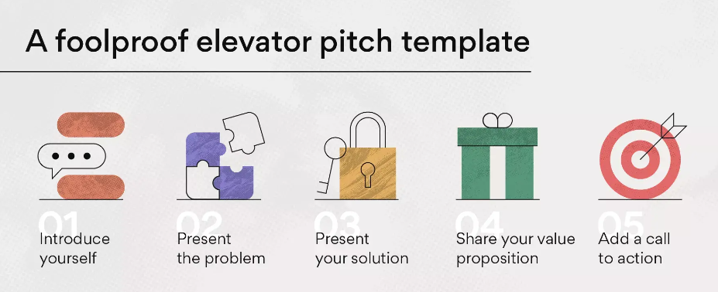
THE STAGES OF AN ELEVATOR PITCH

Slide 24

STEP 1: INTRODUCE YOURSELF
WHAT IS A HOOK?
A hook gets the audience interested in you and/or what you are saying
HOW?
Tell a story
Show an image
Share a fact or statistic
YOUR NAME
YOUR ORGANISATION
USE A HOOK TO CAPTURE ATTENTION

Slide 25
STEP 2: PRESENT THE PROBLEM
TIPS
Connect your problem to your hook
Hook people with the data that you gathered
EXAMPLES
“Did you know that 60% of work time is spent on coordination, rather than doing actual work?”
“We surveyed 45 people, and over 70% said that they could not …”
DESCRIBE THE PROBLEM YOU ARE TRYING TO SOLVE
USE YOUR DATA
MAKE IT CLEAR
MAKE IT RELEVANT TO YOUR AUDIENCE
BE BRIEF

Slide 26
STEP 3: OFFER THE SOLUTION
Did you know that 60% of work time is spend on coordination, rather than doing actual work?
That may be the reason why many in your industry are struggling with productivity issues.
TaskManager’s management tools can help you prevent these issues. We trialed this on 65 people, who found…
CONVINCE AUDIENCE THEY NEED YOUR HELP
ENSURE A STRONG LINK TO THE PROBLEM THAT YOU HAVE RAISED
USE YOUR DATA WHERE POSSIBLE
PERSONALISE YOUR SOLUTION TO THE AUDIENCE, IF POSSIBLE

Slide 27
STEP 4: EXPLAIN YOU UNIQUE VP
Did you know that 60% of work time is spend on coordination, rather than doing actual work?
That may be the reason why many in your industry are struggling with productivity issues.
TaskManager’s management tools can help you prevent these issues
In fact, our platform is the only one that connects company goals with the tasks needed to achieve them.
EXPLAIN WHY YOU SOLUTION IS BETTER THAN THE REST
TALK ABOUT YOUR UNIQUE FEATURE, SKILL, OR ABILITY
OR
MAKE A COMPARISON TO A COMPETITOR

Slide 28

STEP 5: CALL TO ACTION
Did you know that 60% of work time is spend on coordination, rather than doing actual work?
That may be the reason why many in your industry are struggling with productivity issues.
TaskManager’s management tools can help you prevent these issues. We trialed this on 65 people, who found…
In fact, your platform is the only one that connects company goals with the tasks needed to achieve them.
We find this to be an exciting place to operate, and would love to have a follow-up meeting to learn more about your business and how we can help.
ASK THE AUDIENCE TO DO SOMETHING TO CONTINUE COMMUNICATING WITH YOU
E.G.
SCHEDULE A FOLLOW-UP MEETING
CONNECT ON LINKEDIN
EXCHANGE BUSINESS CARDS

Slide 29
EXAMPLE
https://www.youtube.com/watch?v=-1IdJDscYHk
As a class, watch the movie above
Identify the main parts of a pitch:
Introduction
Present the problem
Offer the solution
Explain the unique value proposition
Call to action
Are each of these present?

Slide 30
BREAK (BACK AT 10.20)

Slide 31
TEAM EXERCISE: 1-MINUTE PITCH [25 mins]
1 INTRO
2 PROBLEM
3 SOLUTION
4 UNIQUE VP
5 CALL TO
ACTION
YOUR NAME
YOUR ORGANISATION
USE A HOOK TO CAPTURE ATTENTION
DESCRIBE THE PROBLEM YOU ARE TRYING TO SOLVE
USE YOUR DATA!
MAKE IT CLEAR
MAKE IT RELEVANT TO YOUR AUDIENCE
BE BRIEF
CONVINCE AUDIENCE THEY NEED YOUR HELP
ENSURE STRONG LINK TO THE PROBLEM
USE YOUR DATA WHERE POSSIBLE
PERSONALISE SOLUTION TO AUDIENCE, IF POSSIBLE
EXPLAIN WHY YOU SOLUTION IS BETTER THAN THE REST
TALK ABOUT YOUR UNIQUE FEATURE, SKILL, OR ABILITY
OR
MAKE A COMPARISON TO A COMPETITOR
ASK THE AUDIENCE TO DO SOMETHING TO CONTINUE COMMUNICATING WITH YOU. E.G.
FOLLOW-UP MEETING
CONNECT ON LINKEDIN
EXCHANGE BUSINESS CARDS

Slide 32
INDIVIDUAL EXERCISE: PRACTICE
EVERYONE STAND UP
ON THE COUNT OF 3:
READ YOUR PITCH ALOUD
YES, ALL AT THE SAME TIME
SEE HOW NOISY WE CAN BE
MAKE
SOME
NOISE

Slide 33
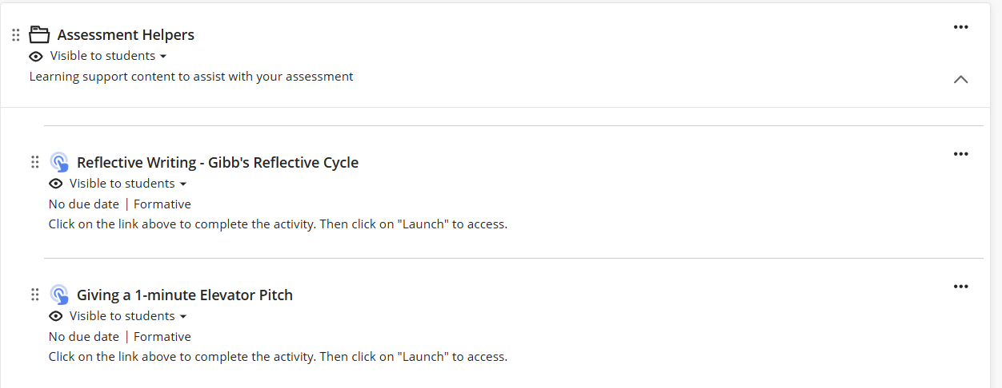
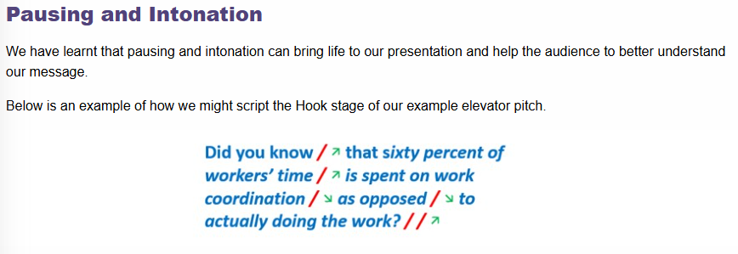
ASSESSMENT HELPER

Slide 34
WEEK 13 SHOWCASE
WHEN: Studio, week 13, 9am-12pm (visitors from 9.30am)
WHAT: An informal showcase of your project. You will need:
A 1-minute elevator pitch, target audience is ‘investors’.
An A2-sized poster, which states your team members, the problem, your value proposition, and links your data to the value proposition.
A single A2 printouts vs 2 x A3 printouts vs 4 x A4 printouts
A demo (e.g. paper prototype, Figma wireframe, or running code).
WHY: To practise presenting technical work and to share what your team accomplished.
WHO:
Everyone must take turns at presenting during the showcase.
Everyone must go around and look at other teams (take turns staffing your table).
WHO ELSE
Staff from the School of Electrical Engineering and Computer Science.
Feel free to invite your friends.
DRESS CODE: Nothing formal, but not too casual.
PRIZES!
BE ON TIME

Slide 35
MVP REMINDER
Your MVP must be a working product, not a prototype:
Running code with real logic (e.g. data handling, interaction, storage, etc).
Version 0.crap: early adopters could install and use, not a demo that you show them.
Wireframes on in tools like Figma are good for early feedback, but they are NOT products.
EVERYONE must code something
Use Github to show your contribution
We care about learning and effort, not high-quality software

Slide 36
REMAINDER OF TODAY
Complete a polished pitch
Continue working on your MVP
EXIT TICKET
Present your pitch to your legend and other teams
Show your legend your MVP or demo so far

Slide 37
Contact
Tim Miller
Professor of Artificial Intelligence
timothy.miller@uq.edu.au
X: @tmiller_uq

