Slide 1

Flow of Functionality (SongSurf)
3/17/2023
Todo: album, artist sl

Slide 2
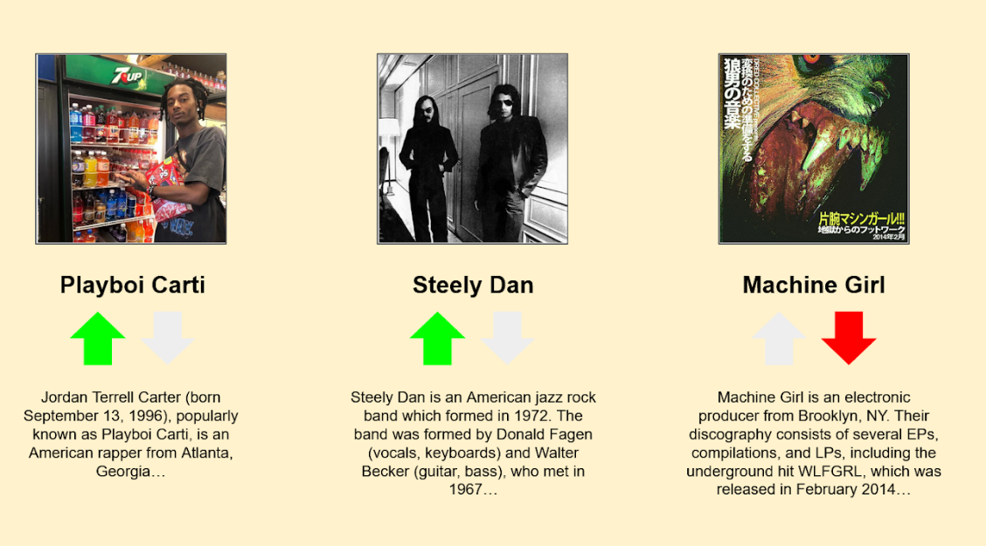
Flowchart – Display 3 tracks on screen after “track search” selected
User – Entity in database that contains aas_searches, likes, and dislikes. To account for in recommendation algorithm
Tracks – list of 3 tracks for user, which contain name, artist, cover, summary
[Display.js] display_tracks(User)
[Track.js] tracks = get_tracks(User)
[Track.js]: Calls
display_cover(tracks);
display_name(tracks);
The next 3 steps is basically this large piece
[Track.py] tags = get_tags(User)
Matches = compare_tags_tracks(User, tags)
top_3_tracks = output_top_3_tracks(User, matches)
Return top_3_tracks
[Track.py]
output_top_3_tracks(User, matches)
display_summary(tracks);
[Track.py] get_tags(User)
[Comparer.py] compare_tags_track(User, tags)
Compare_tags_track() – this will compare the user aas_searches, along with the likes and dislikes. And produce maybe 50 matches
Result

Slide 3
Flowchart – Display 3 albums on screen after “album search” selected
User – Entity in database that contains aas_searches, likes, and dislikes. To account for in recommendation algorithm
albums – list of 3 albums for user, which contain name, artist, cover, summary
[Display.js] display_albums(User)
[Track.js] albums = get_albums(User)
[Track.js]: Calls
display_cover(albums);
display_name(albums);
The next 3 steps is basically this large piece
[Track.py] tags = get_tags(User)
Matches = compare_tags_albums(User, tags)
top_3_albums = output_top_3_albums(User, matches)
Return top_3_albums
[Track.py]
output_top_3_albums(User, matches)
display_summary(albums);
[Track.py] get_tags(User)
[Comparer.py] compare_tags_track(User, tags)
Compare_tags_track() – this will compare the user aas_searches, along with the likes and dislikes. And produce maybe 50 matches
Result

Slide 4
Flowchart – Display 3 artists on screen after “artists search” selected
User – Entity in database that contains aas_searches, likes, and dislikes. To account for in recommendation algorithm
artists – list of 3 artists for user, which contain name, artist, cover, summary
[Display.js] display_artists(User)
[Track.js] artists = get_artists(User)
[Track.js]: Calls
display_cover(artists);
display_name(artists);
The next 3 steps is basically this large piece
[Track.py] tags = get_tags(User)
Matches = compare_tags_artists(User, tags)
top_3_artists = output_top_3_artists(User, matches)
Return top_3_artists
[Track.py]
output_top_3_artists(User, matches)
display_summary(artists);
[Track.py] get_tags(User)
[Comparer.py] compare_tags_track(User, tags)
Compare_tags_track() – this will compare the user aas_searches, along with the likes and dislikes. And produce maybe 50 matches
Result

Slide 5
Other Notes
For every API call save all the data (tracks, albums, artists) into the database. Also known as “API Caching”
Reason: optimizes performance and reduces API calls. Also ease of implementation for new features
If have extra time – implement these features:
(they look like a lot of work when it is not)
1) We can api call the actual song/album/artists and it will play the song
2) we can play songs as you go through the website
3) We can have the user choose how many recommendations to output at once (3,5,7, etc)

