Slide 1
SAFSS
By Danny Dinh

Slide 2
Introduction
SAFSS (Security Application for Security Study)
Encrypting and Decrypting software
Open-source application that allow user to custom their own features
Target: Anyone
Area address: User privacy and basic data protection

Slide 3
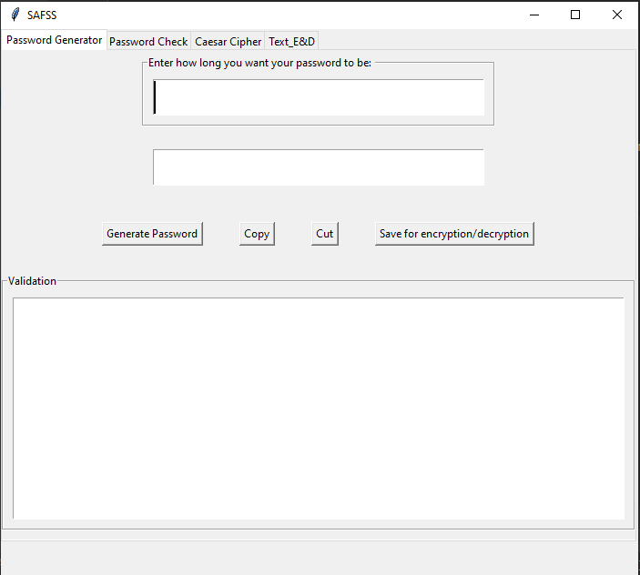
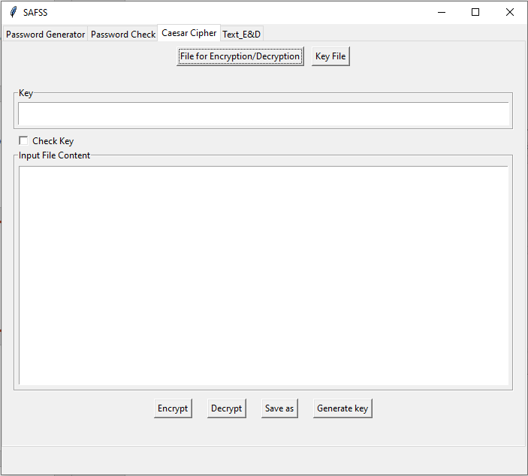
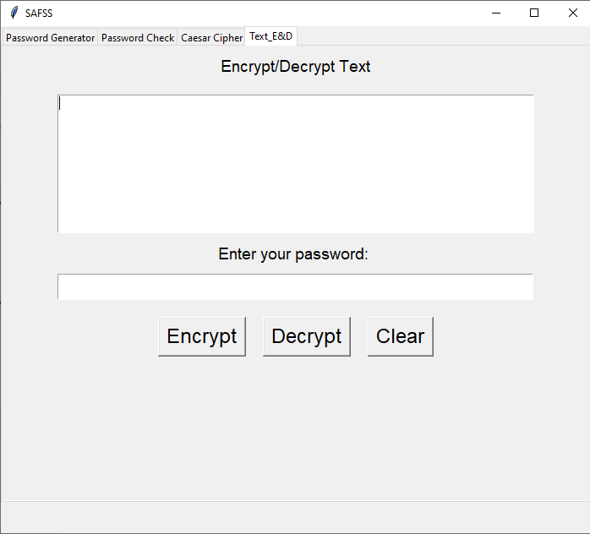
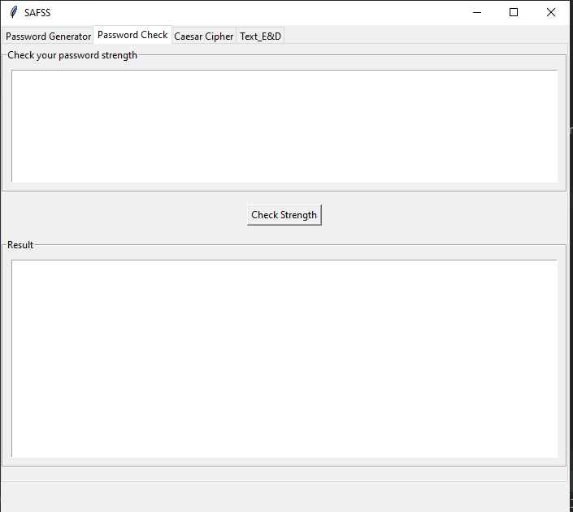
Implementation
Strong password Generator
Caesar Cipher (File version)
Caesar Cipher (Text version)
Password Strength Checking

Slide 4
Evaluation
Advantage:
Friendly Use
Free and open source
Provide Basic services as planned
Functions well run
Disadvantage:
GUI very basic
Not too much options for each services
Don’t have much checking technique such as Entropy Bits or Password-Policy
Beta version

Slide 5
Conclusion
SAFSS is Encrypting / Decrypting software
Outcome Expected:
Provide Strong password with all characters with desire length
Provide a details report of your password
Encrypting/Decrypting your files (TXT) with Key
Encrypting/Decrypting your Text (TXT) with password
If you have any question, you are welcome to pass by and ask

