Slide 1
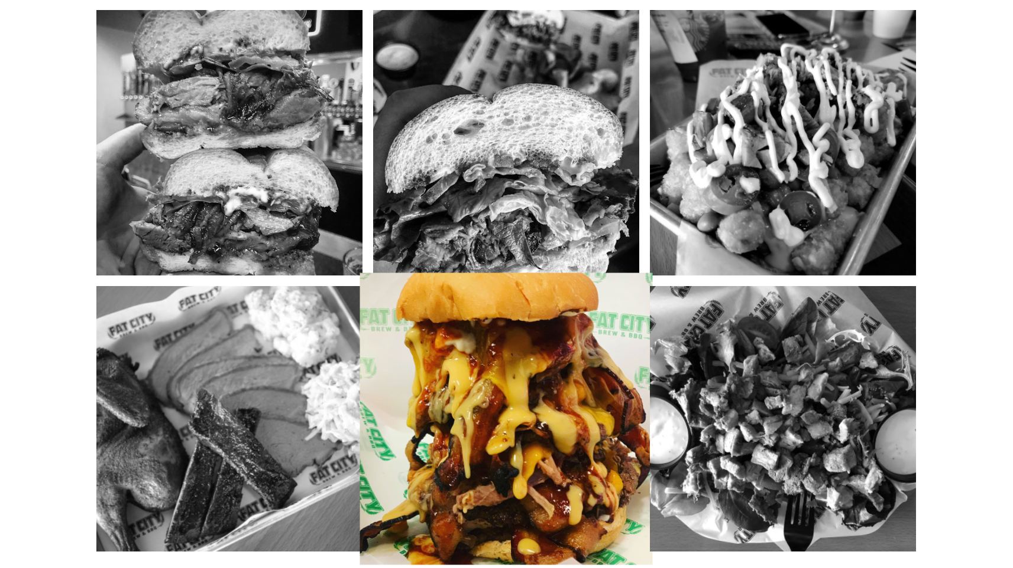
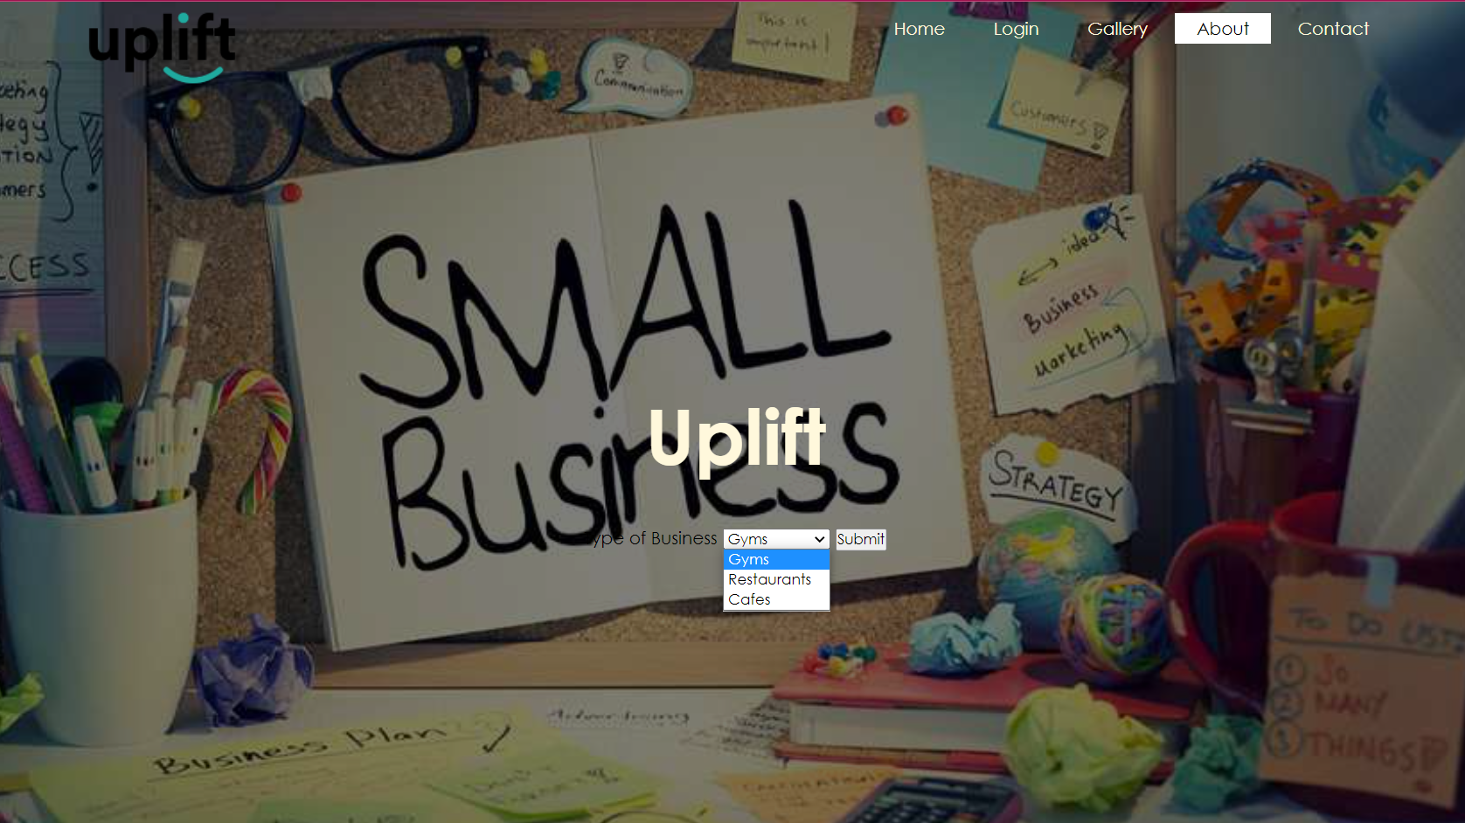

Uplift : Discovering Stockton’s Local Businesses
1. Introduction
2.1 Gallery
Business Background Info
Uplift features locally owned businesses in the Stockton, CA area. Some businesses goes undiscovered due to big chain business occupying the city. The website allows Stockton residents and the general public to discover unknown locally owned restaurants, cafes, and fitness gyms/clubs in efforts to support small business owners. Galleries, menus and business hours will be accessible for viewing. Correspondences can be sent through email which will be accessible through the website.
The website includes a gallery for each business. A black and white grid will display pictures that depicts a popular item on the menu or the establishment itself. Oftentimes, pictures serves a better representation of a business than words alone. Once the user hovers over the image, the image will enlarge and be displayed in color. With only the individual picture existing in color on the grid, it will be the user’s main-focus.
Our local buisness owners have a purpose behind their operation. Some were born and raised here in town and their roots are deeply intertwined with the city. Some moved into our city and never left because it was the perfect city to reside. However, each owner want to help empower Stockton. Their slogaon, purpose and about me will be shared on their individual page so people can read all about their story.
2. Implementation
Conclusion
The website’s purpose is to introduces Stockton residents and the general public to local businesses within the area of Stockton. Designing a simple website is ideal. Incorporating a minimalistic theme throughout the entire website allows users to focus on the elements on the page itself. Navigation is very user-friendly and familiar to most users. Simple drop-down menus will filter selection choices according to business types, Cafes, Restaurant, and Gyms. Simple buttons on the top right can be activated by a simple click.
We wanted to help “Uplift“ Stockton by helping residents and the general public see Stockton the way we Stockton. Some residents are unaware of many features that Stockton has to offer. Creating a website that features important aspects of each business is the perfect way to introduce Stockton. Links that we found helpful to us will also be provided on the businesses, individual page to help users learn more about each establishment and Stockton itself.
2.2 Menu
Uplift Team:
Most places have a menu or a display of their services. Our website will incorporate a picture of live menus, so users are aware of products and services offered. It gives the user a chance to determine the best place to dine or workout. Placed underneath the gallery, users will have a chance to not only view the top seller, but also the entire menu in detail.
Symohn Alasa-as
Marcos Reyes
Thyphien Son
UNIVERSITY OF THE PACIFIC
Tony Tiger and Peter Rabbit

